Slide 1
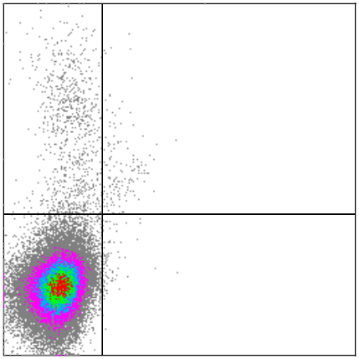
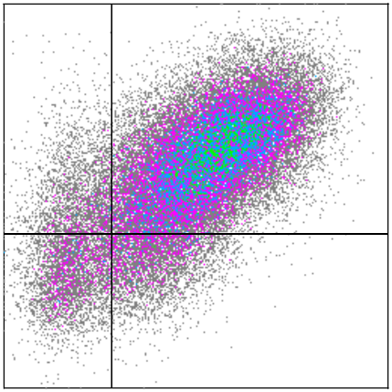
Supplementary Figure 1
A)
Antigen binding domain scFv
Spacer
IgG2-derived
Signaling domain
5’ LTR
ψ
LDR
VH
VL
CH3
TM
41BB
CD3ζ
LTR 3’
Leader sequence
Linker
Hinge
CH3
CD28
B)
NT
2G.4/7ICR
5.6%
77.4%
(n=4)
Anti-IgG (CAR)
% Double positive cells
8.7%
mOrange (4/7ICR)
Supplementary Figure 1: Generation of 2nd generation CAR.MUC1 T cells
(A) Schematic of 2nd generation CAR.MUC1 (2G) retroviral construct. (B) Co-expression of 4/7ICR and 2G CAR as detected by mOrange and anti-IgG, respectively. Summary data (right panel) shows percentage of double-positive cells (mean±SEM, n=4).

