Slide 1
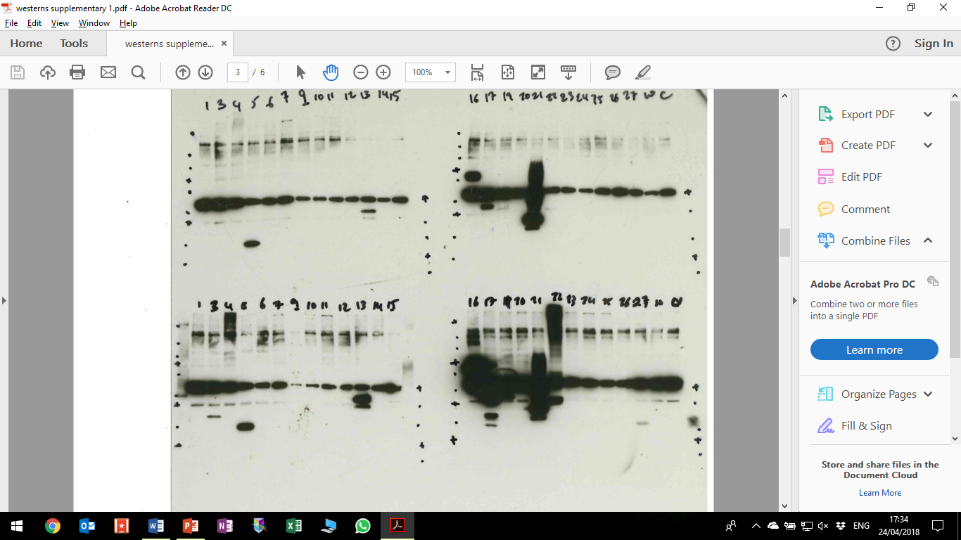
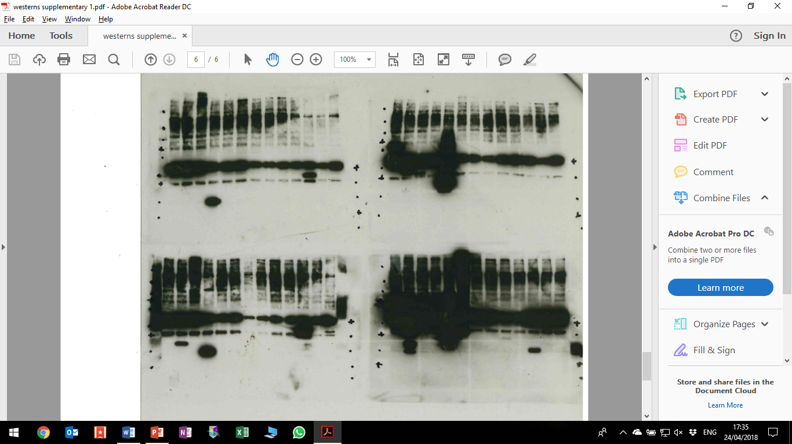
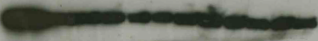
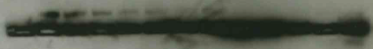
Figure S1
A
1
2
3
4
5
6
7
8
9
10
11
12
13
14
15
16
17
18
19
20
21
22
23
24
25
26
250
250
130
130
100
100
*
3 s
70
70
55
55
35
*
35
*
*
*
25
*
*
25
*
*
Anti-FLAG tag
15
15
10
10
1
2
3
4
5
6
7
8
9
10
11
12
13
14
15
16
17
18
19
20
21
22
23
24
25
26
250
250
130
130
100
100
70
70
30 s
55
55
35
*
*
35
25
*
*
25
*
*
*
15
15
10
10
14
15
16
17
1
18
19
20
21
22
23
24
25
26
2
3
4
5
6
7
8
9
10
11
12
Anti-β-actin
13
B
Sample | ORF | Expected protein size (kDa)
1 | E1A | 28.1
2 | E1B 19K | 20
3 | E1B 55K | 50.6
4 | Protein IX | 11.1
5 | Protein IVa2 | 49.6
6 | Pol | 139
7 | 52K | 40.6
8 | pIIIa | 56
9 | III | 55.4
10 | pVII | 21.9
11 | V | 25.6
12 | pX | 8.3
13 | pVI | 25.9
14 | DBP | 49.8
15 | 33K | 21.6
16 | 22K | 19
17 | pVIII | 23.3
18 | E3 ORFA | 17.7
19 | E4 34K | 30.5
20 | E4 ORFE | 18.9
21 | E4 ORFD | 28.1
22 | E4 ORFC | 16.3
23 | E4 ORFB | 12.2
24 | E4 ORFA | 14.9
25 | EnAd-CMV-GFP | No product
26 | Mock-infected | No product

