Slide 1
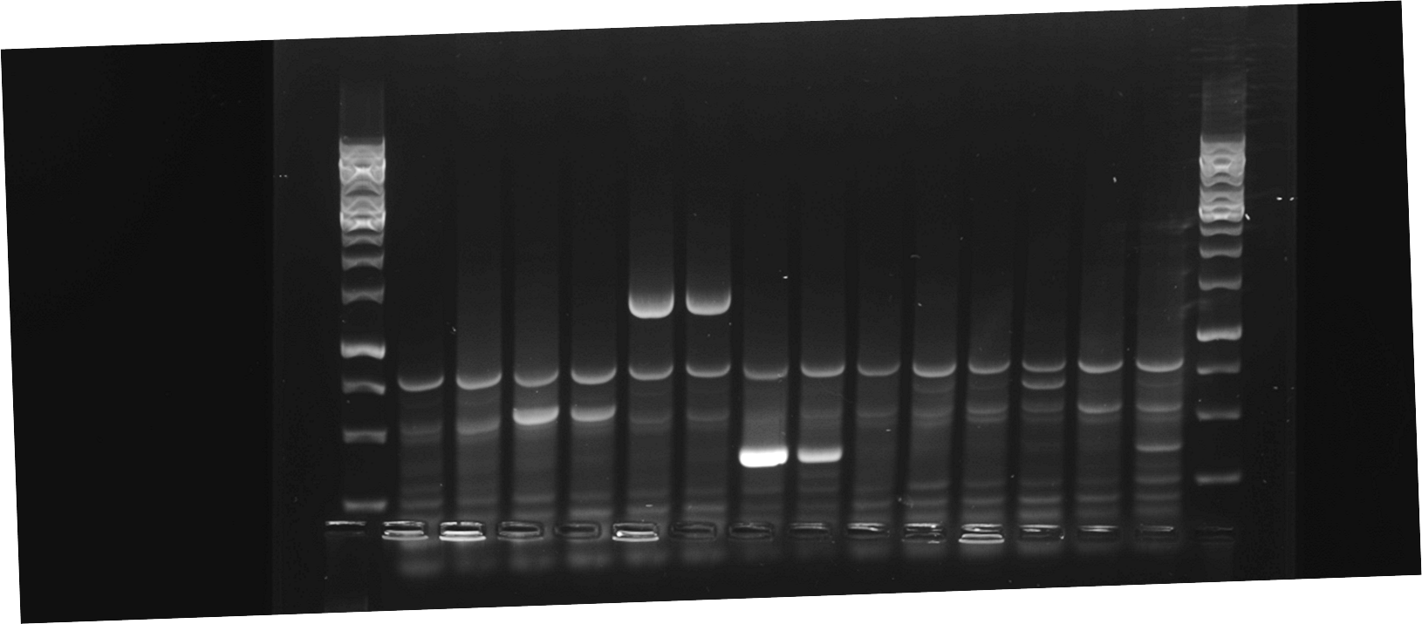
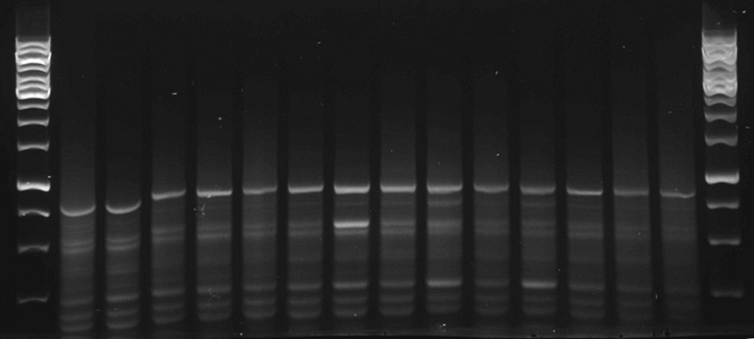
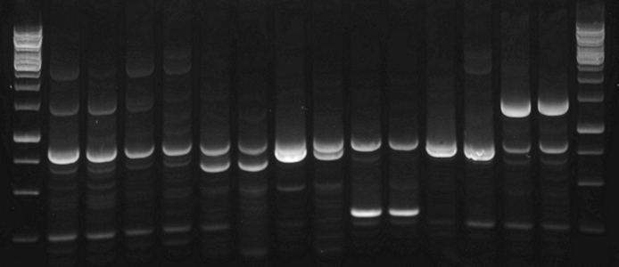
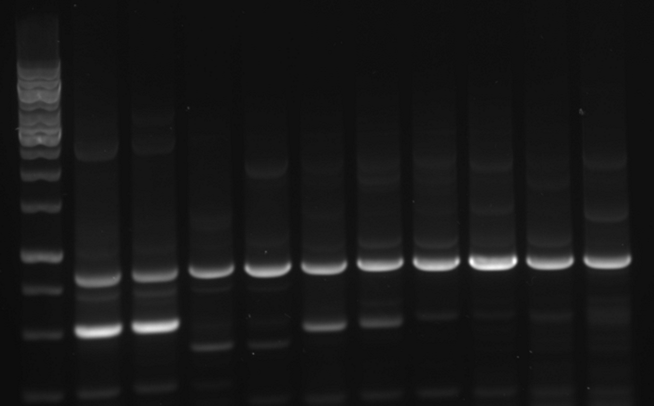
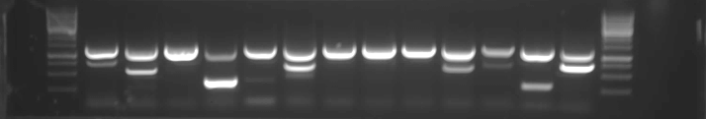

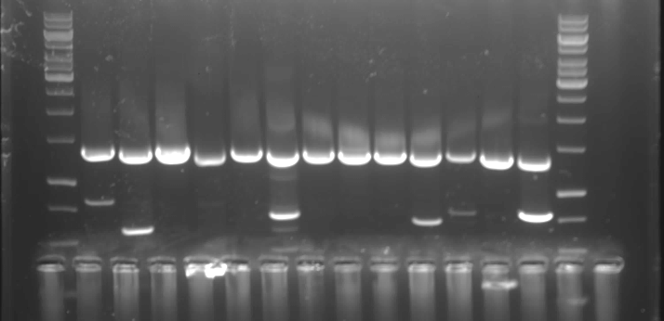
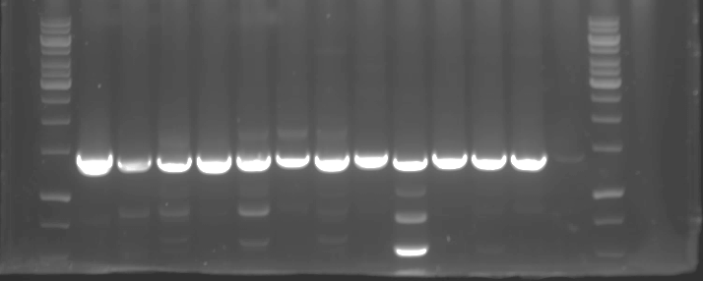
Figure S2
A
L
1
2
3
4
5
6
7
L
15
16
17
18
19
20
21
C
N
C
N
C
N
C
N
C
N
C
N
C
N
L
C
N
C
N
C
N
C
N
C
N
C
N
C
N
L
8
9
10
11
12
13
14
L
22
23
24
25
26
L
C
N
C
N
C
N
C
N
C
N
C
N
C
N
L
C
N
C
N
C
N
C
N
C
N
B
L
1
2
3
4
5
6
7
C
8
9
10
11
12
13
L
Sample | ORF | Expected size (bp)
1 | E1A | 904
2 | E1B 19K | 670
3 | E1B 55K | 1486
4 | Protein IX | 433
5 | Protein IVa2 | 1452
6 | Pol | 3775
7 | 52K | 1222
8 | pIIIa | 1627
9 | III | 1612
10 | pVII | 742
11 | V | 829
12 | pX | 367
13 | pVI | 856
14 | DBP | 1528
15 | 33K | 727
16 | 22K | 655
17 | pVIII | 790
18 | E3 ORFA | 628
19 | E4 34K | 943
20 | E4 ORFE | 649
21 | E4 ORFD | 922
22 | E4 ORFC | 580
23 | E4 ORFB | 493
24 | E4 ORFA | 541
25 | EnAd-CMV-GFP | 792
26 | Mock-infected | No product
*
*
*
*
*
*
*
*
*
L
14
15
16
17
18
19
20
21
22
23
24
25
26
L
*
*
*
*
L
1
2
3
4
5
6
7
8
9
10
11
12
13
L
*
*
*
*
*
*
*
*
*
*
*
*
*
*
L
14
15
16
17
18
19
20
21
22
23
24
25
26
L
*
*
*
*
*
*
*
*

