Slide 1
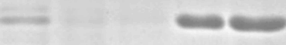
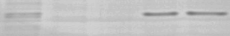
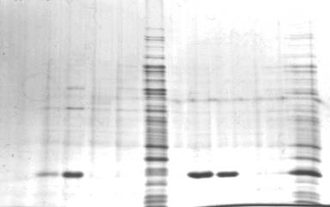

A
B
C
Input
Elution
Wash
1 2 3
E2
E12
F1
F6
H7
D
Human cath-D
(MDA-MB-231 cells)
Cellular
Secreted
Mr
52-
-52
48-
34-
E
Mouse cath-D
(MEF cells)
Cellular
Mr
48-
34-
Figure S4. Generation of anti-cath-D human scFv fragments by phage display

