Slide 1
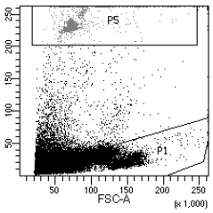
Supplemental figure 2
S2
mCD45
huCD45
TEG001-treated
CD13
Fixable viability dye
CD33
Mock-treated
CD13
Fixable viability dye
CD33

