Slide 1
Chandramohan et al, Supplementary Figure 1.

Slide 2
Final Cure Rate
G1_D2C7-IT 0.03 ug 5/9
G2_D2C7-IT 0.1 ug 3/9
G3_D2C7-IT 0.3 ug 5/9
G4_D2C7-IT 1 ug 2/8
100
75
50
Percent survival
25
0
0
5
10
15
20
25
30
35
40
45
50
55
60
65
70
75
80
85
90
IC CED of D2C7-IT for 72h
Days after Tumor implantation
Surviving mice were euthanized on Day 83
IC injection of CT-2A-dmEGFRvIII-Luc cells
Chandramohan et al, Supplementary Figure 2.

Slide 3
A) C57BL/6: CT-2A-dmEGFRvIII-Luc
Day 0 6 9 12
P=0.5876
P=0.0001
Vehicle 0.1 µg D2C7-IT 0.1 µg P588-IT
IC injection of 200K CT-2A-DmEGFRvIII-Luc cells
IC CED of D2C7-IT or P588-IT or Vehicle for 72h
# Surviving 0/10 3/10 0/10
Median Surv. 12.5 33 13
% Increase - 164% -
B) C57BL/6: CT-2A-Parental
Day 0 6 9 12
IC injection of 100K CT-2A-Parental cells
IC CED of D2C7-IT or P588-IT or Vehicle for 72h
Chandramohan et al, Supplementary Figure 3.

Slide 4
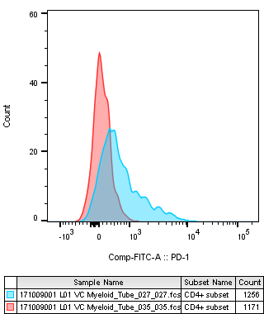
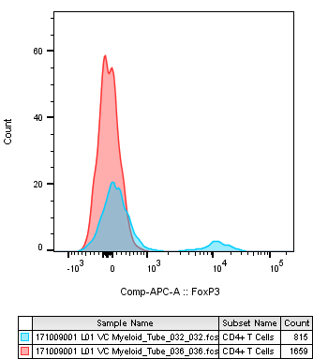
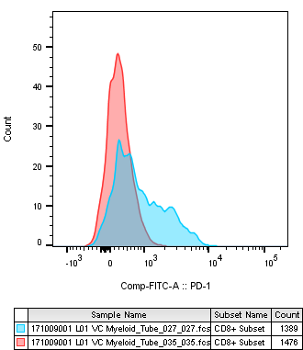
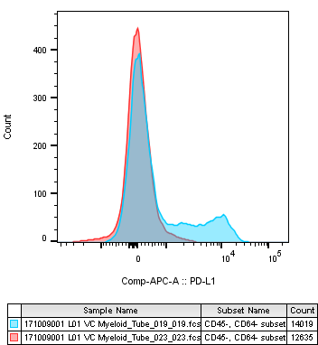
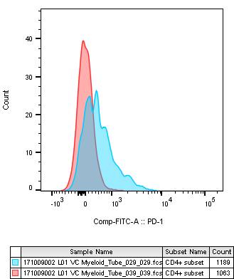
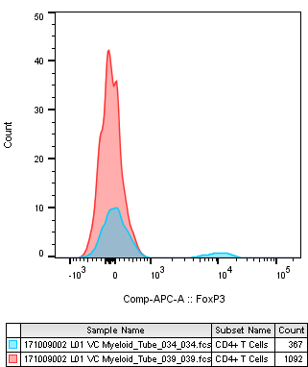
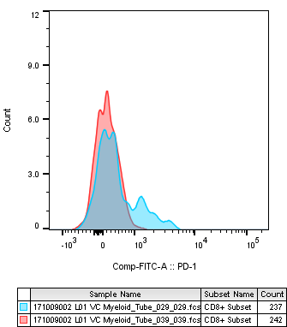
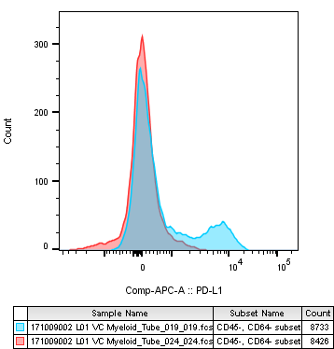
CT-2A-dmEGFRvIII-Luc Day 6 Tumors
A) CD4 T Cells
B) CD4 T Cells
C) CD8 T Cells
D) Tumor Cells
Isotype Control
Isotype Control
Isotype Control
Isotype Control
αPD-1
αFoxP3
αPD-1
αPD-L1
Count
Count
Count
Count
PD-1
FoxP3
PD-1
PD-L1
SMA560-dmEGFRvIII-Luc Day 4 Tumors
E) CD4 T Cells
F) CD4 T Cells
G) CD8 T Cells
H) Tumor Cells
Isotype Control
Isotype Control
Isotype Control
Isotype Control
αPD-1
αFoxP3
αPD-1
αPD-L1
Count
Count
Count
Count
PD-1
FoxP3
PD-1
PD-L1
Chandramohan et al, Supplementary Figure 4.

Slide 5
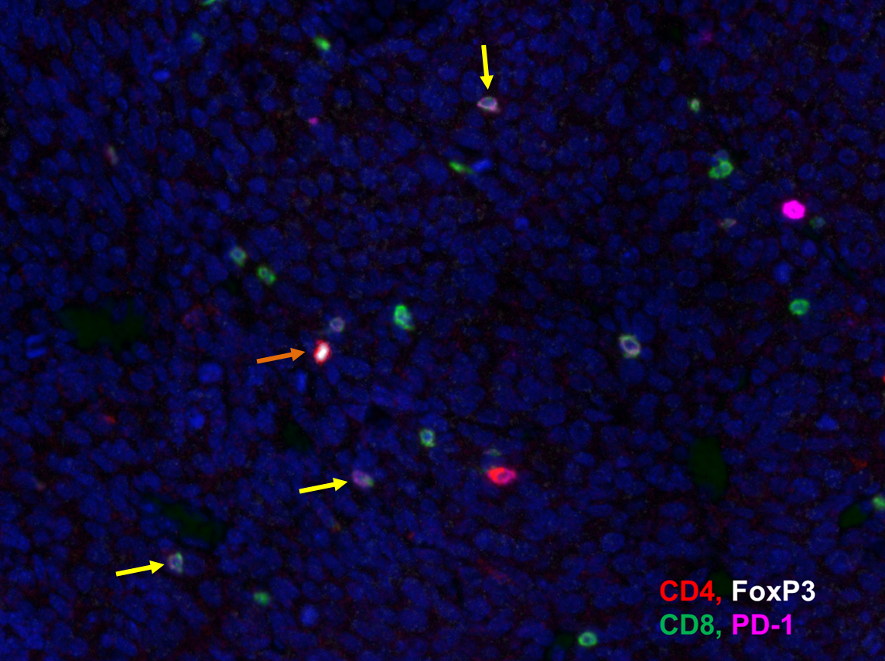
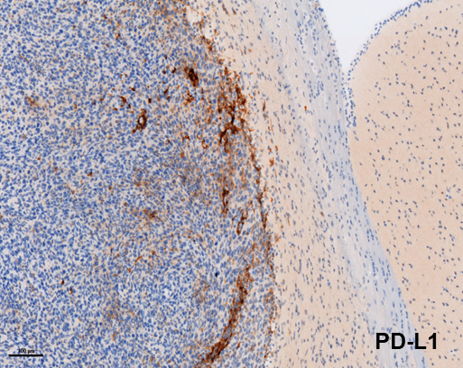
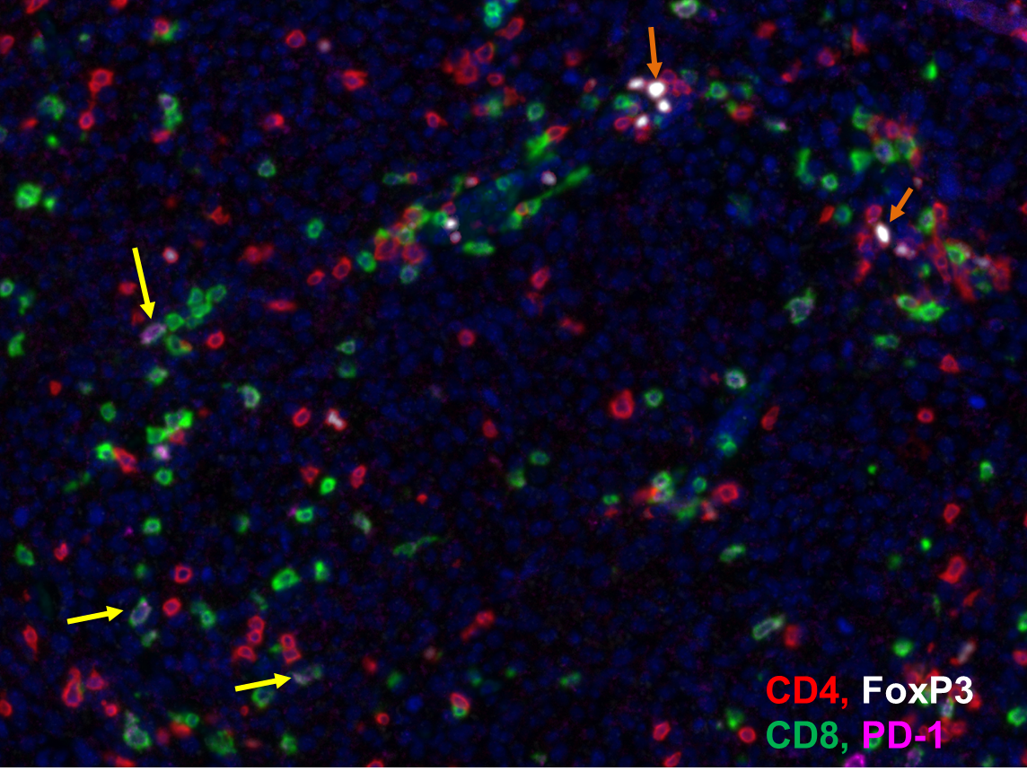
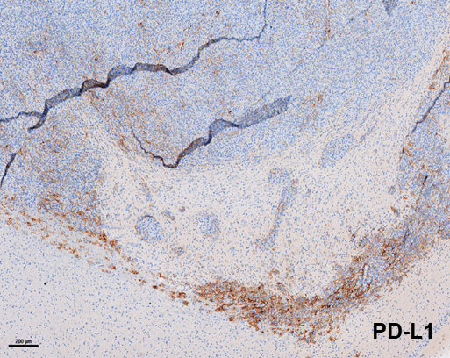
A) CT-2A-dmEGFRvIII-Luc Tumors
B) SMA560-dmEGFRvIII-Luc Tumors
Chandramohan et al, Supplementary Figure 5.

Slide 6
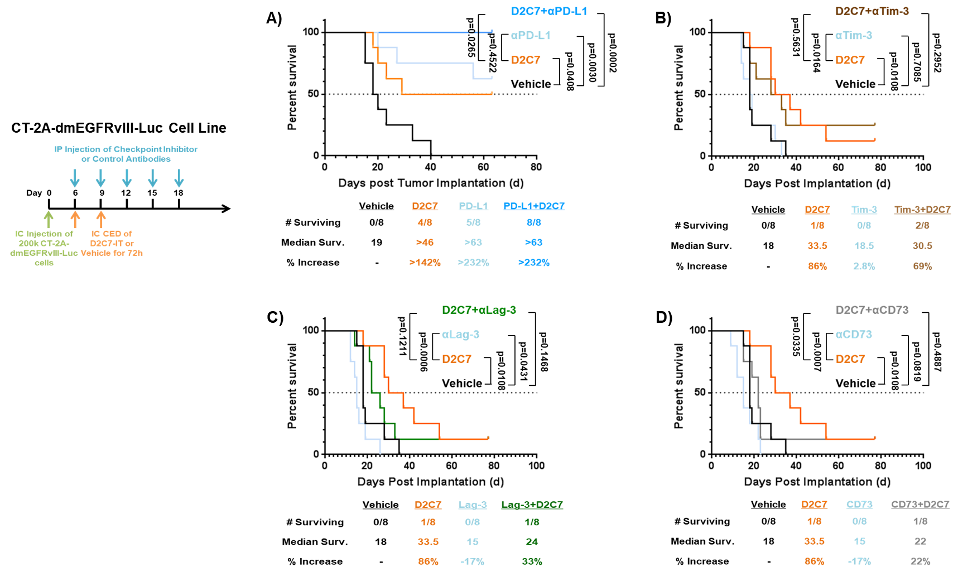
Chandramohan et al, Supplementary Figure 6.

Slide 7
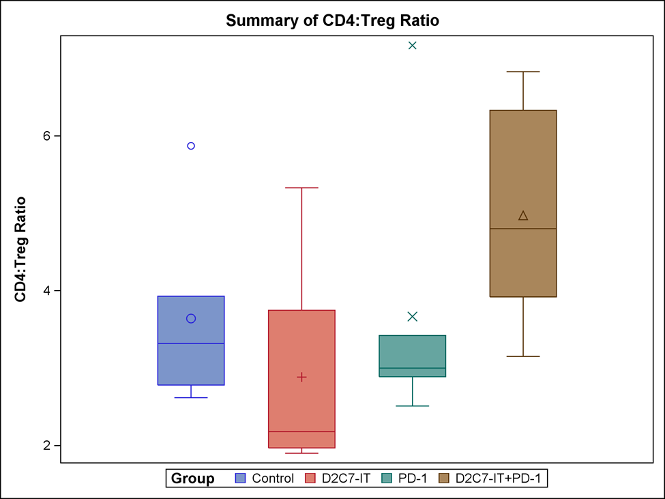
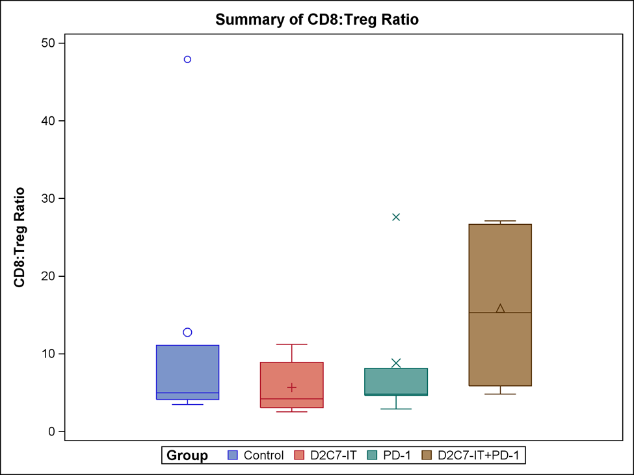
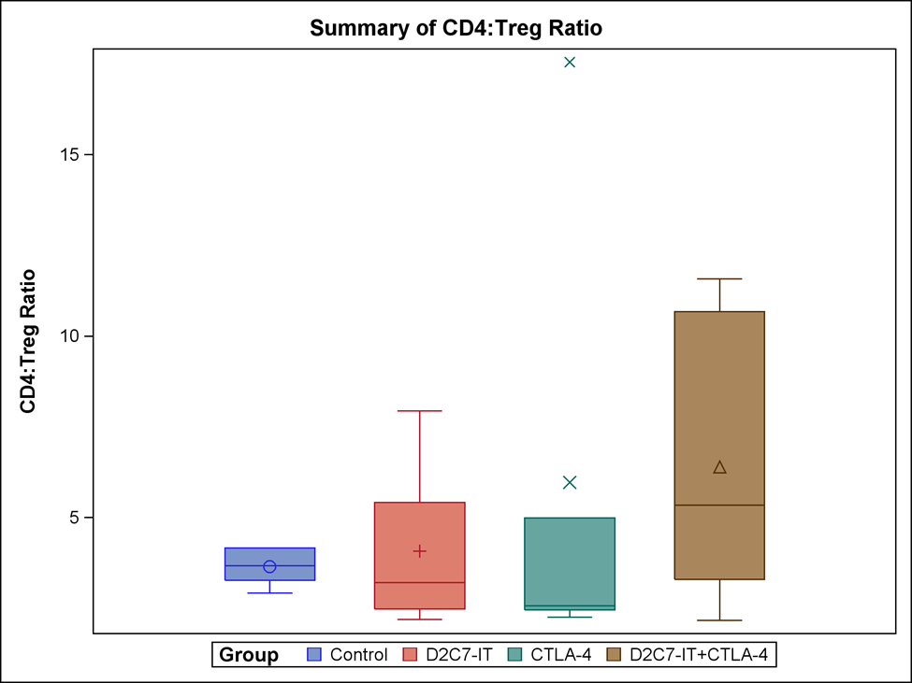
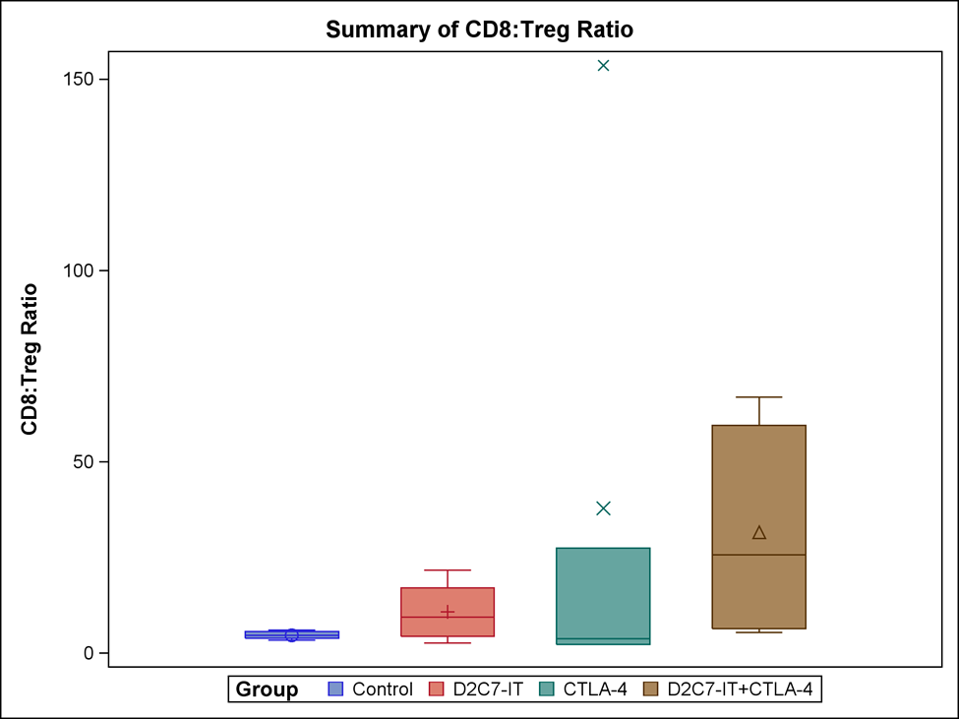
A) D2C7-IT+αPD-1: CD4:Treg Ratio
B) D2C7-IT+αPD-1: CD8:Treg Ratio
C) D2C7-IT+αCTLA-4: CD4:Treg Ratio
D) D2C7-IT+αCTLA-4: CD8:Treg Ratio
Chandramohan et al, Supplementary Figure 7.

