Slide 1
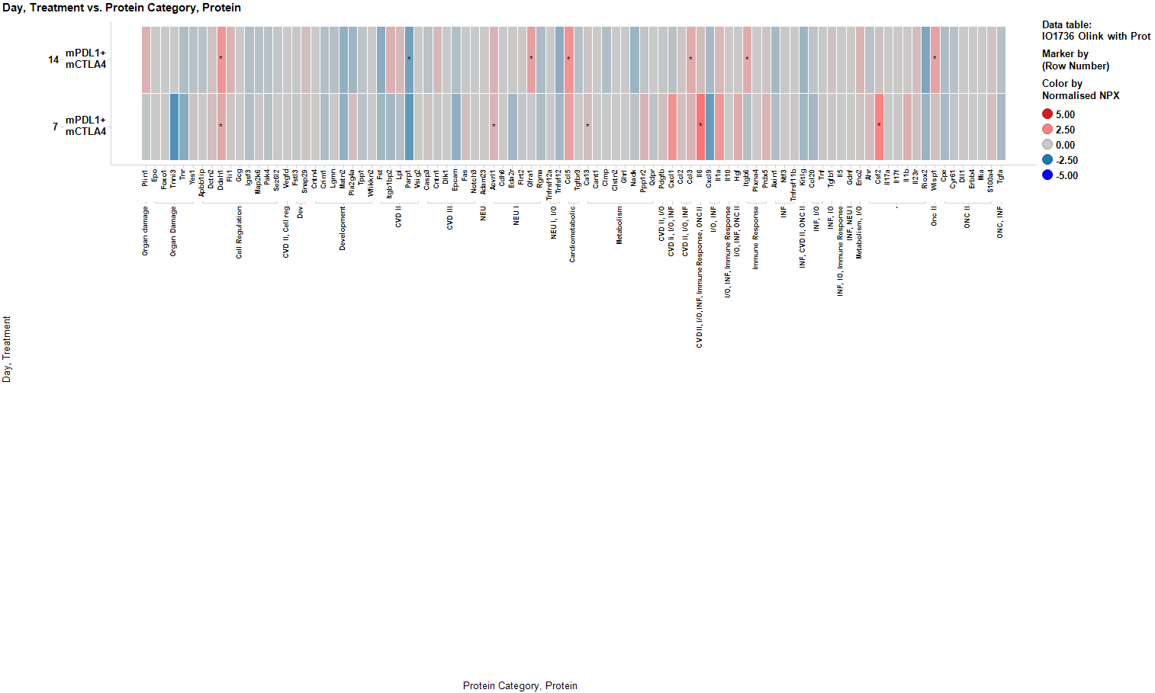
Supplementary Figure 3
Supplementary Figure 3 – Protein expression changes measured by NPX
Normalized protein expression (NPX) levels of chemokines measured by O-link PEA assay normalized to Isotype Control.

