Slide 1
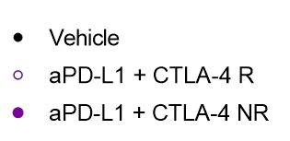
Supplementary Figure 5
A
B
C
D
E
F
Supplementary Figure 5 – Immune cell content in CT-26 responders and non-responders
CT-26 tumors treated with αPD-L1 + αCTLA-4, collected on day 15 after implant, and were divided into responders and non-responders, by taking tumors smaller than the smallest vehicle control (0.187 mm³) as responders and anything larger as a non-responder. Flow cytometry data for (A) CD8+ T-cells, (B) CD4+ T-cells, (C) Tregs, (D) CD11b+ myeloid cells, (E) F4/80 myeloid cells, and (F) DCs populations are shown. n= 10 (vehicle), 9 (Responder, R), 10 (non-responder, NR). Statistical significance is indicated as *p<0.05, **p<0.01,***p<0.001, ****p<0.0001.

