Slide 1
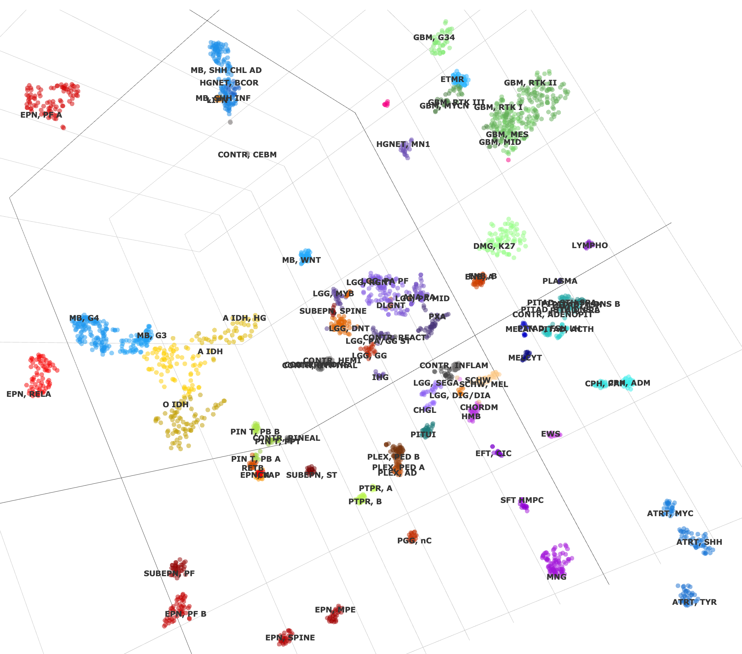
SP-EPN-MYCN

