Slide 1
Antonia Clarissa Wehn^{1,2}, Igor Khalin^{1,2}, Marco Duering^{1,2§}, Farida Hellal^{1,2}, Carsten Culmsee^{3,4}, Peter Vandenabeele^{5,6}, Nikolaus Plesnila^{1,2,7*}, and Nicole Angela Terpolilli^{1,2,8*}
RIPK1 or RIPK3 deletion prevents chronic neuronal cell death and improves memory function after traumatic brain injury
¹Institute for Stroke and Dementia Research (ISD), LMU Klinikum, Ludwig-Maximilians University Munich, Munich, Germany; ²Munich Cluster of Systems Neurology (SyNergy), Munich, Germany; ³Institute for Pharmacology and Clinical Pharmacy, Biochemical-Pharmacological Center Marburg and ⁴Center for Mind, Brain and Behavior – CMBB, University of Marburg, Germany; ⁵Molecular Signaling and Cell Death Unit, VIB-UGent Center for Inflammation Research, Ghent, Belgium; ⁶Department of Biomedical Molecular Biology, Ghent University, Ghent, Belgium; ⁷Graduate School of Systemic Neurosciences (GSN), Ludwig-Maximilians University Munich, Munich, Germany; ⁸Department of Neurosurgery, LMU Klinikum, Ludwig-Maximilians University Munich, Munich, Germany.
*equal contribution
§ Current address: Medical Image Analysis Center (MIAC AG) and qbig, Department of Biomedical Engineering, University of Basel, Basel, Switzerland
Corresponding author:
Nikolaus Plesnila, MD, PhD, Institute for Stroke and Dementia Research, LMU Klinikum, Feodor-Lynen-Str. 17, 81377 Munich, Germany, Tel: +49 89 4400 46220, Fax: +49 89 4400 46113, nikolaus.plesnila@med.uni-muenchen.de

Slide 2









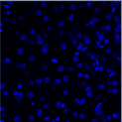
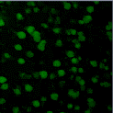
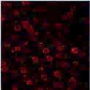
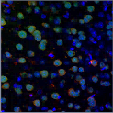
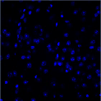
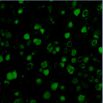
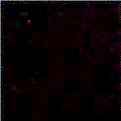
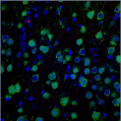
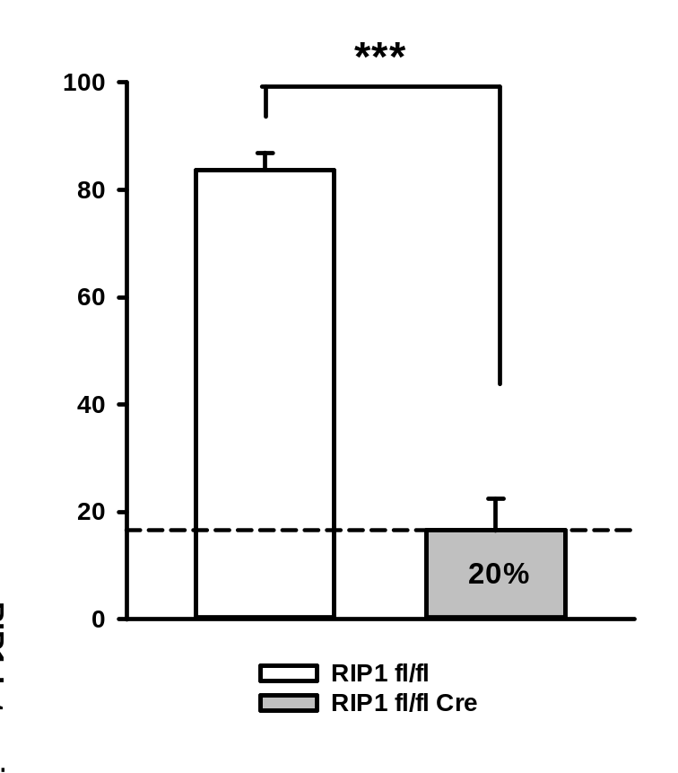
Supplementary Figure 1
a
b
Flox band (361 bp)
RIPK1
WT band (287 bp)
KO band (485 bp)
RIPK3
Cre band (375 bp)
Camk2
creERT2
WT band (287 bp)
WT band (290 bp)
1. gen
2. gen
Exp
Ctrl
1. gen
2. gen
Exp
Ctrl
DP
c
DAPI
NeuN
RIPK1
merged
Ripk1 fl/fl
Cortex
Ripk1 fl/fl Cre
d
Notes:
RIP3 KO PCR hinzufügen

Slide 3
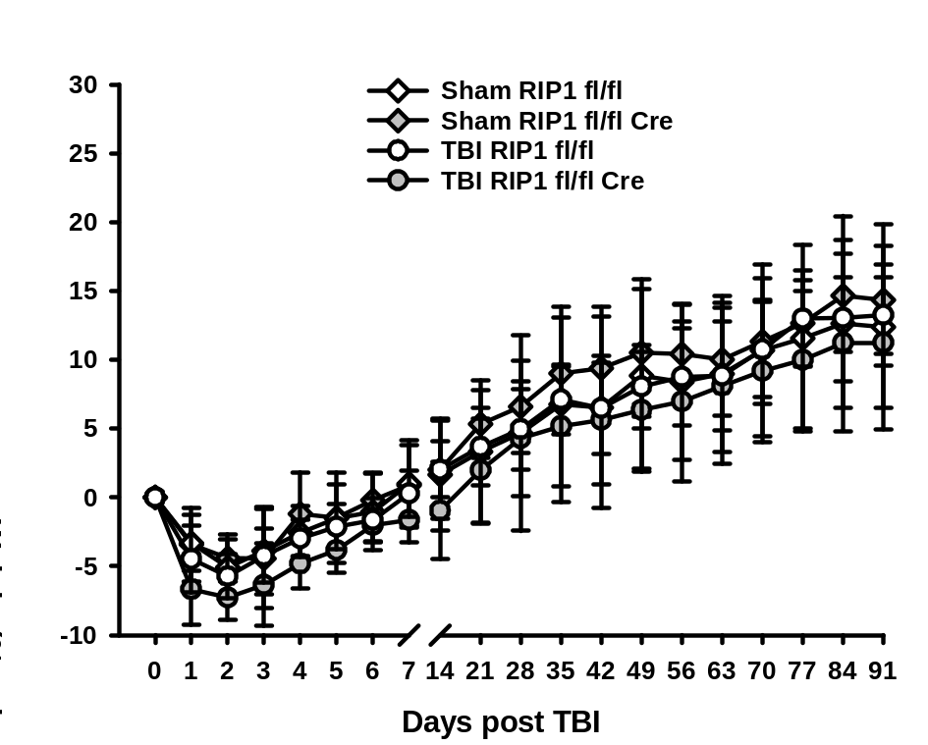
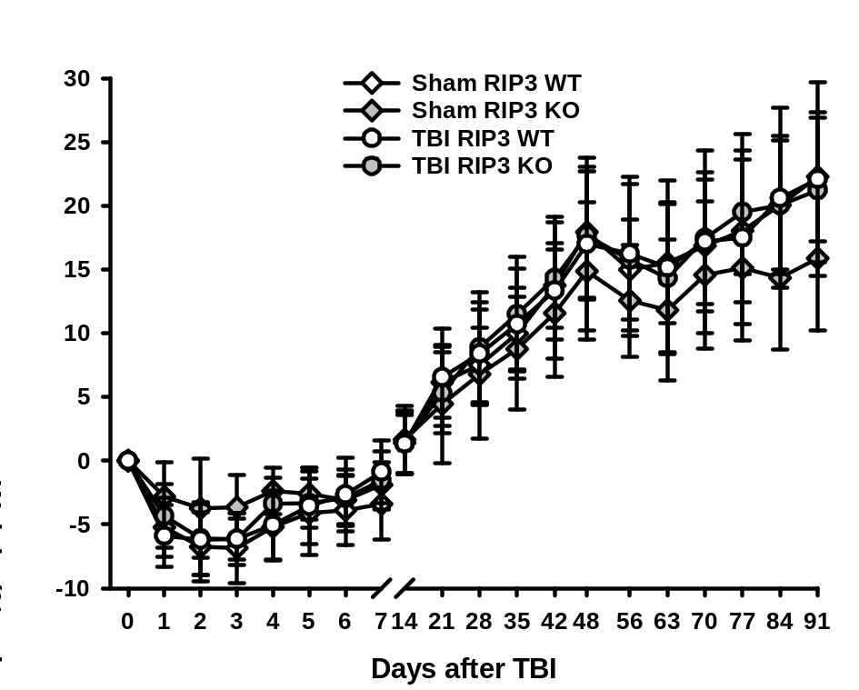
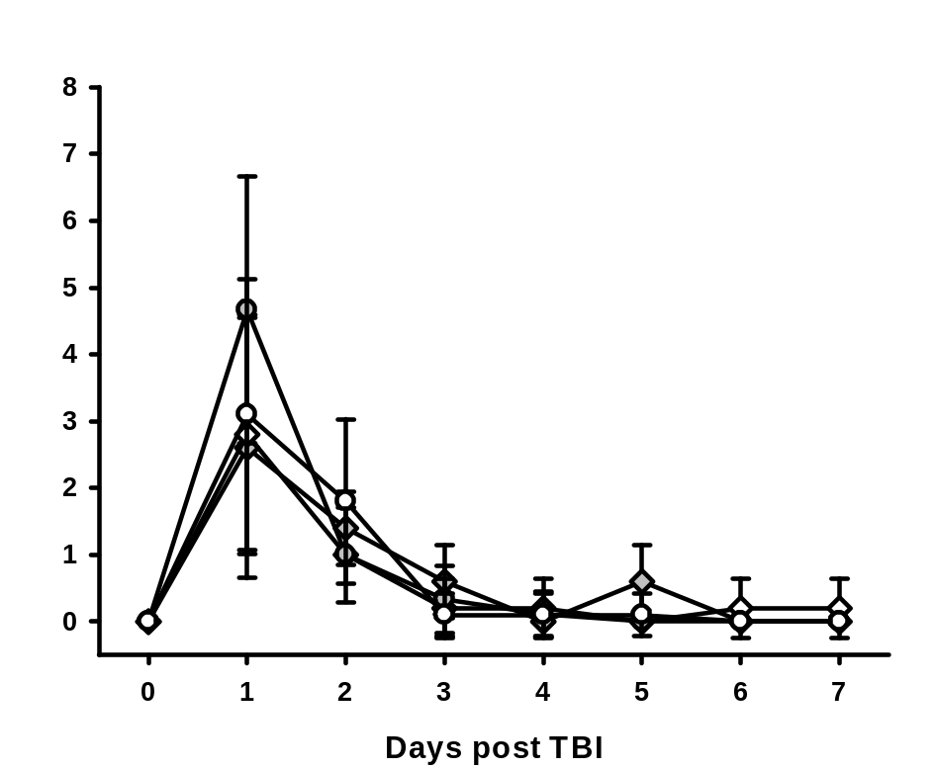
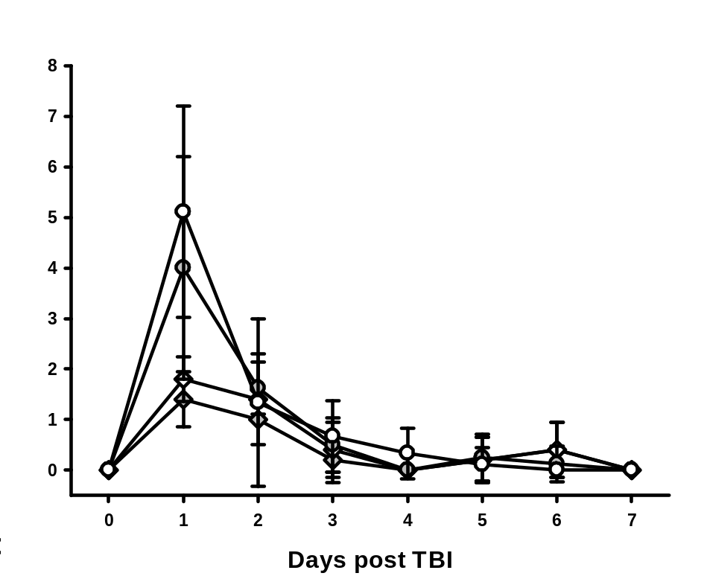
Supplementary Figure 2
RIPK1
RIPK3
a
b
c
d

Slide 4
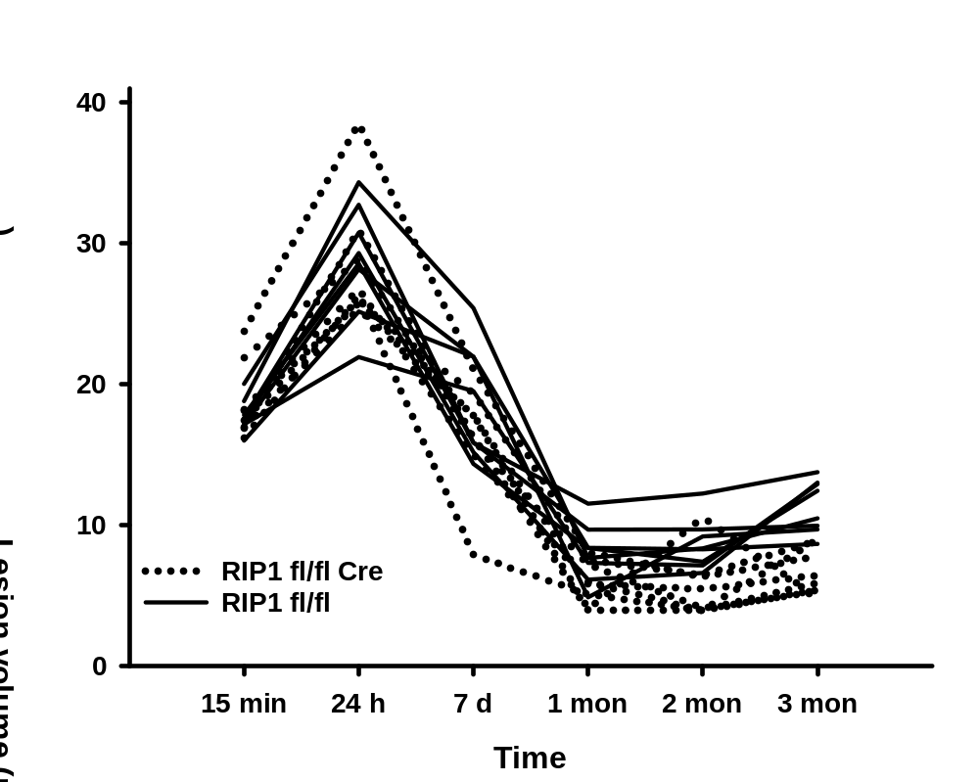
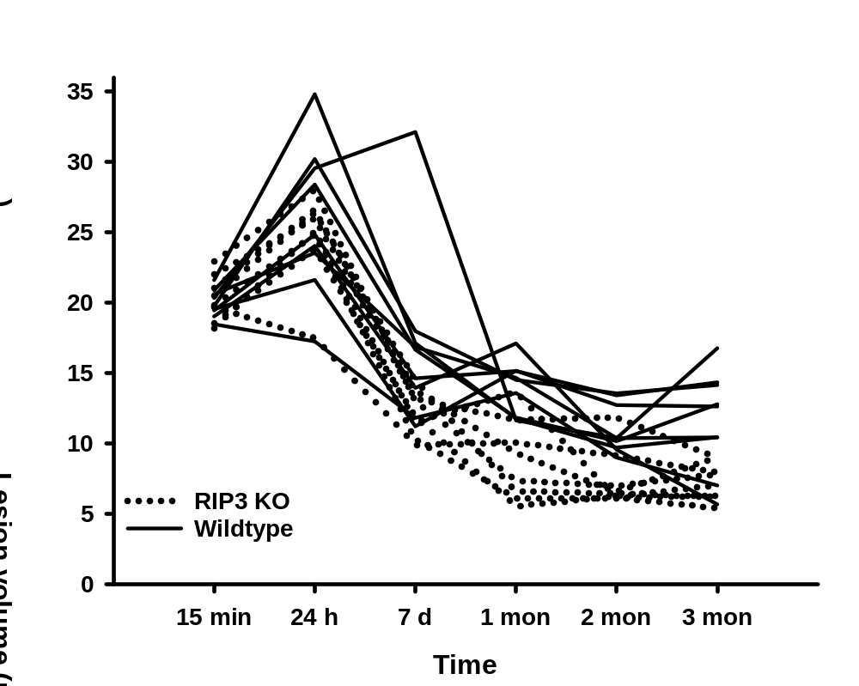
Supplementary Figure 3
a
b

Slide 5
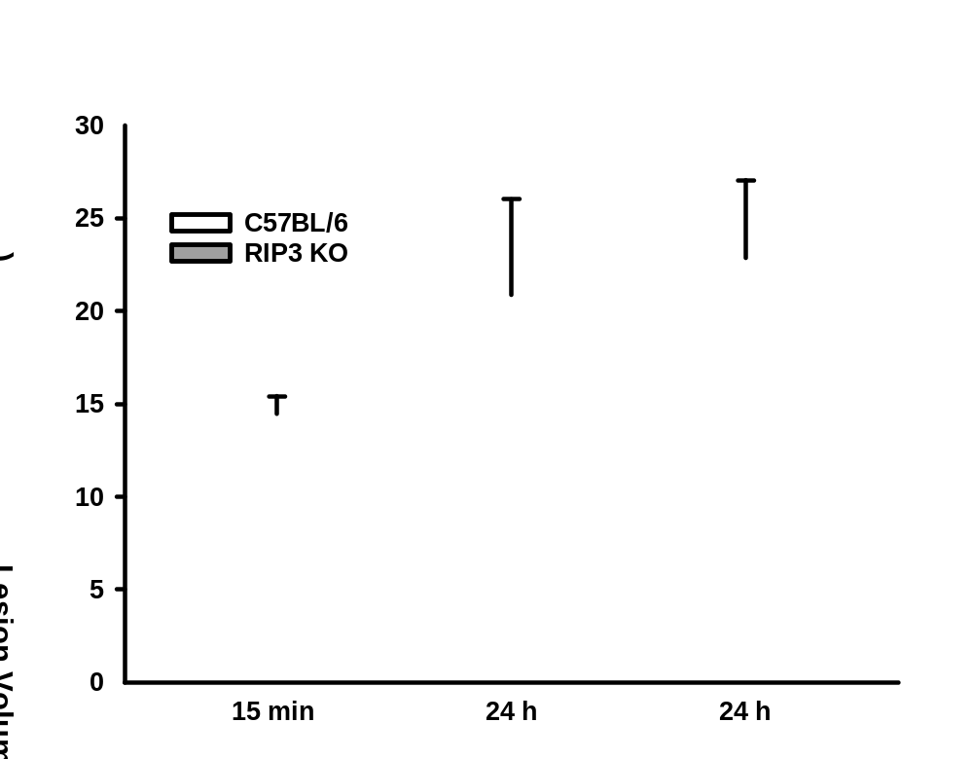
Supplementary Figure 4

Slide 6
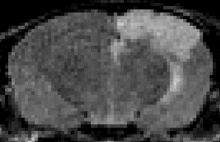
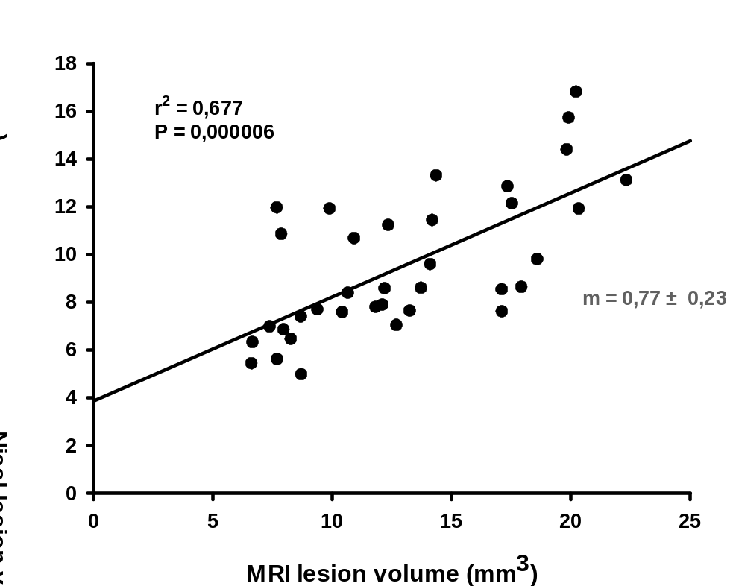
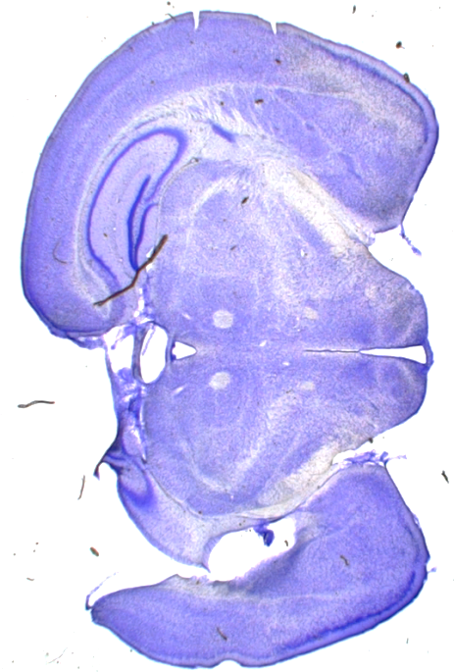
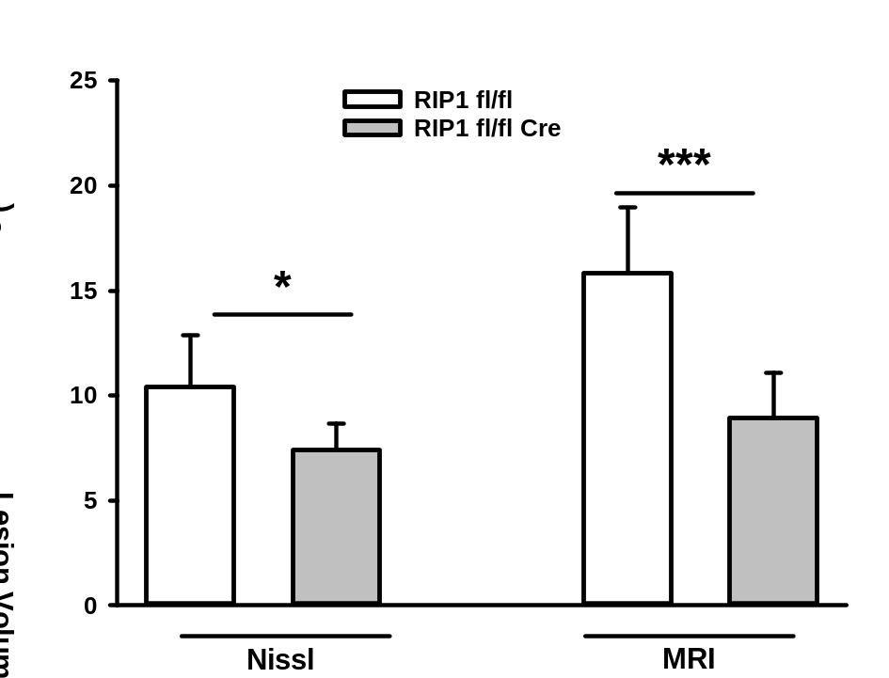
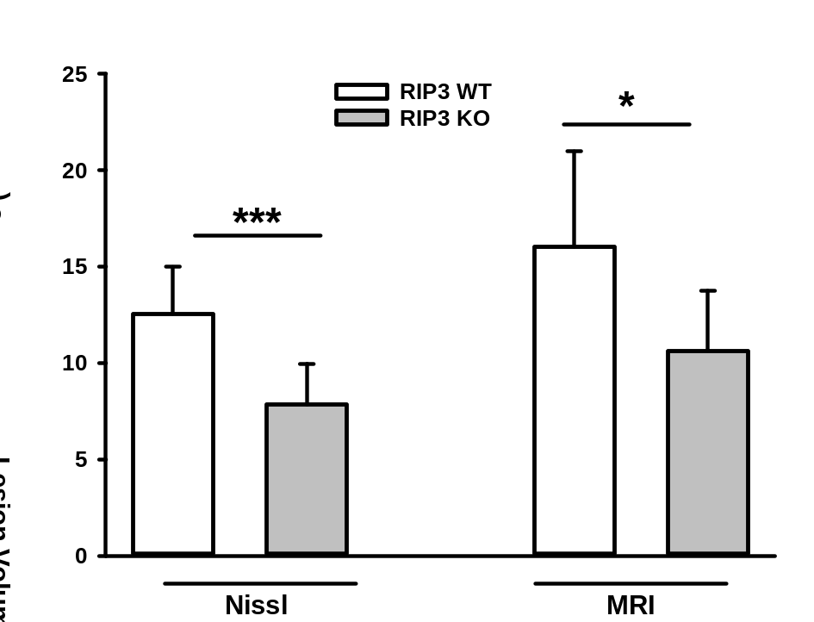
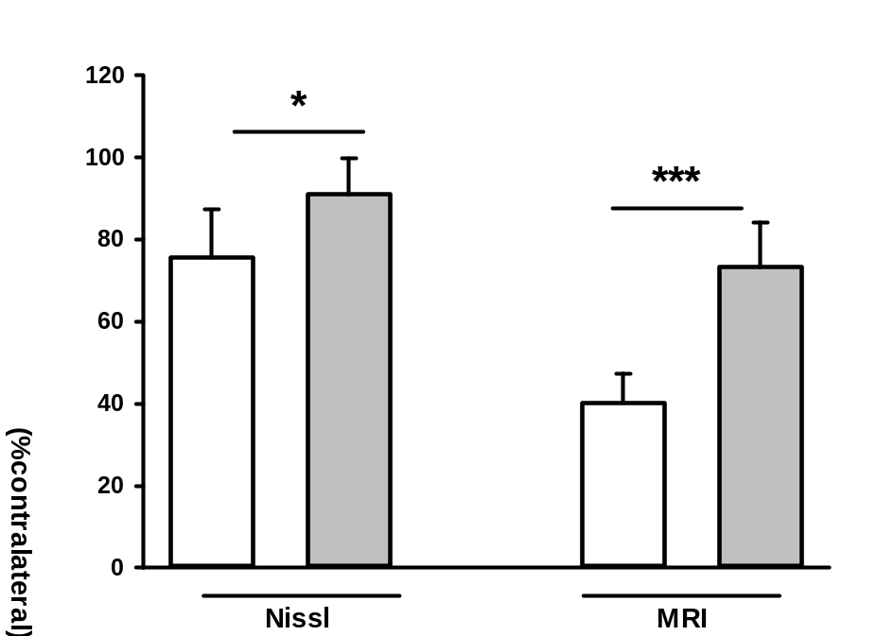
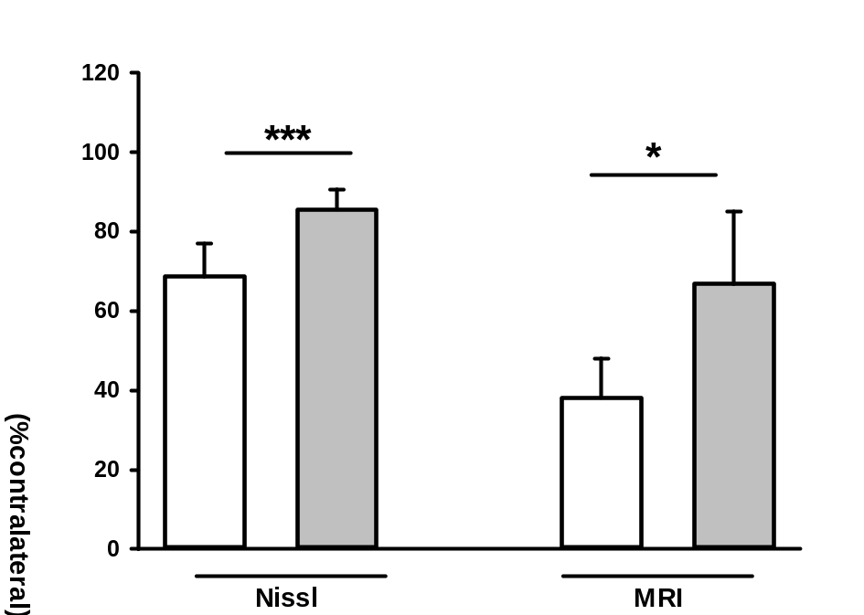
Supplementary Figure 5
a
b
c
d
e
f

