Slide 1
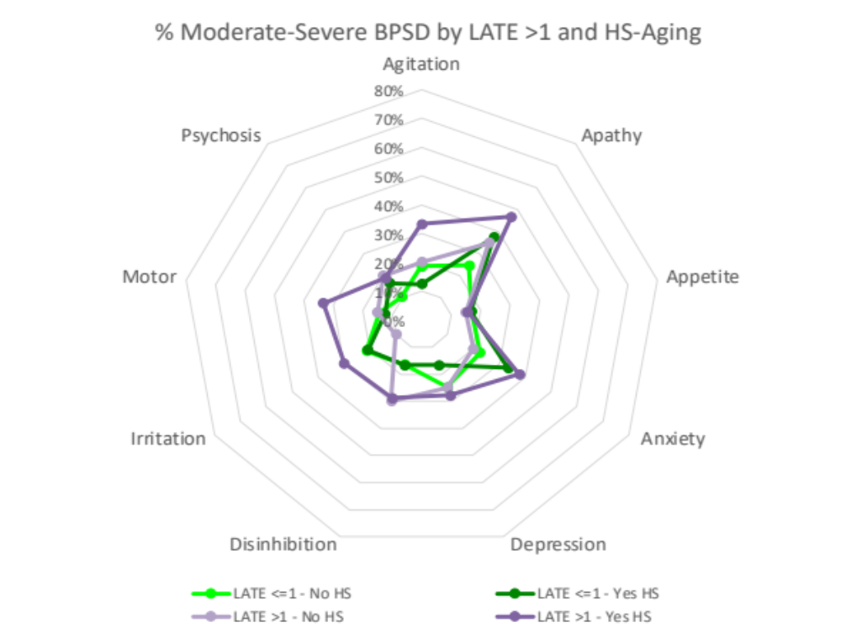
R Nelson et al, Supplemental Fig. 1
BPSDs and Hippocampal Sclerosis (HS)

Slide 2
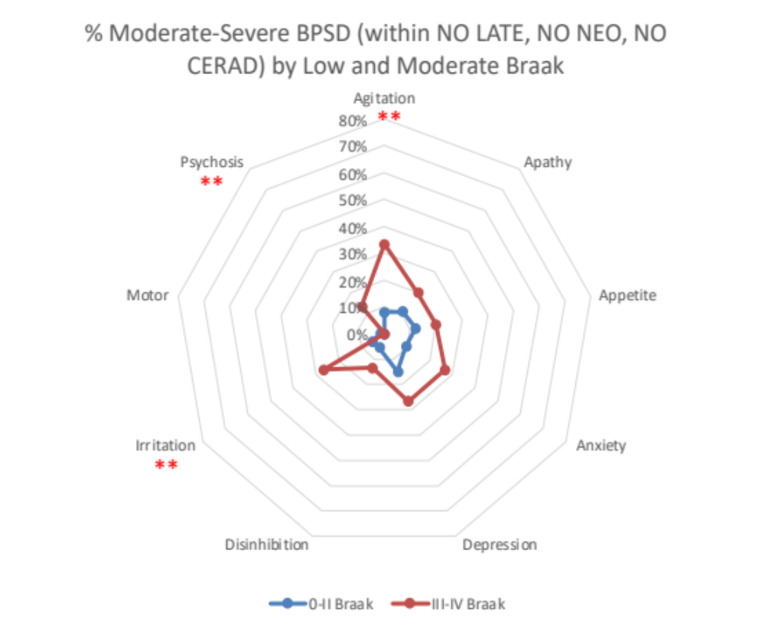
R Nelson et al, Supplemental Fig. 2
BPSDs and PART

Slide 3
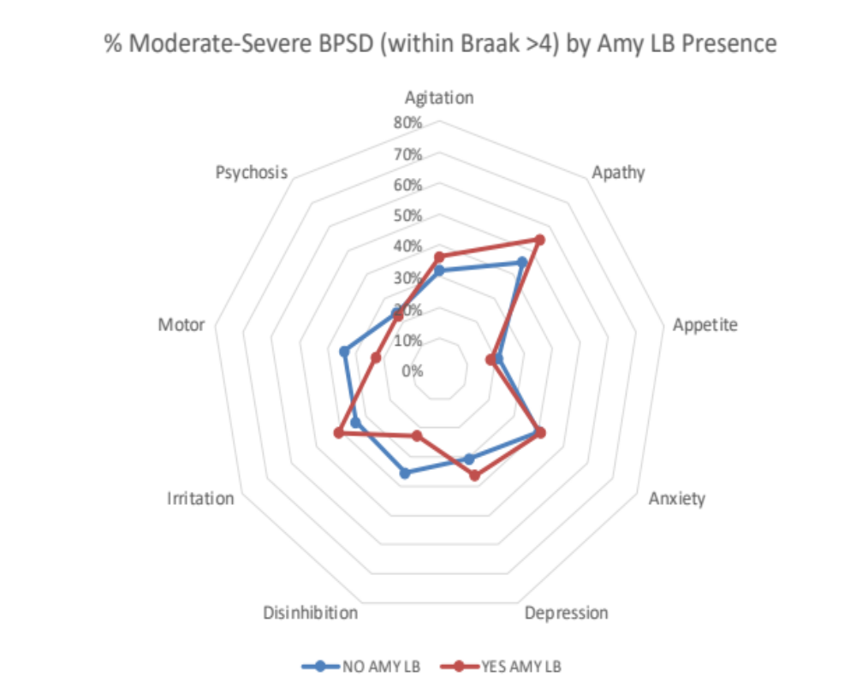
R Nelson et al, Supplemental Fig. 3
BPSDs and Amygdala Lewy bodies

Slide 4
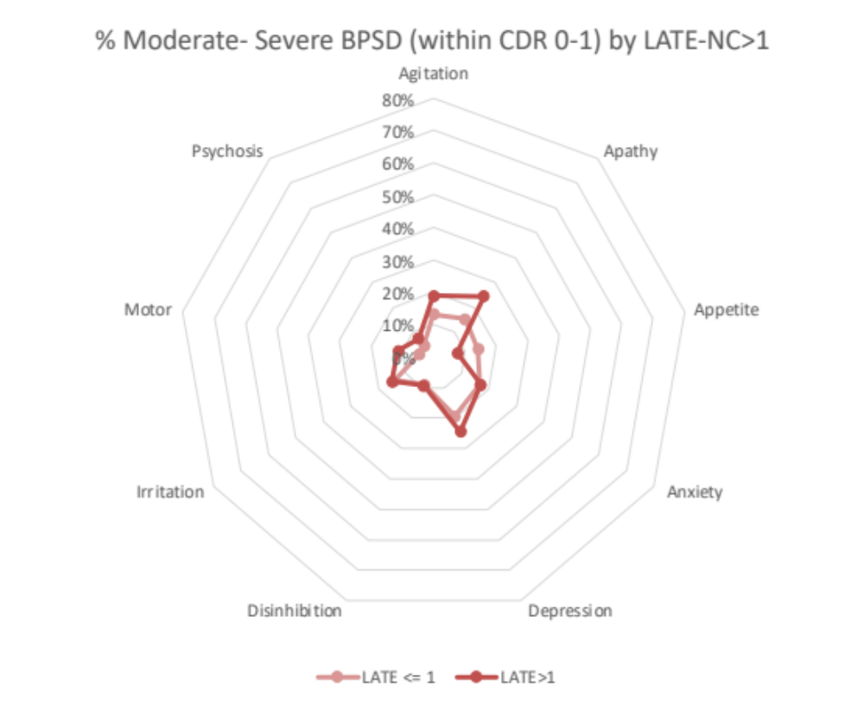
R Nelson et al, Supplemental Fig. 4

Slide 5
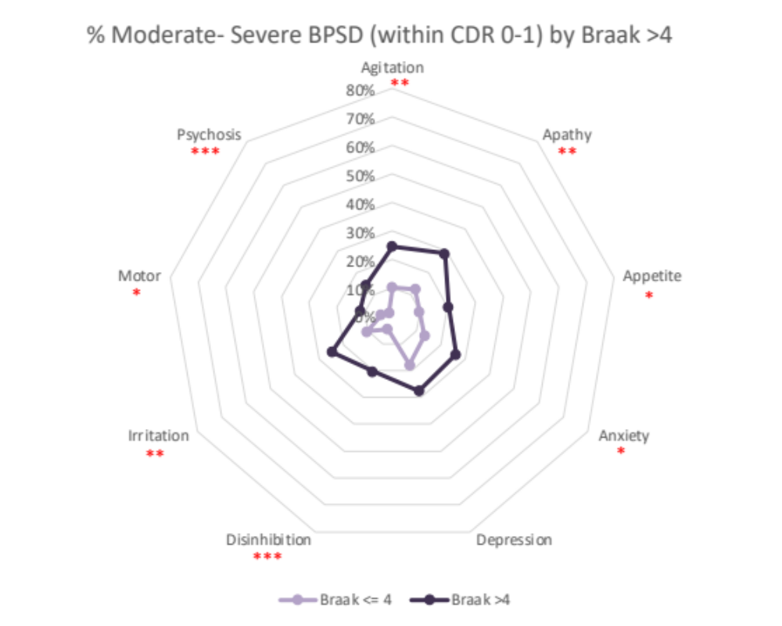
R Nelson et al, Supplemental Fig. 5

Slide 6
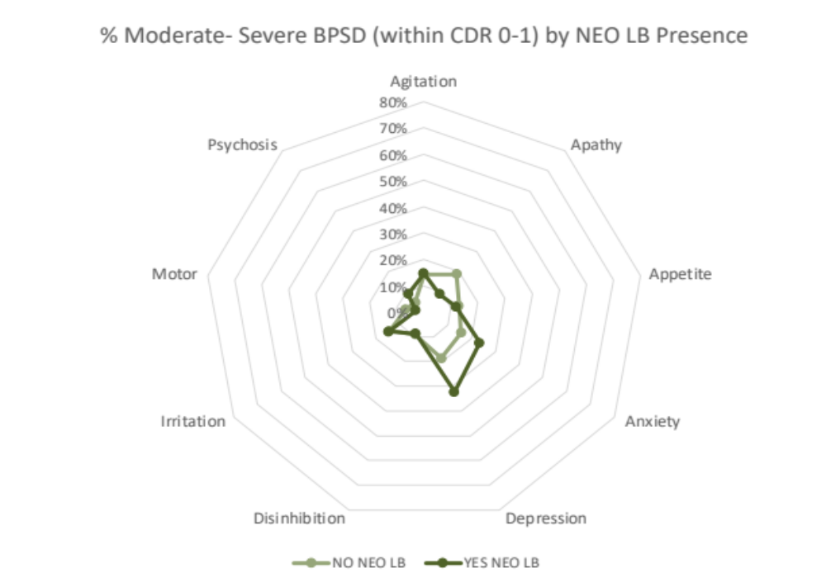
R Nelson et al, Supplemental Fig. 6

