Slide 1
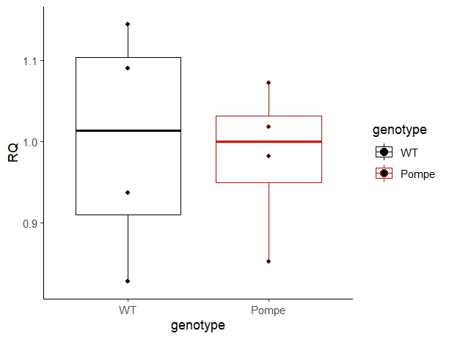
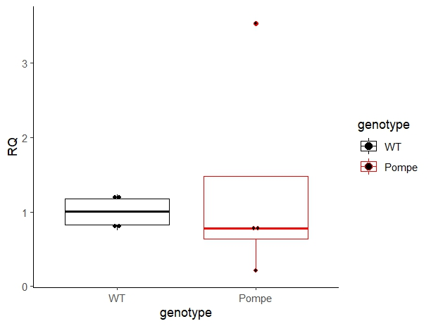
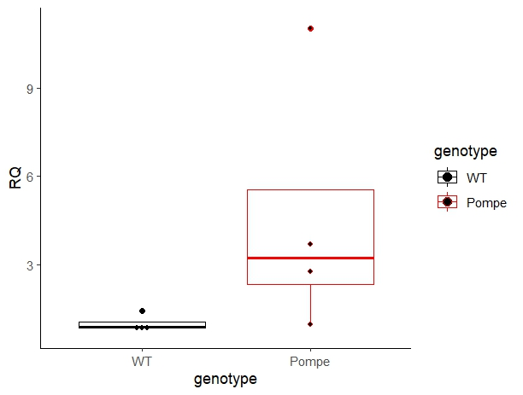

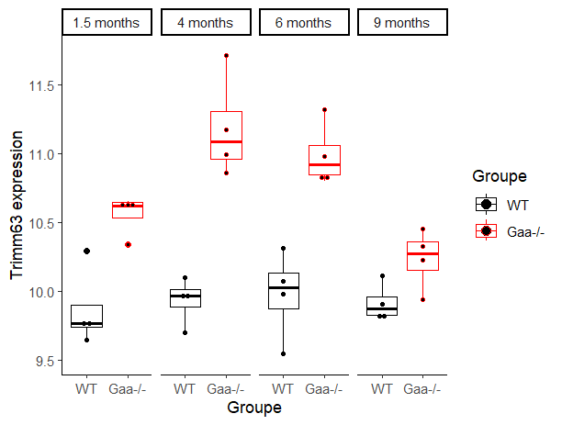
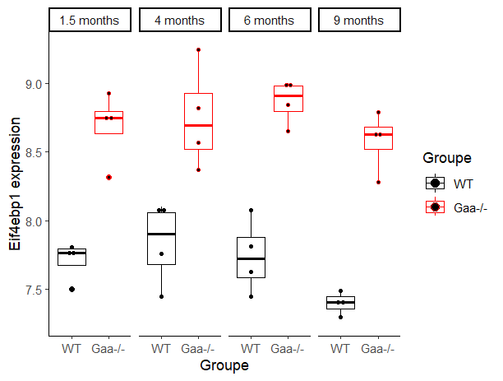
a
1.1
3
9
Furin transcript relative expression
Bmp1 transcript relative expression
Tll1 transcript
relative expression
1
2
6
0.9
1
3
WT
Gaa^{-/-}
0
WT
Gaa^{-/-}
WT
Gaa^{-/-}
b
****
WT
****
WT
11.5
****
Gaa^{-/-}
****
****
Gaa^{-/-}
9
****
11
****
8.5
Trim63 transcript expression
****
10.5
Eif4ebp1 transcript expression
8
10
7.5
9.5
1.5 mo
4 mo
6 mo
9 mo
1.5 mo
4 mo
6 mo
9 mo

Slide 2
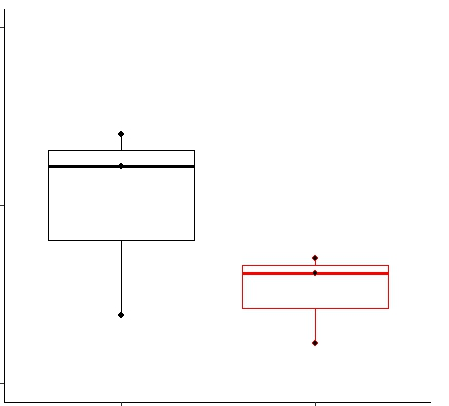
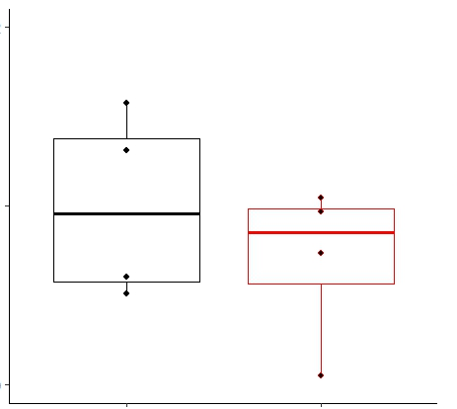
2
2
IL6 transcript
relative expression
IL10 transcript relative expression
1
1
0
WT
Gaa^{-/-}
0
WT
Gaa^{-/-}

