Slide 1
Johannes Vermeer’s Mistress and Maid: New Discoveries Cast Light on Changes to the Composition and the Discoloration of Some Paint Passages
Dorothy Mahon¹, Silvia A. Centeno^{2*}, Margaret Iacono³, Federico Carό², Heike Stege⁴, Andrea Obermeier⁴
1-Department of Paintings Conservation, The Metropolitan Museum of Art, 1000 Fifth Avenue, New York, NY
2-Department of Scientific Research, The Metropolitan Museum of Art
3- The Frick Collection, 1 East 70th Street, New York, NY 10021.
4- Scientific Department, Doerner Institut, Bavarian State Painting Collections, Barer Str. 29, 80799 Munich, Germany
*Corresponding author
Additional Information

Slide 2
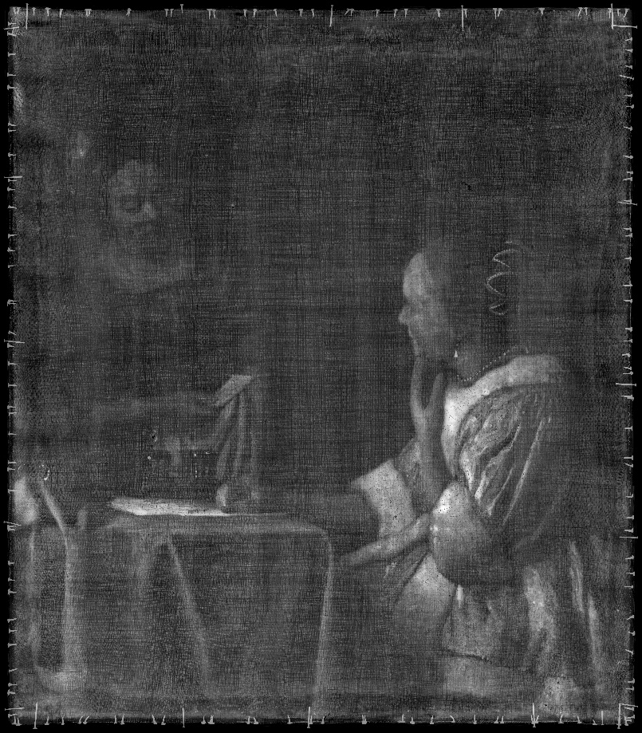
Fig. S1. Photomicrograph of pin prick at a possible perspective point. The location of this point is indicated in the X-radiograph by a red arrow on the fire to the right. Original magnification 75x.

Slide 3
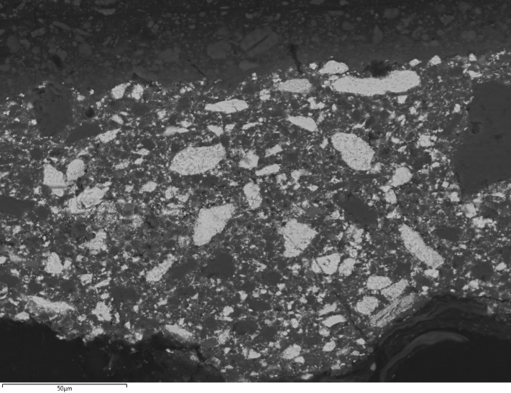
a
b
c
Fig. S2. Paint-cross section S3 removed from the curtain area, approximately from the location indicated in Fig. 3a. Photomicrographs taken with visible (a) and with UV illumination (b), original magnification 400x; and backscattered electron image taken in the rectangle included in b (c).

Slide 4
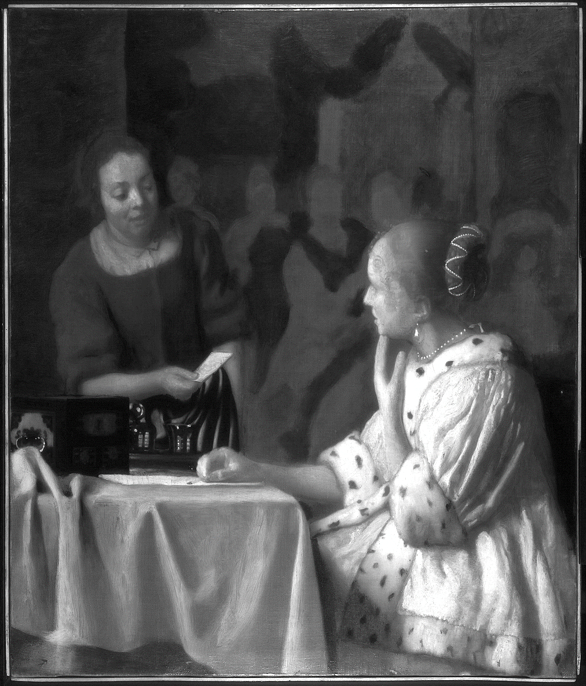
Fig. S3. Infrared Reflectogram. The white rectangle indicates the location of the detail shown in Fig. 2c, and the red rectangle draws attention to the vertical section discussed in the main text.
b

Slide 5
Fig. S4. Photomicrograph of a green pigment agglomerate present in the darkened and discolored curtain paint passage in the top right of the painting, original magnification 600x.

Slide 6
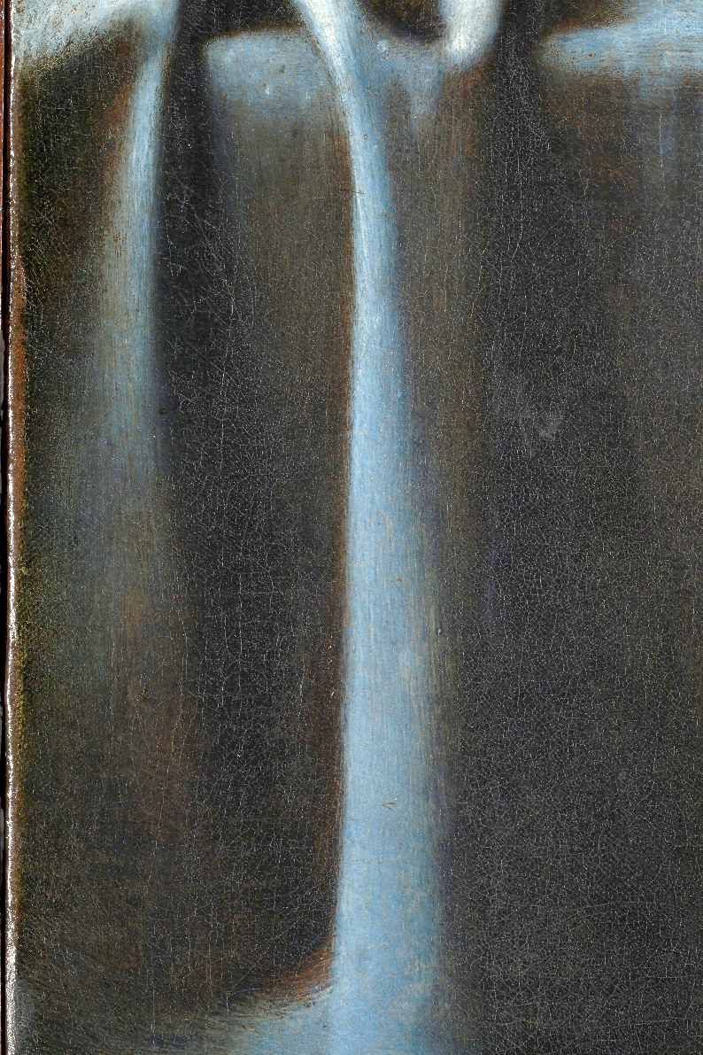
Fig. S5. Detail of the highlight and shadow areas in the tablecloth, taken in the area indicated by a white rectangle in the full image of the painting, showing the darkening/browning of the shadows due to the discoloration of the copper-based green pigment and the blueness of the highlight due to fading of the yellow lake. The red arrow in the detail shows the location where the photomicrograph of the preserved green paint shown in Fig. 7a was taken from.

Slide 7
a
b
Fig. S6. Paint-cross section FC5a removed from the mistress’ robe (Fig. 3a). Photomicrographs taken with visible (a) and with UV illumination (b), original magnification 1000x. Photomicrographs of the same cross-section taken with a 200x magnification are shown in Fig. 5a and b.

Slide 8
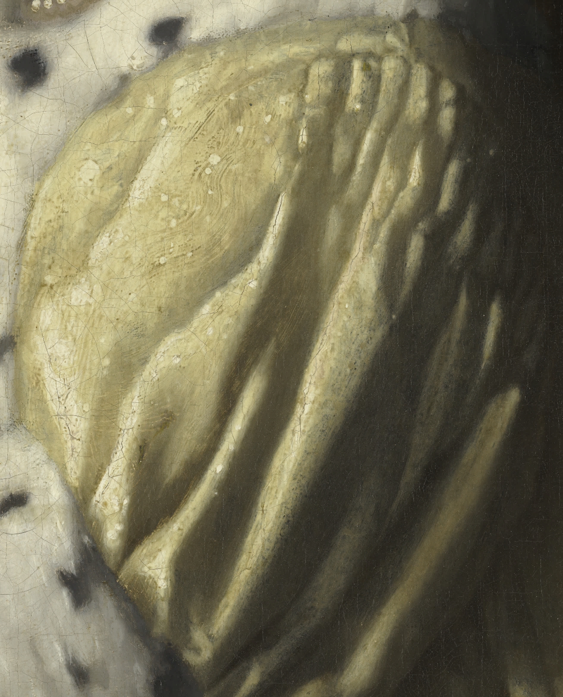
Fig. S7. Detail of the mistress’ yellow satin jacket with white arrow pointing to dark undermodeling.

