Slide 1
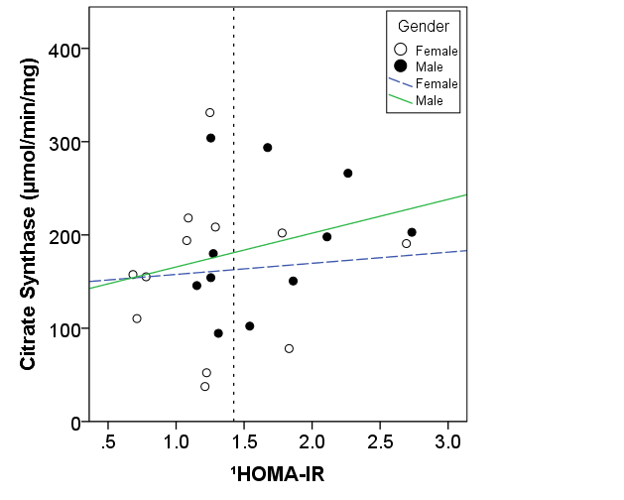
Supplementary Figure 2: Scatterplot and Regression Lines Between CS Activity and HOMA-IR
R= 0.26
P= 0.44
R= 0.08
P= 0.80
  HOMA-IR=homeostatic model assessment of insulin resistance, OCR=oxygen consumption rate.
  ¹ Variable was square-root transformed to achieve normal distribution

