Slide 1
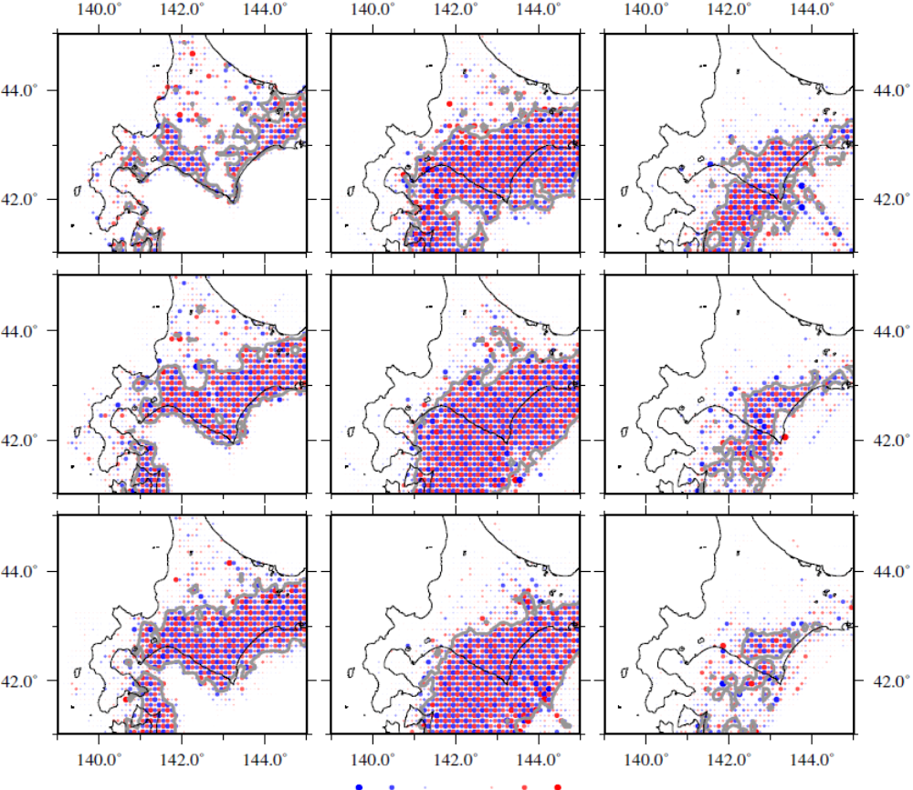
0-10 km
30-40 km
60-70 km
10-20 km
40-50 km
70-80 km
20-30 km
50-60 km
80-90 km
Qs 2000 400 222 160 125 100 83
Figure S1
The results of the checkerboard resolution test at depths of 0-90 km.
Gray lines denote the contour of the restoration index RI of 0.001.

