Slide 1
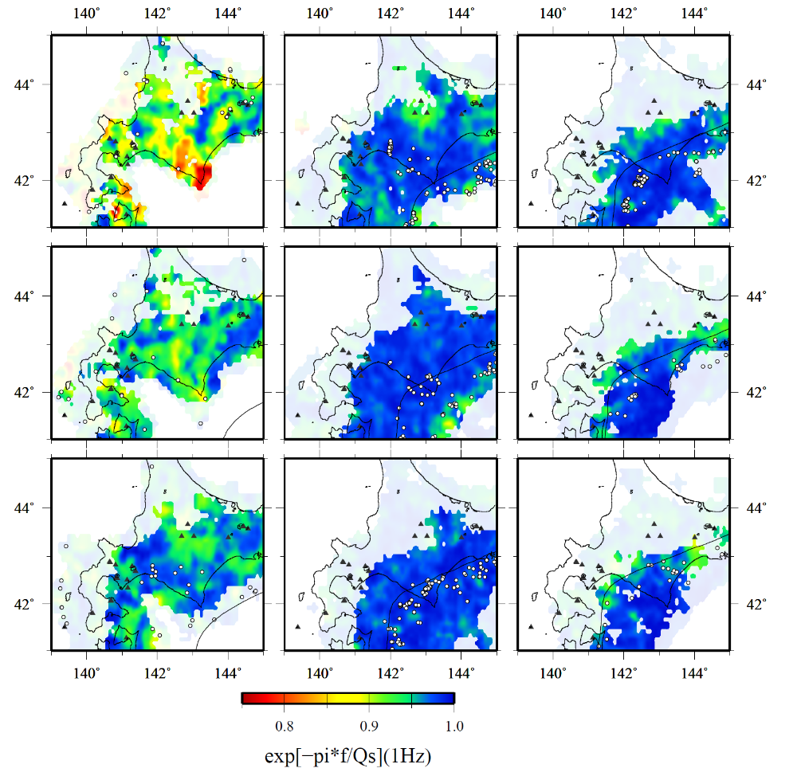
(a) 1 Hz
0-10 km
30-40 km
60-70 km
10-20 km
40-50 km
70-80 km
20-30 km
50-60 km
80-90 km
Figure S2
S-wave attenuation (Qs) structures at depths of 0-90 km in and around Hokkaido, Japan, at frequencies of 1-9 Hz. The symbols and lines are the same in Figure 2.

Slide 2
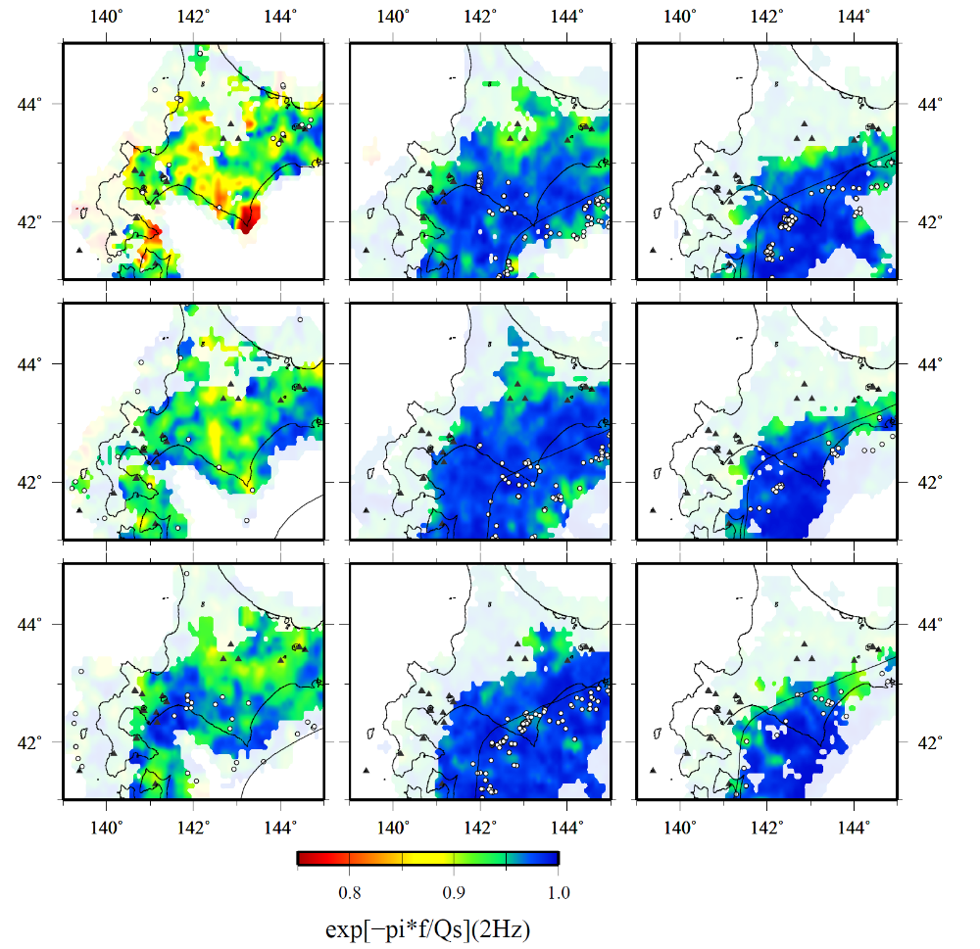
(b) 2 Hz
0-10 km
30-40 km
60-70 km
10-20 km
40-50 km
70-80 km
20-30 km
50-60 km
80-90 km
Figure S2 continued

Slide 3
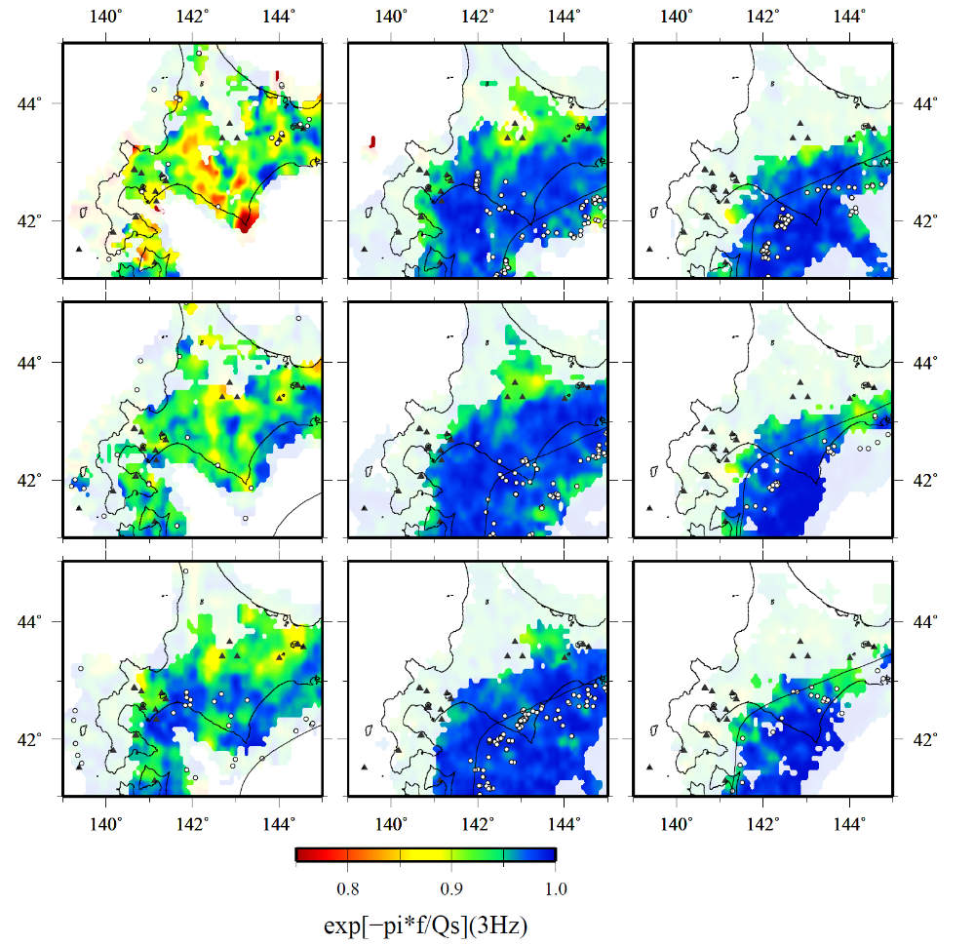
(c) 3 Hz
0-10 km
30-40 km
60-70 km
10-20 km
40-50 km
70-80 km
20-30 km
50-60 km
80-90 km
Figure S2 continued

Slide 4
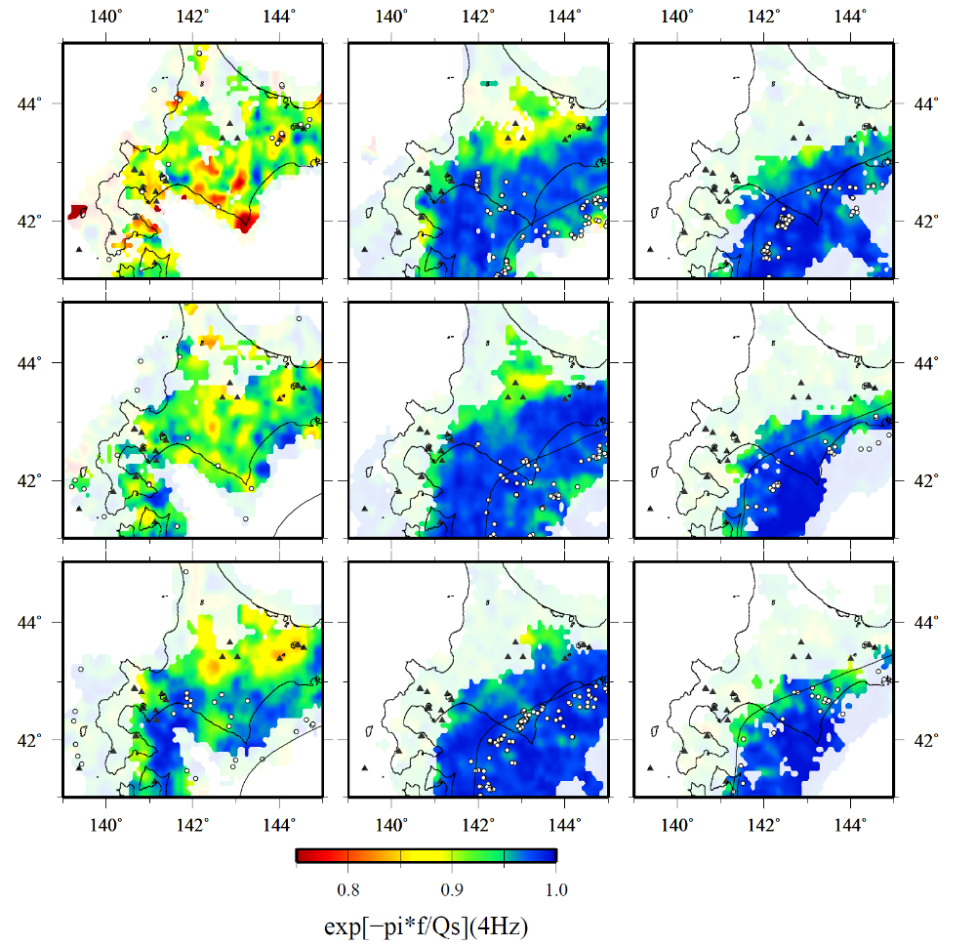
(d) 4 Hz
0-10 km
30-40 km
60-70 km
10-20 km
40-50 km
70-80 km
20-30 km
50-60 km
80-90 km
Figure S2 continued

Slide 5
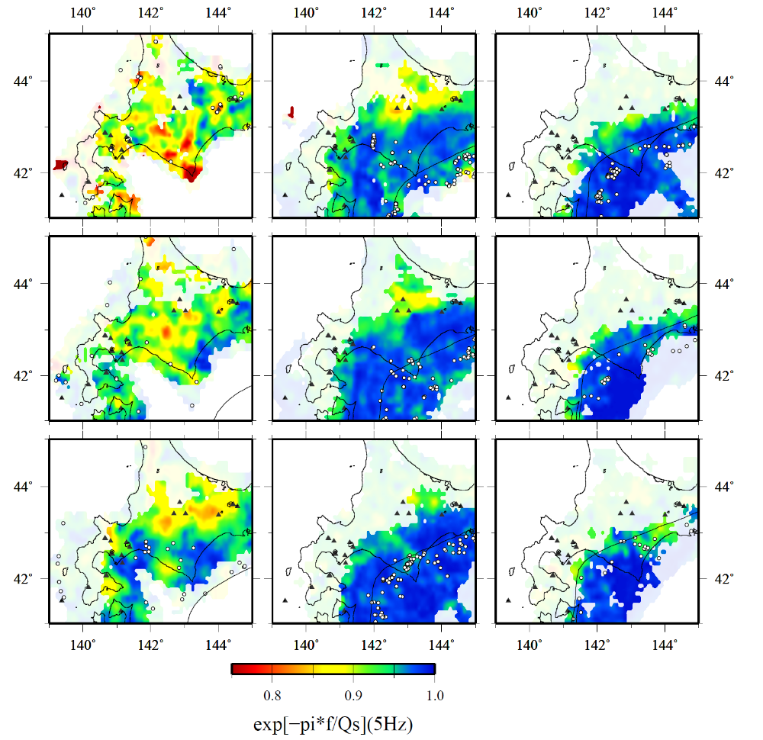
(e) 5 Hz
0-10 km
30-40 km
60-70 km
10-20 km
40-50 km
70-80 km
20-30 km
50-60 km
80-90 km
Figure S2 continued

Slide 6
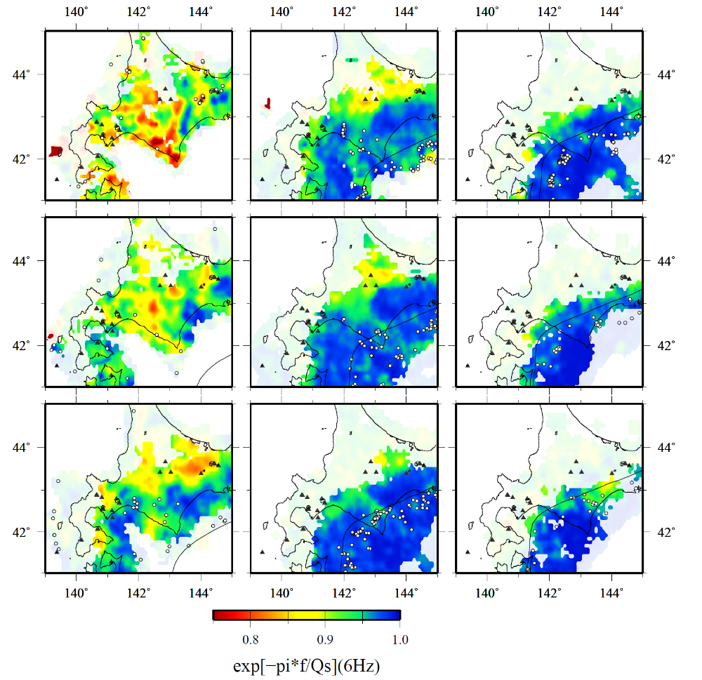
(f) 6 Hz
0-10 km
30-40 km
60-70 km
10-20 km
40-50 km
70-80 km
20-30 km
50-60 km
80-90 km
Figure S2 continued

Slide 7

(g) 7 Hz
0-10 km
30-40 km
60-70 km
10-20 km
40-50 km
70-80 km
20-30 km
50-60 km
80-90 km
Figure S2 continued

Slide 8
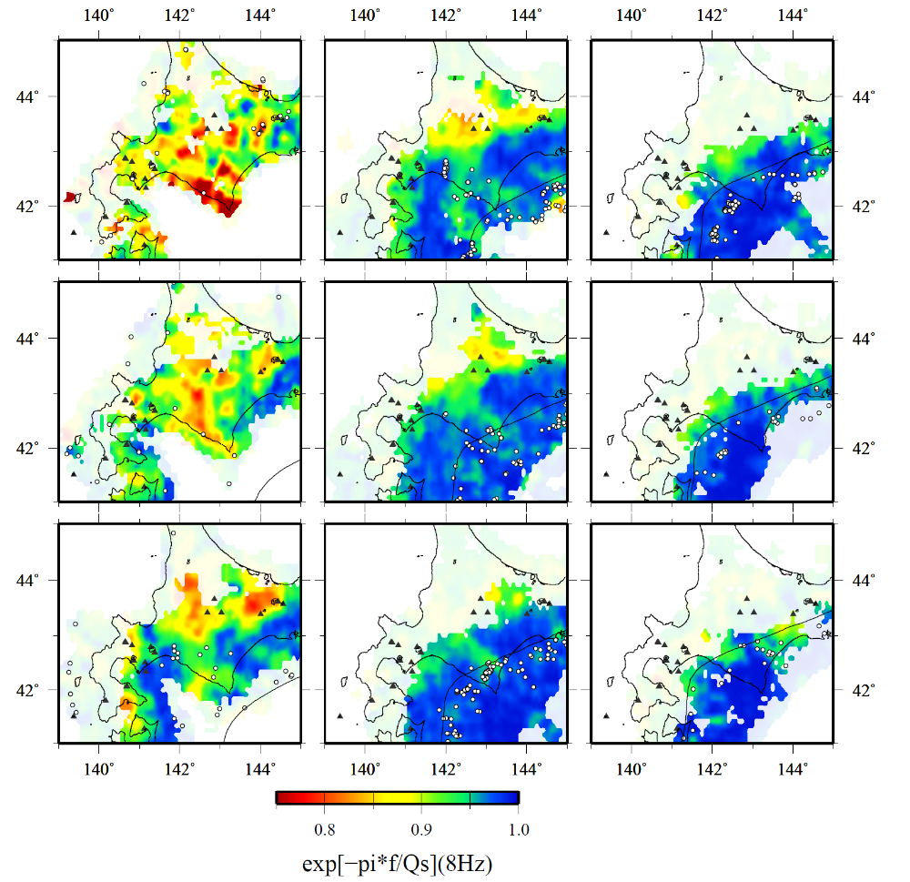
(h) 8 Hz
0-10 km
30-40 km
60-70 km
10-20 km
40-50 km
70-80 km
20-30 km
50-60 km
80-90 km
Figure S2 continued

Slide 9
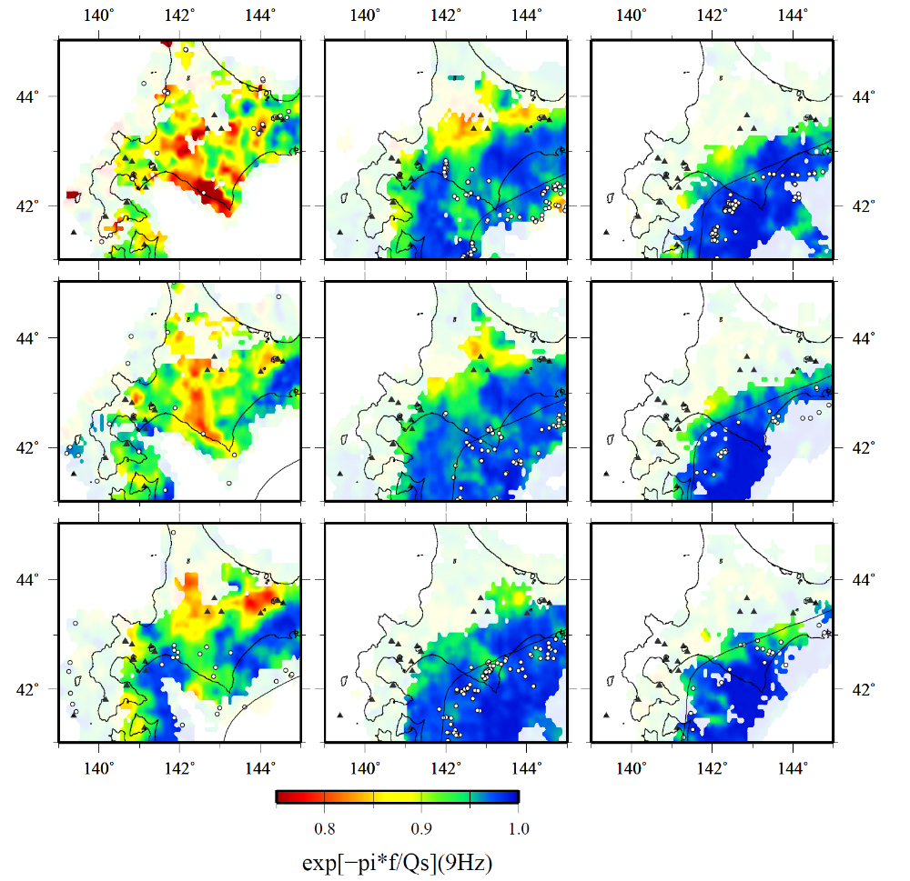
(i) 9 Hz
0-10 km
30-40 km
60-70 km
10-20 km
40-50 km
70-80 km
20-30 km
50-60 km
80-90 km
Figure S2 continued

