Slide 1
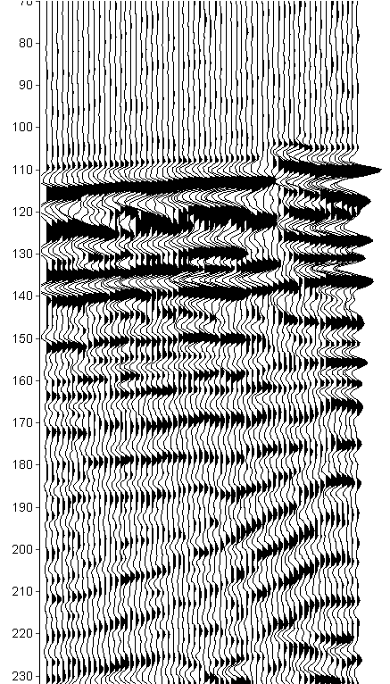
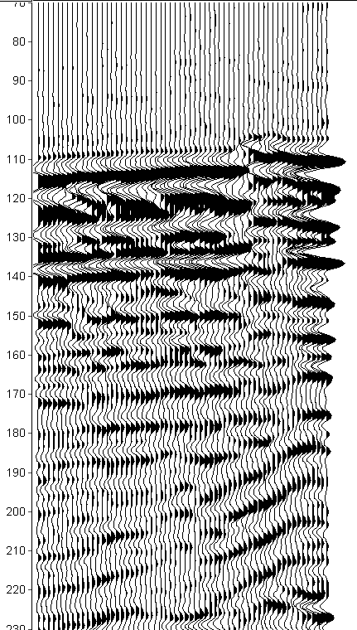
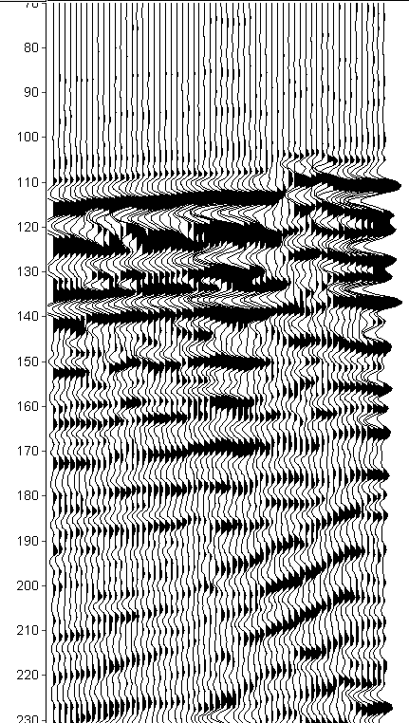
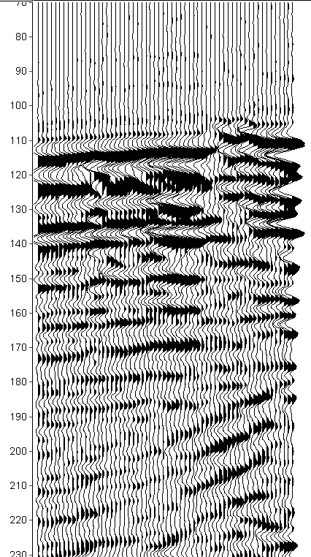
Shot No.
10
30
50
Shot No.
10
30
50
Shot No.
10
30
50
Shot No.
10
30
50
Line 1
Line 2
Line 3
Line 4
Two-way traveltime (ms)

Slide 2
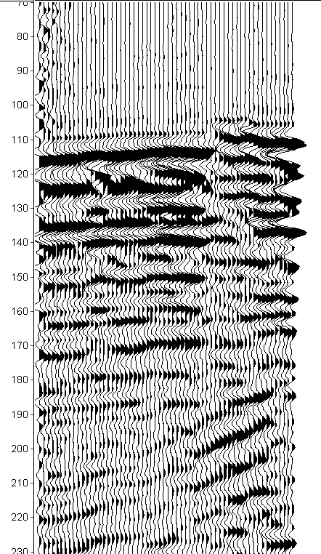
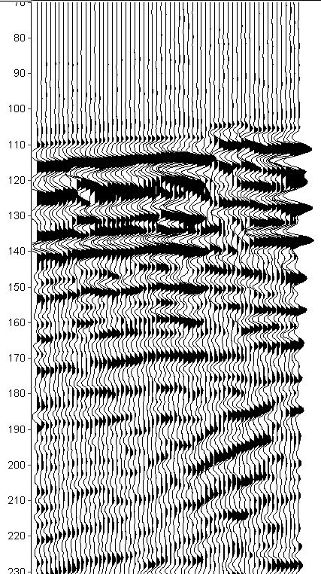
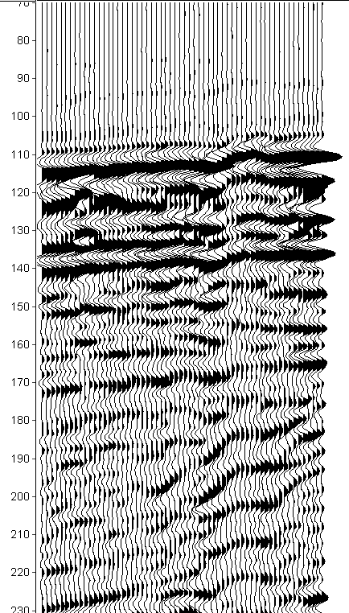
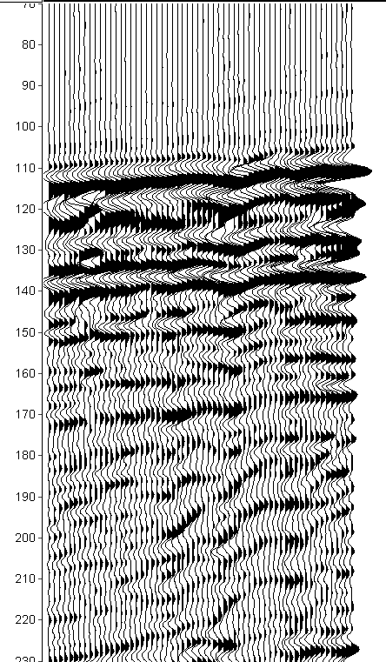
Shot No.
10
30
50
Shot No.
10
30
50
Shot No.
10
30
50
Shot No.
10
30
50
Line 5
Line 6
Line 7
Line 8
Two-way traveltime (ms)

Slide 3
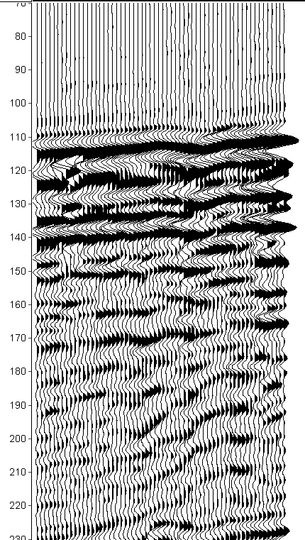
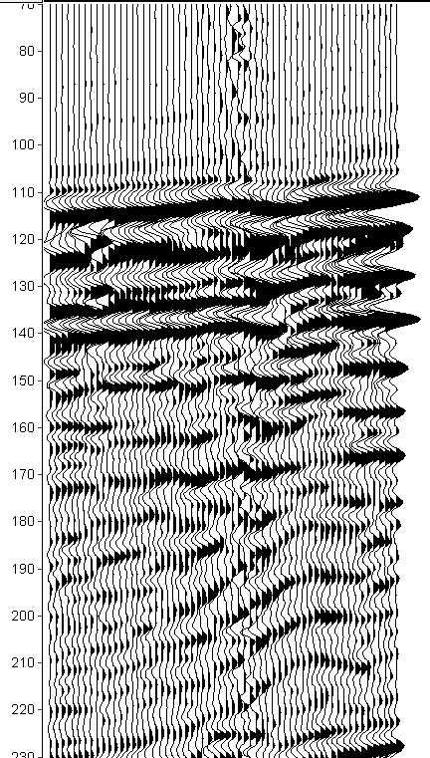
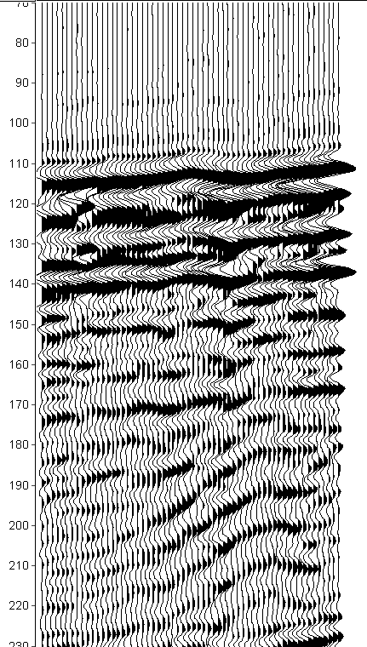
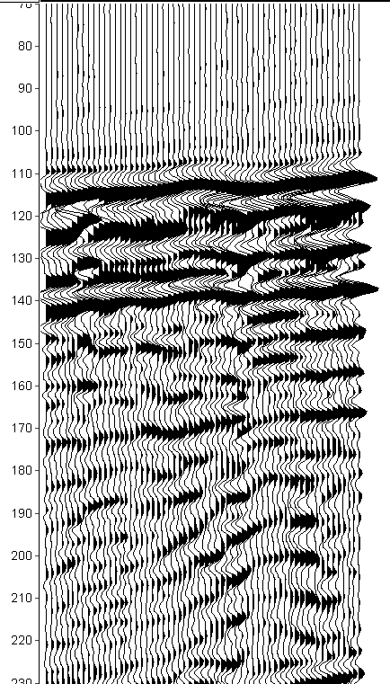
Shot No.
10
30
50
Shot No.
10
30
50
Shot No.
10
30
50
Shot No.
10
30
50
Line 9
Line 10
Line 11
Line 12
Two-way traveltime (ms)

Slide 4
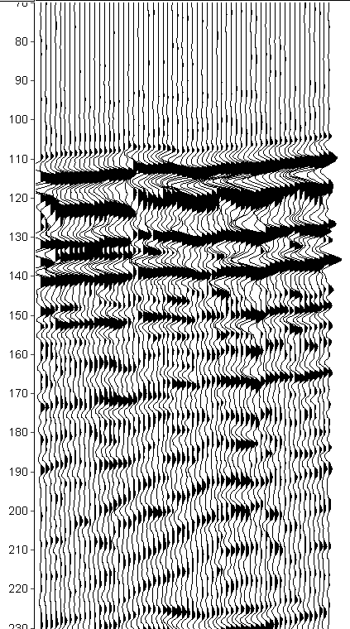
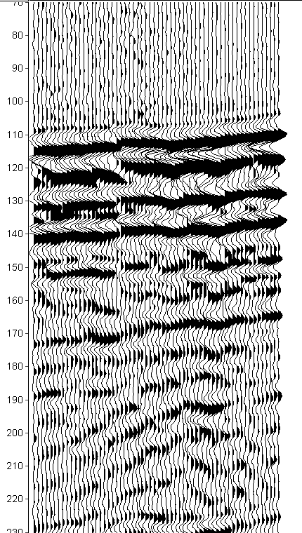


Shot No.
10
30
50
Shot No.
10
30
50
Shot No.
10
30
50
Shot No.
10
30
50
Line 13
Line 14
Line 15
Line 16
Two-way traveltime (ms)

Slide 5
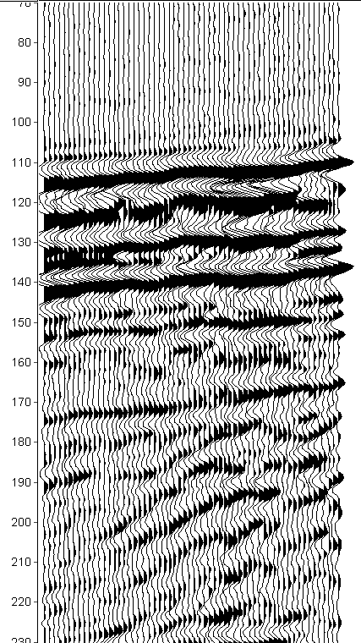

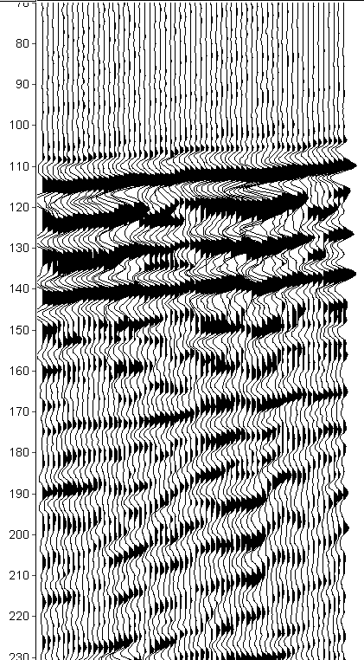
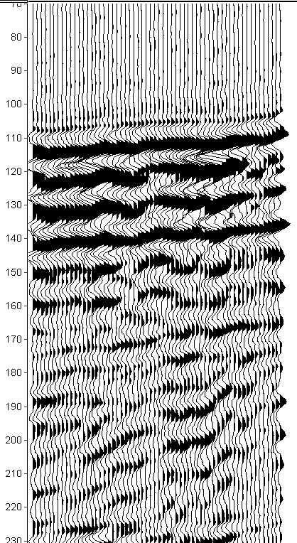
Shot No.
10
30
50
Shot No.
10
30
50
Shot No.
10
30
50
Shot No.
10
30
50
Line 17
Line 18
Line 19
Line 20
Two-way traveltime (ms)

