Slide 1
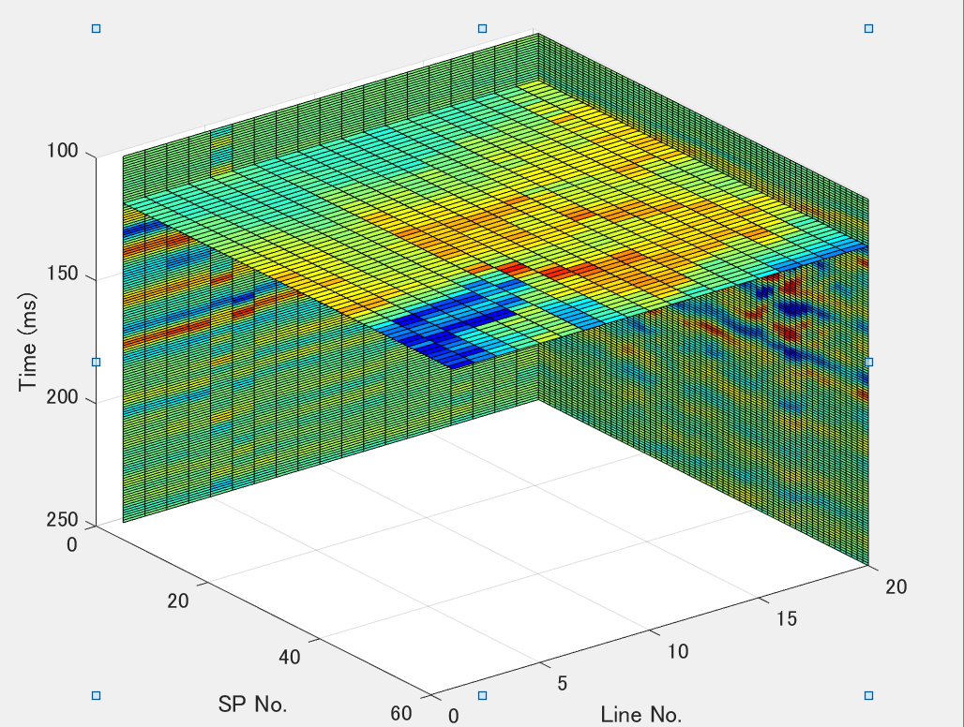
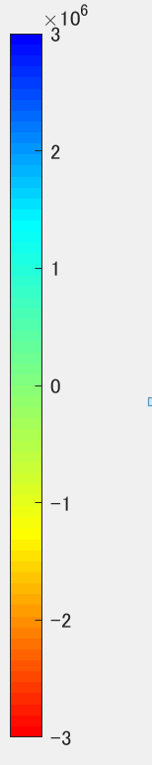
Time slice at 120ms
Amplitude

Slide 2
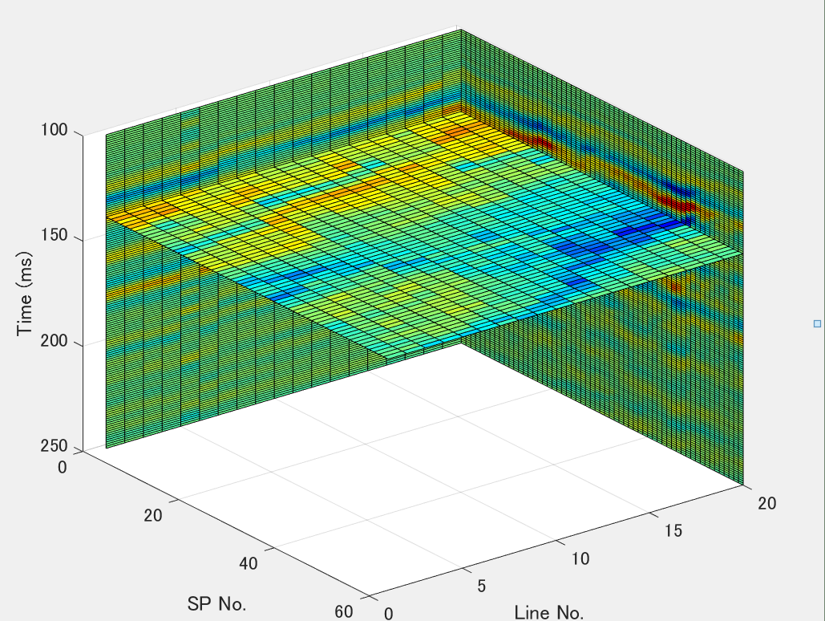
Time slice at 140ms
Amplitude

Slide 3
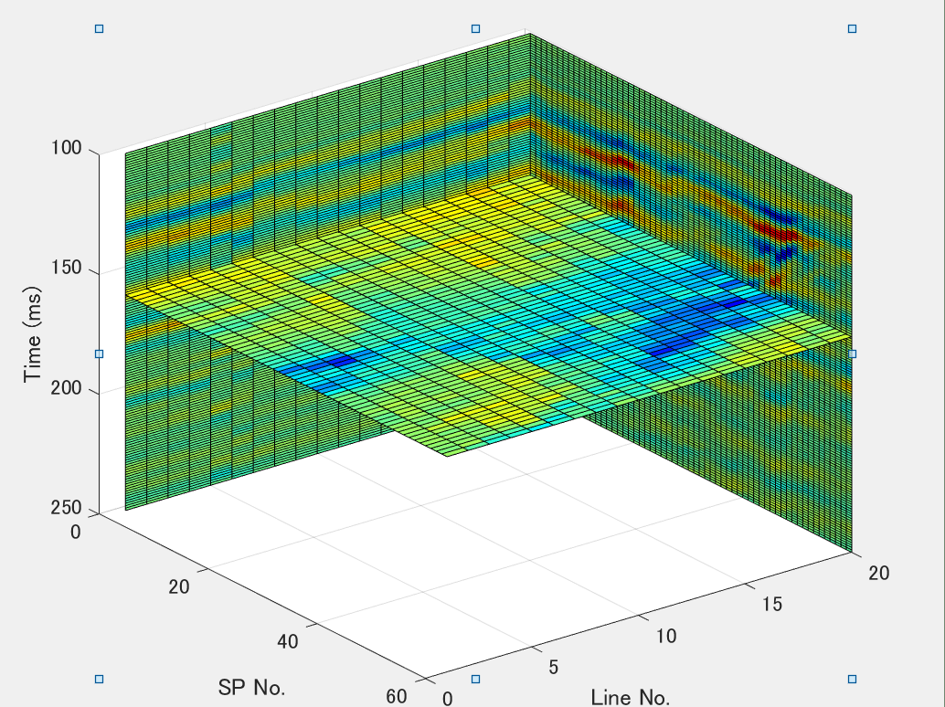
Time slice at 160ms
Amplitude

Slide 4
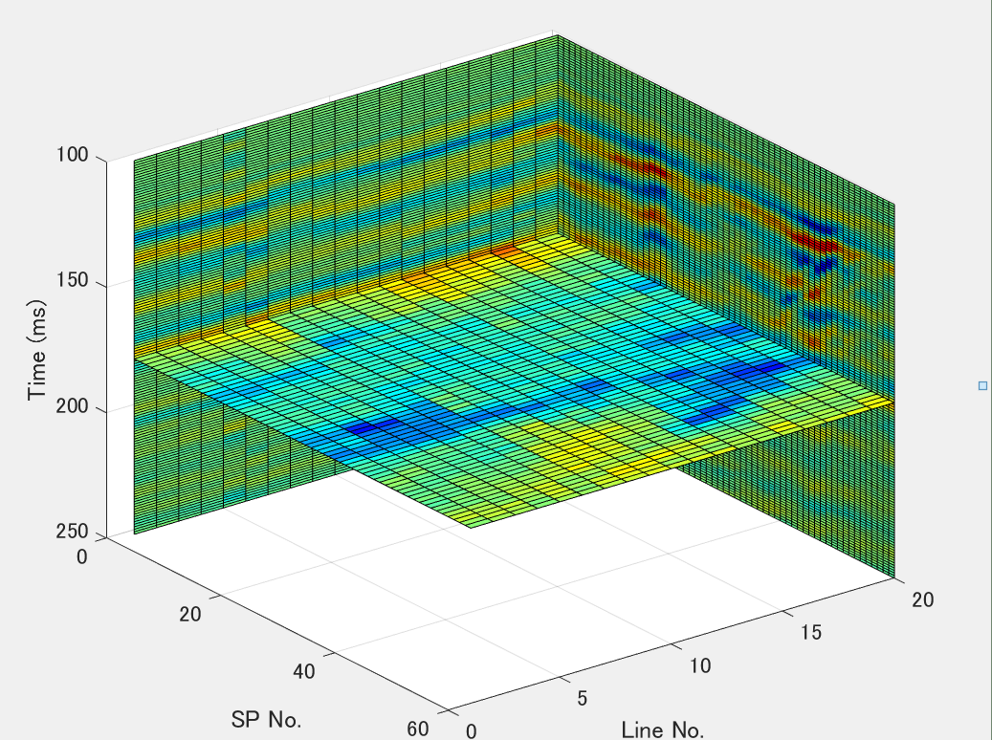
Time slice at 180ms
Amplitude

Slide 5
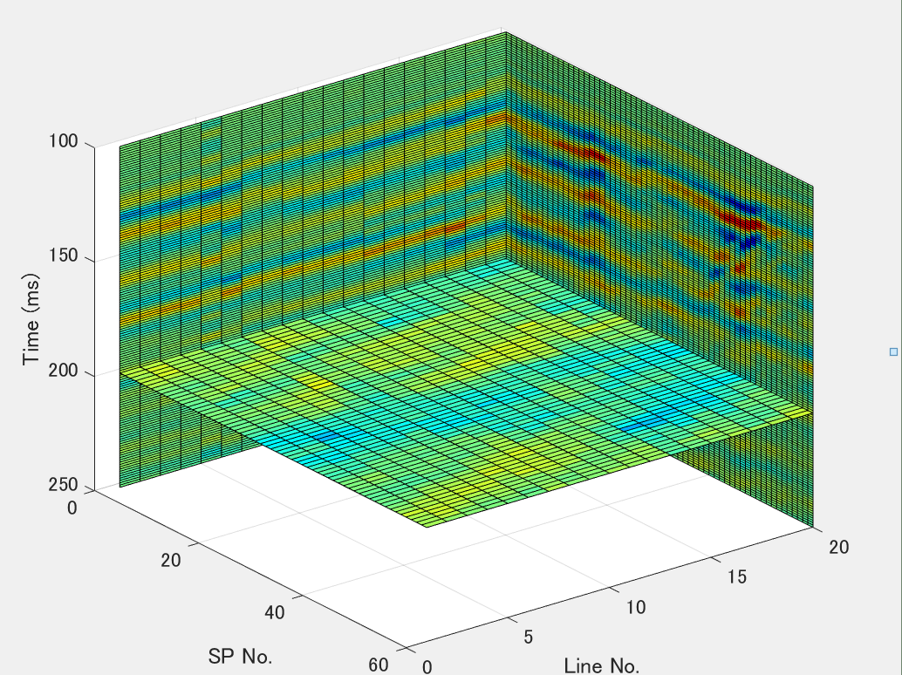
Time slice at 200ms
Amplitude

Slide 6
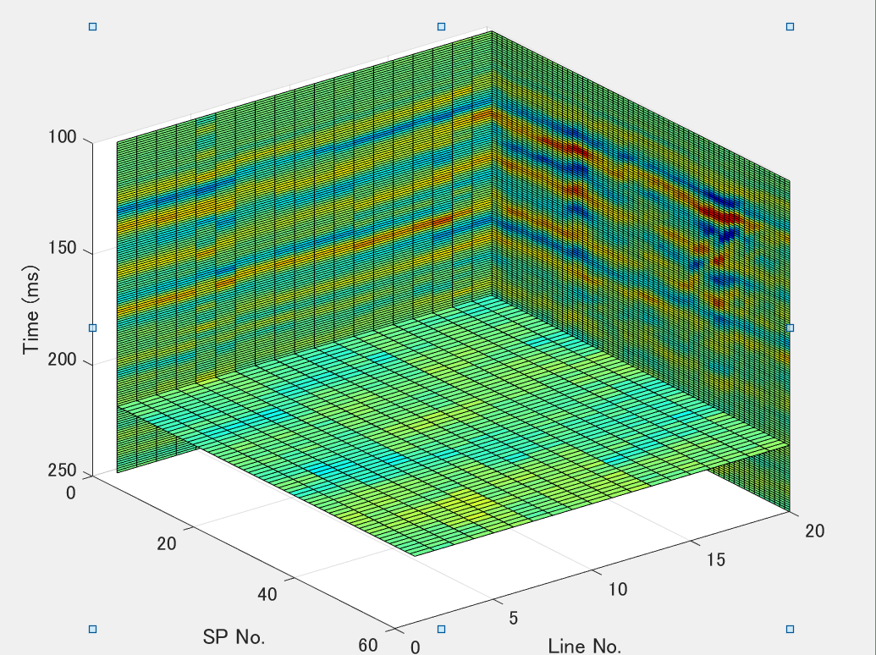
Time slice at 220ms
Amplitude

