Slide 1
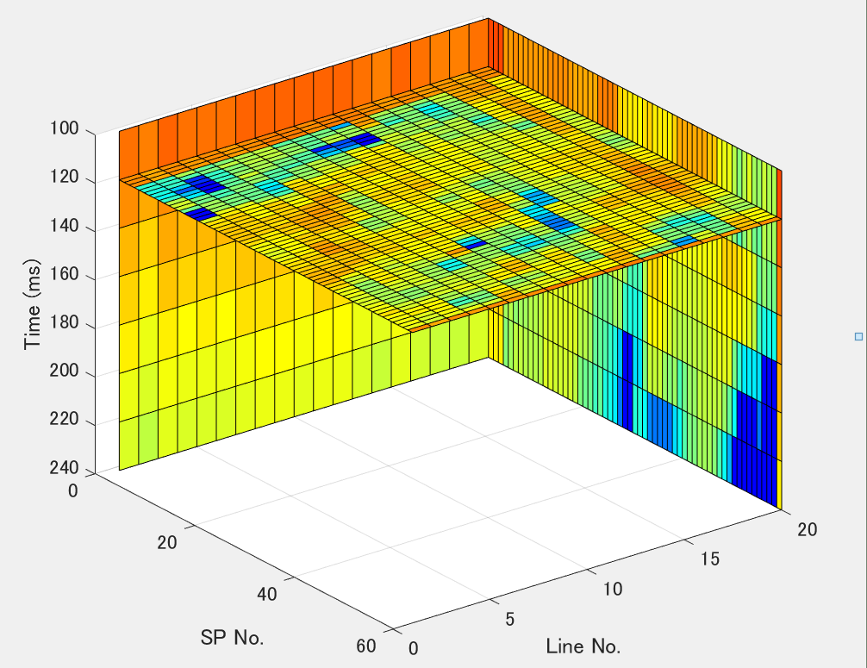
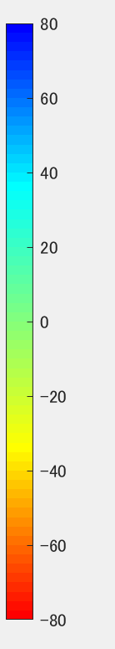
Q slice at 120ms
Perturbation of average Q (%)

Slide 2
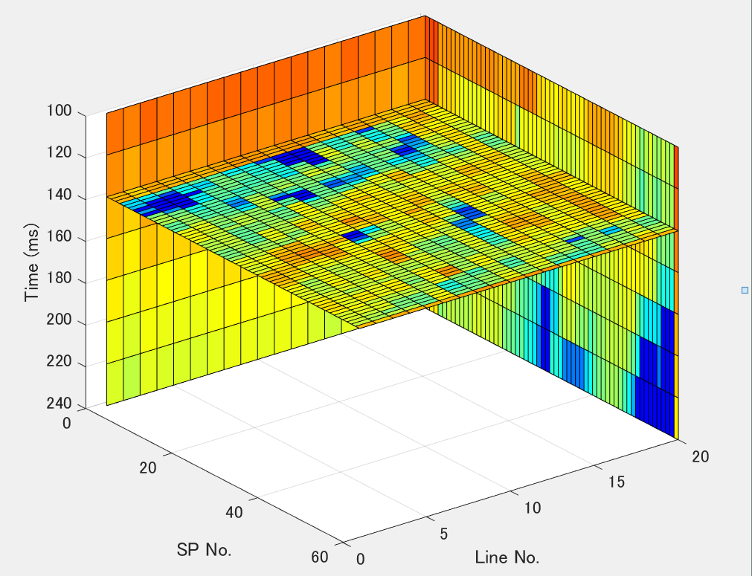
Q slice at 140ms
Perturbation of average Q (%)

Slide 3
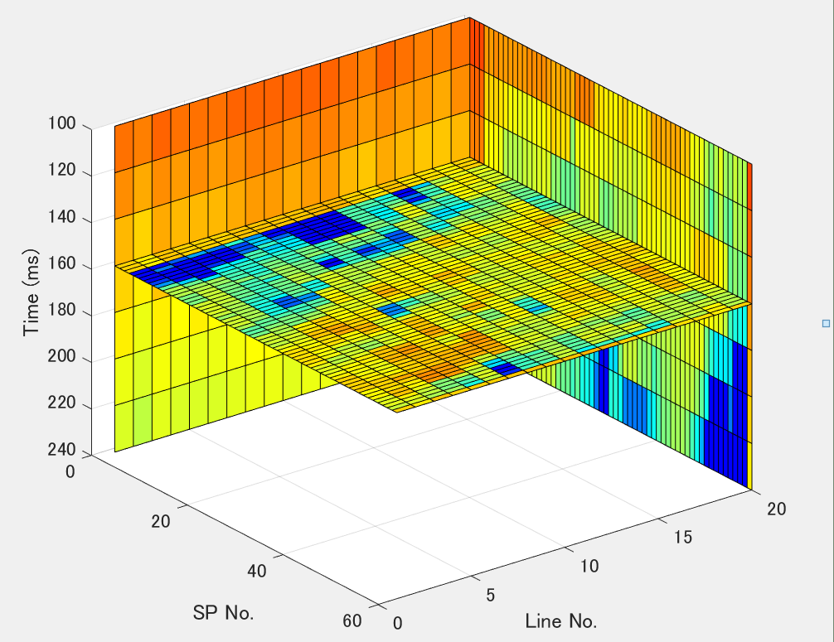
Q slice at 160ms
Perturbation of average Q (%)

Slide 4
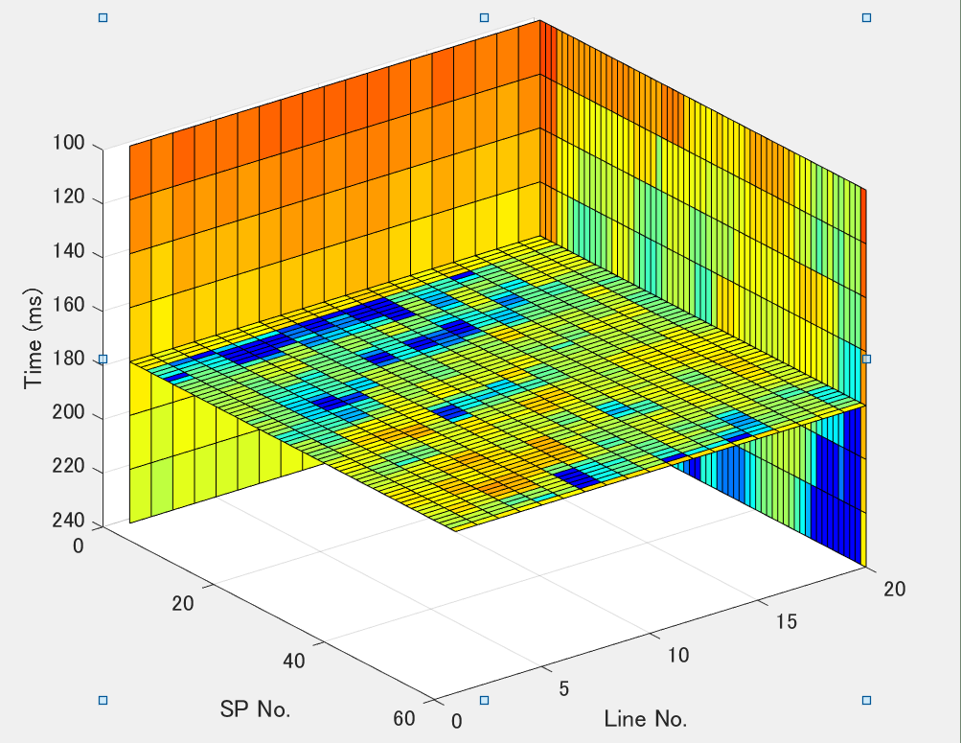
Q slice at 180ms
Perturbation of average Q (%)

Slide 5
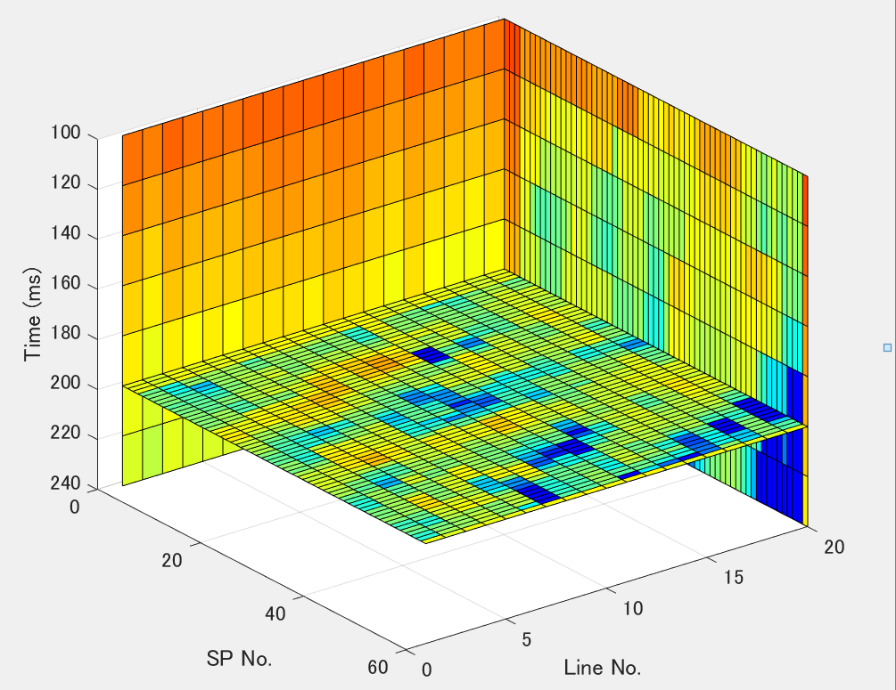
Q slice at 200ms
Perturbation of average Q (%)

Slide 6
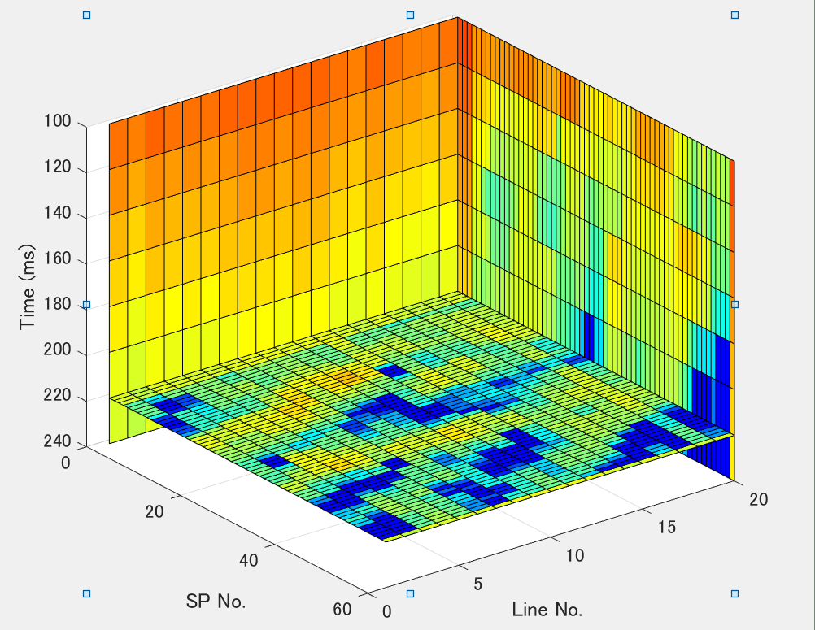
Q slice at 220ms
Perturbation of average Q (%)

