Slide 1
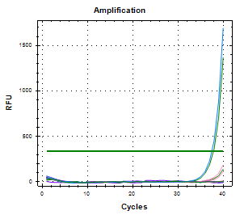
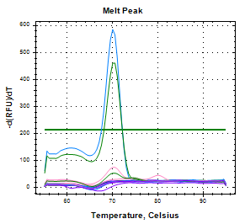
circNFAT5 expression profiles in blood compartments in samples from 3 volunteers
a.
White blood cells isolation from 3 volunteers
b.
Serum samples from 3 volunteers
PBMC = peripheral blood mononuclear cell
Amplification curves showing very low expressions of circNFAT5 in serum samples from volunteers
RT → 650 ng
Expression levels normalised with 18s

