Slide 1
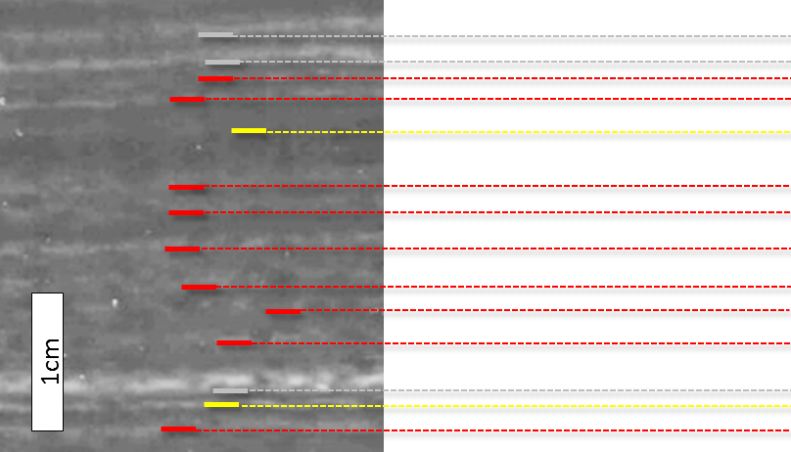
Gradient of gray scale
Soft-X image
Varve count age / Fine tuned age
1999±2.5 / 1999.7
1999±2.5 / 1998.8
1998±2.5 / 1998
1997±2.5 / 1997
1996.5±3 / (1996)
1995.5±3 / 1996
1994.5±3 / 1995
1993.5±3 / 1994
1992.5±3 / 1993
1991.5±3 / 1992
1990.5±3 / 1991
1990.5±3 / 1990.8
1990±3.5 / (1990)
1989±3.5 / 1990
Gray scale
Figure S1
A typical case of recognition, classification and counting of varves. Red lines are clear varves showing moderate (~100) peaks with moderate gradient (5~10) in gray scale. Gray lines are event layers showing high (>100) peaks with high gradient (10~30) in gray scale. Yellow lines are unclear varves (counted as 0~1 year) showing low peaks in gray scale or not horizontally continuous.

Slide 2
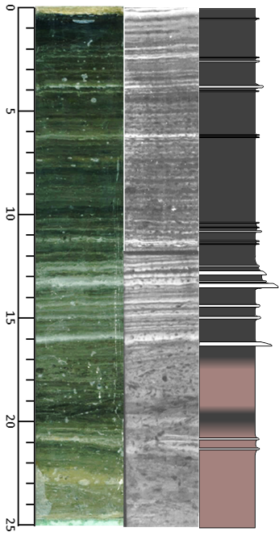
(A)
si1
si2
si3
si4
si5
si6
si7
si8
si9
si10
si11
Age( year A.D.)
Depth (cm)
Bioturbated
■ black diatom ooze
■ brown diatom ooze
□ event layer
(B)
Age difference (yrs)
Figure S2
(A) Sample intervals of SG12LM3 used for Bayesian analysis and (B) estimated age differences between the centers of neighboring sample intervals using Bayesian analysis. Open and close ranges show probabilities of age differences based on varve counting and its coupling with Bayesian analysis, respectively.

