Slide 1
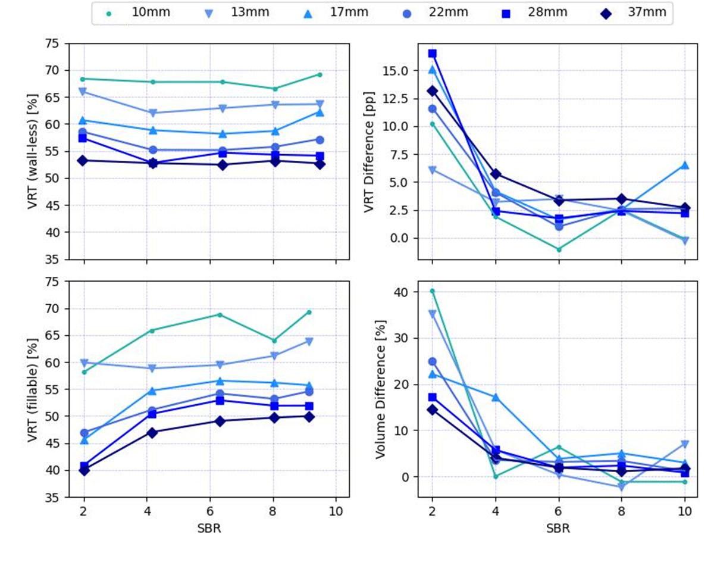
Fig. S1: Data from the Siemens Biograph 64 TruePoint PET/CT scanner. Line plots of volume-reproducing threshold (VRT) against signal-to-background ratio (SBR) for 6 sphere diameters, VRT difference between wall-less and fillable spheres, and the resulting difference of segmented volumes. pp: percentage points

