Slide 1
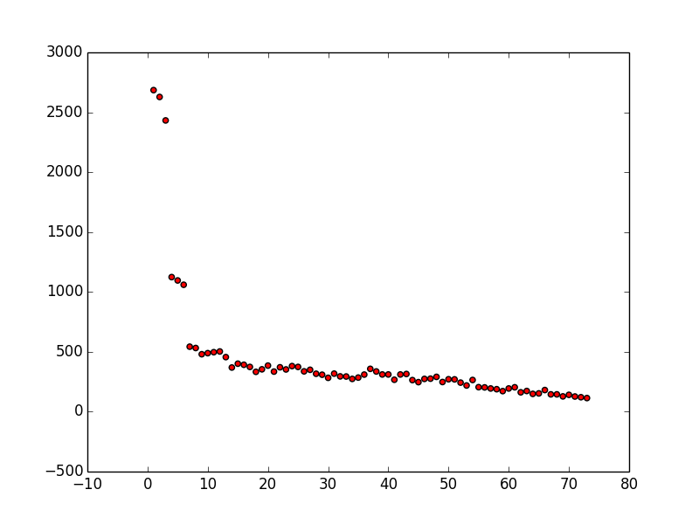
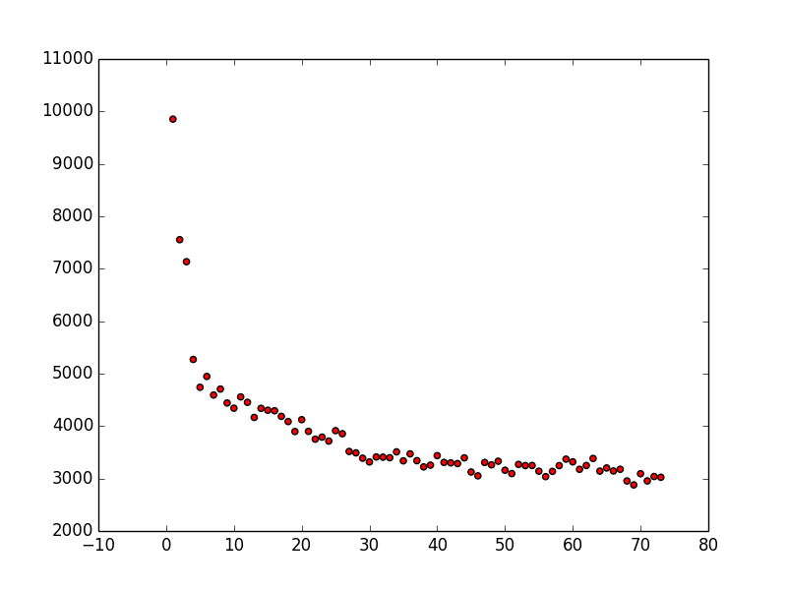
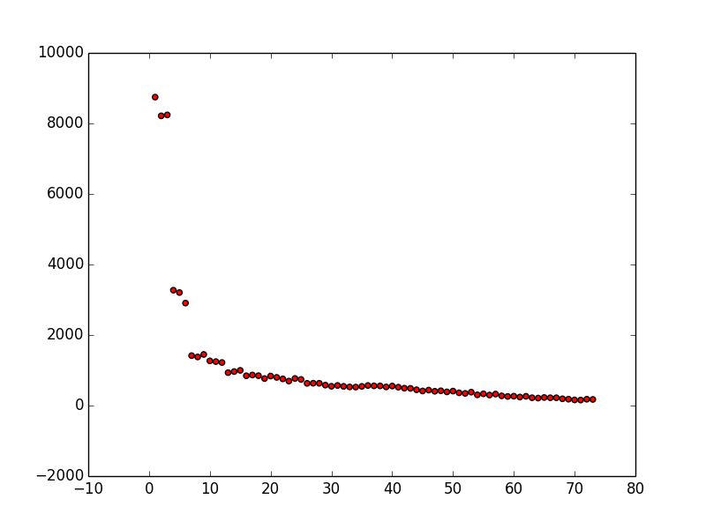
Mengovirus AnrB3741
Middelburg ArTB5290
mean: 22.3
median: 15.0
mean: 32.7
median: 31.0
Mengovirus ArB1907
mean: 16.7
median: 8.0

