Slide 1
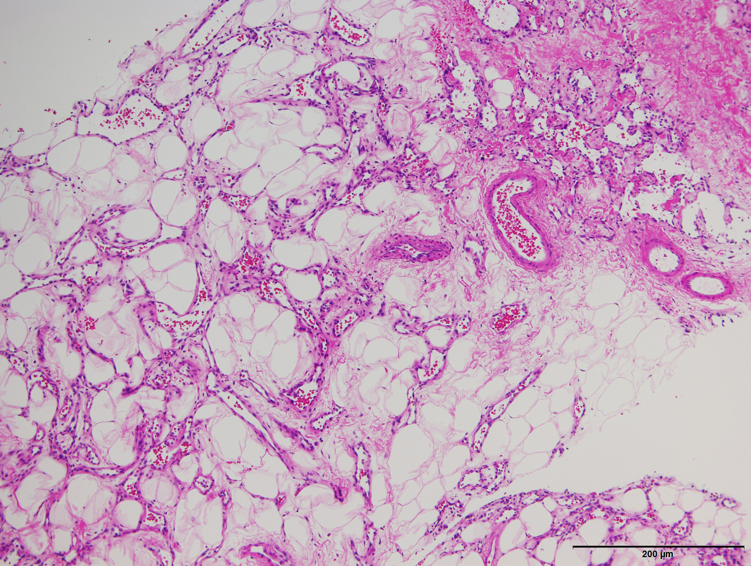
Core needle biopsy
200 μm

