Slide 1
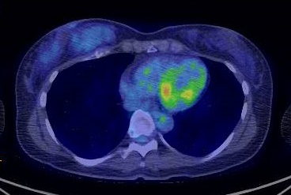
Positron emission tomography-CT

