Slide 1
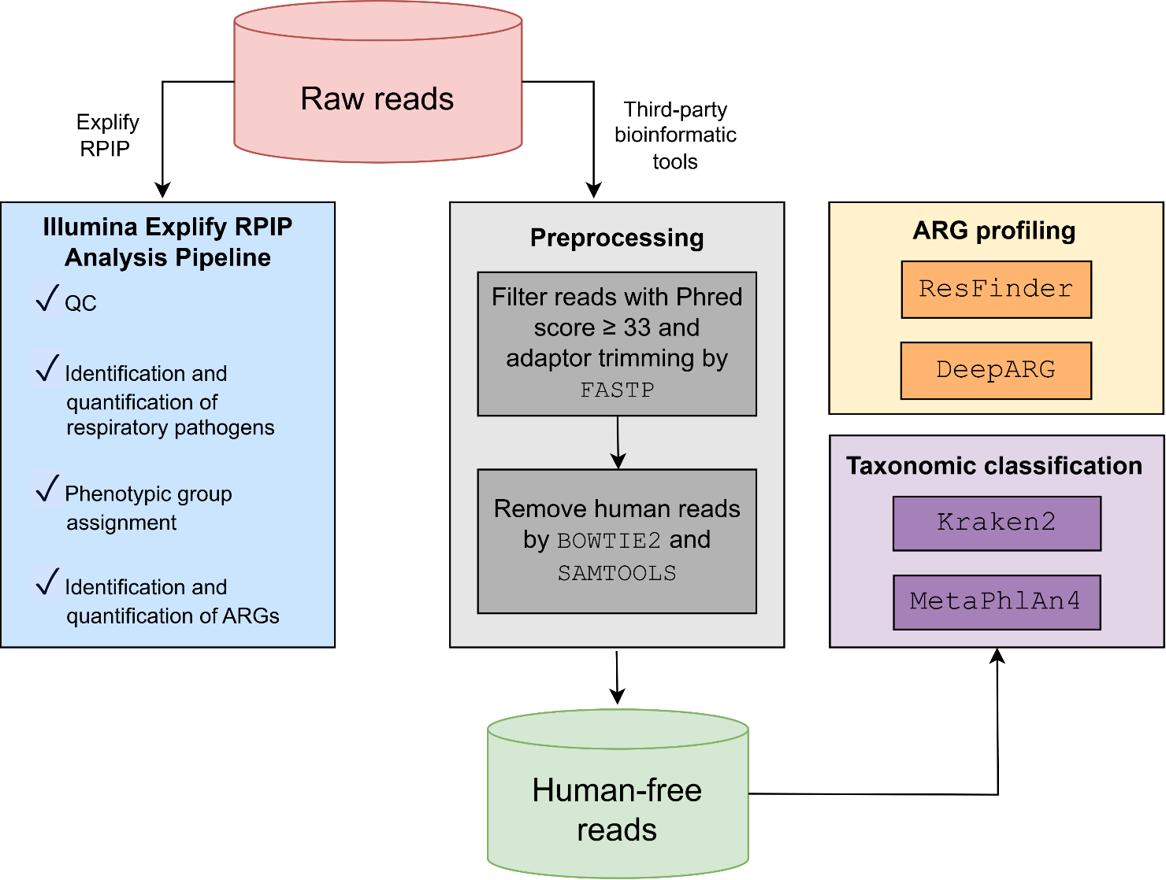
Notes:
Supplementary Figure S1. Bioinformatic analysis workflow.

Slide 2
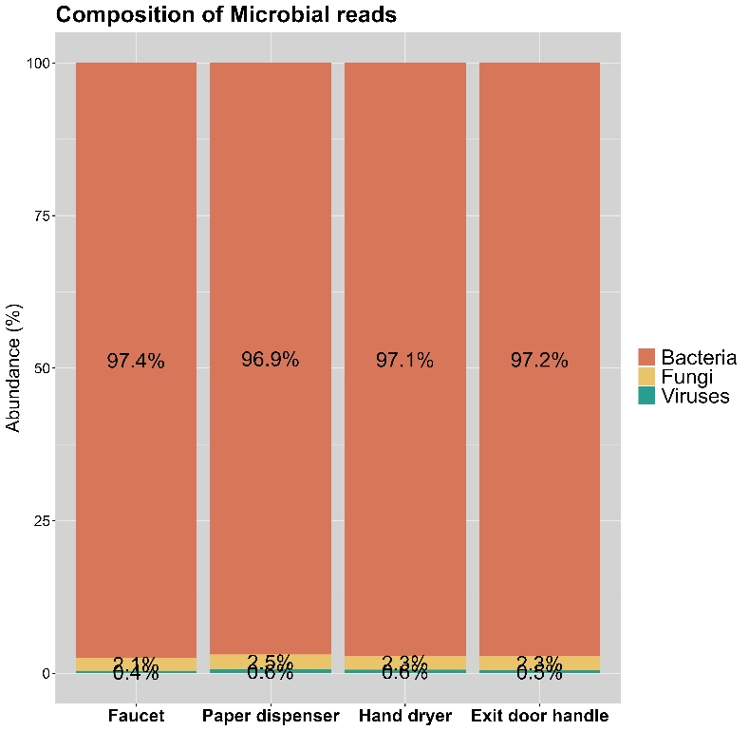














A
B
$${1.84×10}^{7}$$
$${1.50×10}^{7}$$
$${1.39×10}^{7}$$
$${1.26×10}^{7}$$
$${1.55×10}^{6}$$
$${1.51×10}^{6}$$
$${1.38×10}^{6}$$
$${1.18×10}^{6}$$
$${9.25×10}^{5}$$
$${1.23×10}^{6}$$
${(2.18×10}^{7}$)
$${(1.58×10}^{7})$$
${(1.80×10}^{7}$)
${(1.72×10}^{7}$)
Notes:
Supplementary Figure S2. Sequencing metrics of post-handwashing surface samples from public washrooms. (A) Bar plot showing the composition of sequencing reads yielded from four post-handwashing sites, with orange, blue, and black lines indicating microbial, human, and unclassified reads, respectively. Mean post-quality reads per site were shown in parentheses. (B) Taxonomic compositions of overall microbial reads of the four post-handwashing sites.

Slide 3
Clinically critical ARGs detected by Explify RPIP | ResFinder | DeepARG
blaCTX-M-64 | Detected | Detected
blaCTX-M-65 | Not detected | Detected
blaGES-5 | Detected | Detected
blaGES-15 | Not detected | Detected
blaIMP-26 | Detected | Detected
blaNDM-4 | Detected | Detected
blaNDM-5 | Detected | Detected
blaSHV-1 | Not detected | Detected
blaSHV-11 | Not detected | Detected
blaSHV-104 | Not detected | Detected
blaVIM-2 | Detected | Detected
mecA | Detected | Detected
vanC | Not detected | Detected
Notes:
Supplementary Figure S3. Validation of clinically critical ARGs identified by Explify RPIP using two third-party ARG profiling tools - ResFinder and DeepARG.

