Slide 1
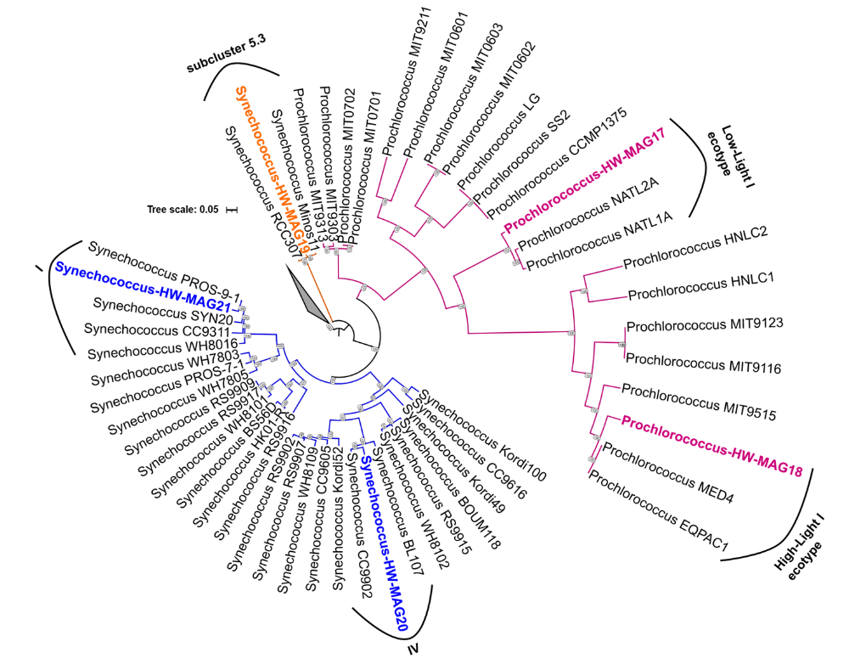
Additional File 6. hylogenetic tree showing the placement of metagenome-assembled genomes (MAGs) classified as Synechococcus and Prochlorococcus.

