Slide 1
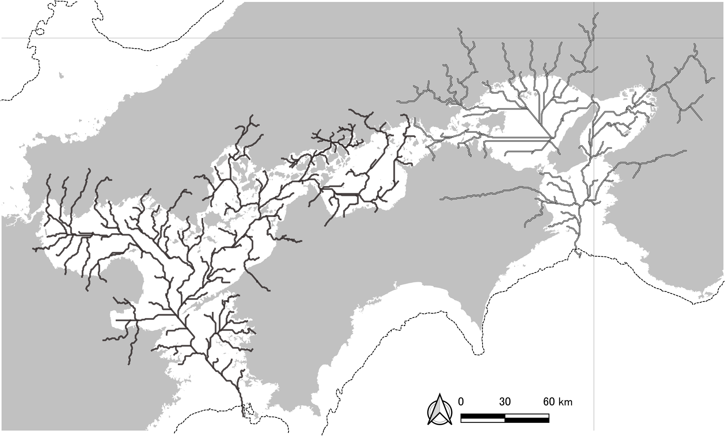
Additional file 1
35ºN
Hoyo River
Kitan River
135ºE

