Slide 1
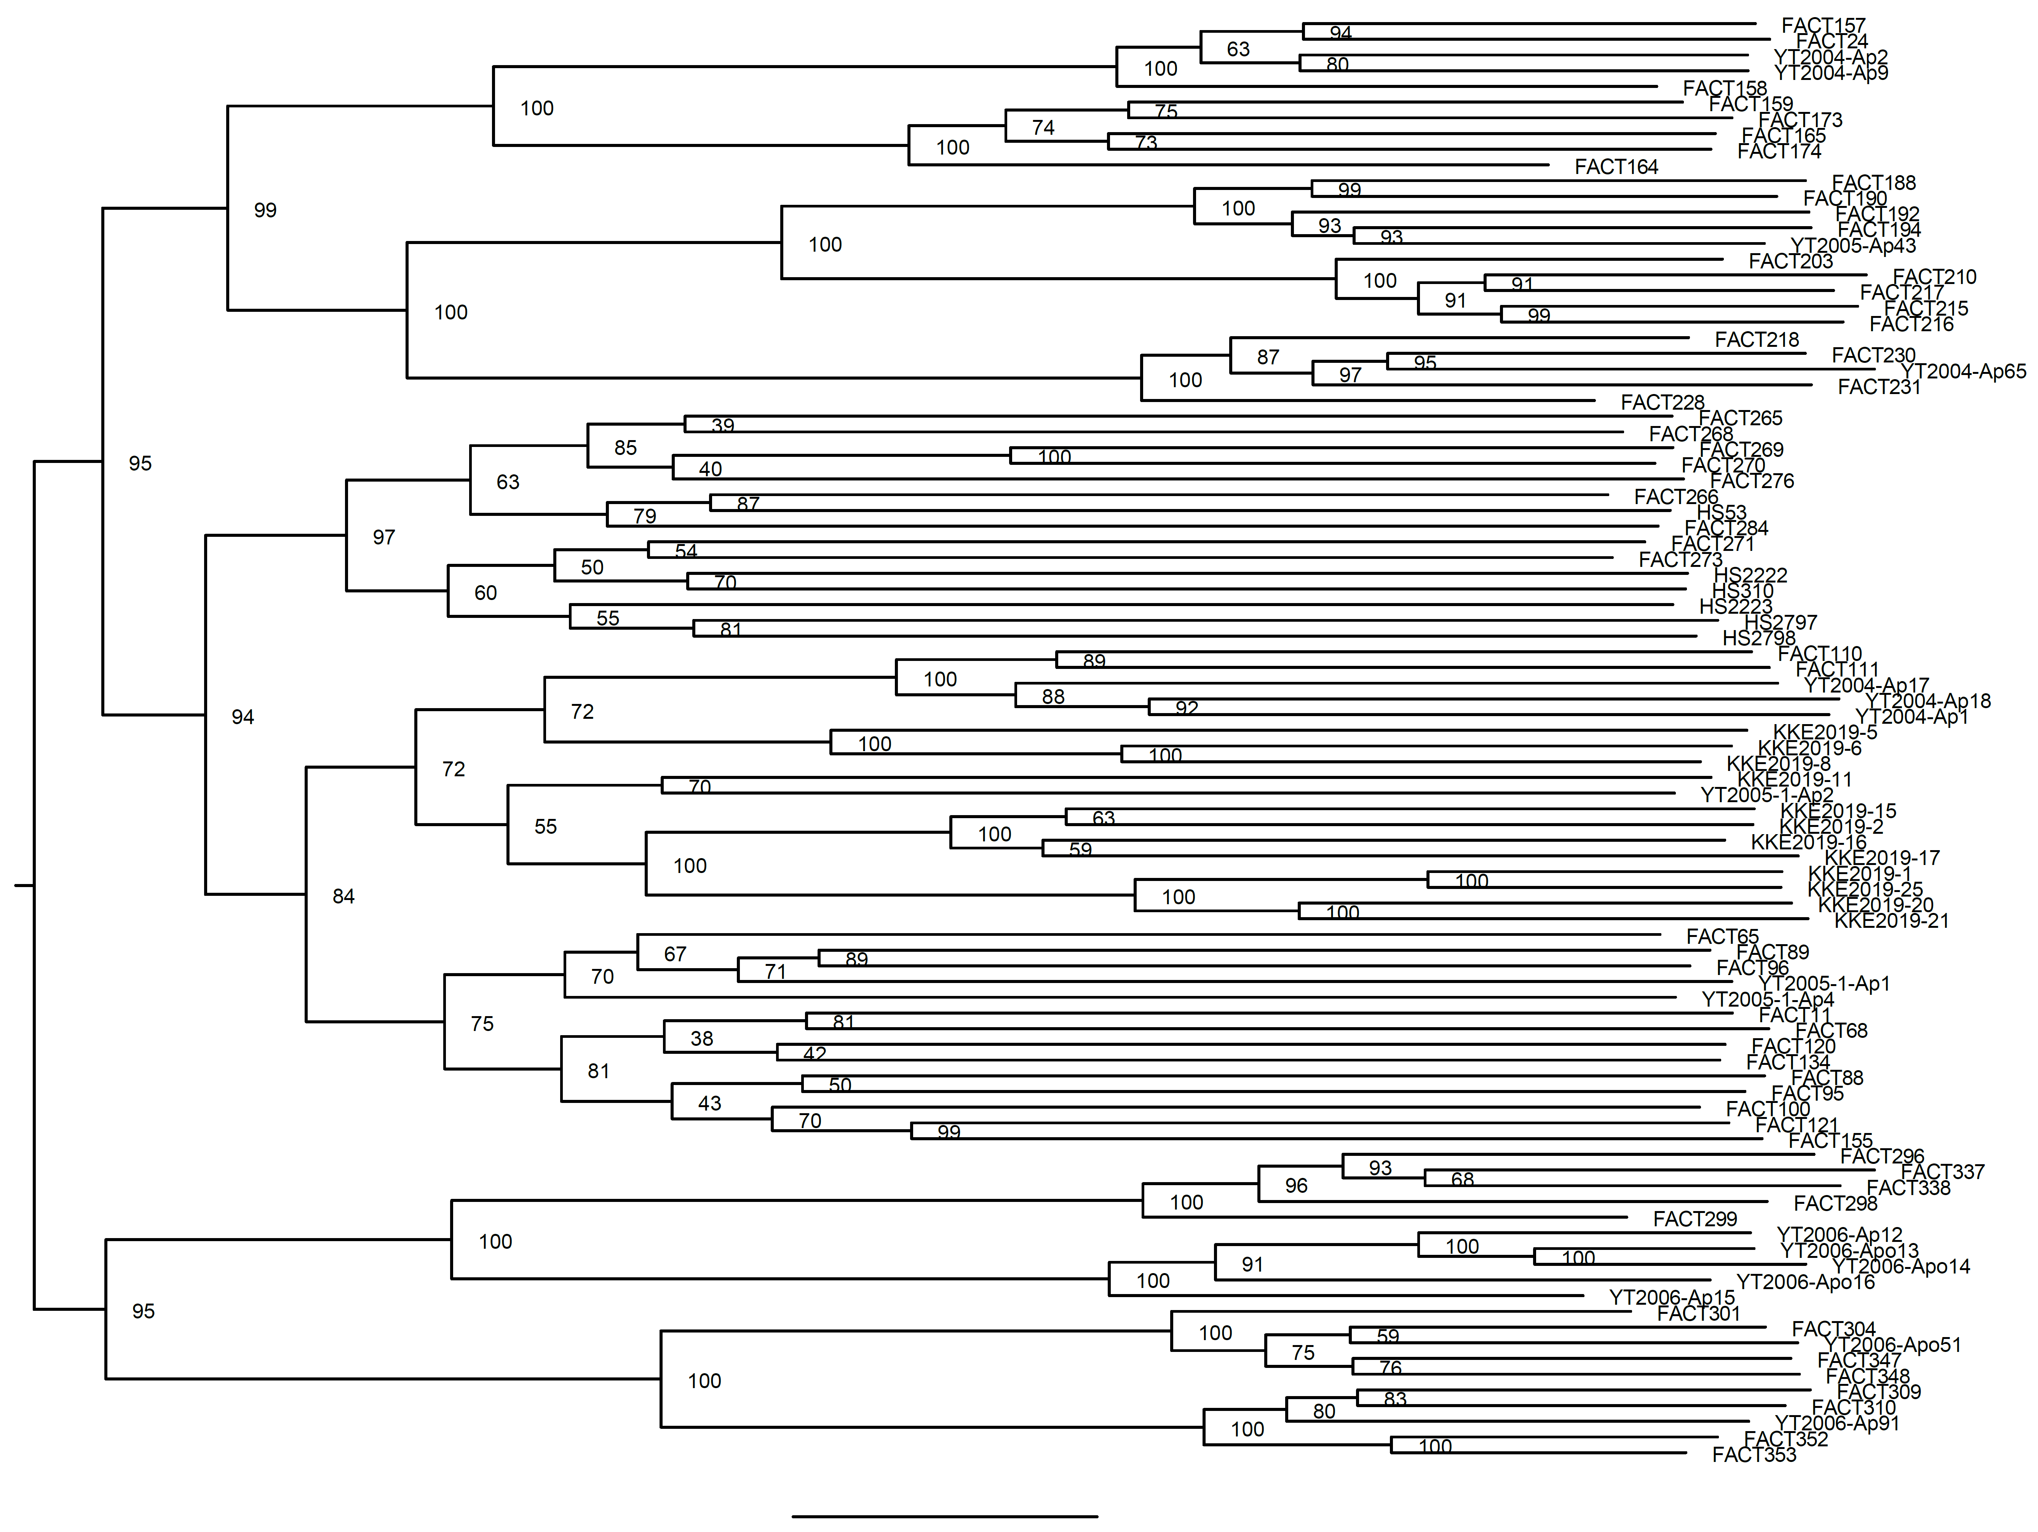
Additional file 4
Inn
Iku
Ohm
Hak
Ohs
Ima
+
Koc#
#
Tsu
Muk
Kre
Osk
Ono
Kra
Eta
*
Fuk
+
Ono*
Kk
Sk
Oss
Osk
Kk
Sk
0.06

