Slide 1
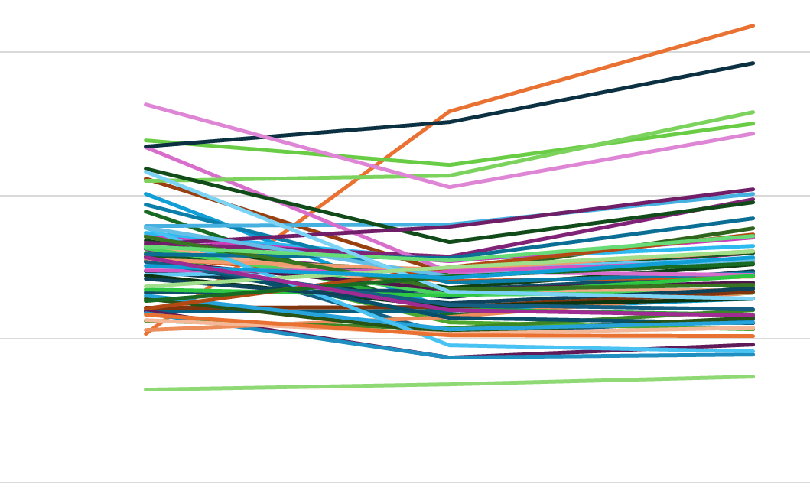
eGFR(mL/min/1.73m²)
15
10
5
0
4 M Before
AVF/AVG creation
4M
After
Supplementary Figure 1

