Slide 1
Additional figures
Targeted quantitation of CFTR protein expression in vivo using immunoprecipitation & parallel reaction monitoring tandem mass spectrometry
Hui Wang*, Yunxiang Dai, Nicholas Clark, Lianne Boeglin, Caroline Woo, Richard Wooster, Gang Sun*, James C. Sullivan*

Slide 2
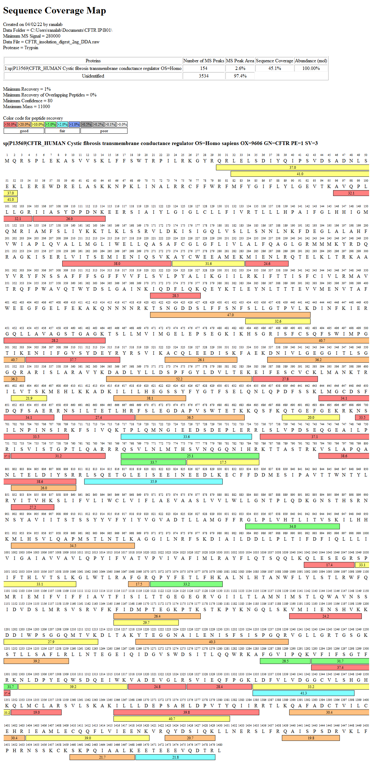
Figure S1. Peptide mapping for trypsin/LysC digests of recombinant human CFTR protein (UniProtKB-P13569).

Slide 3
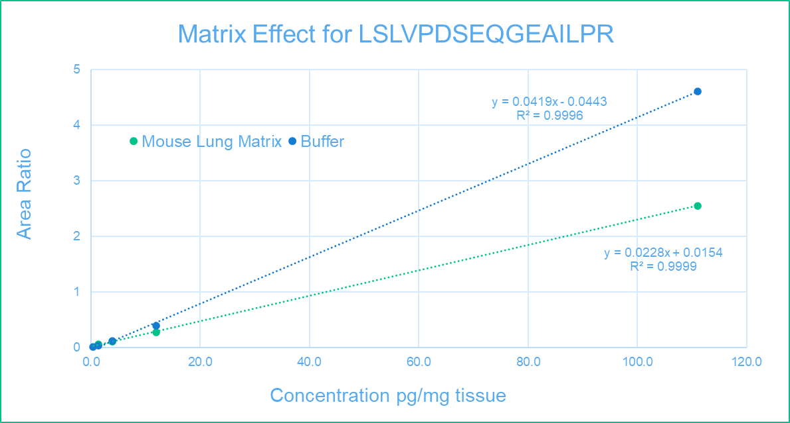
Figure S2. Standard curve of hCFTR peptide LSLVPDSEQGEAILPR peak area ratio vs protein centration in 50 mg mouse lung membrane protein extracts and 4% BSA-PBST buffer. hCFTR concentration was 0.5, 1.4, 4.1, 12, and 111 pg per mg tissue.

Slide 4
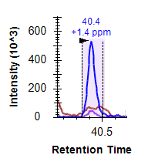
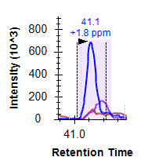
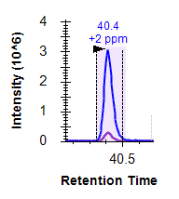
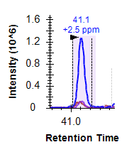
Figure S3. Human CFTR peptide LSLVPDSEQGEAILPR in wild type human lung tissue after IP-MS Analysis. A and B represent two different human lungs.
A B
Heavy Light
Heavy Light

Slide 5
Figure S4. Antibody screening using targeted quantification of peptide LSLVPDSEQGEAILPR with replicates.

