Slide 1
Full unedited gel for Figure 1";

Slide 2
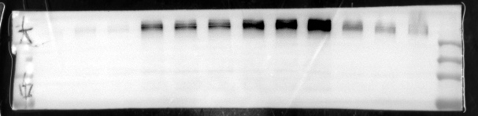

Full unedited gel for Figure 1F";
Day1
Day4
Day7
Day14
marker
marker
245kDa TN-C
42kDa β-actin

Slide 3
Full unedited gel for Figure 2";

Slide 4
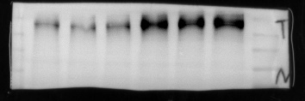
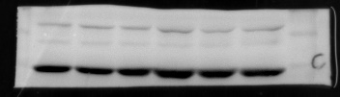
Full unedited gel for Figure 2E";
21%O₂
85%O₂
marker
marker
245kDa TN-C
42kDa β-actin

Slide 5
Full unedited gel for Figure 3";

Slide 6

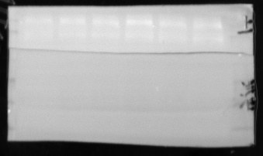
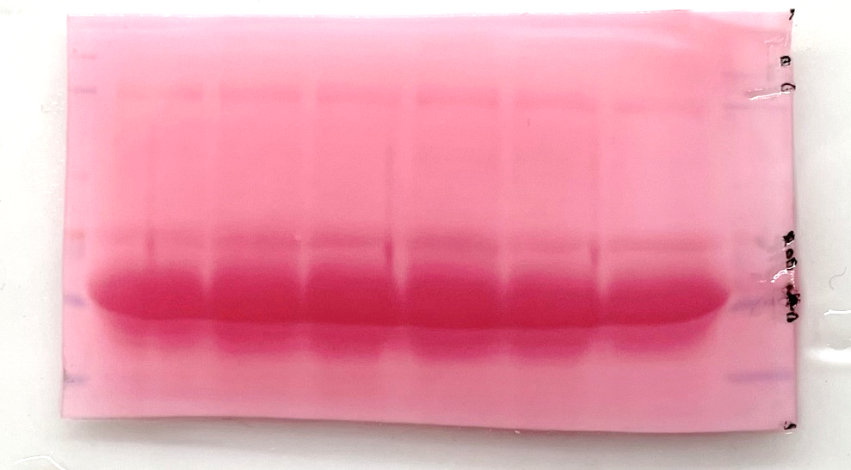
Full unedited gel for Figure 3A";
marker
21%O₂
85%O₂
marker
180-245kDa TN-C
60kDa Ponceau S

Slide 7

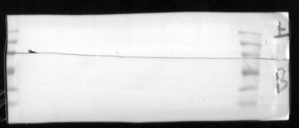
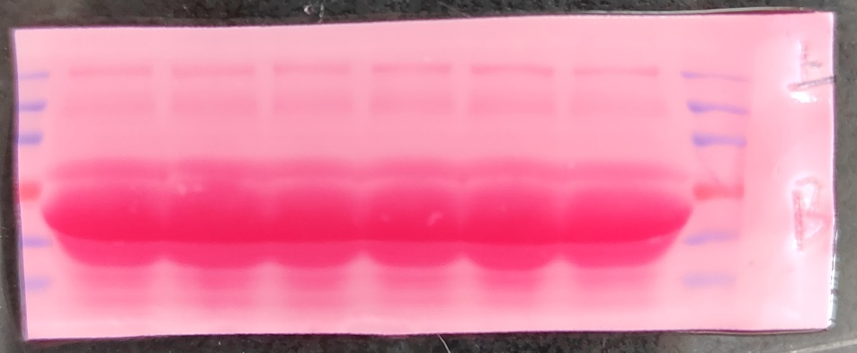
Full unedited gel for Figure 3B";
marker
21%O₂
85%O₂
marker
180-245kDa TN-C
60kDa Ponceau S

Slide 8

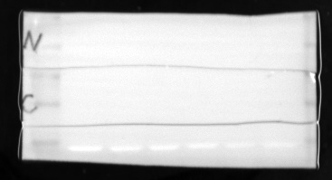

Full unedited gel for Figure 3C";
marker
21%O₂
85%O₂
marker
90-120kDa HIF-1α
42kDa β-actin

Slide 9
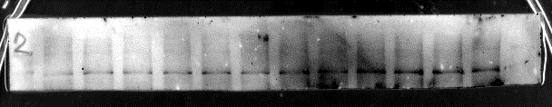

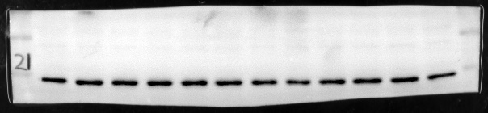
Full unedited gel for Figure 3D";
marker
CON
DMSO
10μM
20μM
marker
180kDa TN-C
90-120kDa HIF-1α
42kDa β-actin

Slide 10


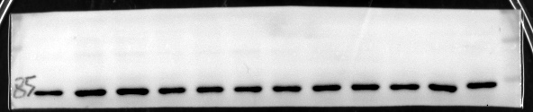
Full unedited gel for Figure 3E";
CON
DMSO
10μM
20μM
marker
marker
180kDa TN-C
90-120kDa HIF-1α
42kDa β-actin

Slide 11
Full unedited gel for Figure 4";

Slide 12

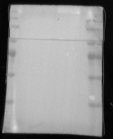
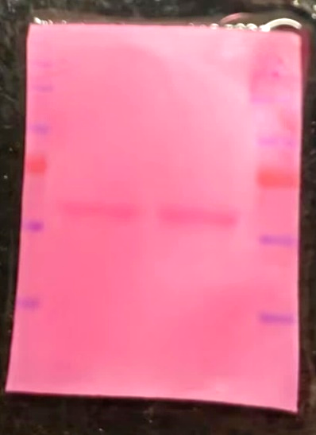
Full unedited gel for Figure 4A";
blank Vector
TN-C OE
marker
marker
180-245kDa TN-C
60kDa Ponceau S

Slide 13
Full unedited gel for Figure 5";

Slide 14


Full unedited gel for Figure 5G";
marker
21%O₂
85%O₂
marker
50-70kDa ICAM-1
42kDa β-actin

Slide 15
Full unedited gel for Figure 6";

Slide 16
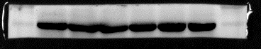
Full unedited gel for Figure 6A";
marker
WT
TN-C KO
marker
180-245kDa TN-C
42kDa β-actin

Slide 17
Full unedited gel for Figure 7";

Slide 18
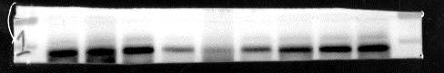
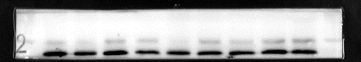
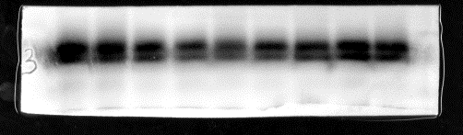
Full unedited gel for Figure 7 G";
85%O₂+
Rat IgG
85%O₂+
TN-C Neu Ab
21%O₂
marker
marker
50kDa RAGE
37kDa GAPDH
25kDa SP-C

