Slide 1
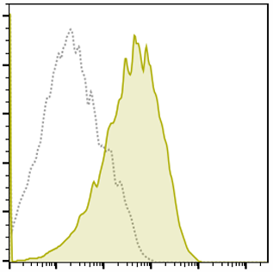
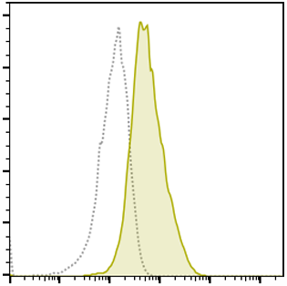
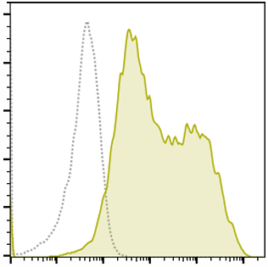
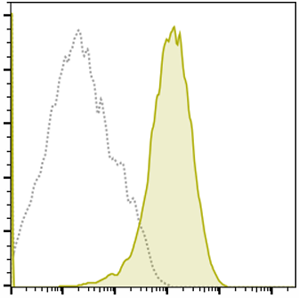
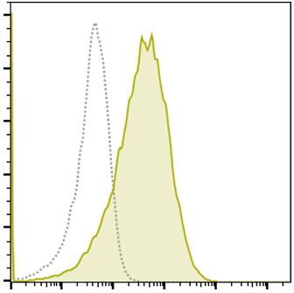
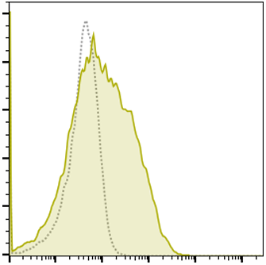
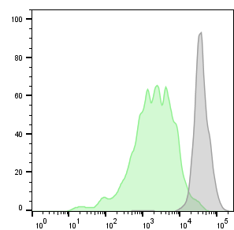
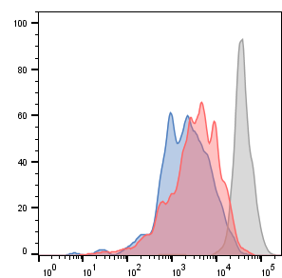
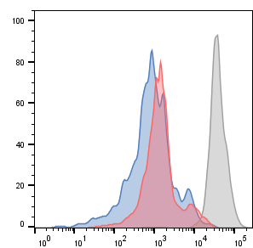
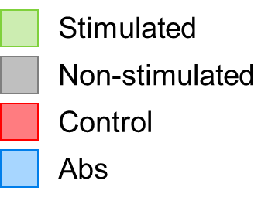
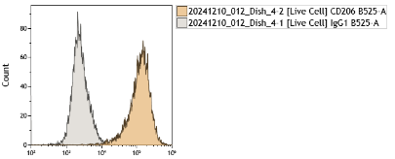
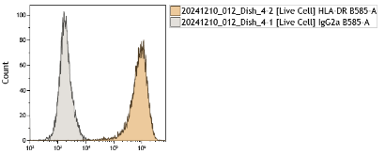
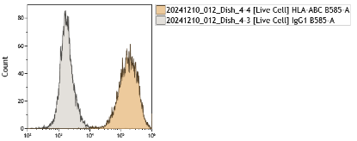
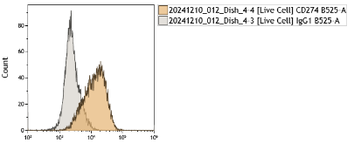
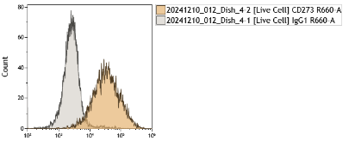
Figure S1 Phenotype and function of CSF-1+IL-4 Mf
A mRNA expressions normalized to Gapdh (quantitative RT-PCR)
M1 molecule
M2 molecules
MMPs
2^{-⊿Ct} value
Immunosuppressive
molecules
■ CSF-1 Mf
■ IL-34 Mf
■ CSF-1+IL-4 Mf
■ IL-34+IL-4 Mf
B Cell surface molecular expressions (FACS)
Cell counts
Mouse
CSF-1+IL-4 Mf
F4/80
CD206
I-A/I-E
H-2 D^{b}/K^{b}
PD-L1
PD-L2
C T cell inhibition assay
T cell proliferation without co-culture
CD4
CD8
Cell counts
Cocultured with CSF-1+IL-4 Mf
CFSE
D Cell surface molecular expressions (FACS)
Cell counts
Human
CSF-1 +IL-4 Mf
CD206
HLA-DR
HLA-ABC
PD-L1
PD-L2
Notes:
IL34 FPKM 2<削除、 TTEST<0.05, 34/CSF1>1.5 Biological proces

