Slide 1
Supplemental Figure 1 LSE: EQ-5D-5L
Mean Score
Mean Change from Baseline
BNT162B2 – Unvaccinated Difference in Mean Change from Baseline
VAS
Utility Index

Slide 2
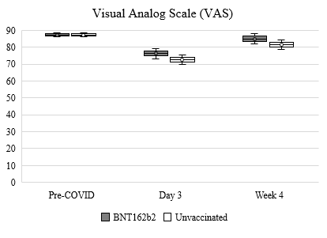
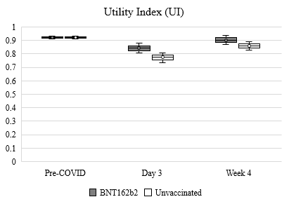
Supplemental Figure 2 EQ-5D-5L trend

Slide 3
Supplemental Figure 3 LSE: WPAI-GH
Mean Score
Mean Change from Baseline
BNT162B2 – Unvaccinated Difference in Mean Change from Baseline
Absenteeism
Presenteeism
Work Productivity Loss
Activity Impairment

Slide 4
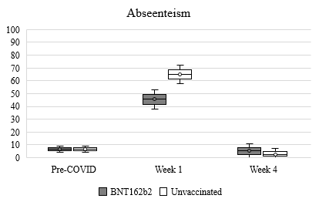
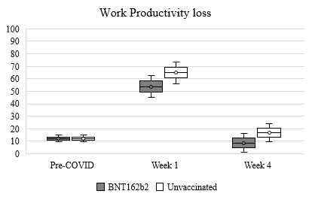
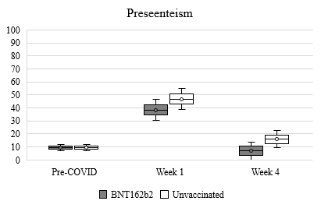
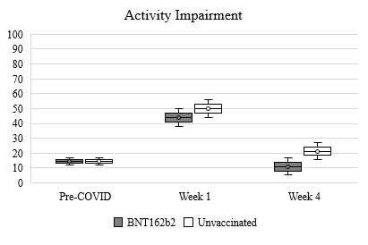
Supplemental Figure 4 EQ-5D-5L trend

