Slide 1
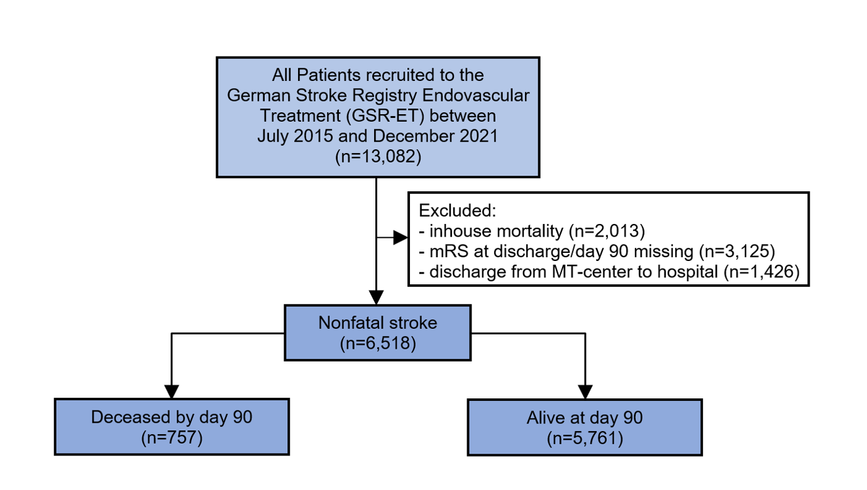
Figure S1. Study population.
Abbreviations: mRS: modified Rankin Scale, MT: mechanical thrombectomy.

