Slide 1
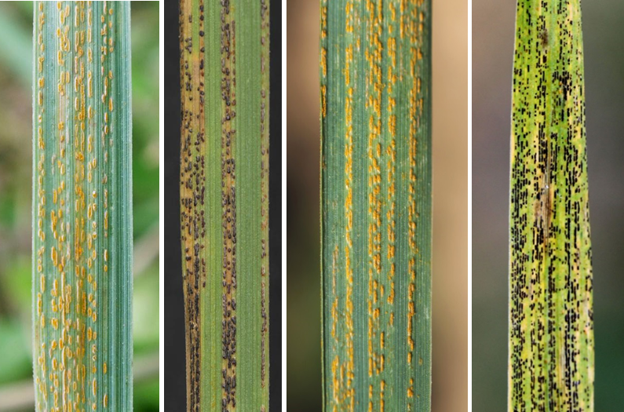
Huang et al., Phytopathology Research, Figure S4
a
b
c
d

