Slide 1
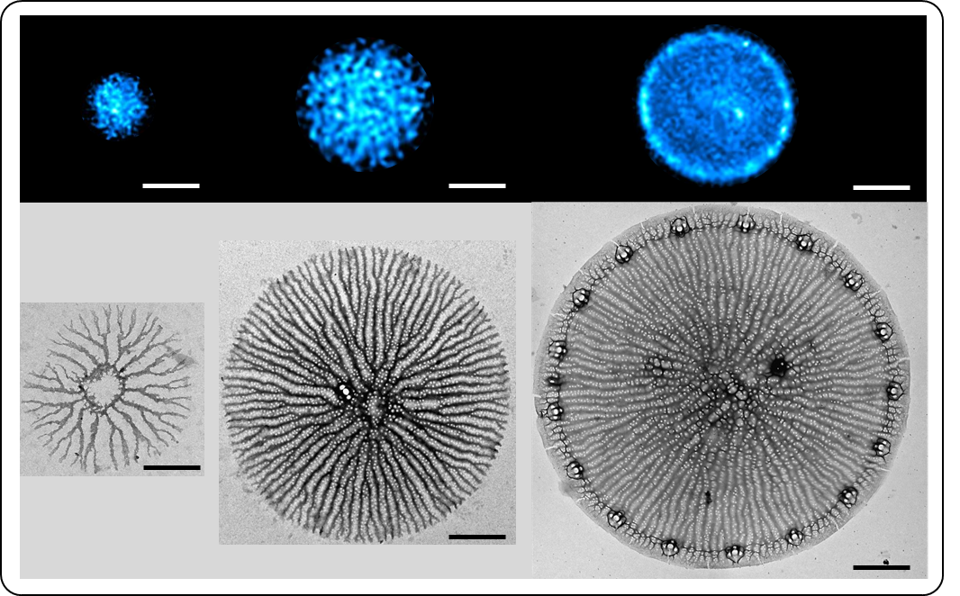
Figure S1. Comparison of PDMPO fluorescence pattern (top row) and biosilica structure by TEM (bottom row) in T. pseudonana valve SDVs. Scale bars: 3 µm (top row) and 1 µm (bottom row).

