Slide 1
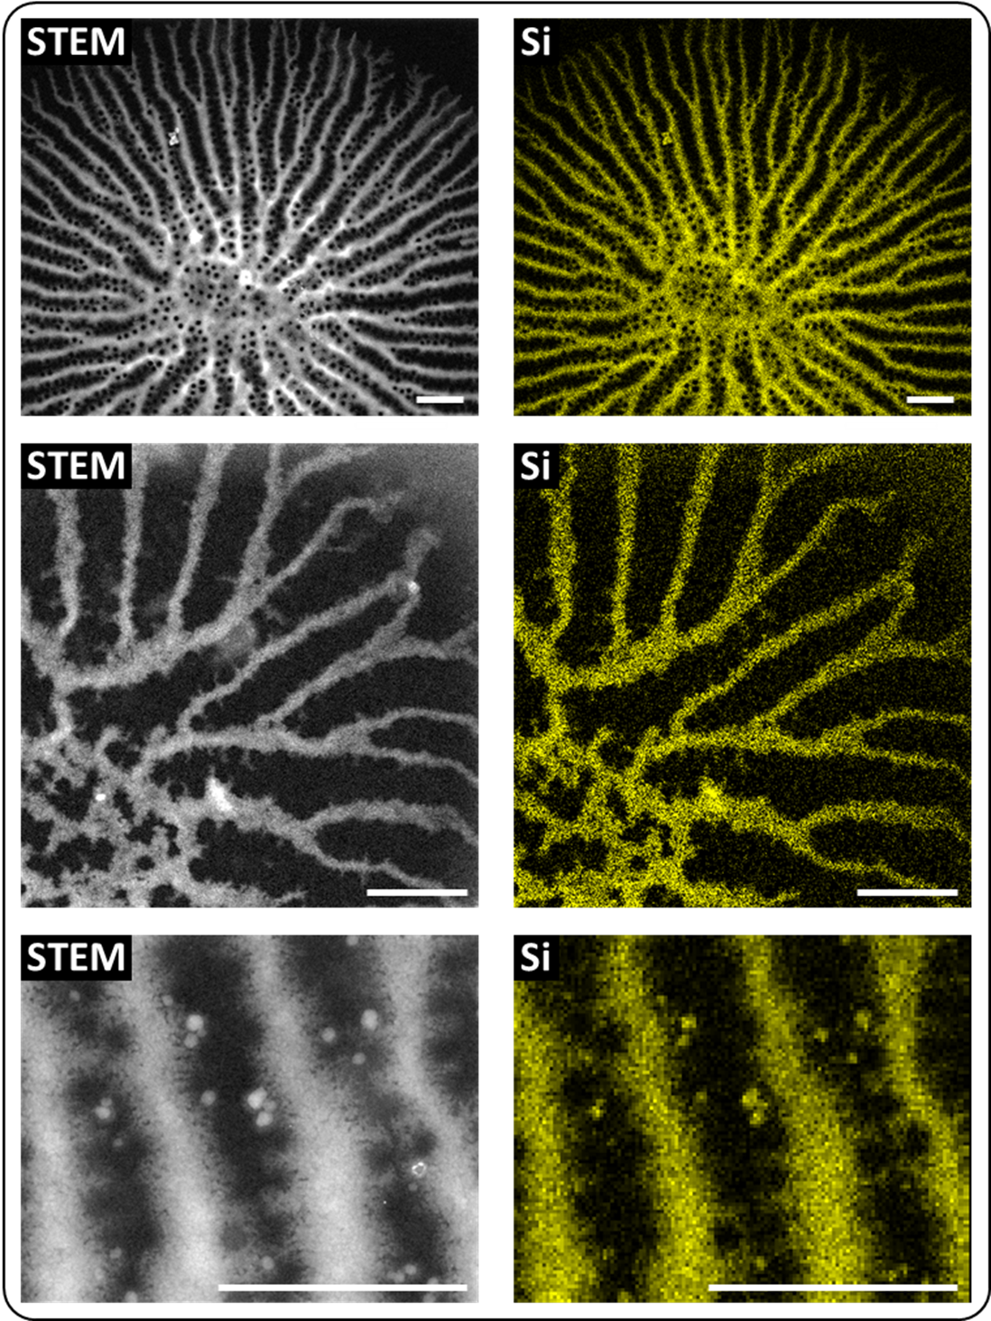
Figure S2. STEM imaging and EDX analysis of T. pseudonana valve SDVs from different developmental stages. Scale bar: 300 nm.

