Slide 1
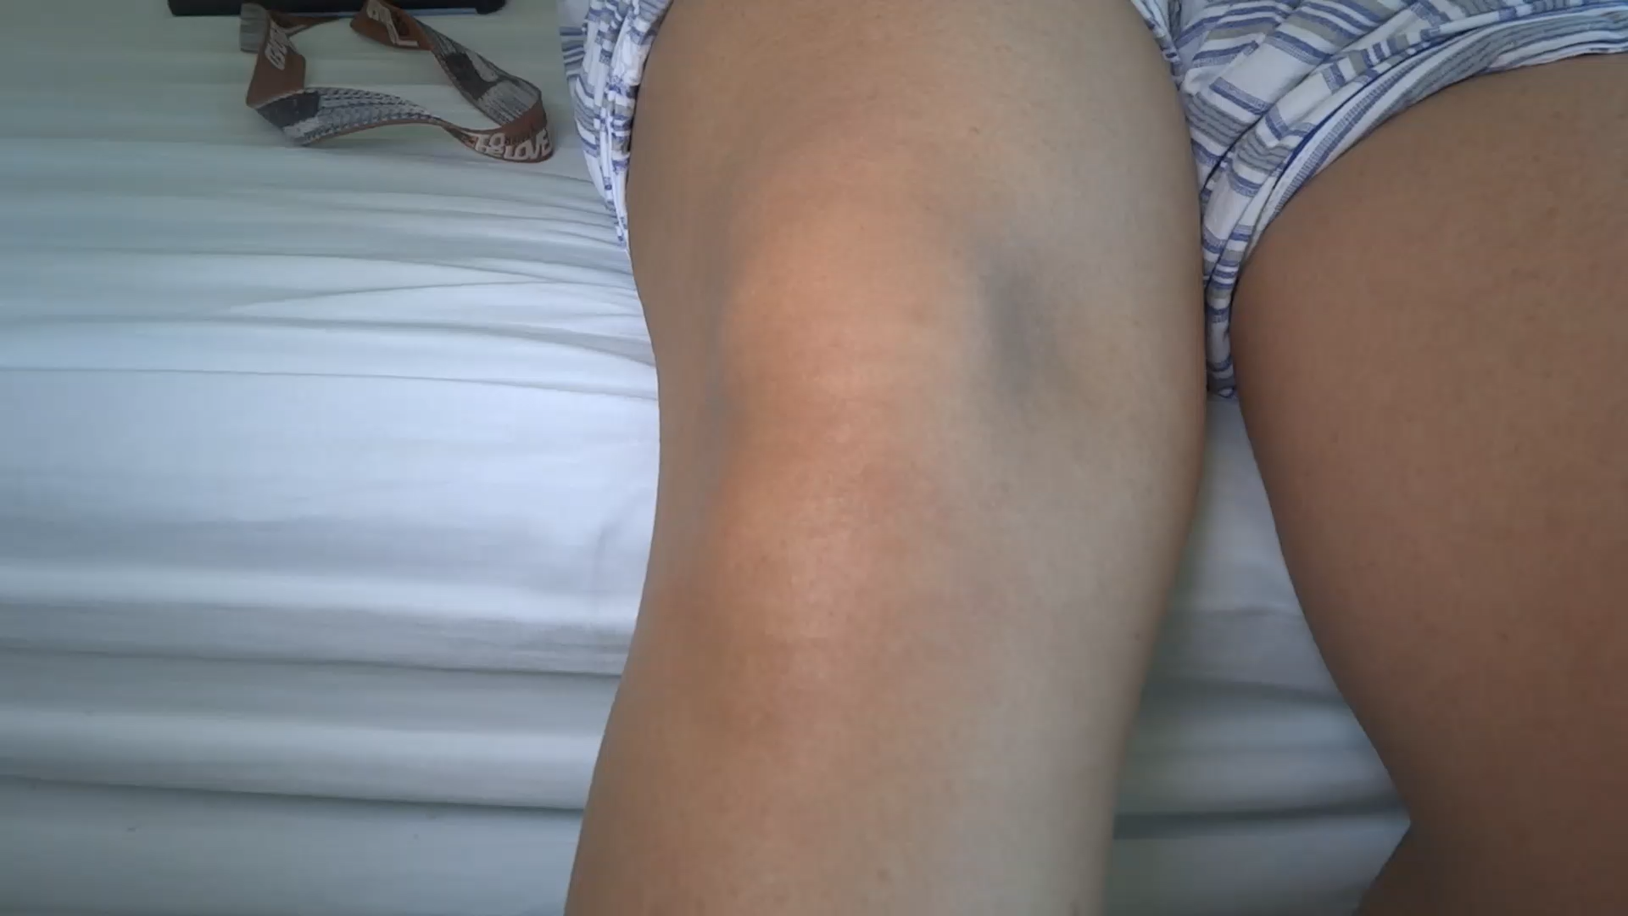
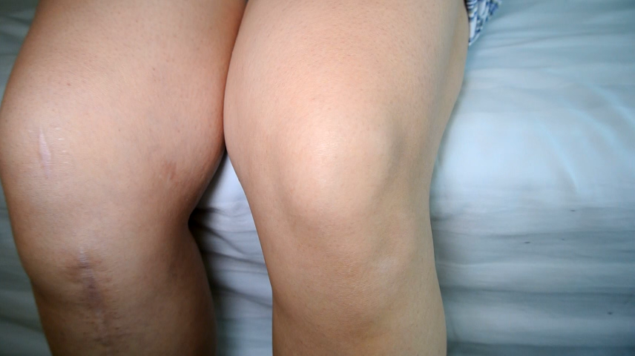
Appendix-2-1 Xu XX_RPD-R_Jumping sign
Appendix-2-2 Liu XX_RPD-L_Gliding sign

