Slide 1
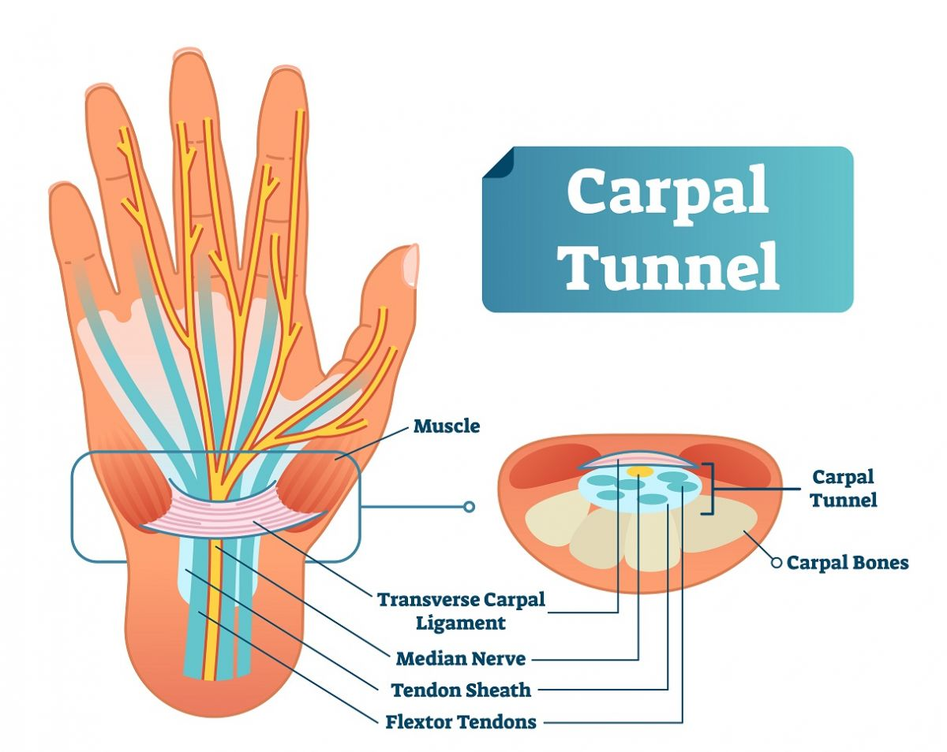
Impact of Ultrasound-Guided Flexor Retinaculum Fenestration on Outcome of Hydro-Dissection of Median Nerve in Patients with CTS
Dr. Ahmad Zidane
Lecturer of Radiodiagnosis & IR Al-Azhar University

Slide 2
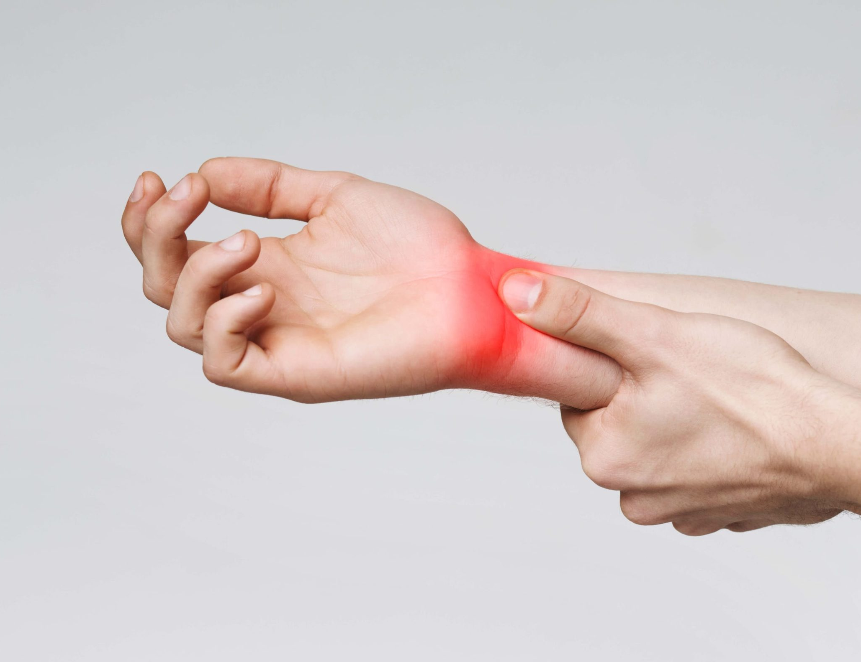
Contents
Section 1: Understanding Carpal Tunnel Syndrome
Section 2: Diagnostic Methods for CTS
Section 3: Conventional Treatment Approaches
Section 4: US Anatomy and Diagnoses of CTS
Section 5: Intervention Techniques for CTS
Section 6: Patient Outcomes and Future Considerations

Slide 3
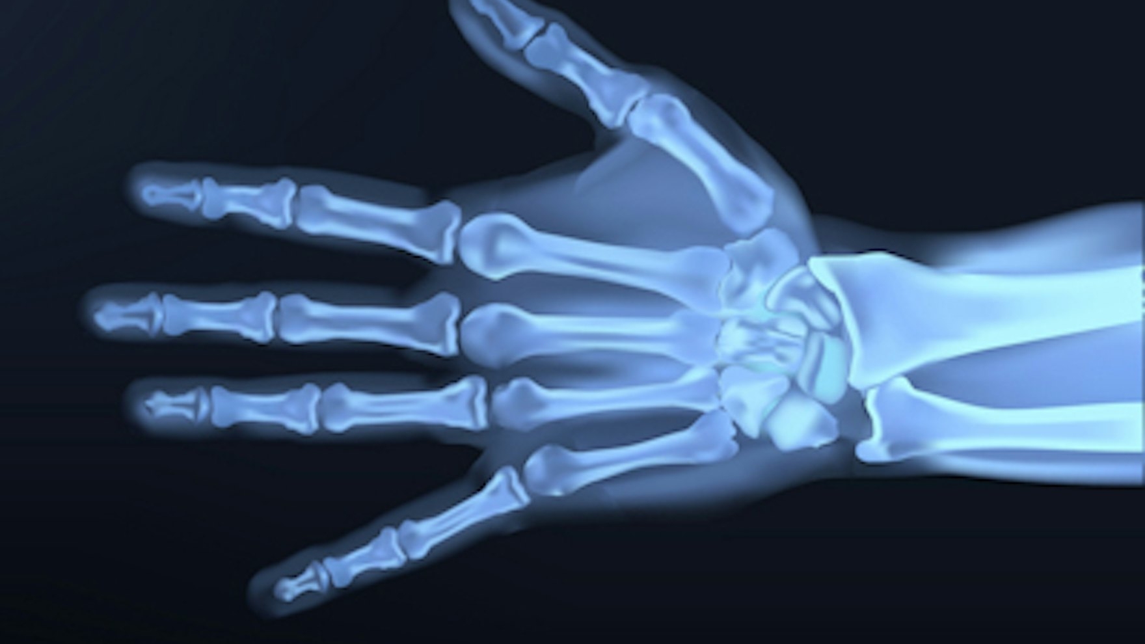
Section 1:
Understanding Carpal Tunnel Syndrome

Slide 4
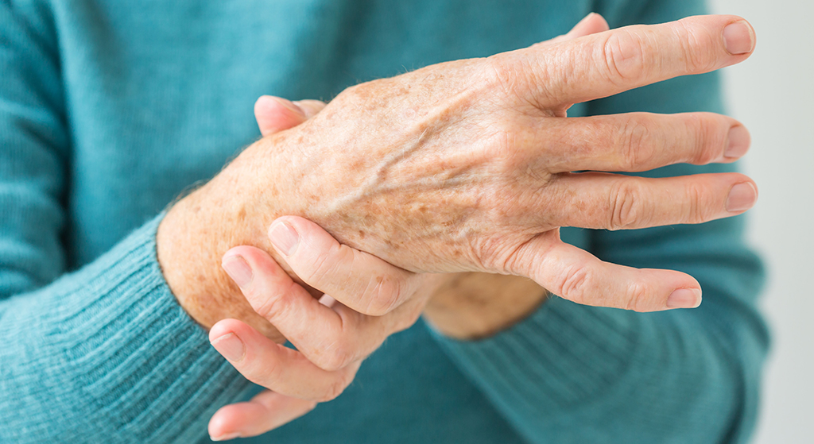
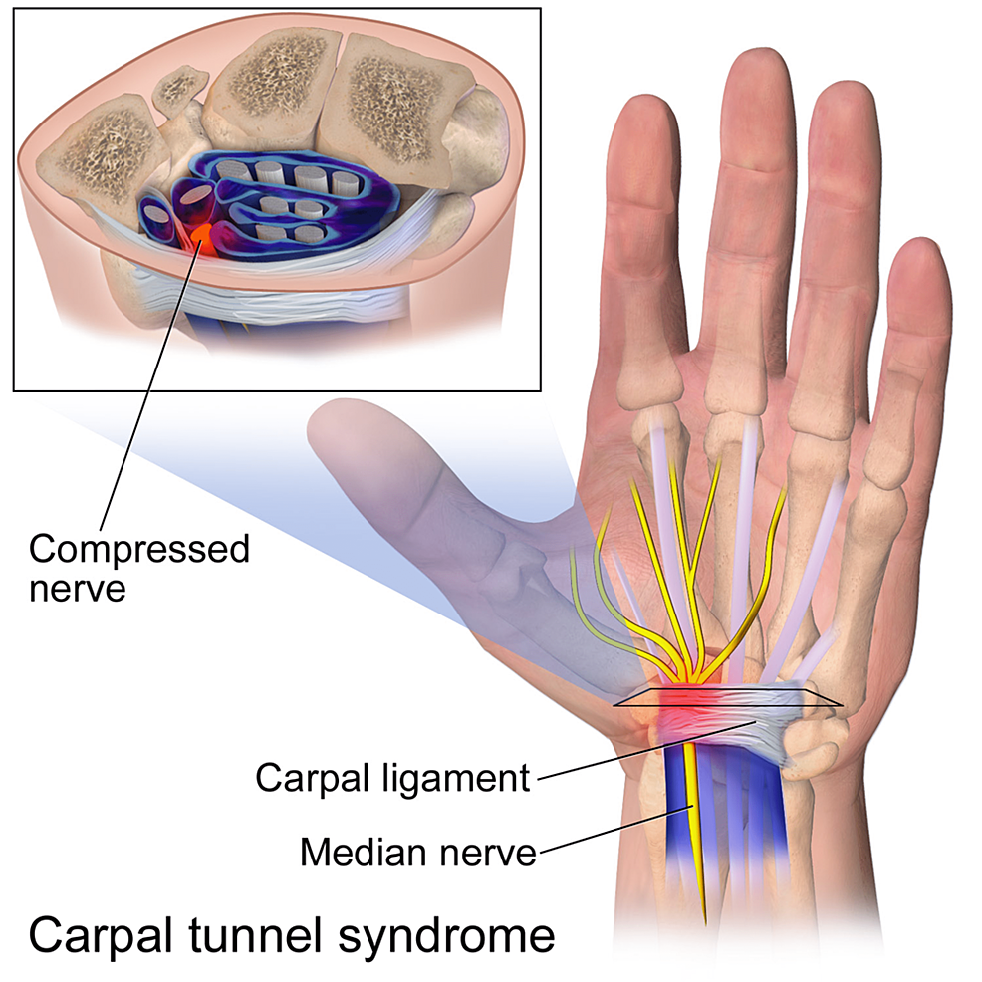
Understanding Carpal Tunnel Syndrome
Carpal Tunnel Syndrome: (CTS) is condition characterized by the compression of the median nerve within the carpal tunnel, leading to symptoms such as pain, numbness, and weakness in the hand and wrist.
Impact on Daily Life: The symptoms of CTS can significantly impact daily activities, affecting work, sleep, and overall quality of life.
Risk Factors: Various factors, including repetitive hand movements (as in manual workers and house wives) ,, underlying health conditions (as DM and hypothyroidism) and anatomical factors.

Slide 5
Pathophysiology of CTS
Perineural Adhesions
Thickened TCL
Nerve Compression
Gliding Reduction
Nerve Damage

Slide 6
Section 2:
Diagnostic Methods for CTS

Slide 7
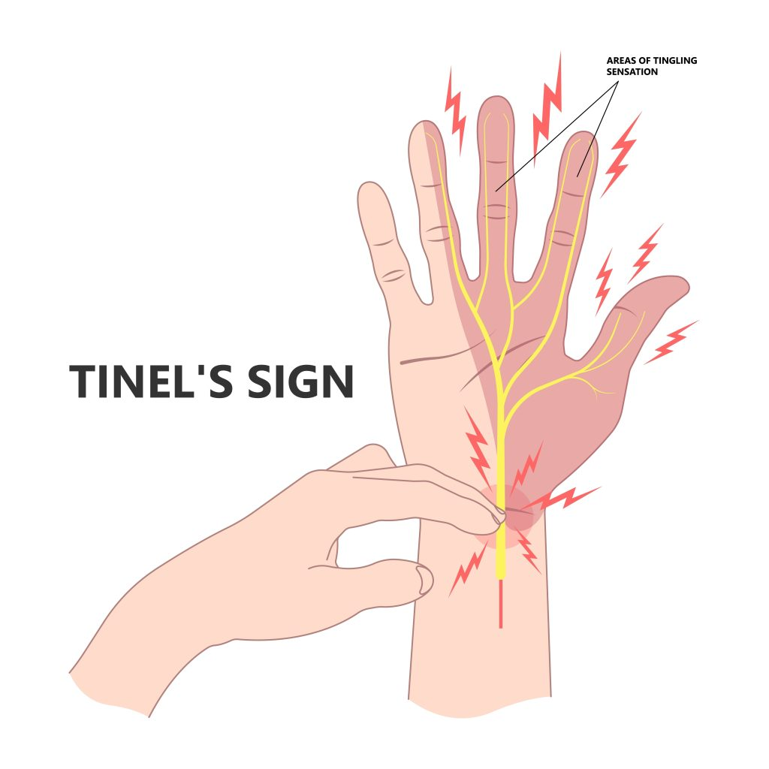
Diagnostic Methods for CTS
Clinical Assessment: for demonstration of symptoms (pain and numbness along medial 3.5 fingers of the hand ,, weak hand grip) ,,,,, physical examination, and specific test as phalen and Tinel's test.
Electrodiagnostic Studies: confirming the diagnosis ,, assessing the severity and grade of nerve damage.
Imaging Techniques: Such as ultrasound and MRI can provide detailed visualization of the median nerve and surrounding structures.

Slide 8
Section 3:
Conventional Treatment Approaches

Slide 9
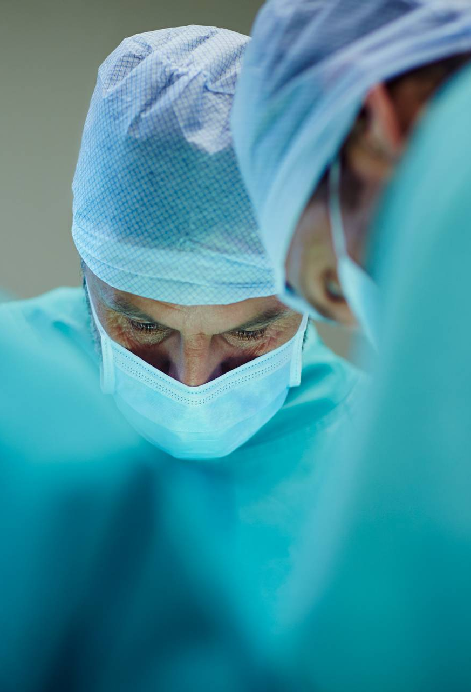
Conventional Treatment Approaches
Splinting and Bracing: are commonly prescribed to alleviate symptoms and reduce pressure on the median nerve.
Blind Corticosteroid Injections: To reduce inflammation and alleviate symptoms , offering temporary relief for many patients.
Surgical Release: In cases of severe or refractory CTS, aiming to decompress the median nerve and alleviate symptoms.

Slide 10

Limitations of Conventional Treatments
Variable Efficacy: Conventional treatments usually provide partial or temporary improvement in symptoms.
Risk of Complications:
Non guided injection: carry risk of nerve trauma , inadequate decompression of the median nerve.
Surgical interventions: carry risk of infection, nerve injury , tender scar , inadequate decompression and prolonged recovery periods .

Slide 11


Need for Innovation
The limitations of existing treatment approaches underscore the need for innovative and effective interventions to improve outcomes for patients with CTS.

Slide 12
Section 4:
Ultrasound anatomy and diagnosis of CTS.

Slide 13
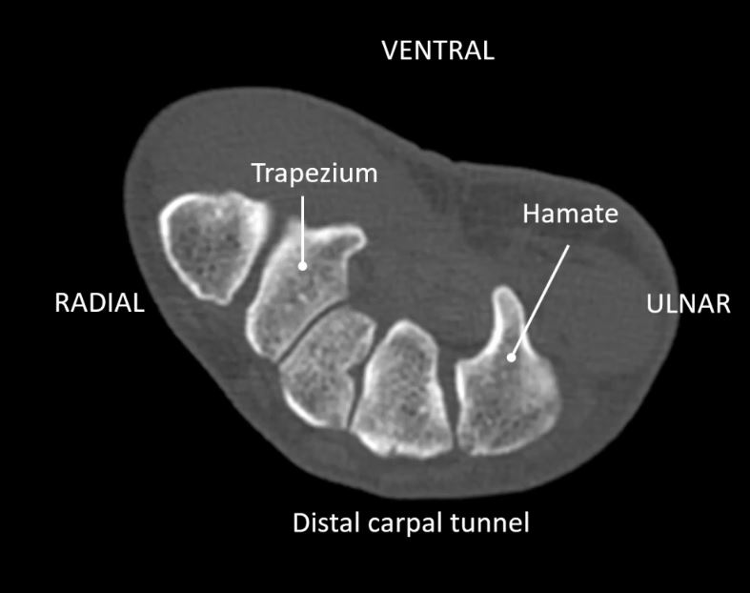
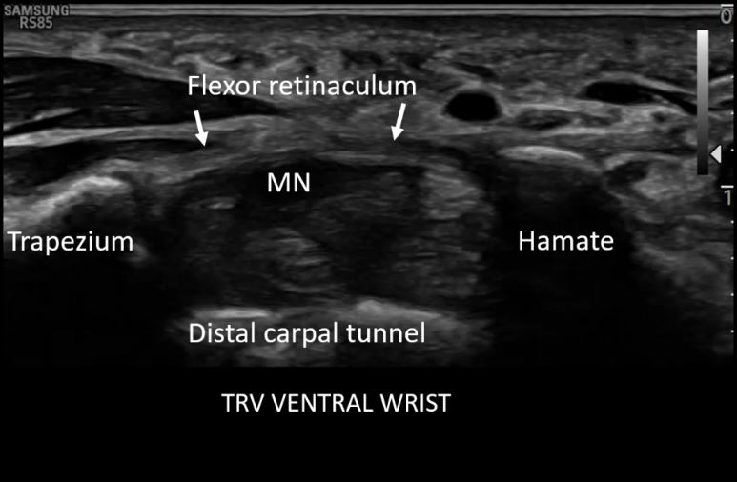
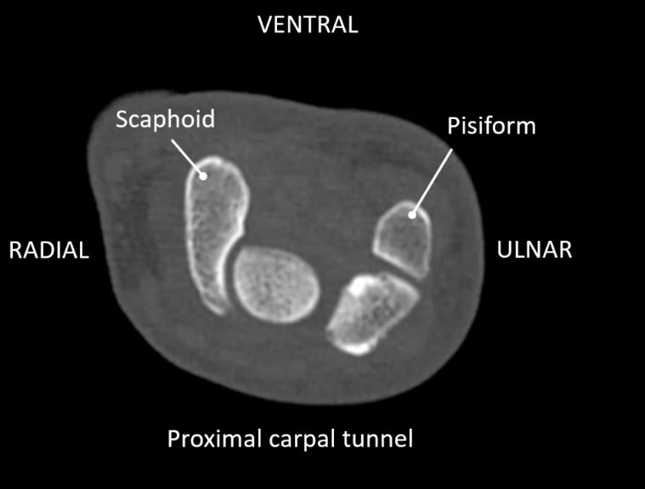
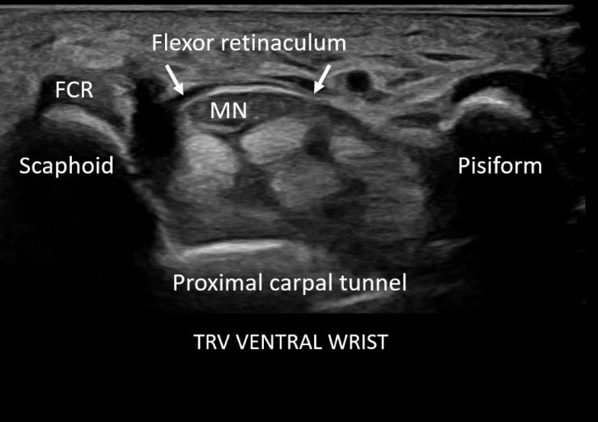
Ultrasound anatomy of carpal tunnel

Slide 14
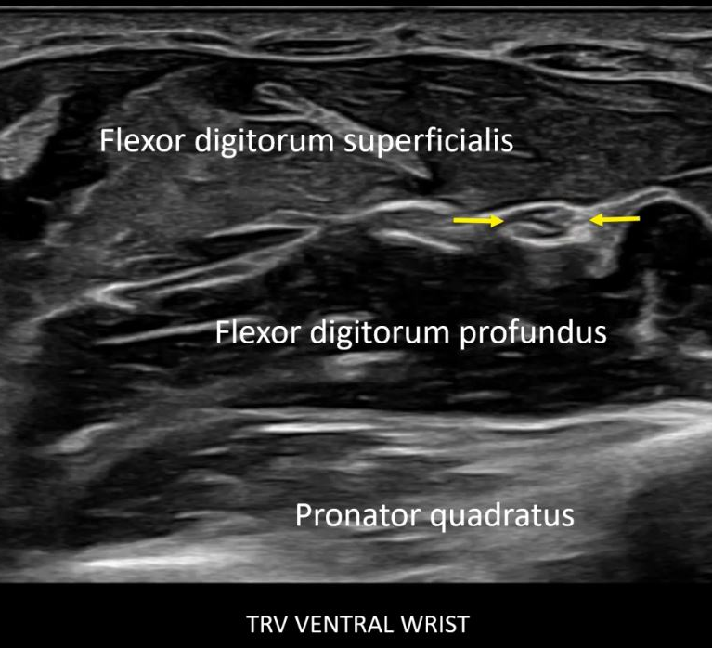
Ultrasound anatomy of carpal tunnel

Slide 15
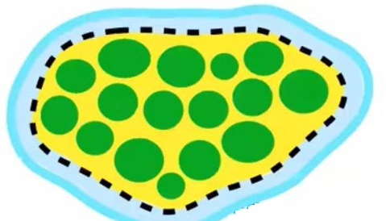
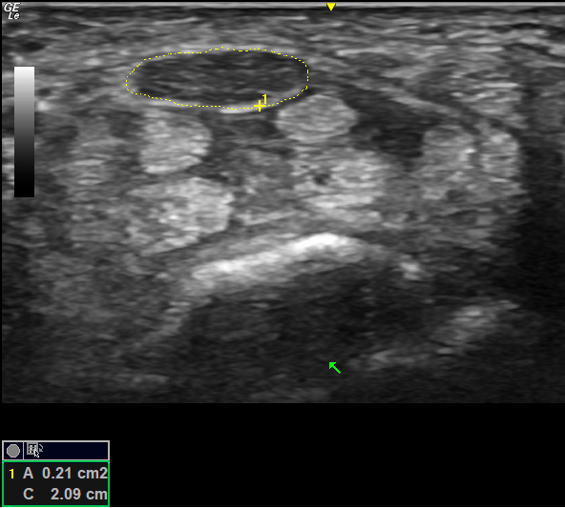
Ultrasound Measurements Of CTS
Median nerve area
<10 mm²= Normal
10-12 mm² = Borderline compare @ PQ
>12 mm² = Abnormal

Slide 16
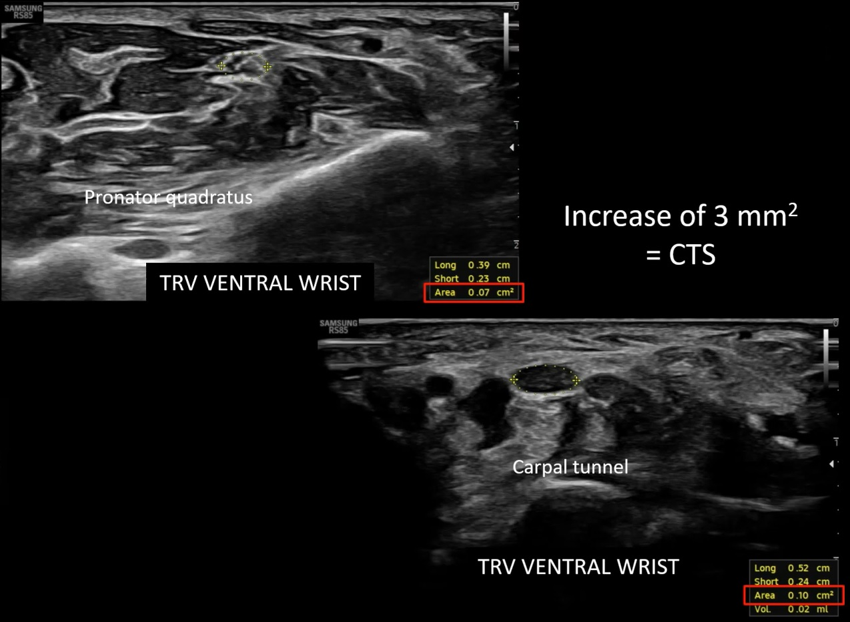
Ultrasound Measurements Of CTS
Most accurate to compare area at proximal pronator quadratus muscle and carpal tunnel
Increase of 2 mm from proximal to distal = 99% sensitive and 100% specific for CTS
Measure inside the echogenic epineurium

Slide 17
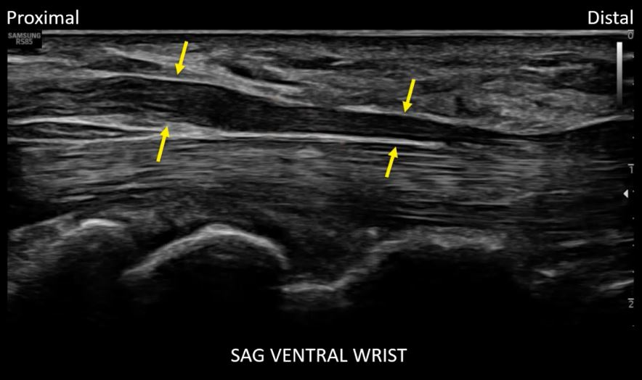
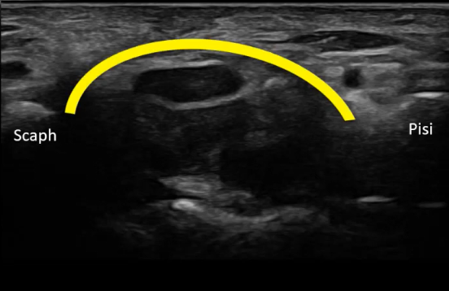
Ultrasound Measurements Of CTS
Enlargement median nerve as enters carpal tunnel with flattening of nerve = Notch sign.
Bulging of TCL > 2-4 mm

Slide 18
Section 5:
Intervention Techniques for Carpal Tunnel Syndrome

Slide 19
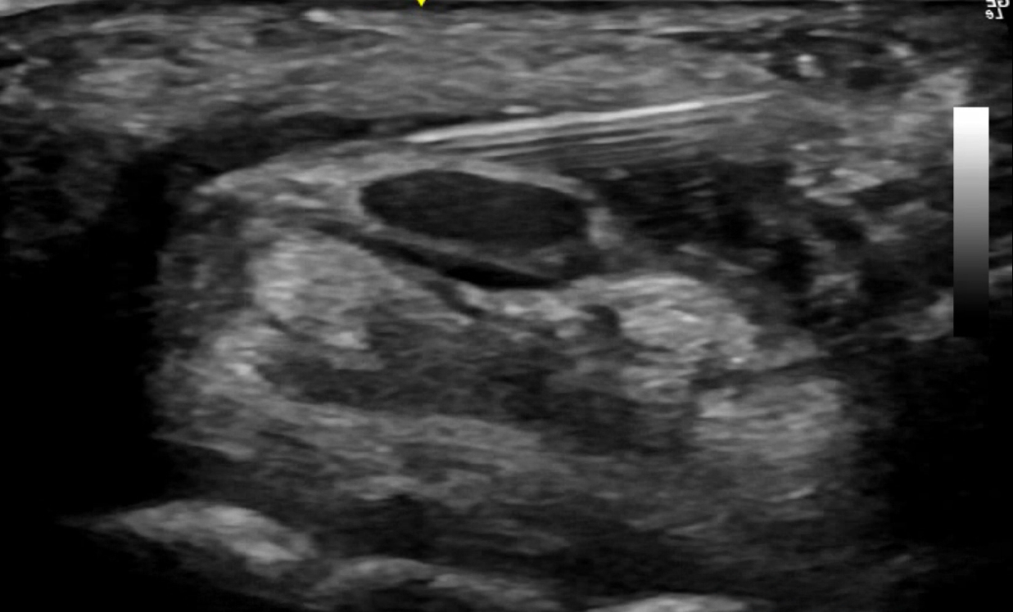
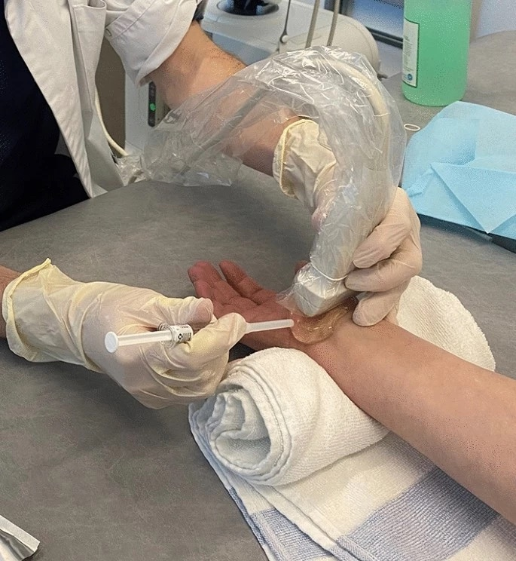
Ultrasound-Guided Percutaneous Hydrodissection of MN
Principle of Hydrodissection: Ultrasound-guided hydrodissection involves the use of fluid (10-15ml of D5w) to create space around the median nerve, Separating it from TCL and flexor tendons reducing compression and improving nerve gliding within the carpal tunnel.

Slide 20
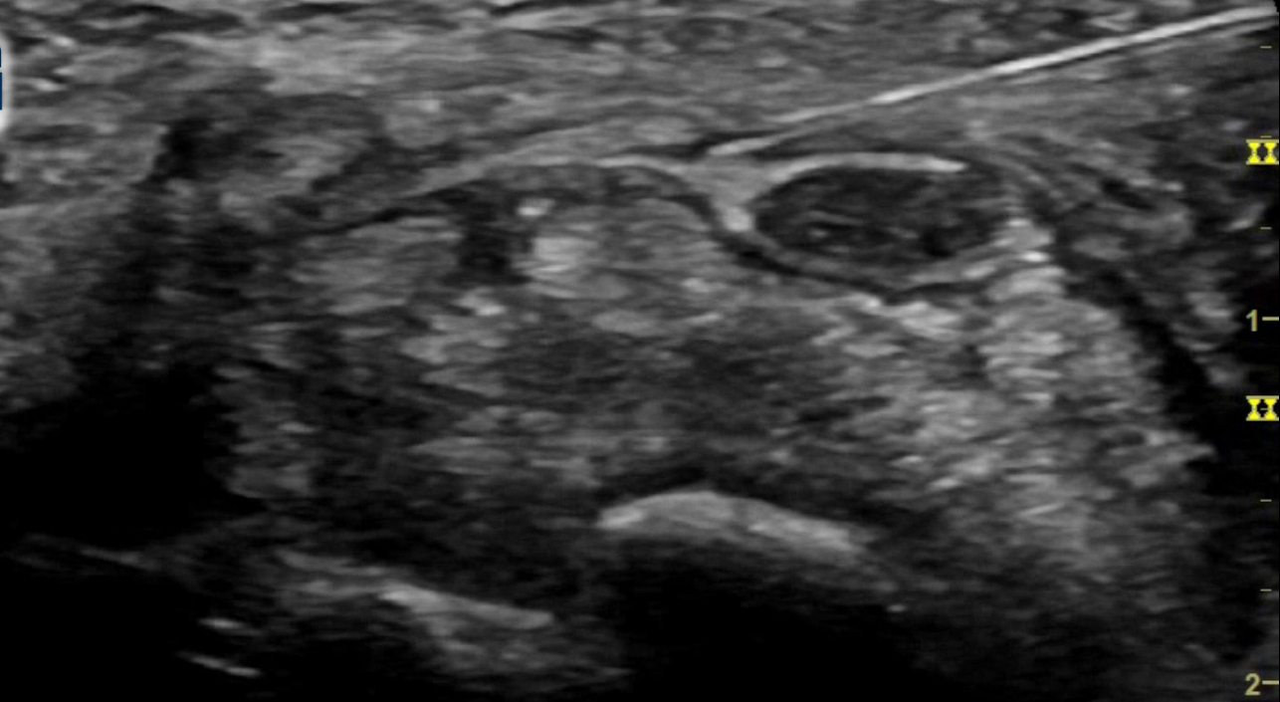
Ultrasound-Guided Percutaneous Flexor Retinaculum Fenestration
Principle of Flexor Retinaculum Fenestration: Following the application of local anesthetic, the needle was used under continuous ultrasound guidance to repeatedly puncture the transverse carpal ligament in a direction parallel to the median nerve in axial and longitudinal planes in fan like manner. In the event that the needle penetrates the ligament with ease, it will be recommended that the ligament be released sufficiently
Percutaneous fenestration aim for loosening, softening and thinning out the flexor retinaculum , addressing the primary site of median nerve compression.

Slide 21

Hydrodissection & fenestration aim to
Hydro-dissection
b
Peri Neural Adhysiolysis
c
Enhance Nerve Gliding.
a
Fenestration
b
TCL loosening
c
Reduce Nerve Compression
a

Slide 22
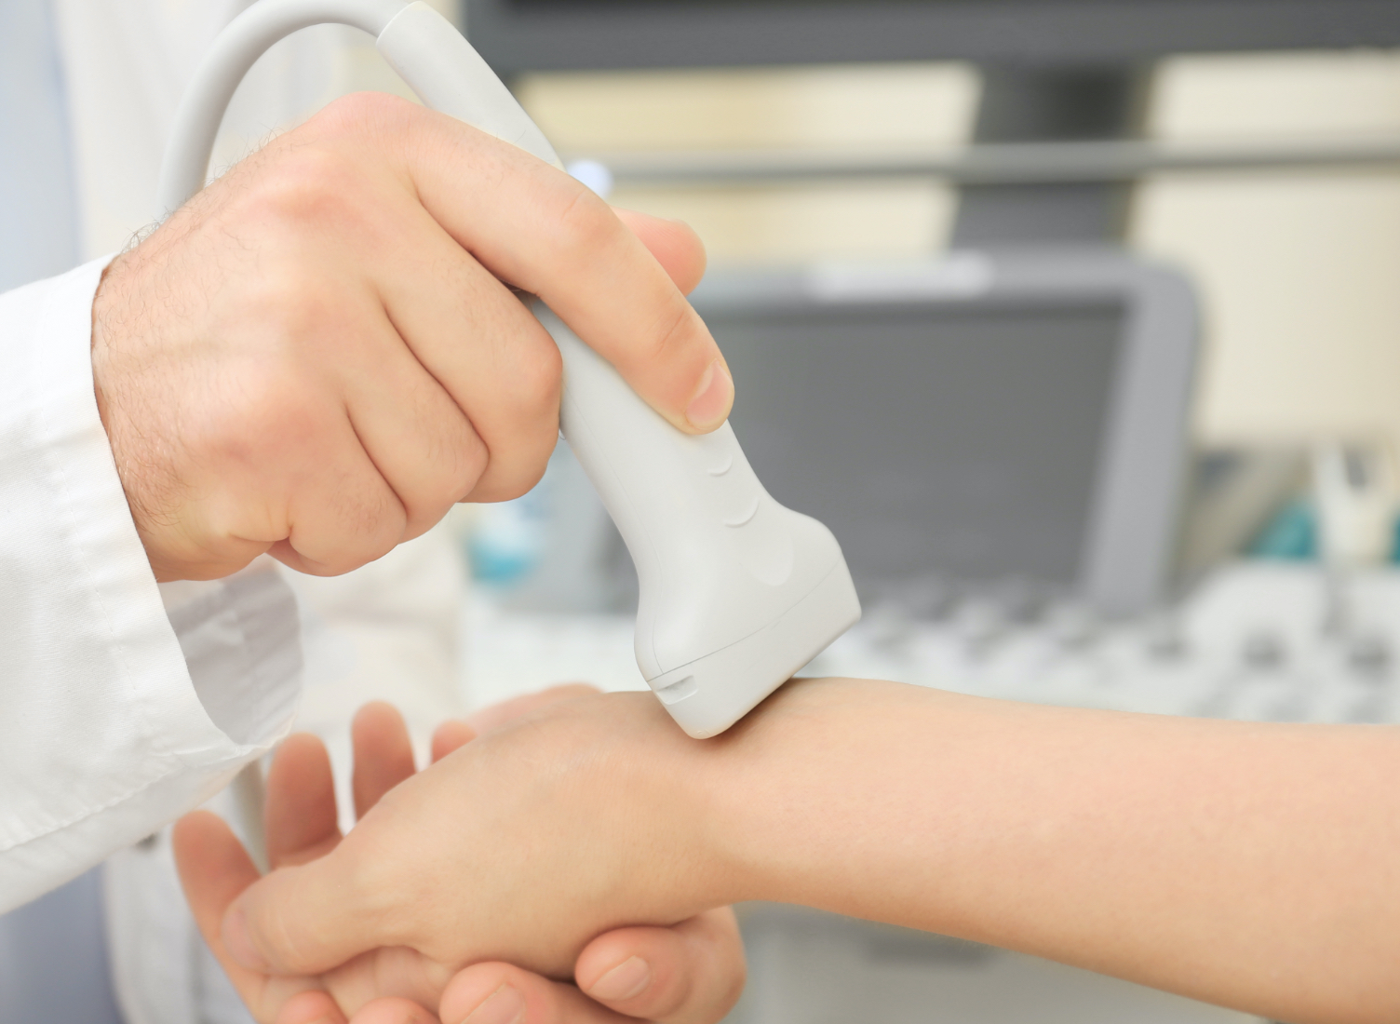

Advantages of Minimally Invasive Techniques
Reduced Recovery Time: Minimally invasive procedures typically involve smaller incisions and result in faster recovery and return to normal activities.
Lower Risk of Complications: Compared to traditional open surgery, minimally invasive approaches are associated with lower risks of infection, scarring, and postoperative pain.
Outpatient Setting: Many of these advanced techniques can be performed in an outpatient setting, minimizing hospital stays and associated costs.

Slide 23
Section 6:
Patient Outcomes and Future Considerations

Slide 24

Clinical Efficacy and Patient Reported Outcomes
Sustained Relief: Follow-up data demonstrating the long-term efficacy and durability of the advanced treatment techniques in maintaining symptom relief.
Functional Recovery: Objective measures of functional improvement and nerve function, providing evidence of sustained benefits for patients.

Slide 25

Future Directions and Research
Advancements in CTS Care: Insights into ongoing research and development efforts aimed at further refining and expanding the scope of minimally invasive treatments for CTS.

Slide 26

Minimally Invasive Nature
The percutaneous approach, guided by ultrasound visualization, offers a minimally invasive alternative to traditional surgical release, potentially reducing the risks and recovery time associated with open surgery.

Slide 27
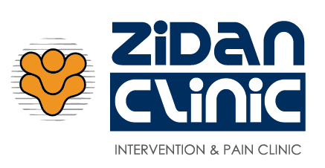





THANKS!
Do you have any questions?
DrAhmadZidane@Gmail.com
+20 0100 205 68 69
/dr.zidan.clinic
/drahmed.zidane
/zidan.clinic

