Slide 1
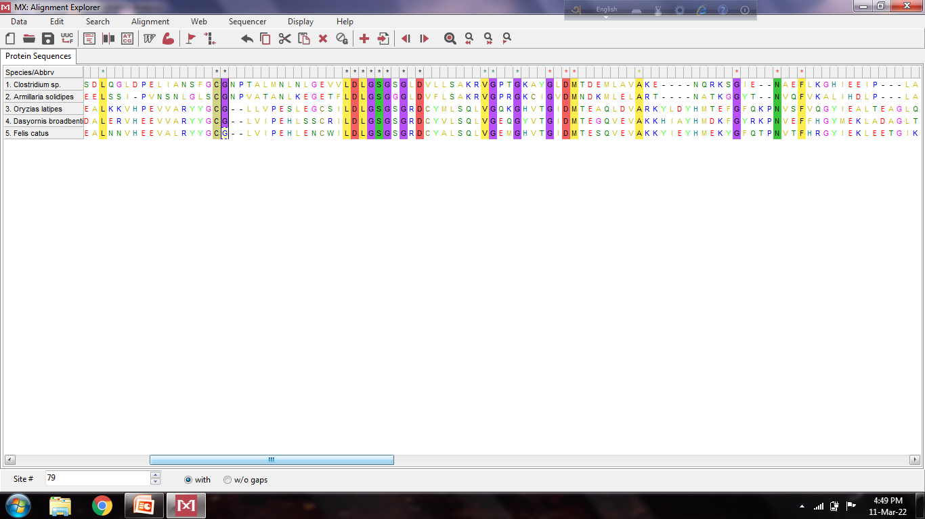
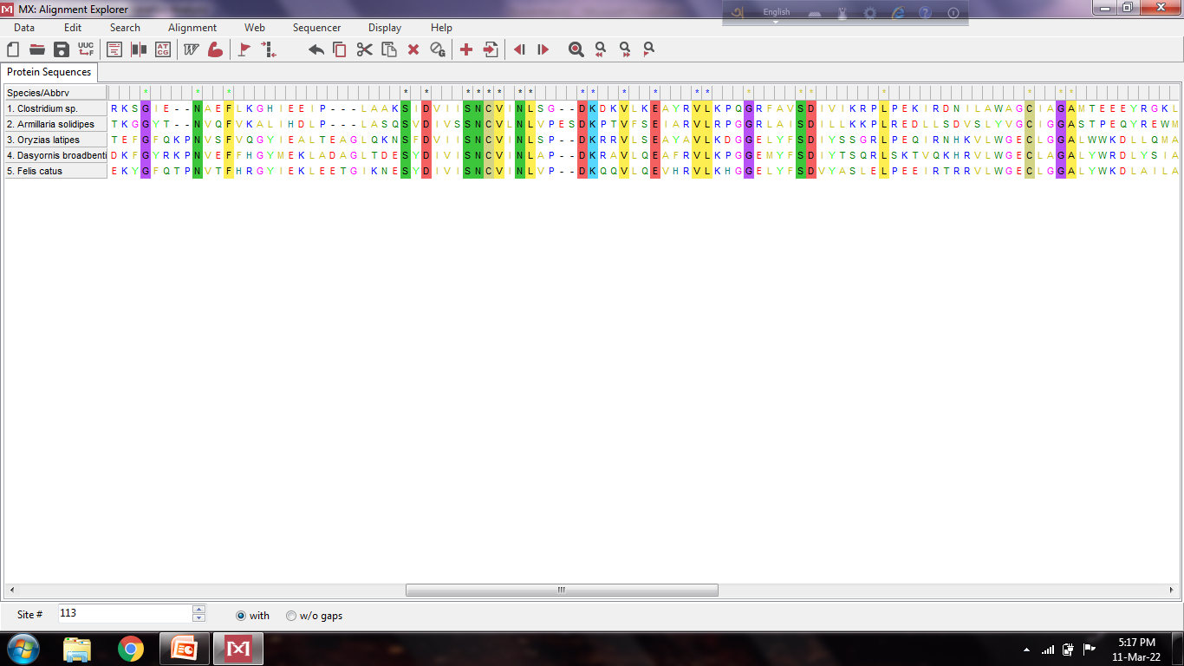
Alignment of enzymes to find out conserved structural amino acids
64
78
79
94
99
111
115
167
173
179
184
198
209
230
233

