Slide 1
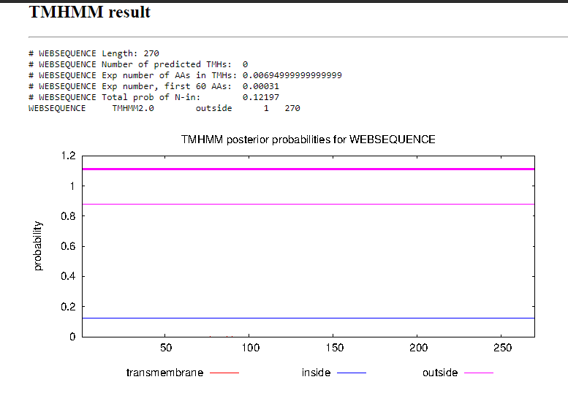
Clostridium sp.

Slide 2
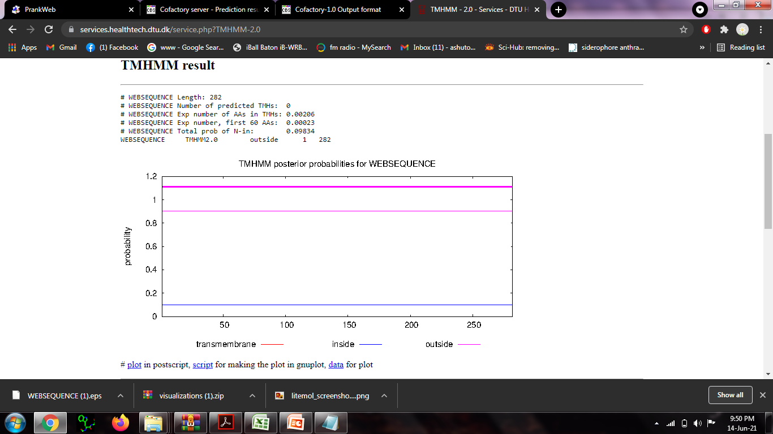
Armillaria solidipes

Slide 3
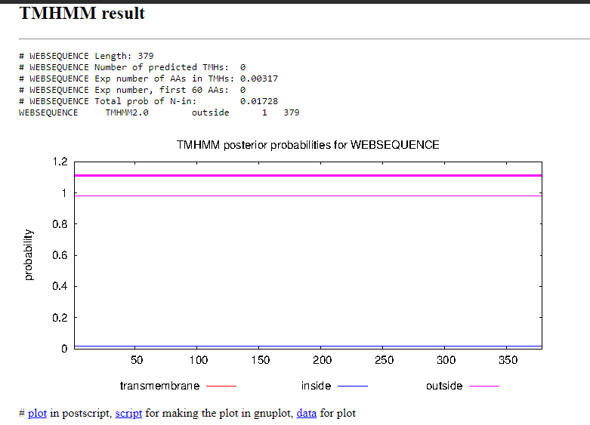
Oryzias latipes
fish

Slide 4
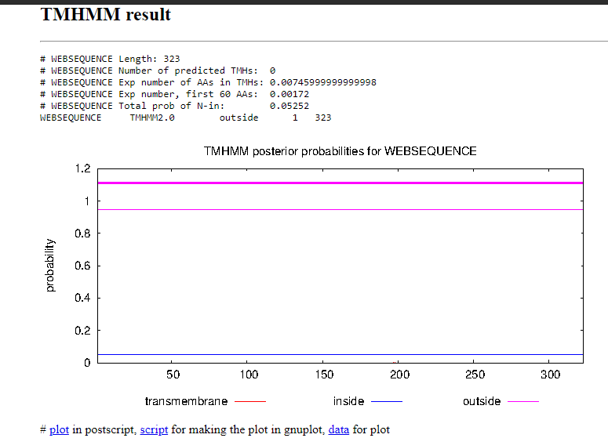
Dasyornis broadbenti
bird

Slide 5
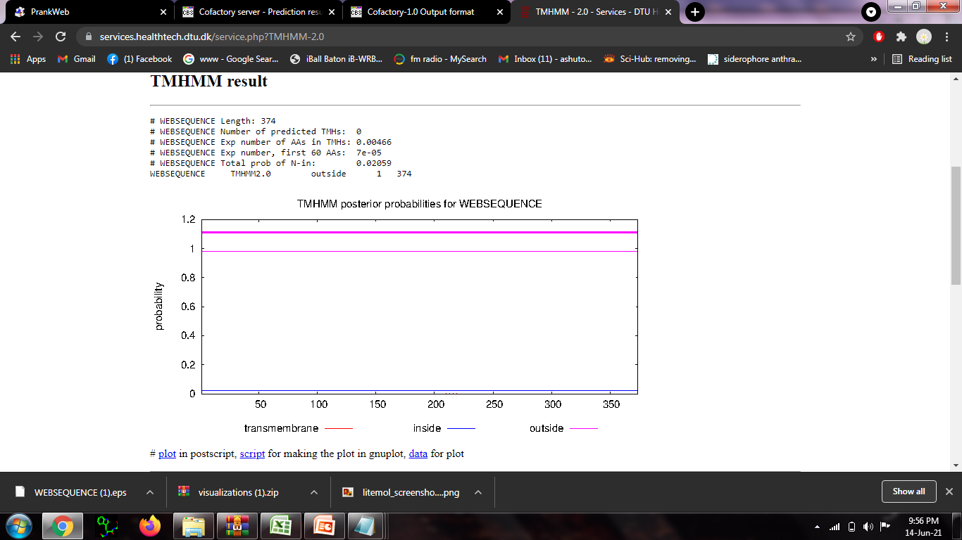
Felis catus

