Slide 1
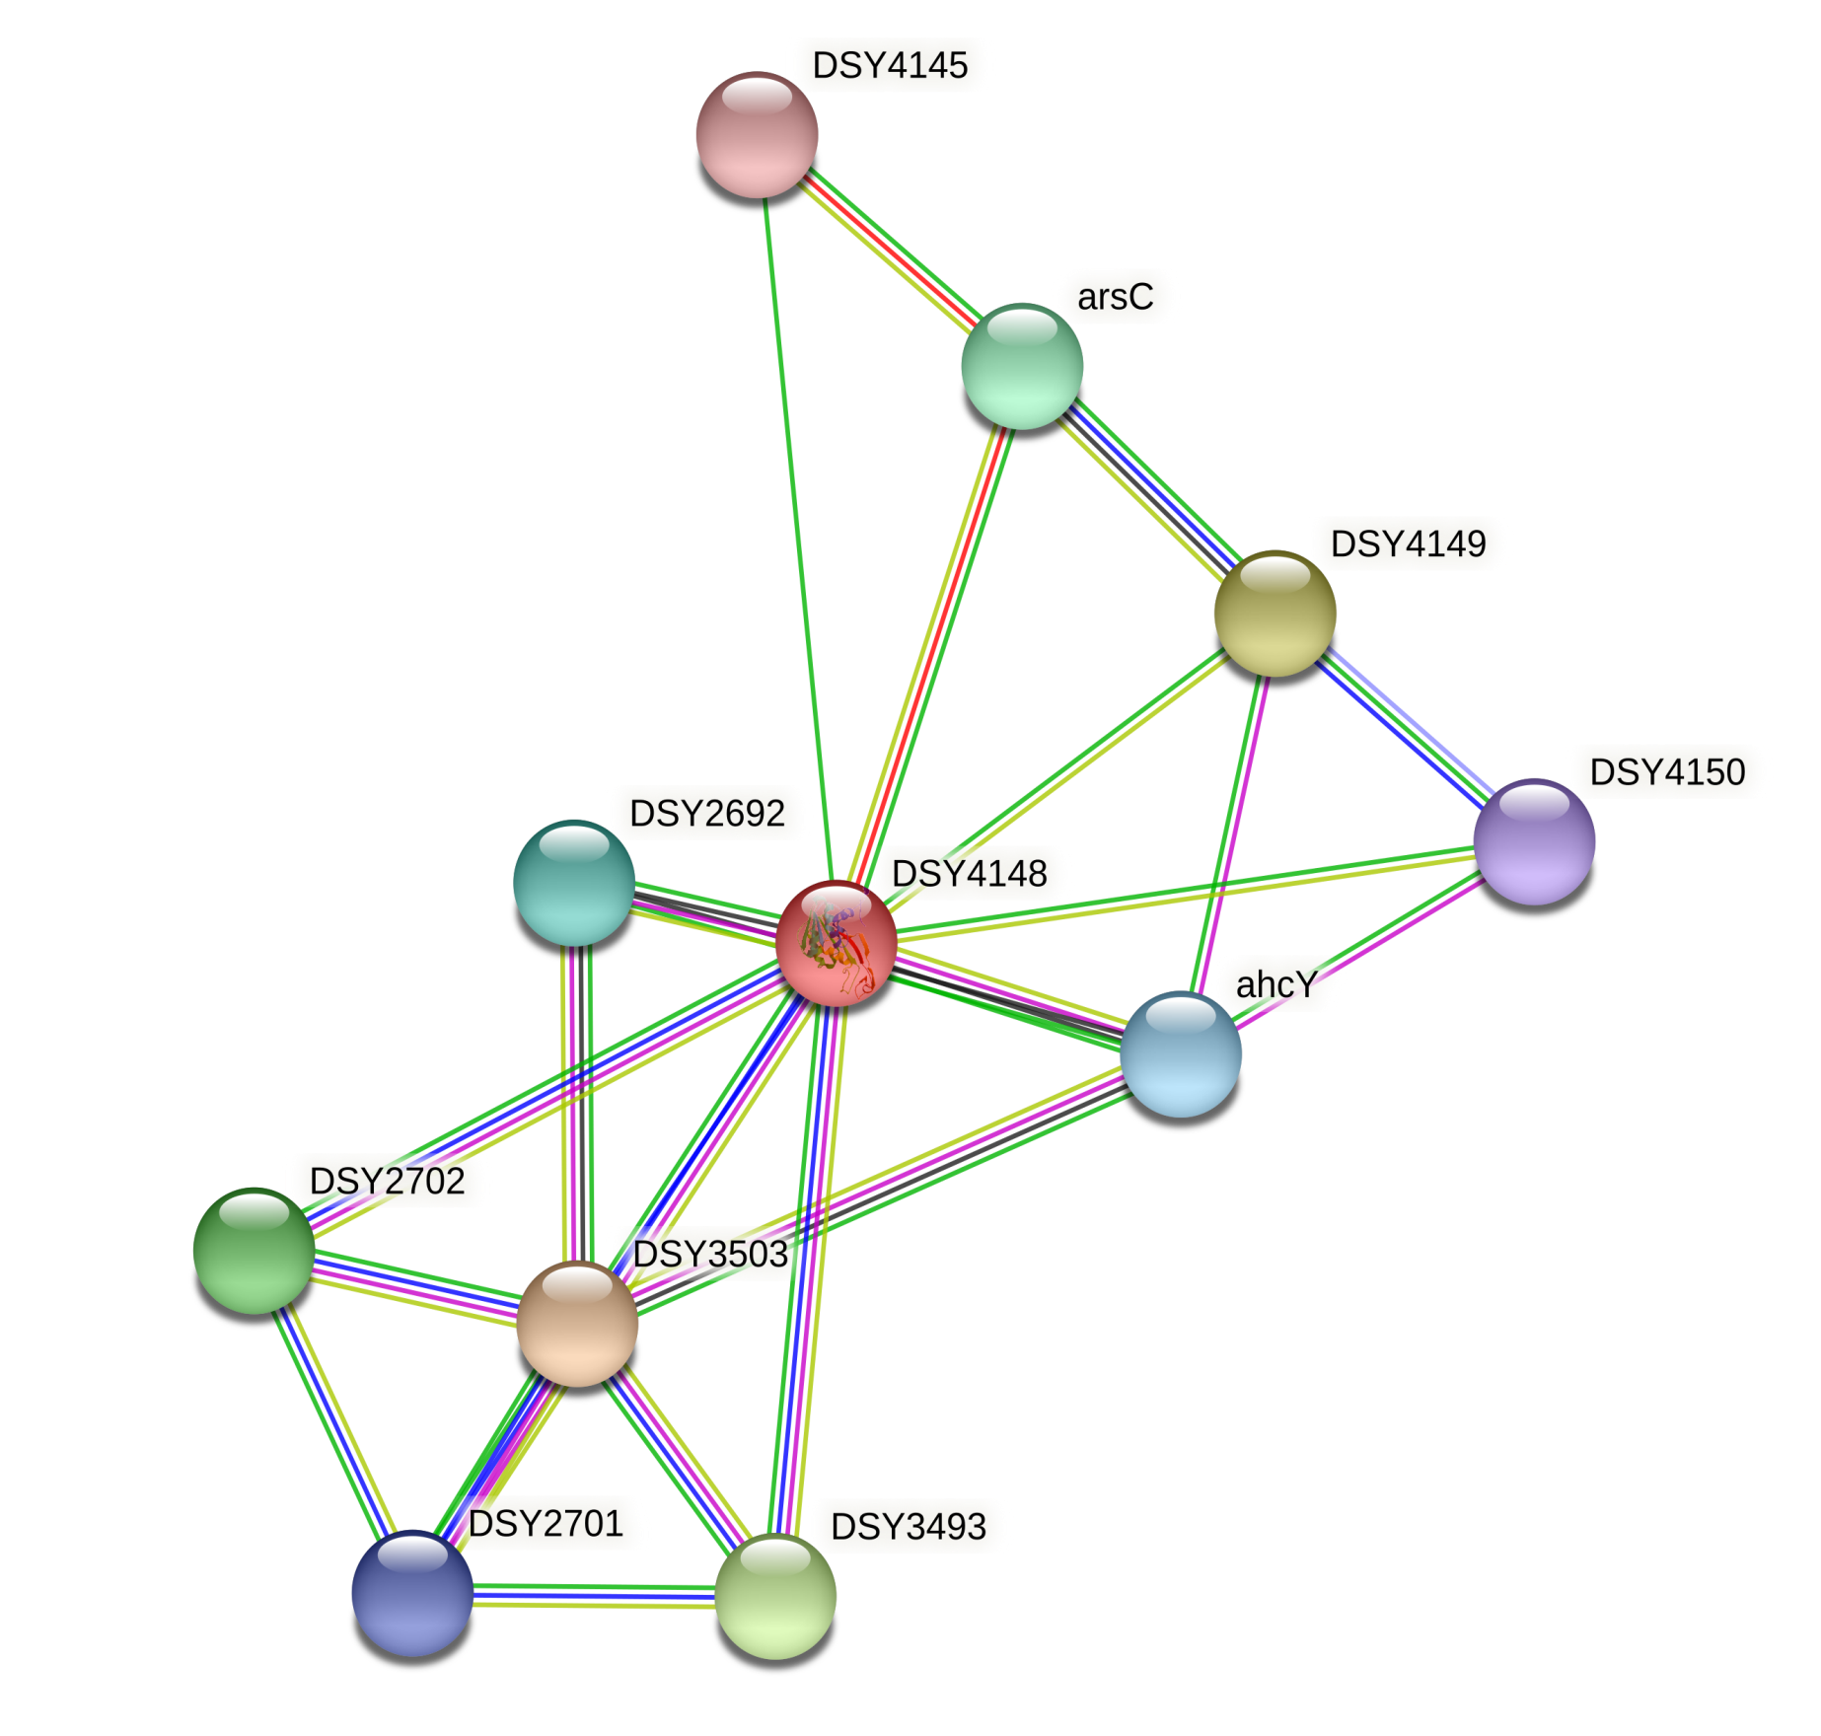
Result of STRING analysis of Clostridium sp. enzyme

Slide 2
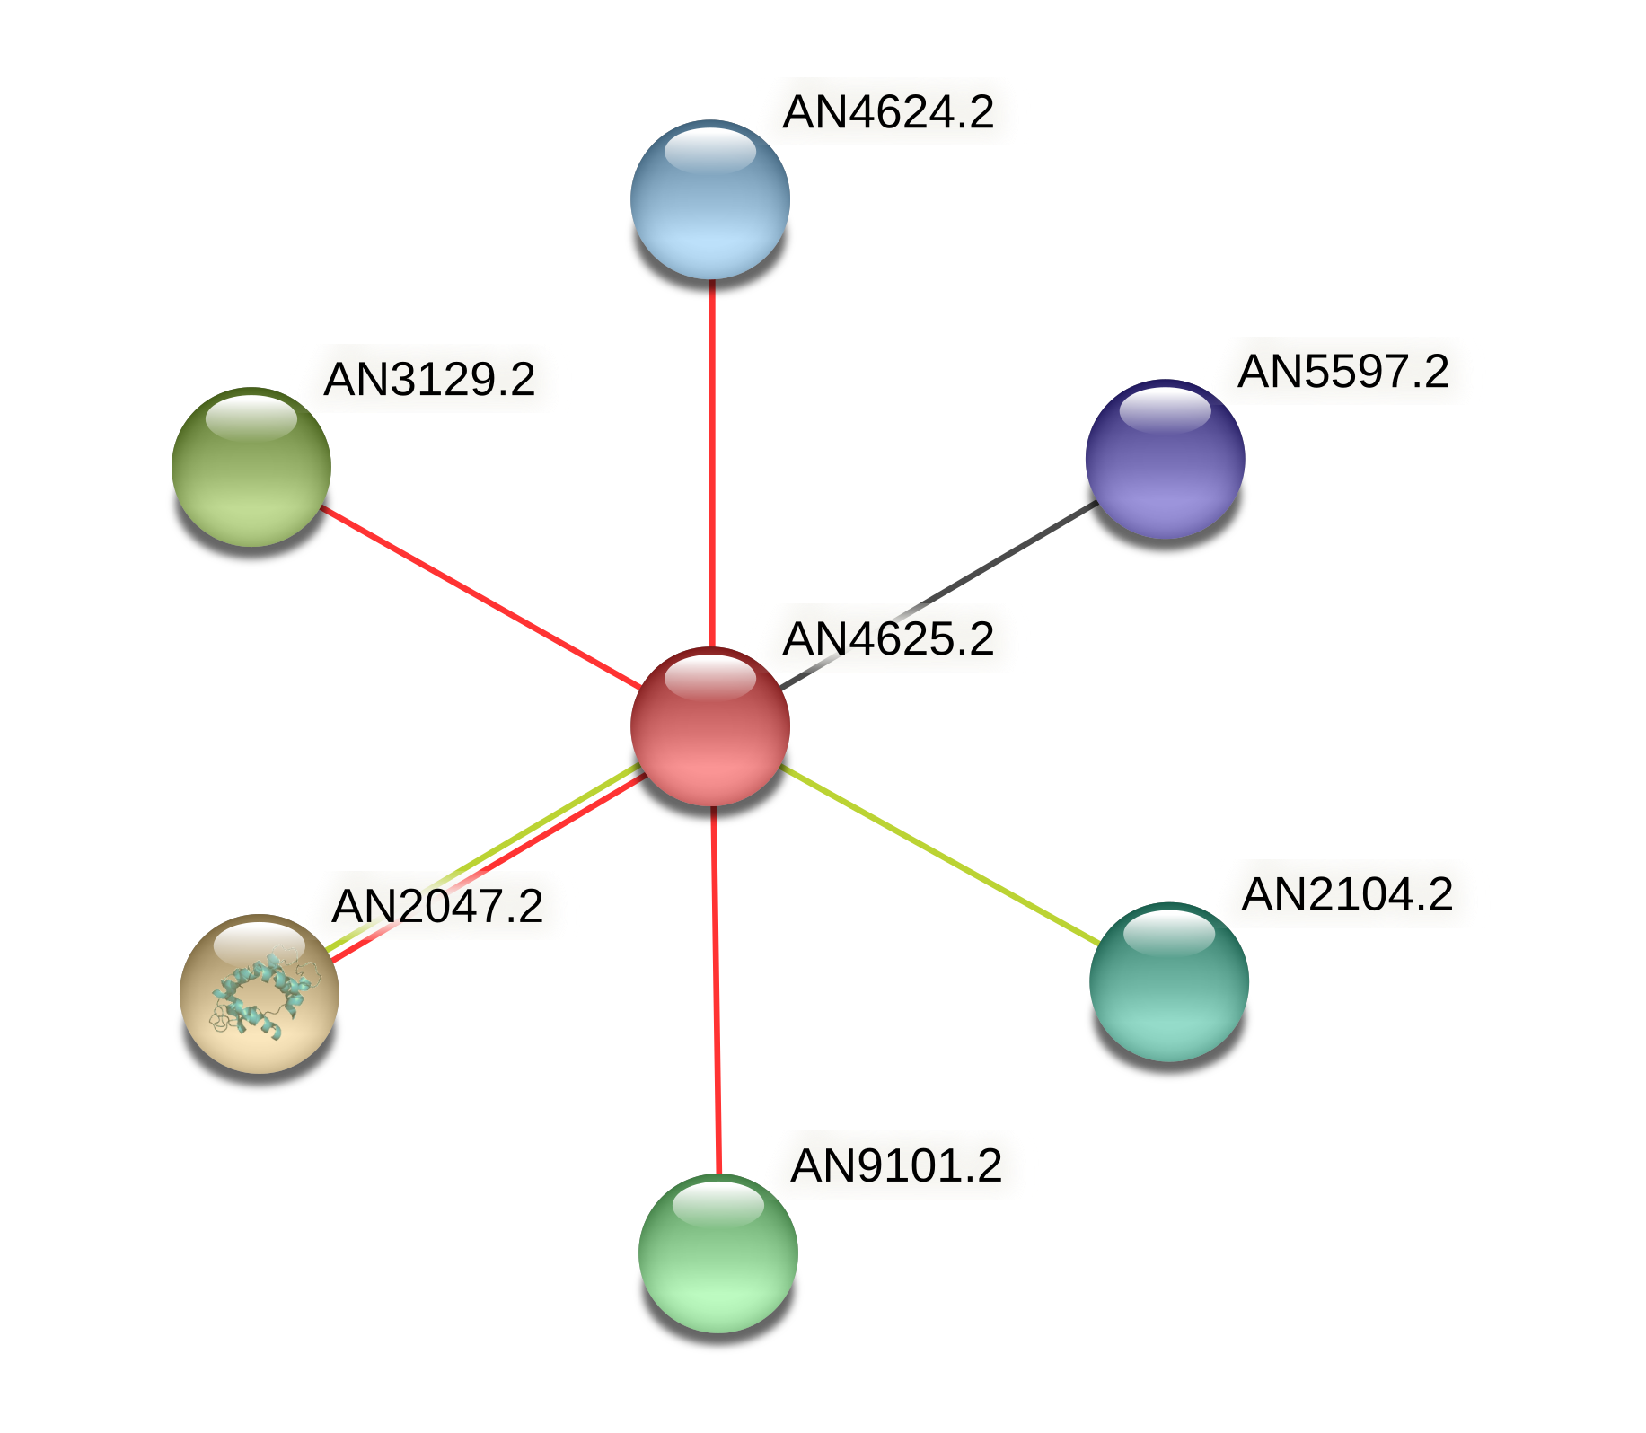
Result of STRING analysis of Armillaria solidipes enzyme

Slide 3
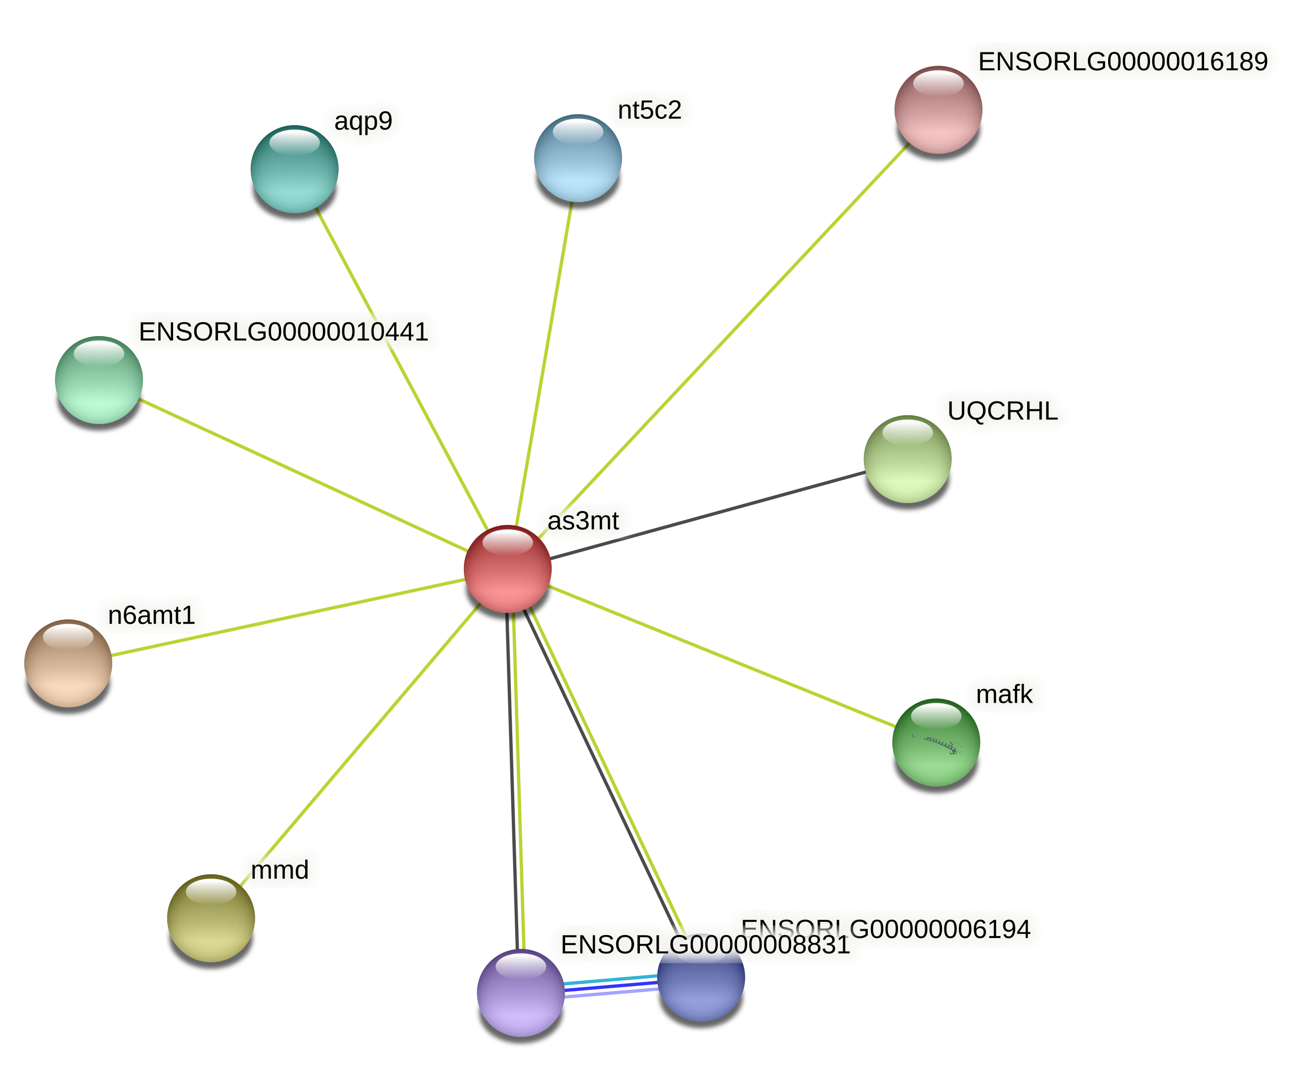
Result of STRING analysis of Oryzias latipes enzyme

Slide 4
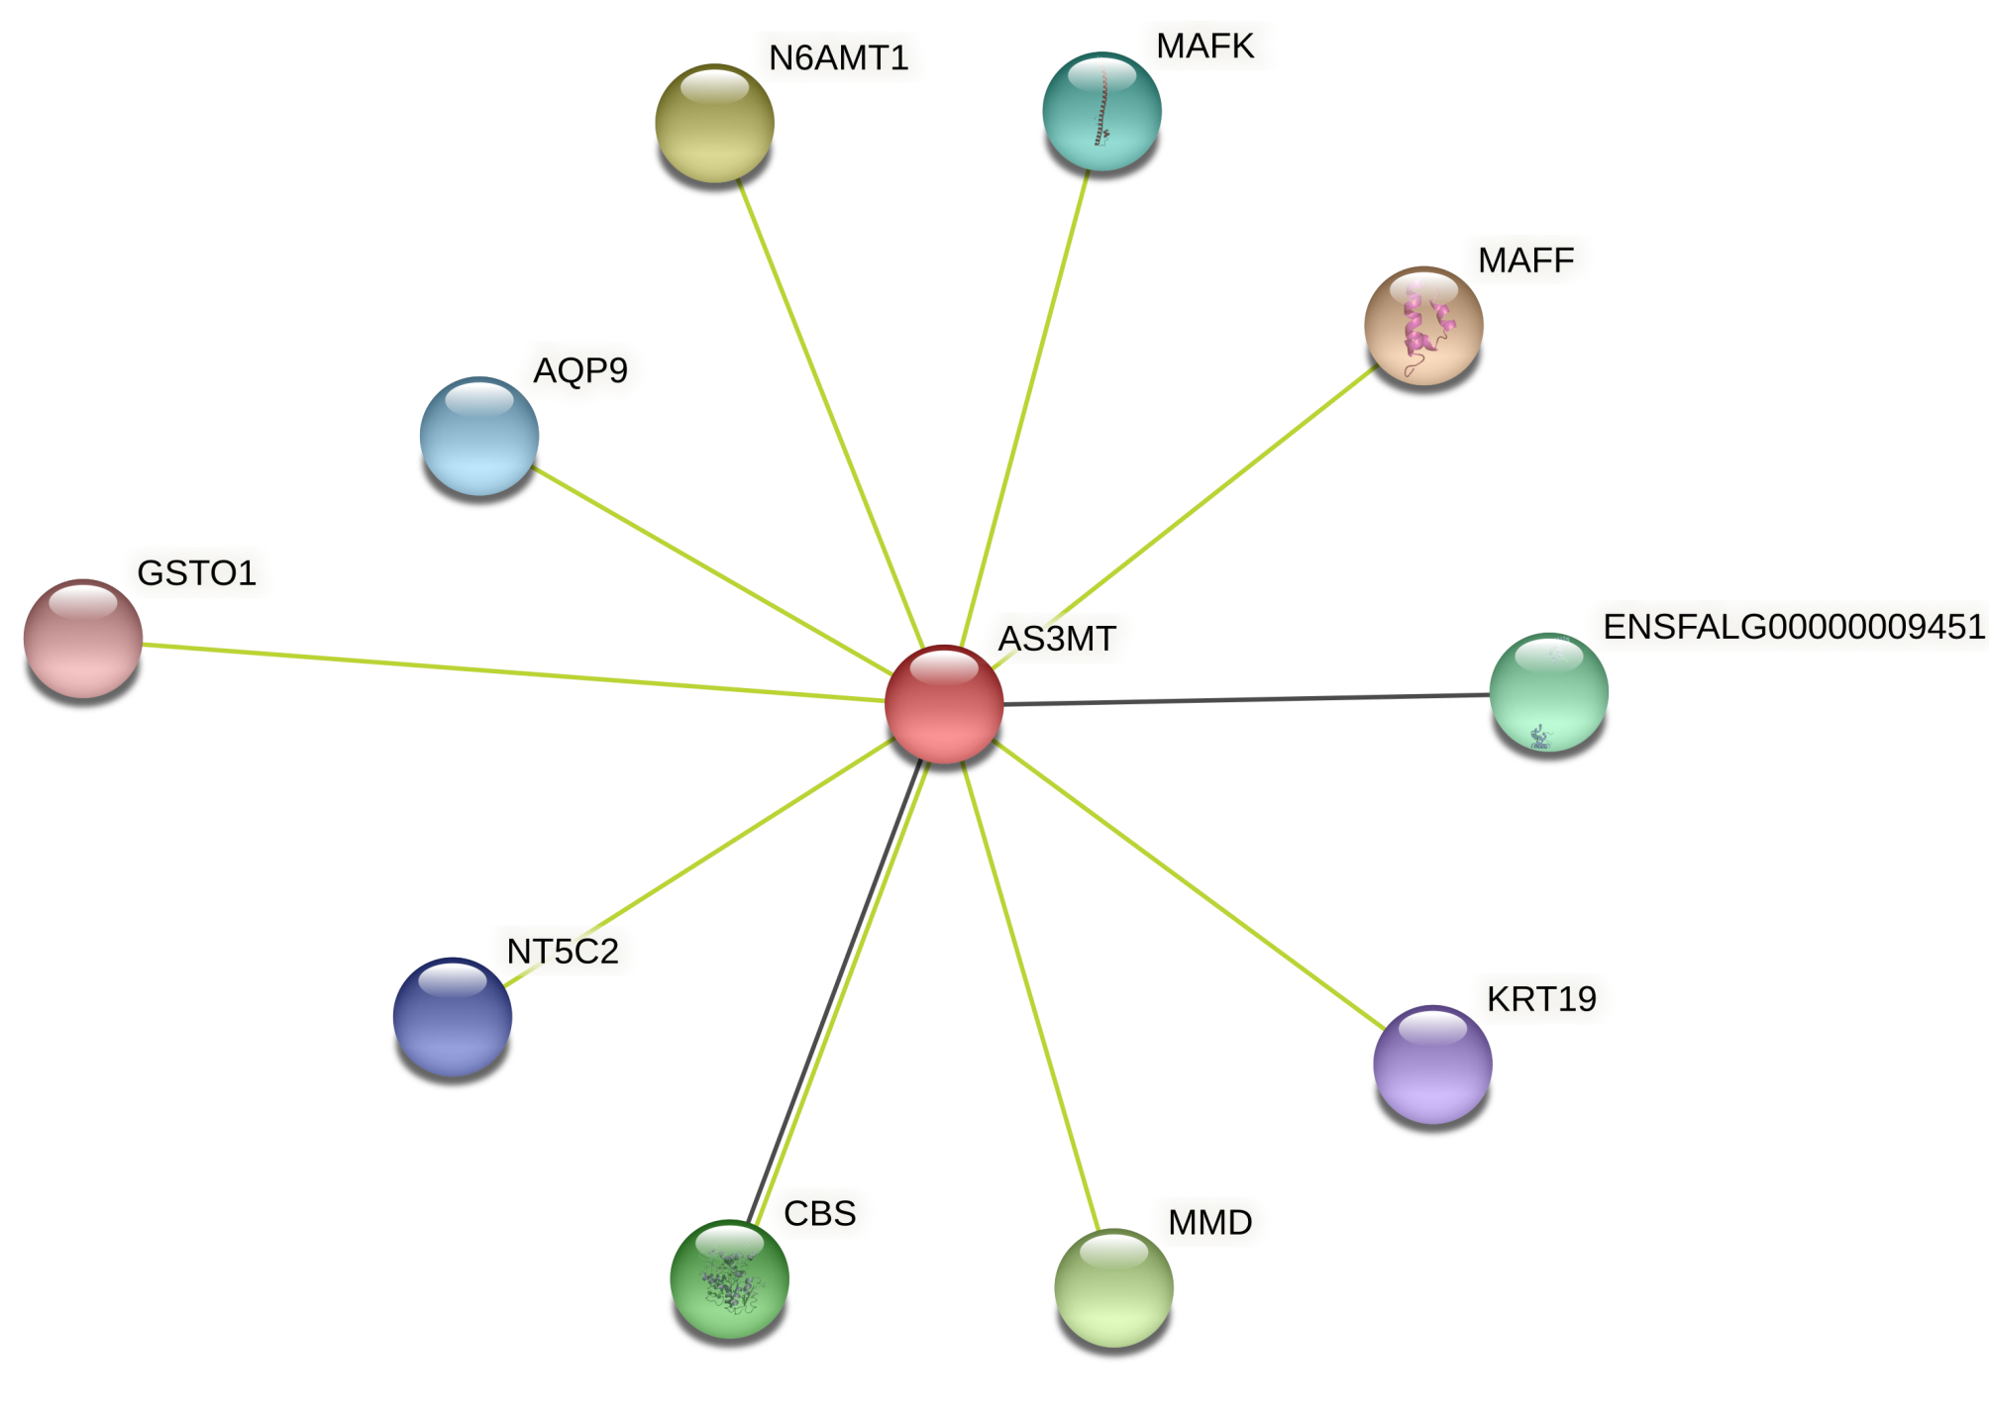
Result of STRING analysis of Dasyornis broadbenti enzyme

Slide 5
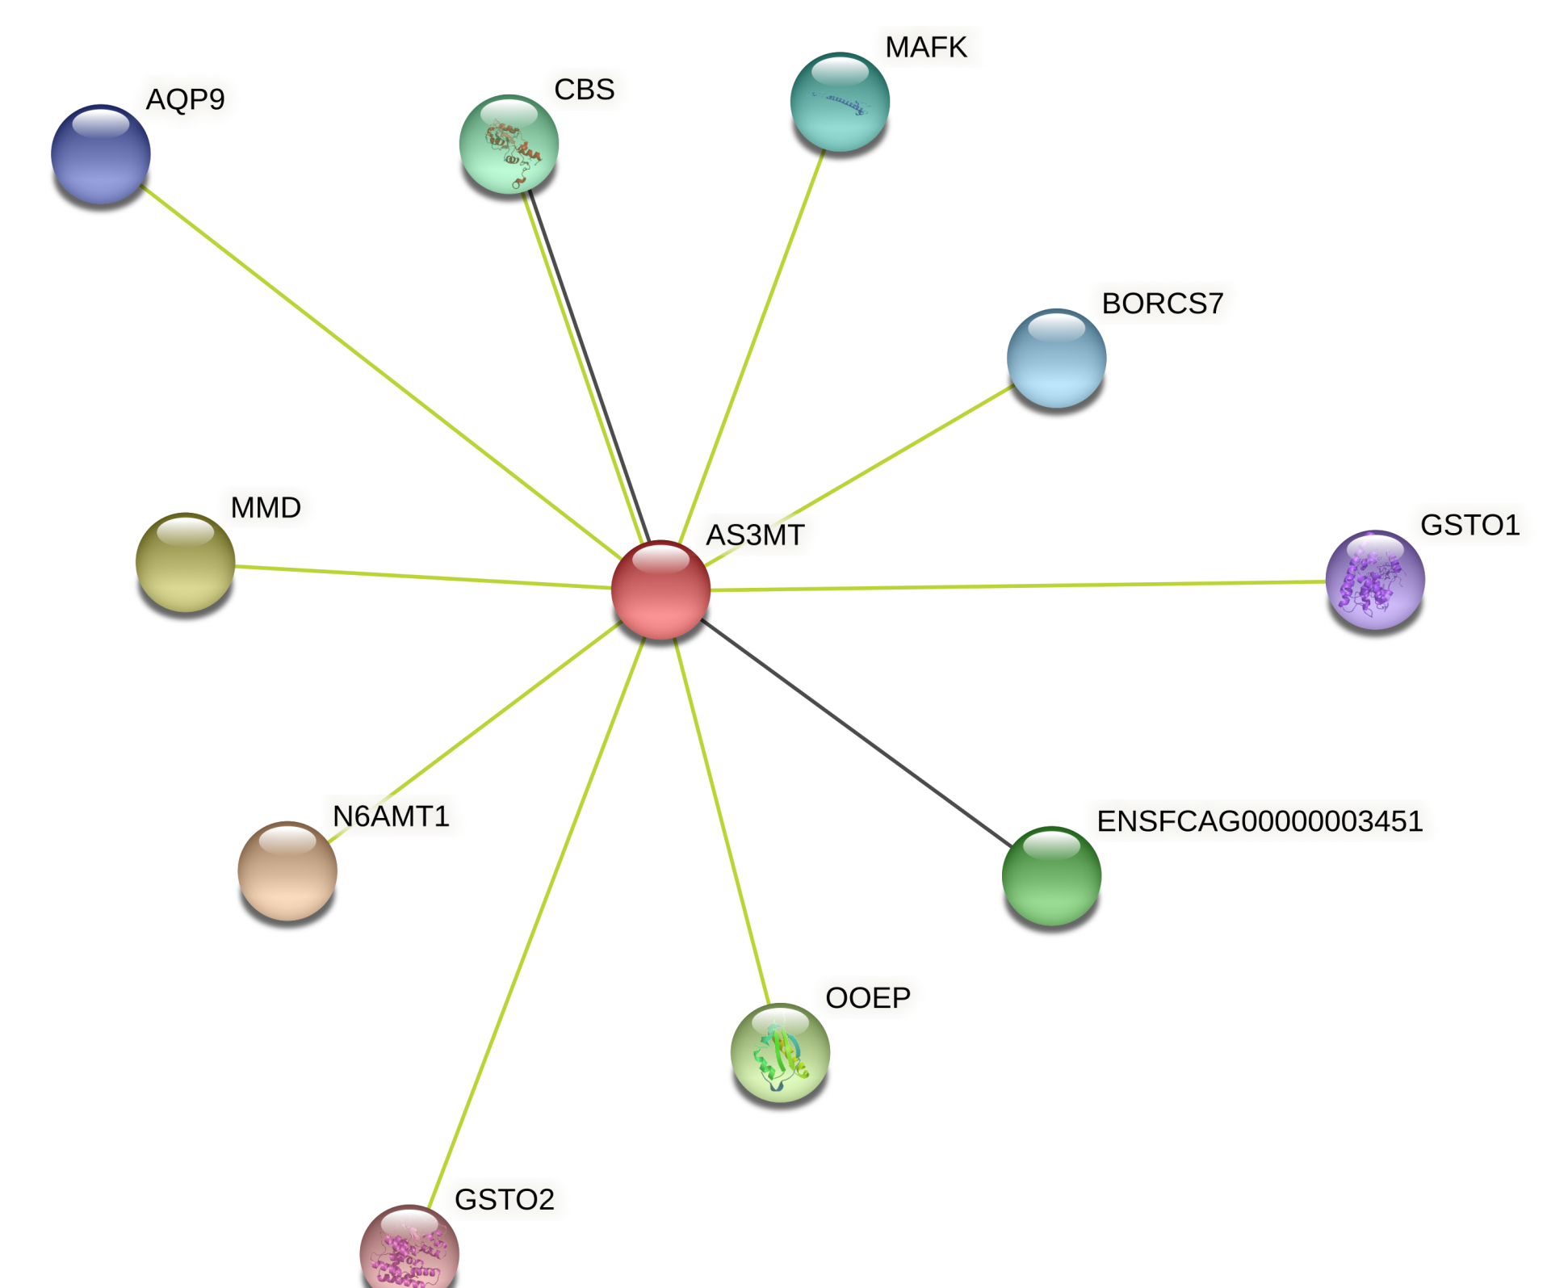
Result of STRING analysis of Felis catus enzyme

