Slide 1
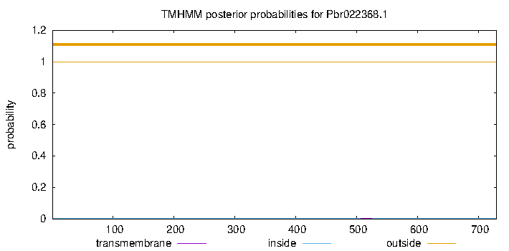
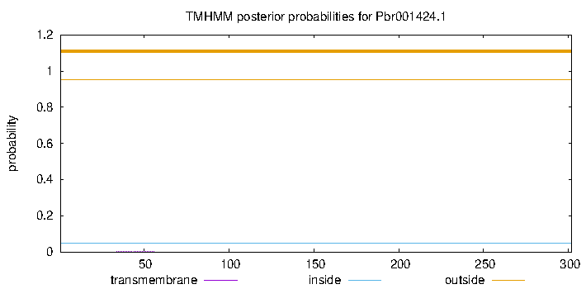
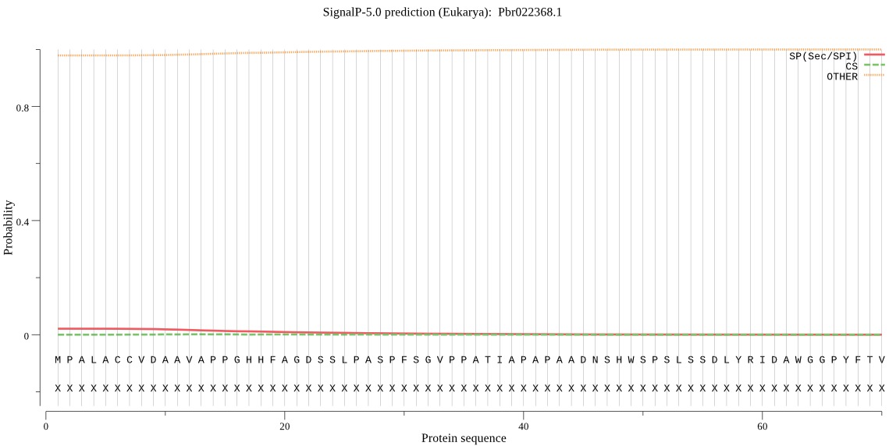
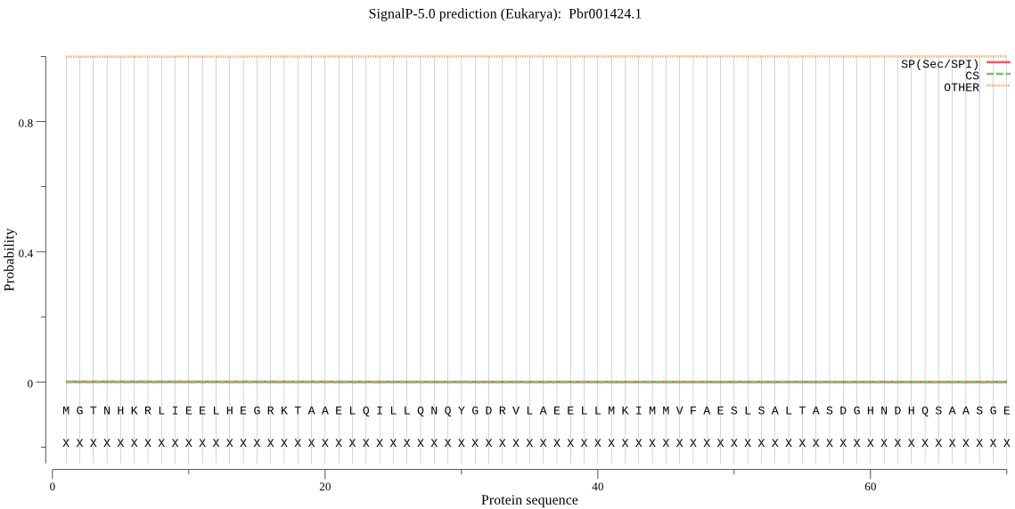
Fig. S5
a
a-i
a-ii
TMHMM posterior probabilities for PbrADC1
1.2
TMHMM posterior probabilities for PbrWRKY62
1.2
1.0
1.0
0.8
0.8
PbrADC1
Probability
PbrWRKY62
0.6
0.6
Probability
0.4
0.4
0.2
0.2
0.0
100
200
300
400
500
600
700
0.0
50
100
150
200
250
300
transmembrane
inside
outside
transmembrane
inside
outside
b
b-i
b-ii
SignalP-5.0 prediction (Eukarya): PbrADC1
SignalP-5.0 prediction (Eukarya): PbrWRKY62
0.8
0.8
0.4
PbrADC1
0.4
PbrWRKY62
Probability
Probability
0.0
0.0
0
20
40
60
0
20
40
60
Protein sequence
Protein sequence

