Slide 1
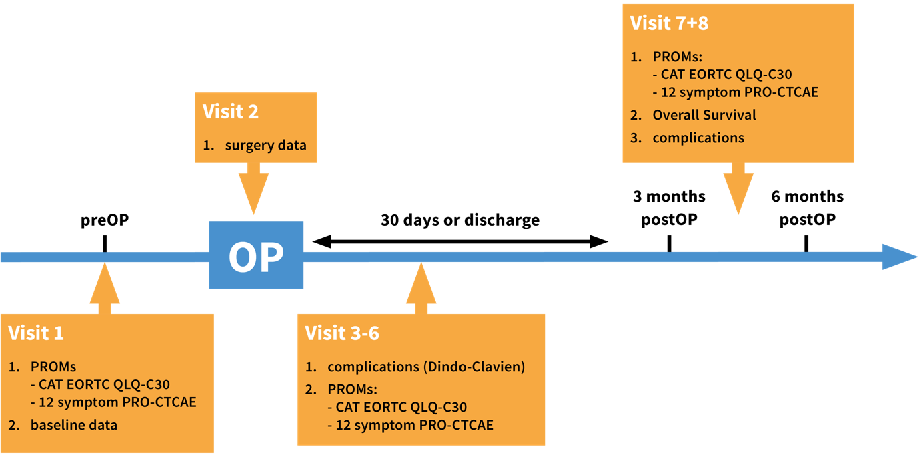
Supplementary figure 1. Patient’s schedule for visits 1 to 8 for the PATRONUS study.

