Slide 1
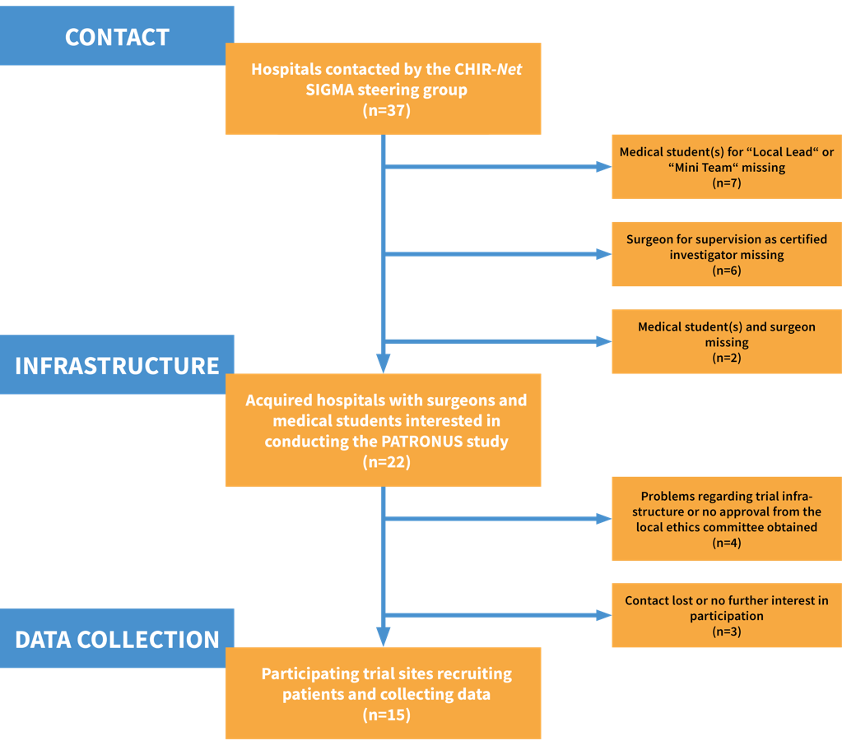
Supplementary figure 2. Flowchart illustrating the acquisition of study centers in the PATRONUS study.

