Slide 1
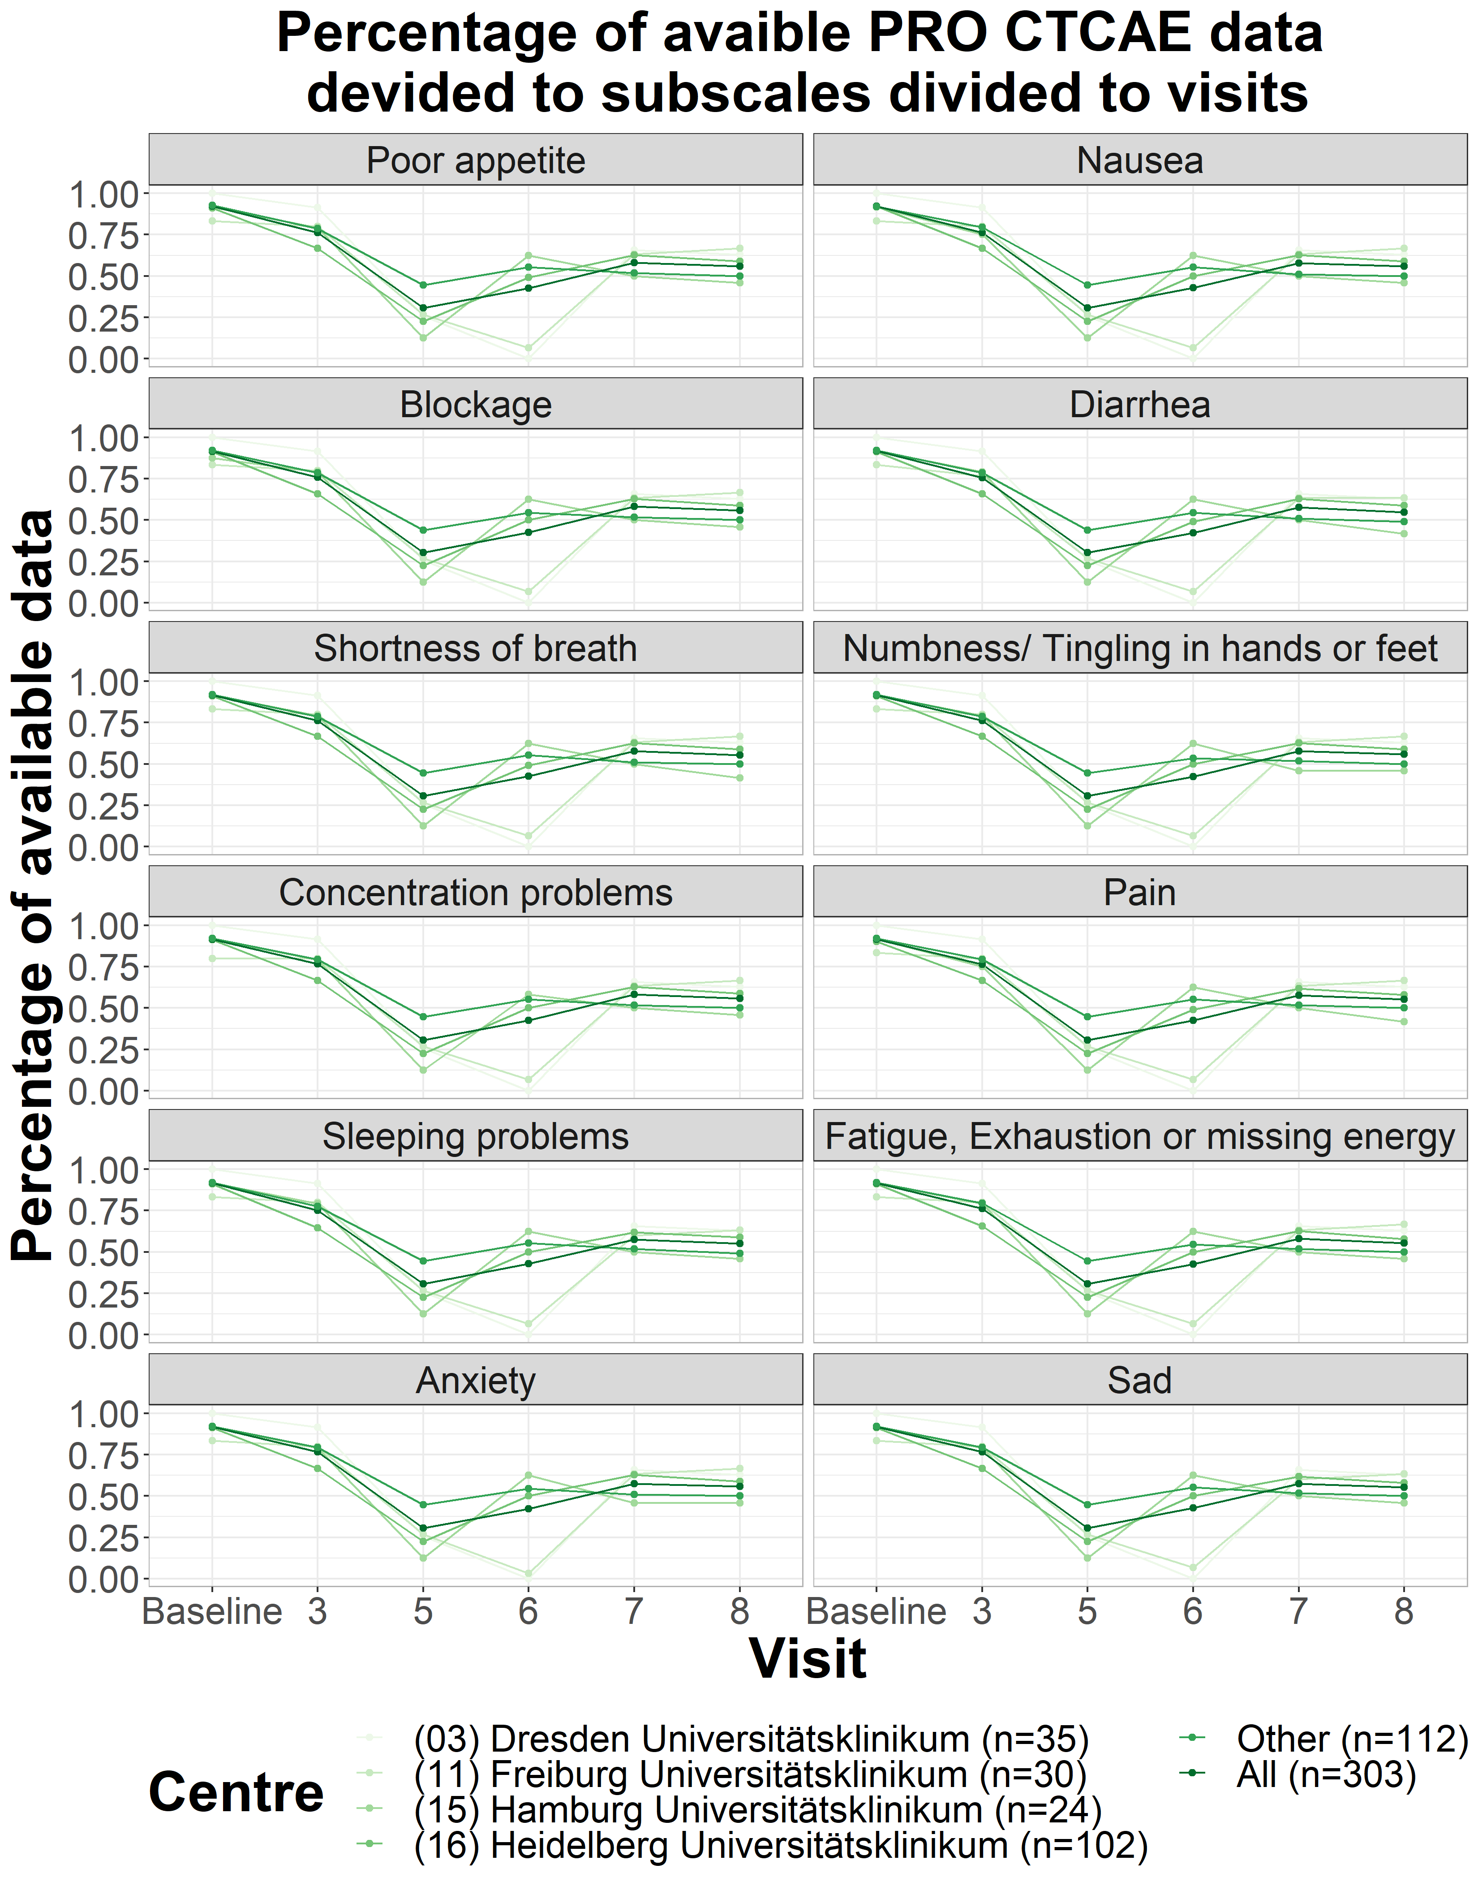
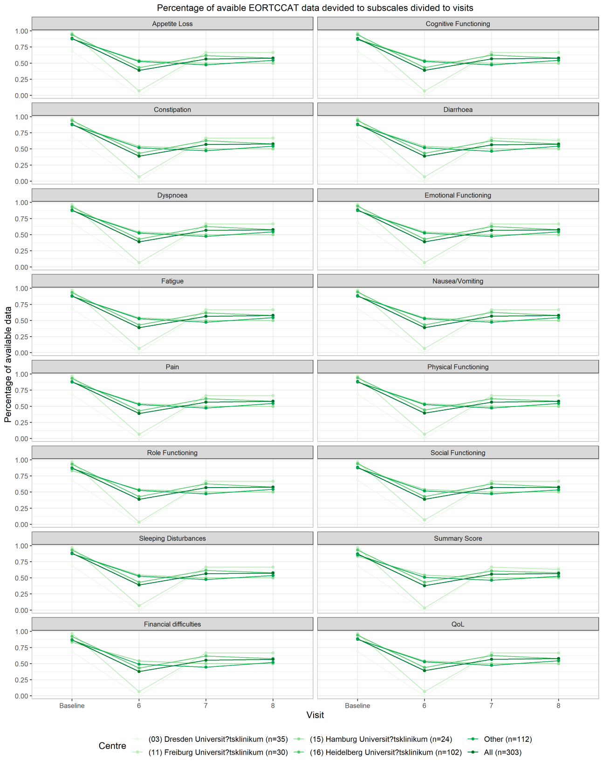
A.
B.
Supplementary figure 3. Completeness of PRO data for all study visits.
Notes:
Supplementary figure 3. Completeness of PRO data for all study visits.

