Slide 1
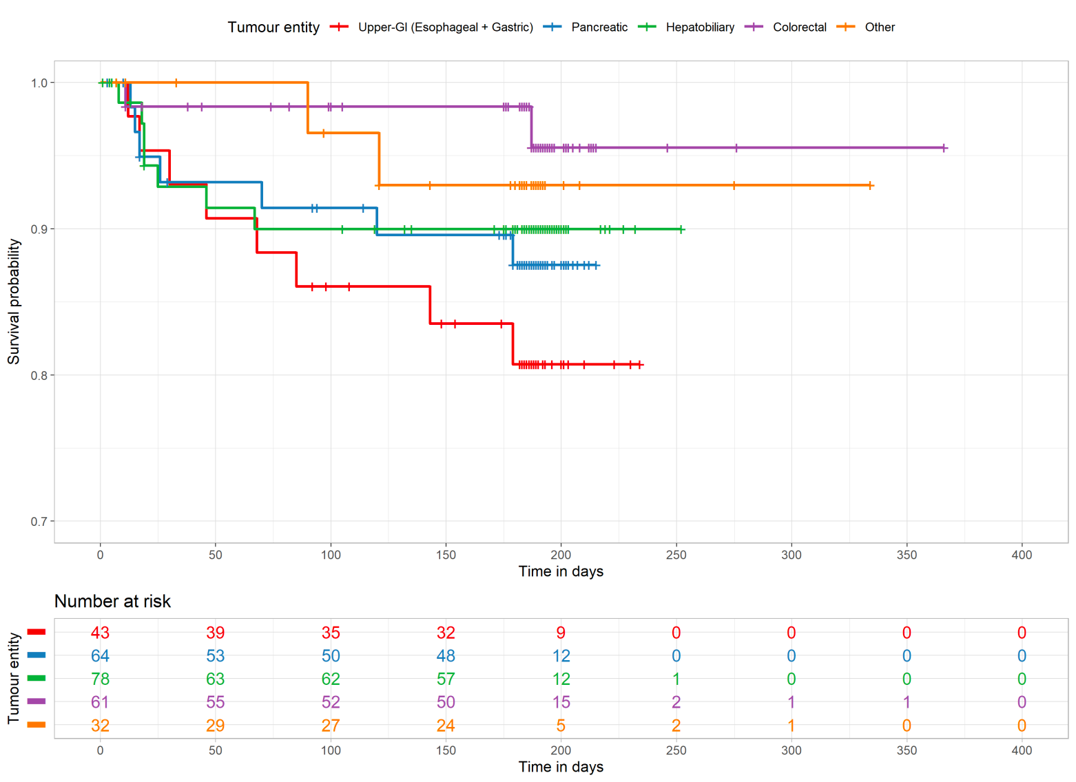
Supplementary figure 4. Kaplan-Meier curves showing the survival of included patients according to tumor entity.

