Slide 1
Supplementary Figures S1–S5
A Neuron Projection Guidance signature associates with immune-cold tumor microenvironment and poor outcomes in breast cancer
Kei Kawashima MD1,2, Kohei Chida MD1, Masanori Oshi MD, PhD2, Akimitsu Yamada MD, PhD2, Kazutaka Narui MD, PhD3, Shipra Gandhi MD4, John M. L. Ebos PhD5, Scott I. Abrams PhD6, Arin Bhattacharjee PhD7, Itaru Endo MD, PhD2, Kazuaki Takabe, MD, PhD, FACS, FSSO1,2,8,9,10,11
1 Department of Surgical Oncology, Roswell Park Comprehensive Cancer Center, Buffalo, NY 14263, USA
2 Department of Gastroenterological Surgery, Yokohama City University Graduate School of Medicine, Kanagawa, 236-0004, Japan
3 Department of Breast and Thyroid Surgery, Yokohama City University Medical Center, 4-57 Urafune-cho, Minami-ku, Yokohama City, Kanagawa, 232-0024, Japan.
4 Department of Medicine, Winship Cancer Institute of Emory University, Atlanta, GA, USA.
5 Department of Cancer Genetics and Genomics, Roswell Park Comprehensive Cancer Center, Buffalo, NY, USA.
6 Department of Immunology, Roswell Park Comprehensive Cancer Center, Buffalo, NY, USA
7 Department of Pharmacology and Toxicology, University at Buffalo Jacobs School of Medicine and Biomedical Sciences, the State University of New York, Buffalo, NY, USA
8 Department of Surgery, University at Buffalo Jacobs School of Medicine and Biomedical Sciences, the State University of New York, Buffalo, NY, USA
9 Division of Digestive and General Surgery, Niigata University Graduate School of Medical and Dental Sciences, Niigata, Japan
10 Department of Breast Surgery and Oncology, Tokyo Medical University, Tokyo, Japan
11 Department of Breast Surgery, Fukushima Medical University, Fukushima, Japan

Slide 2
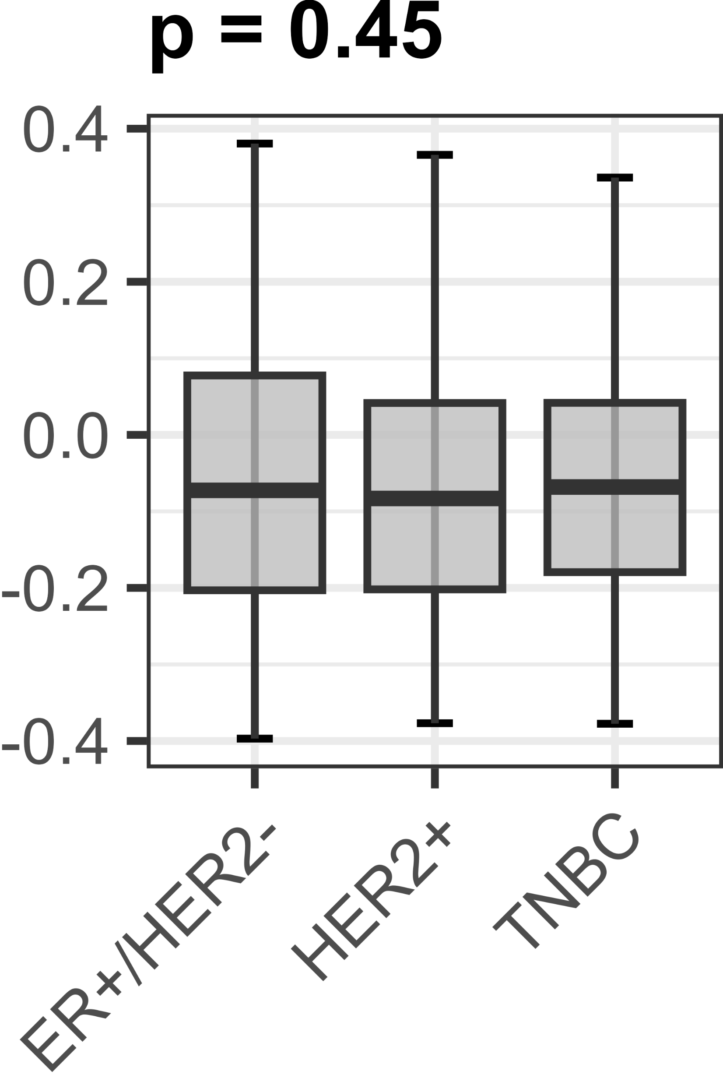
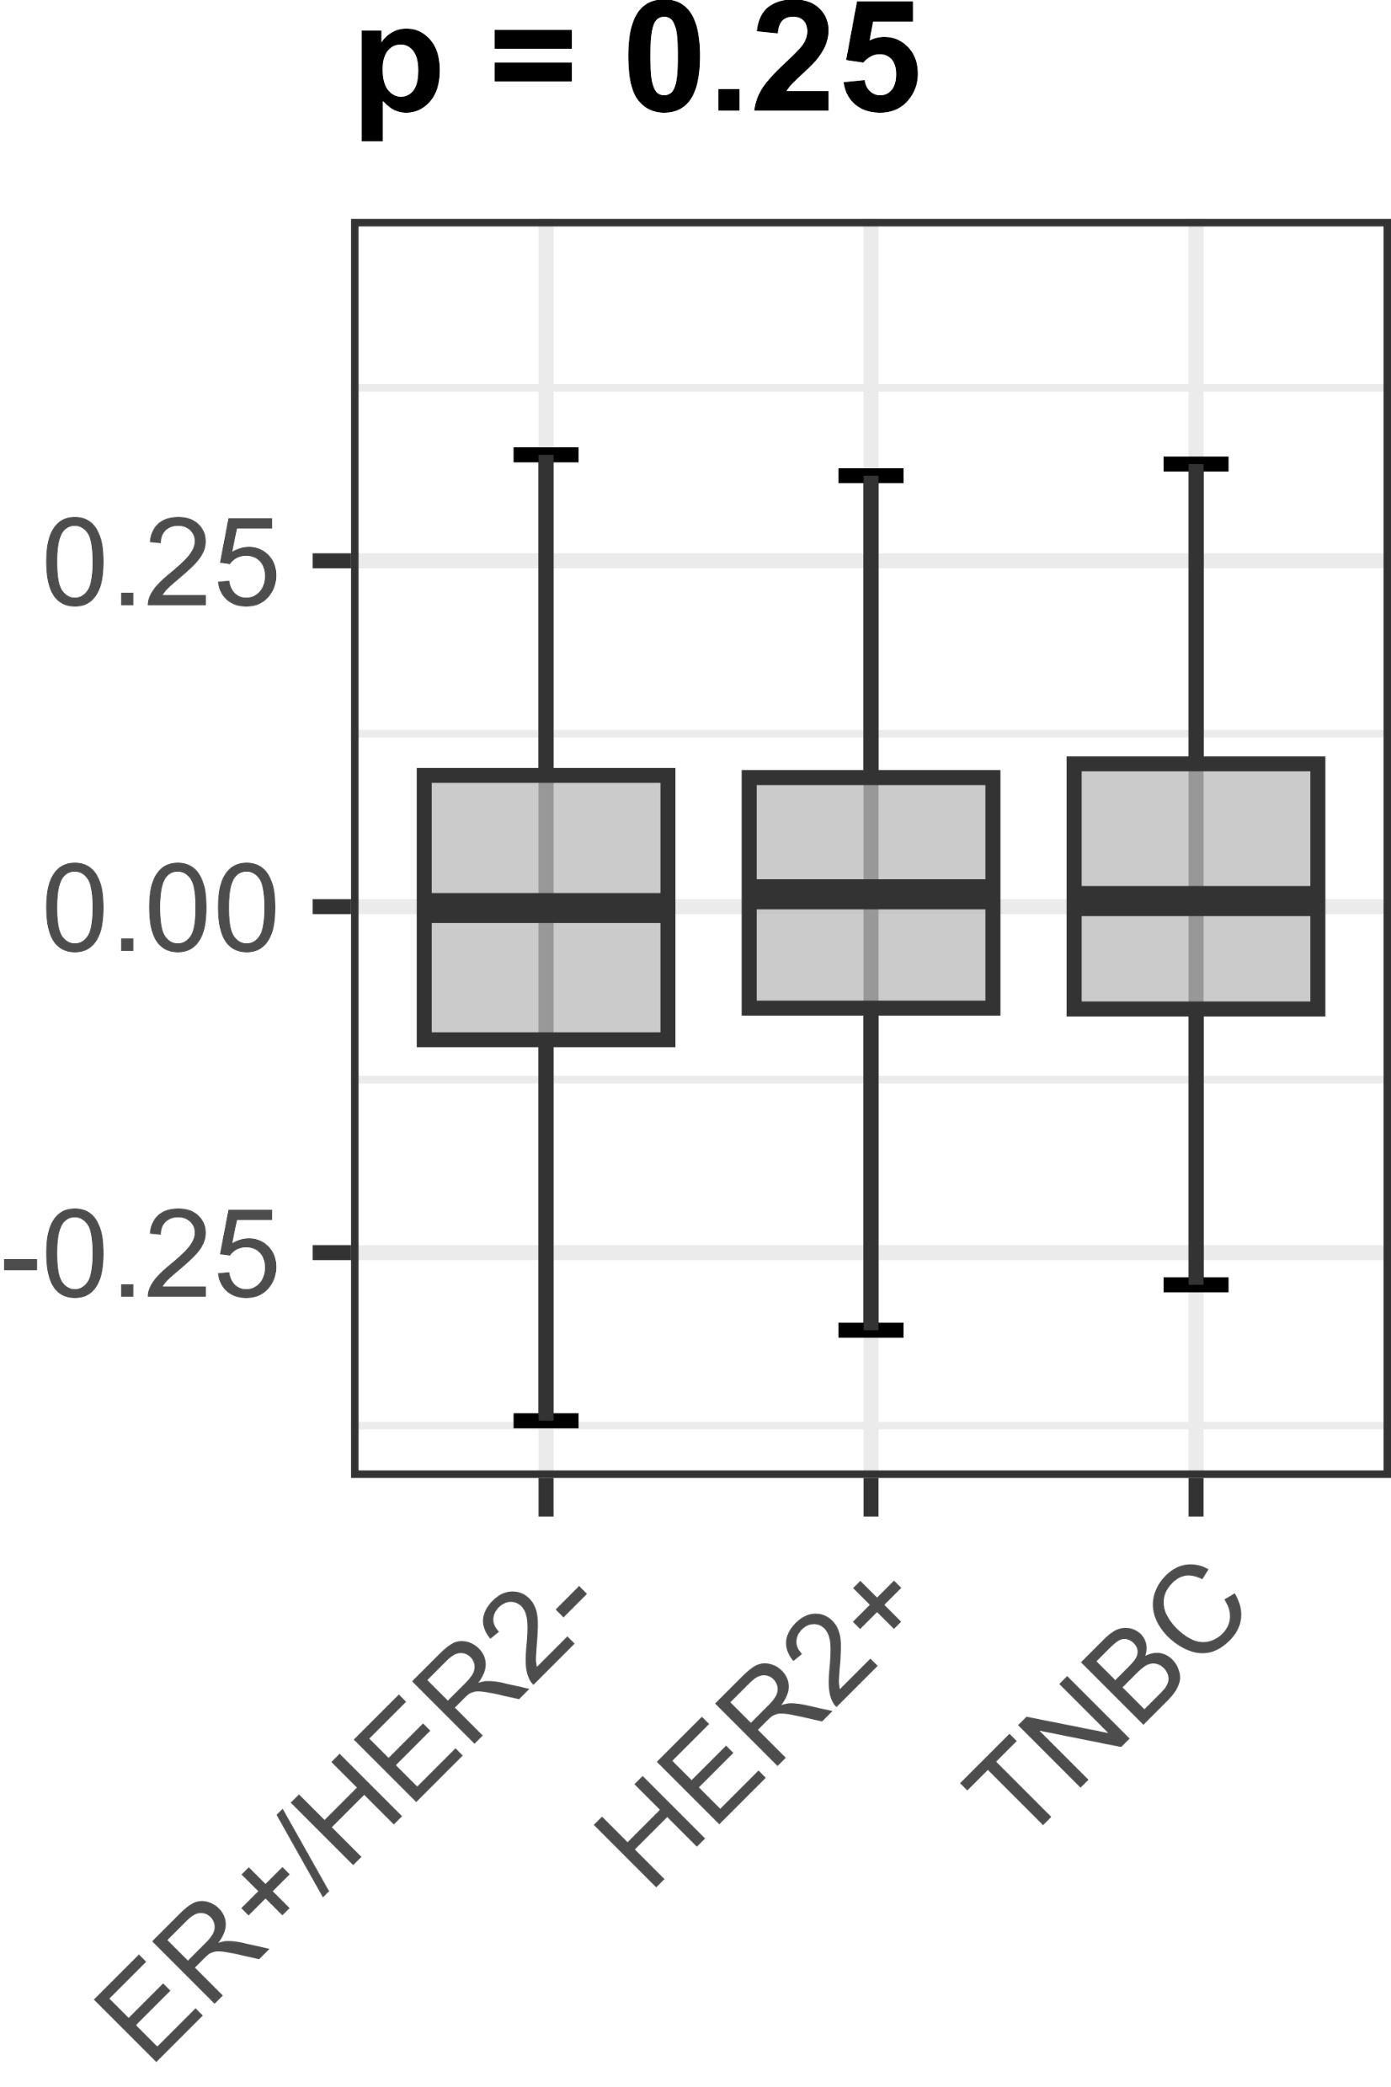
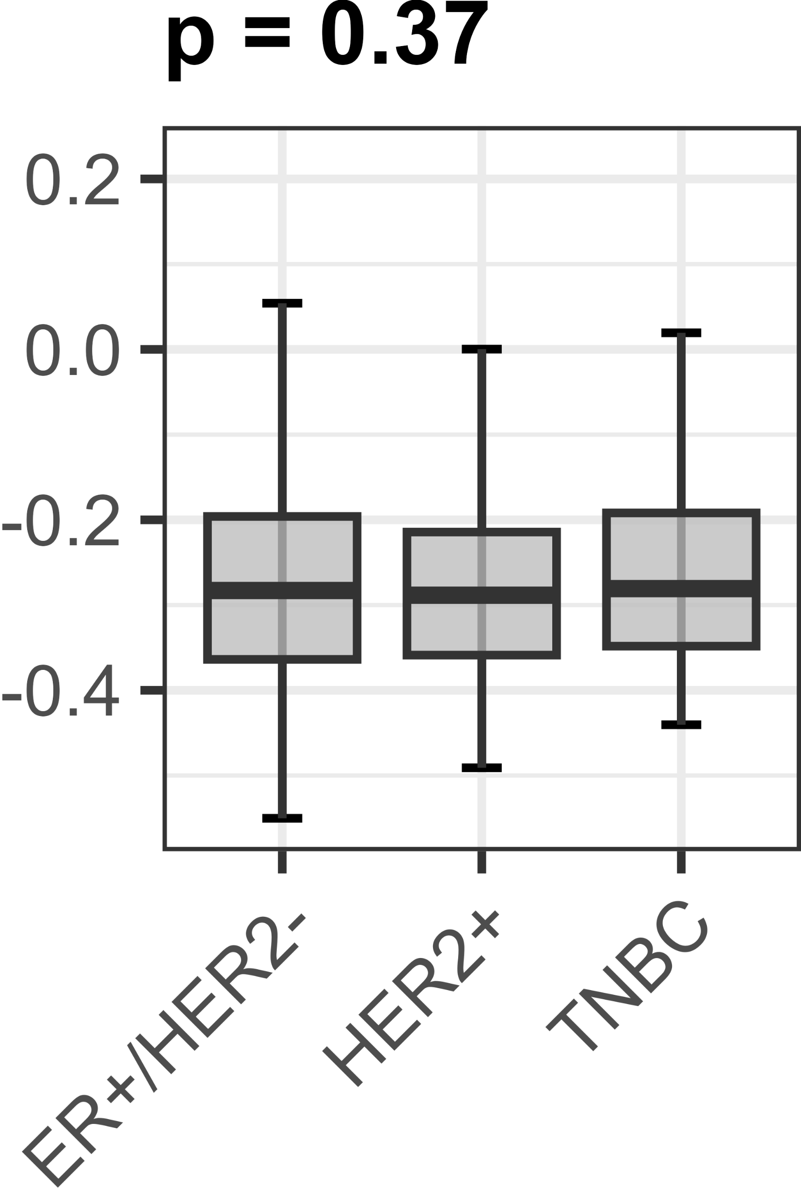
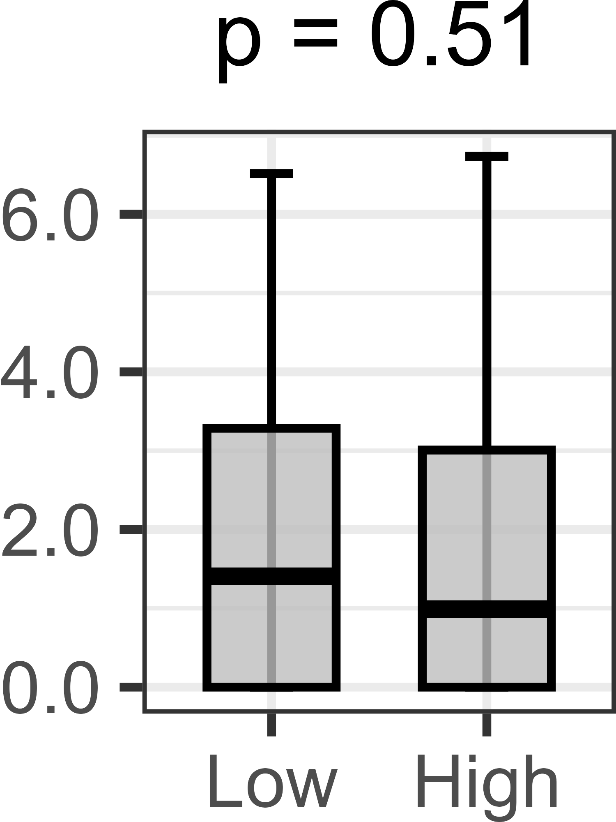
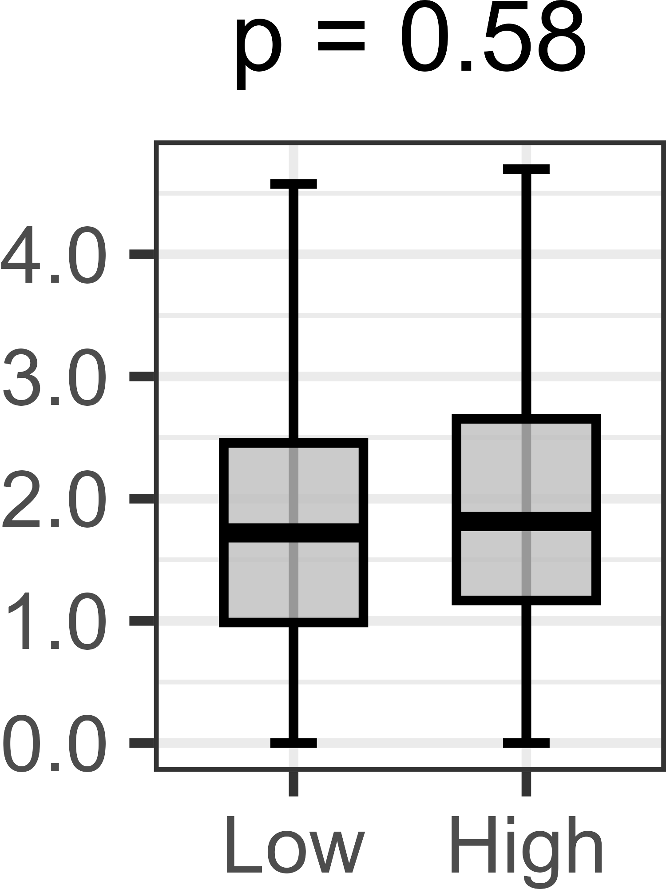
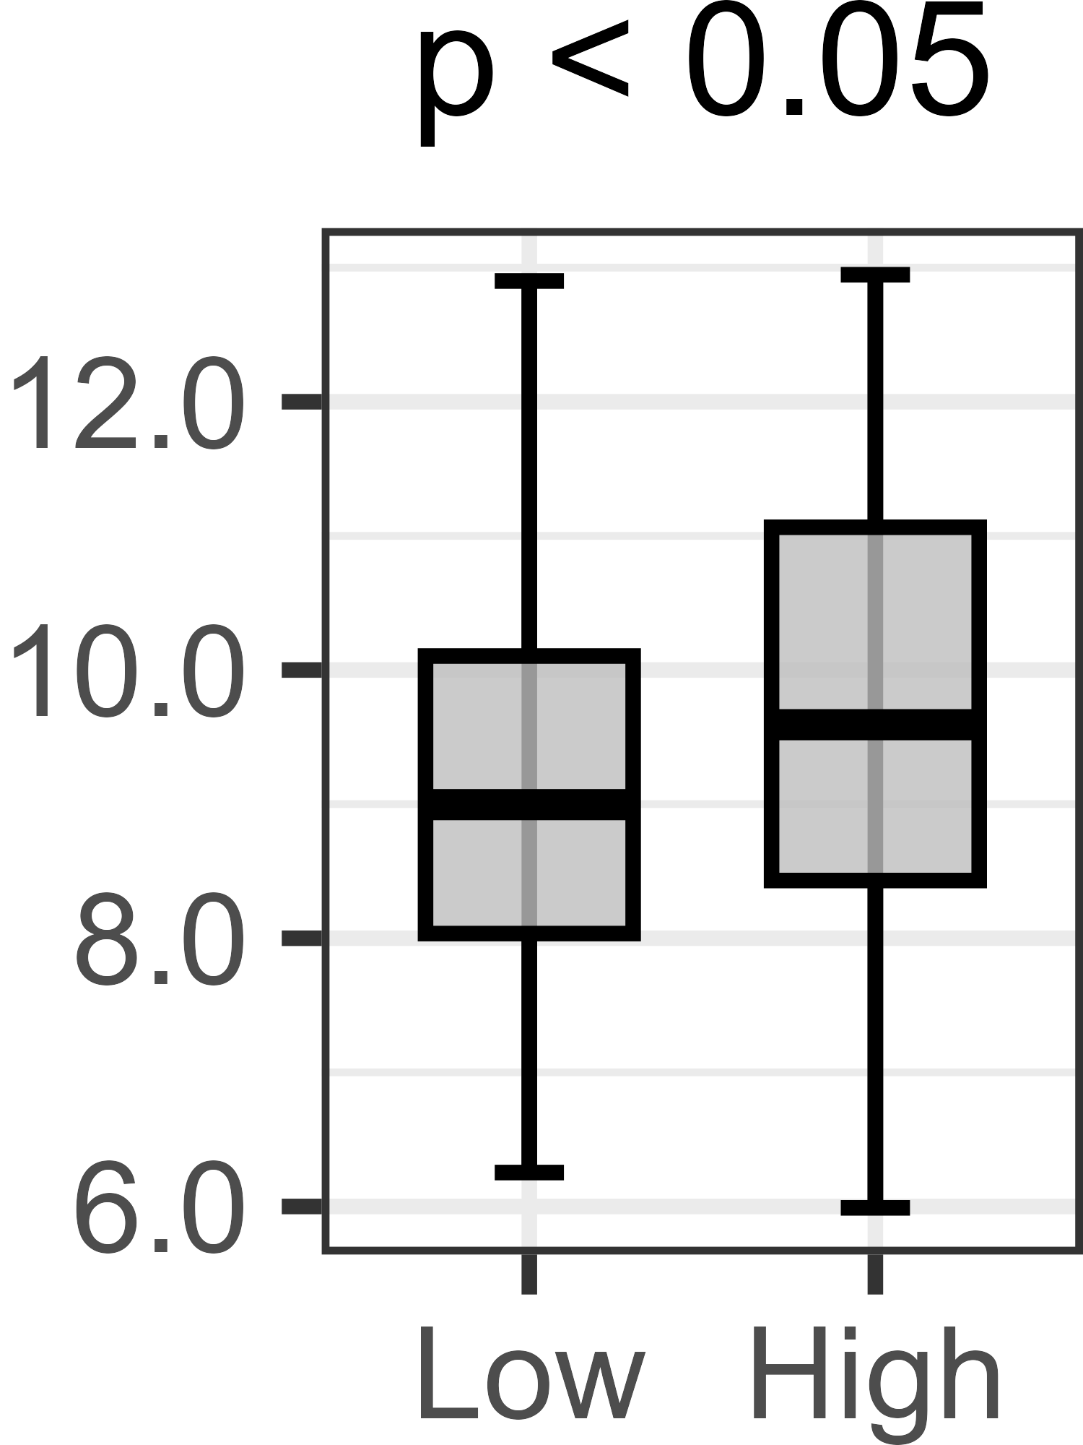
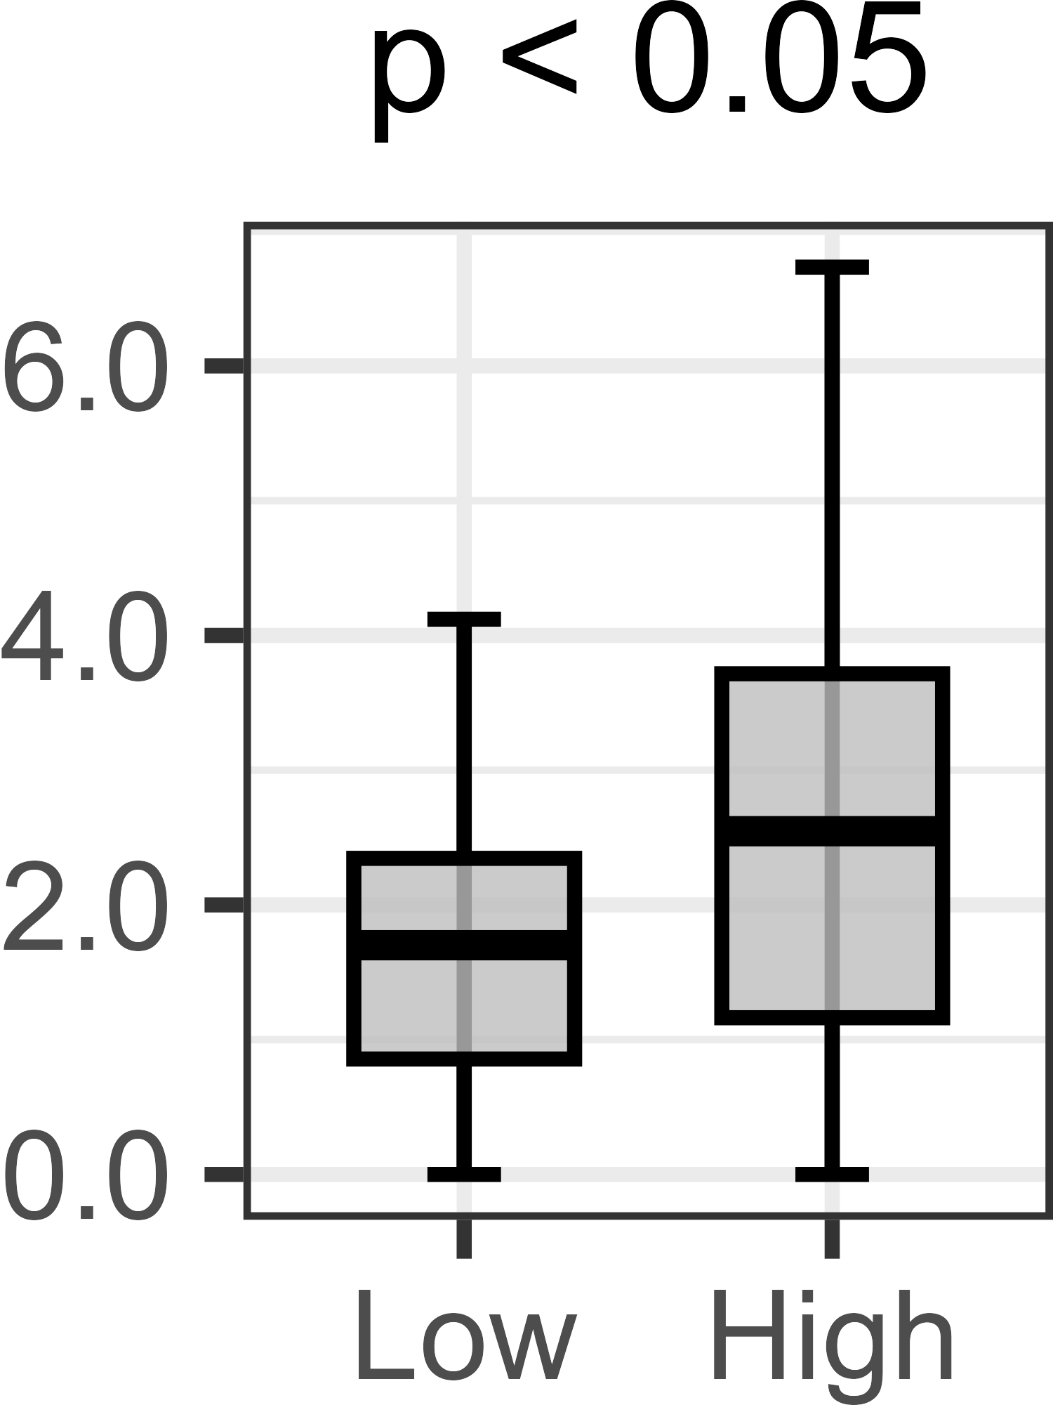
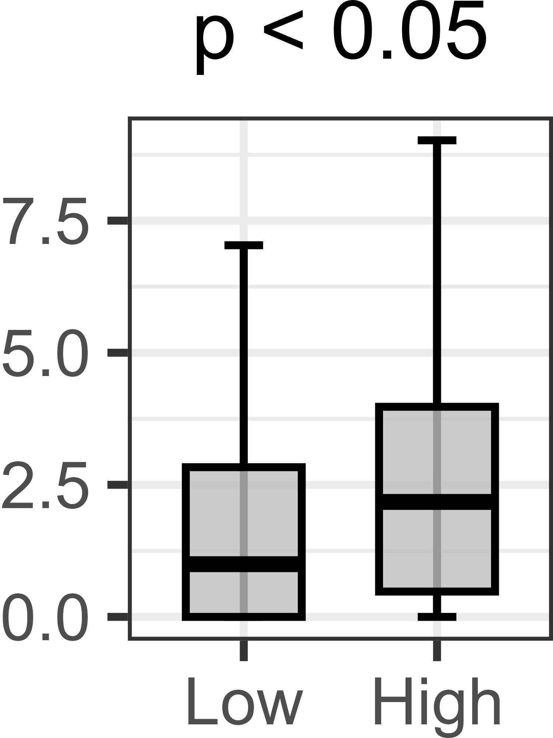
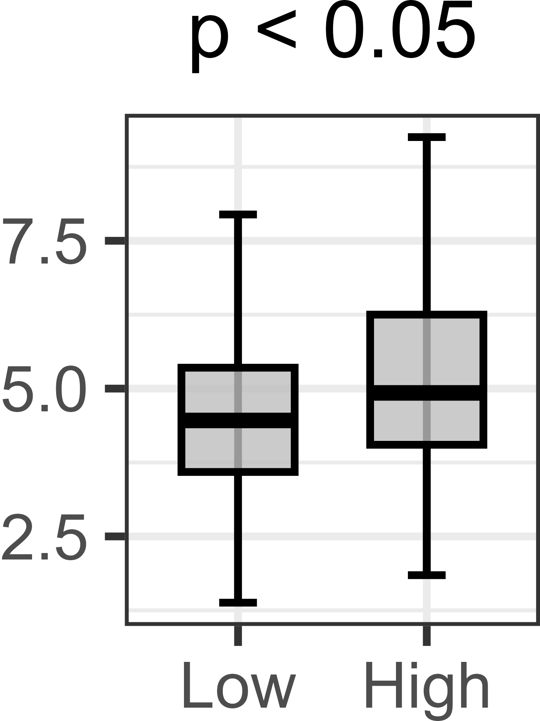
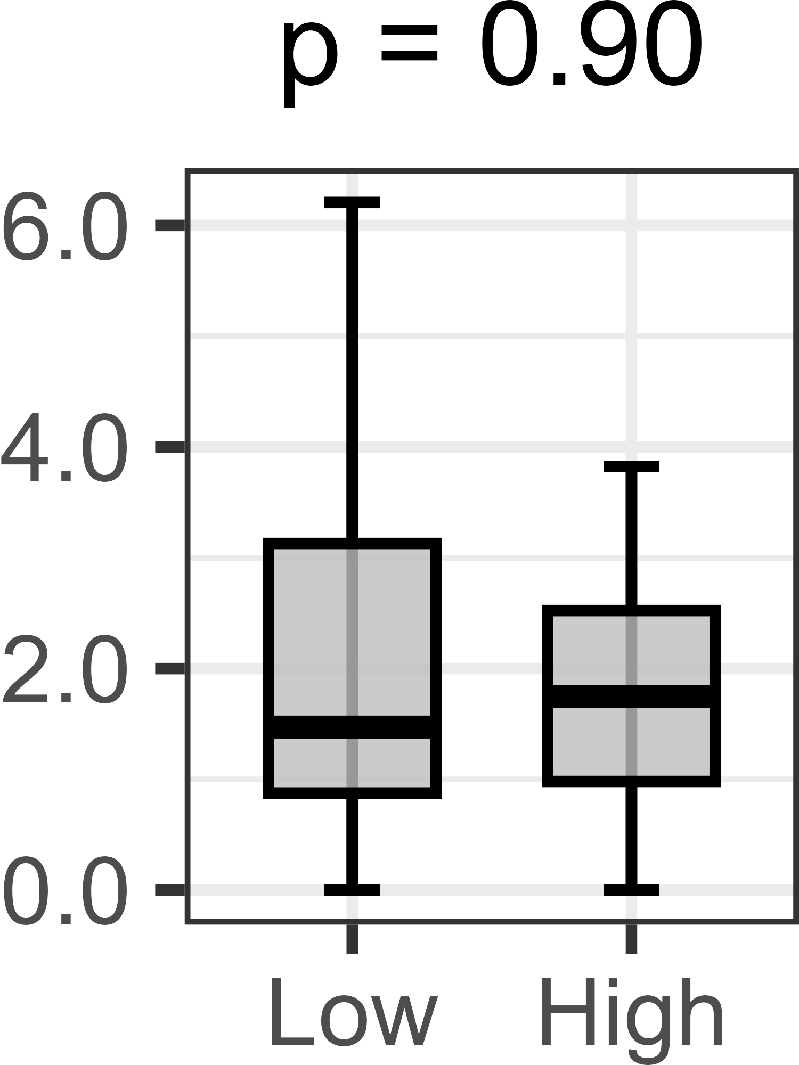
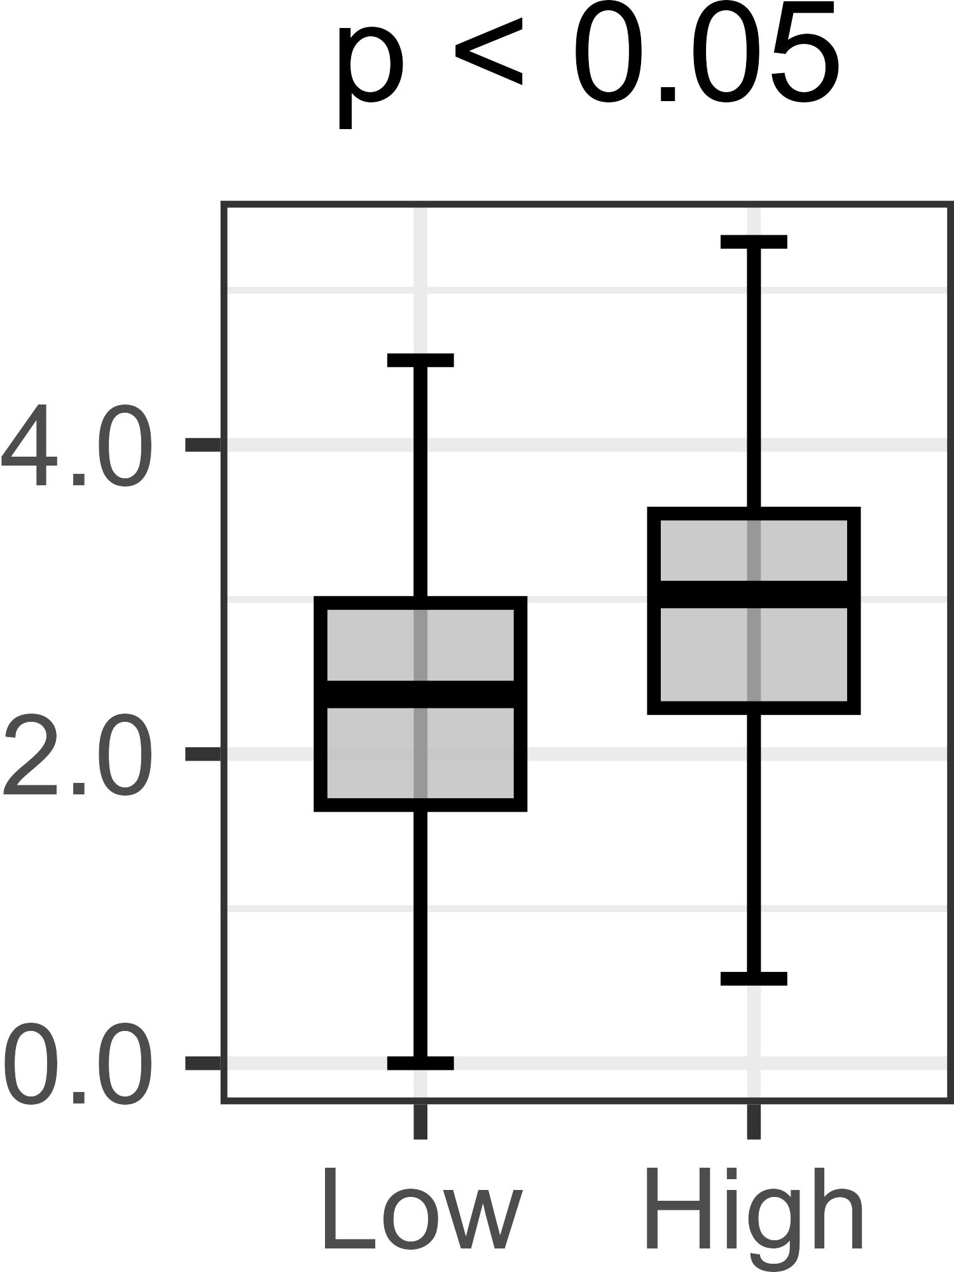
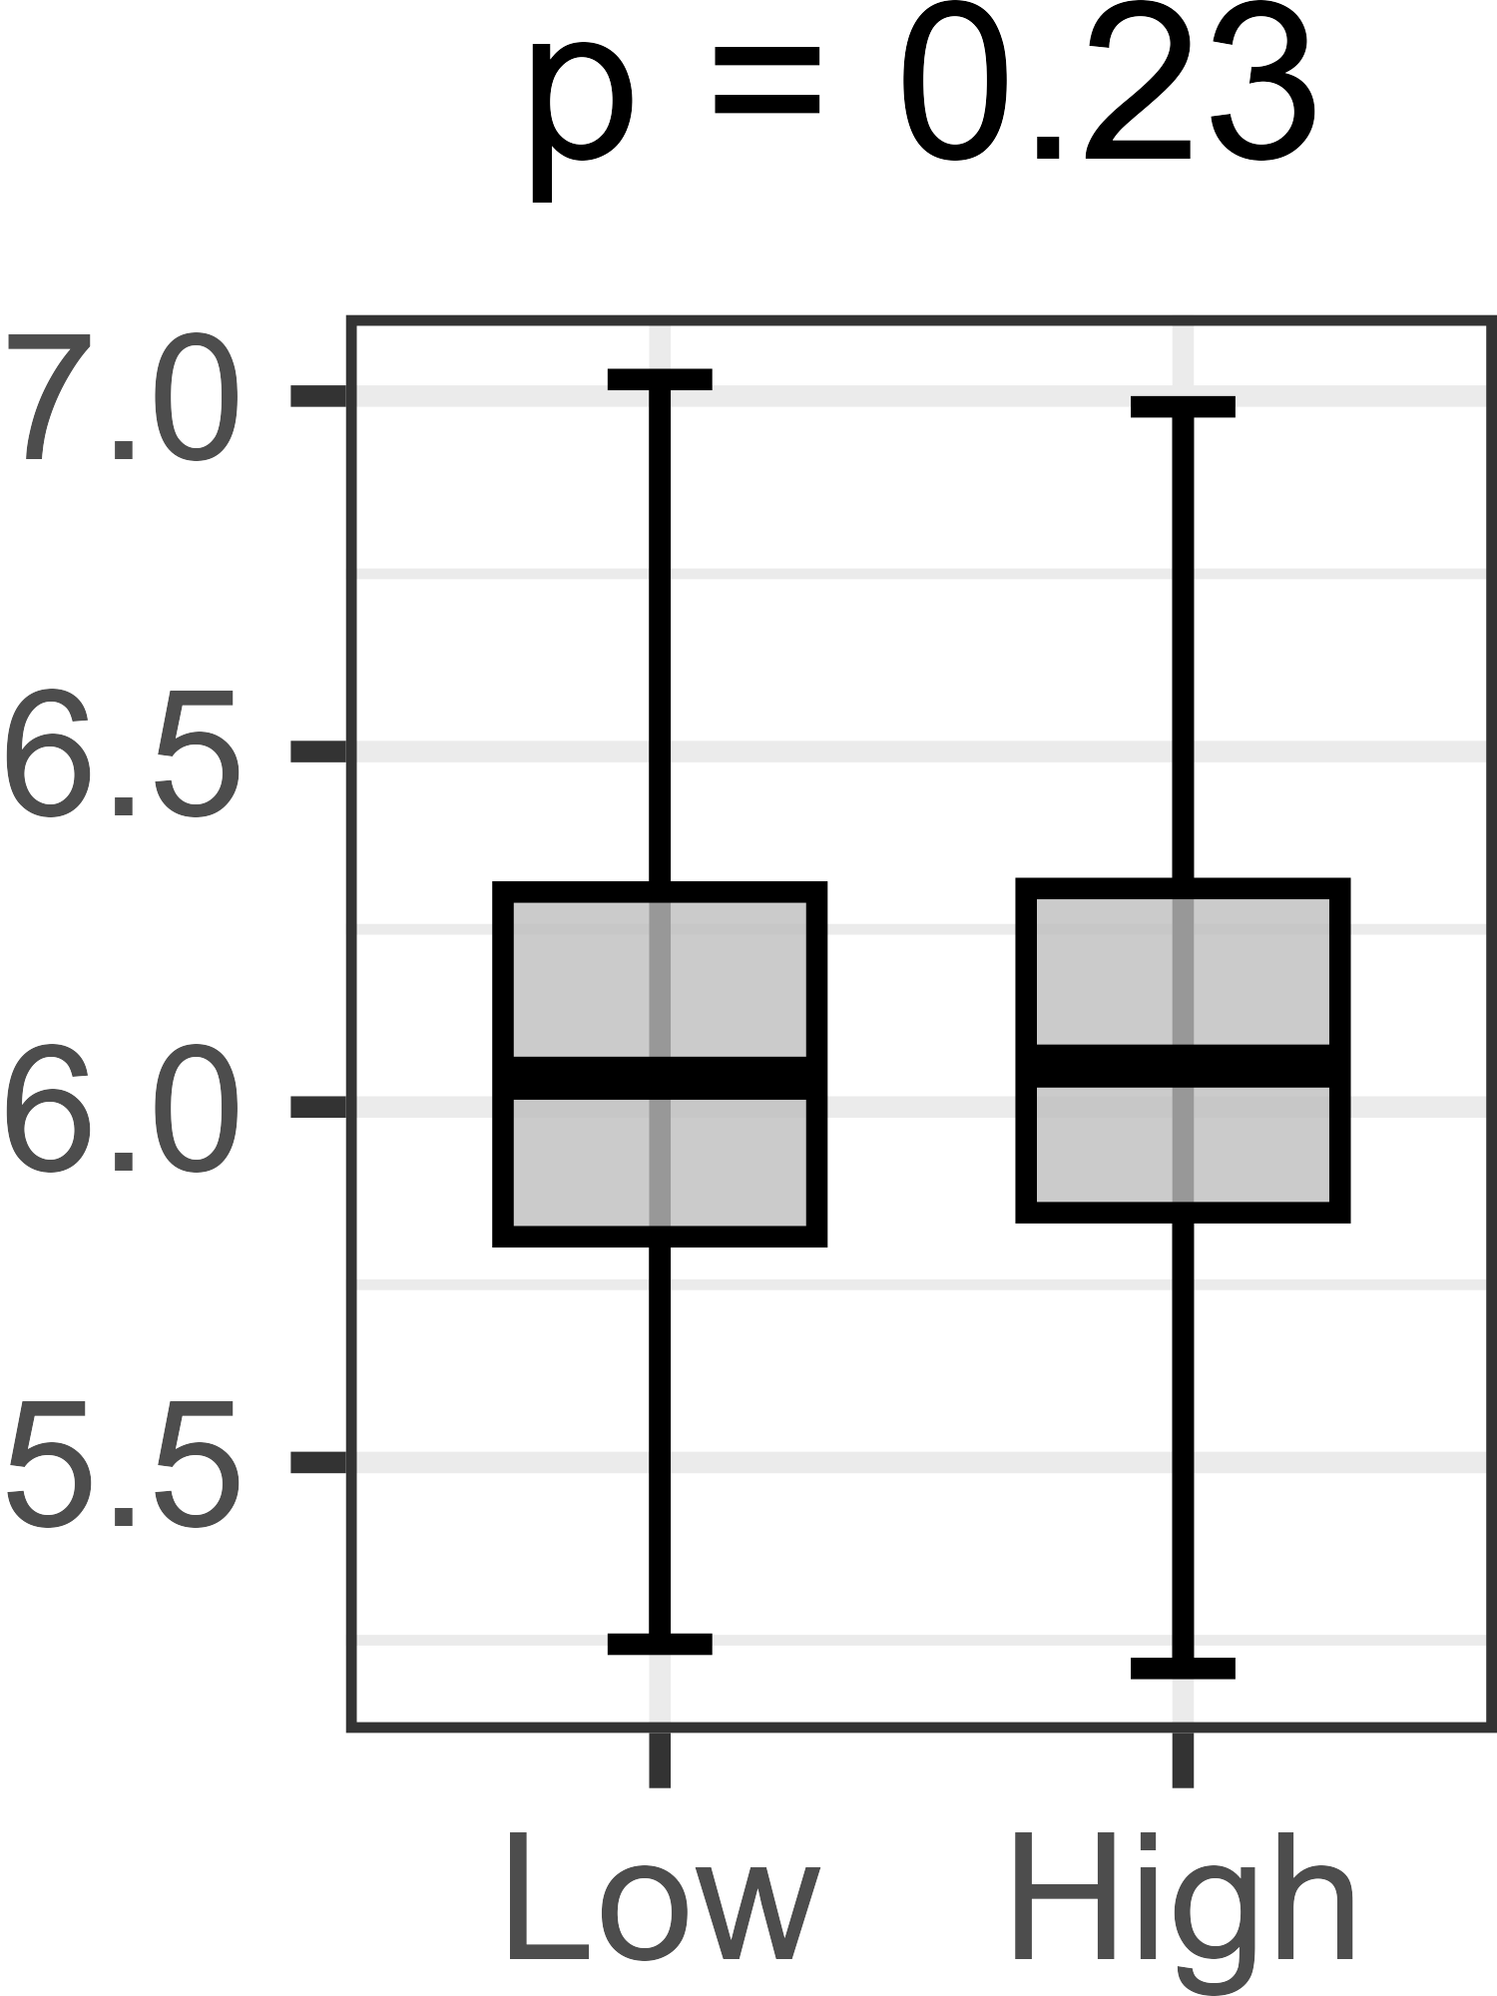
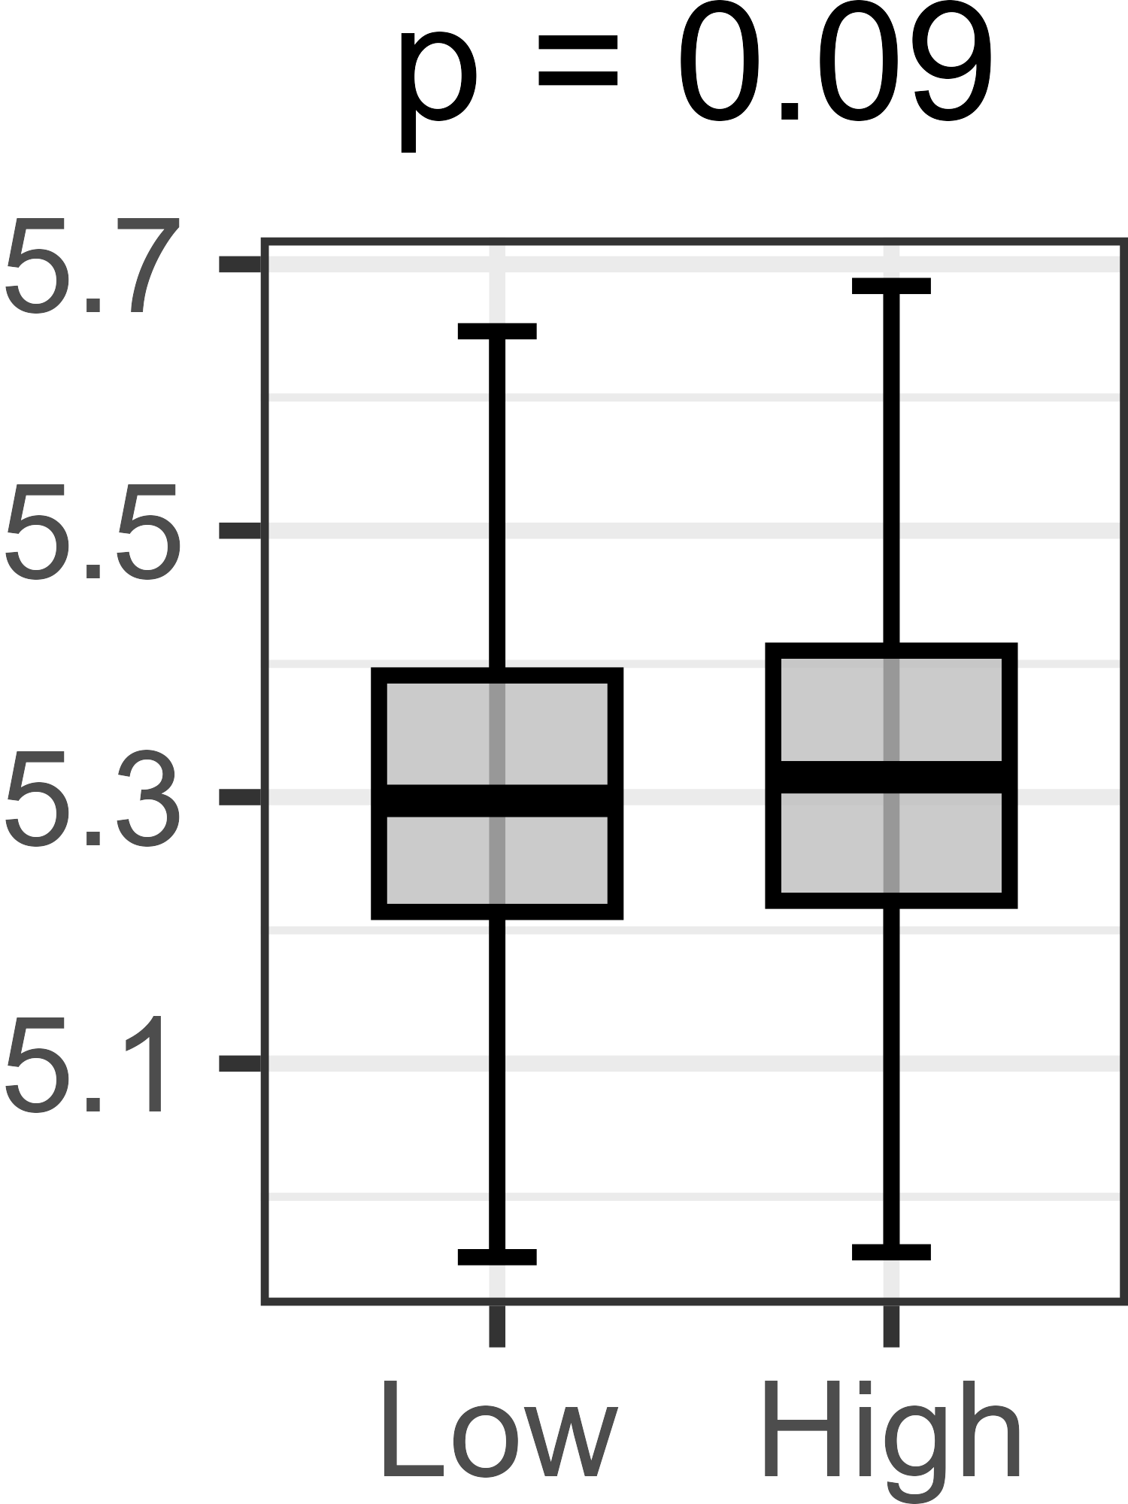
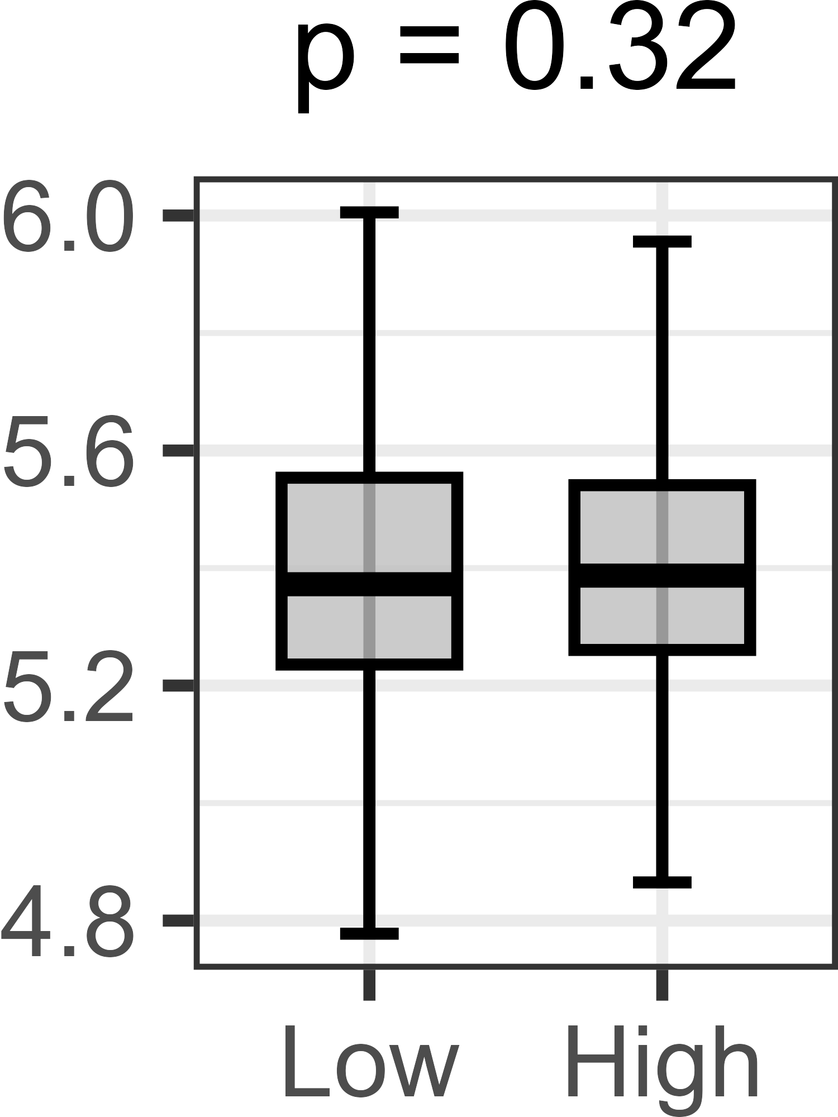
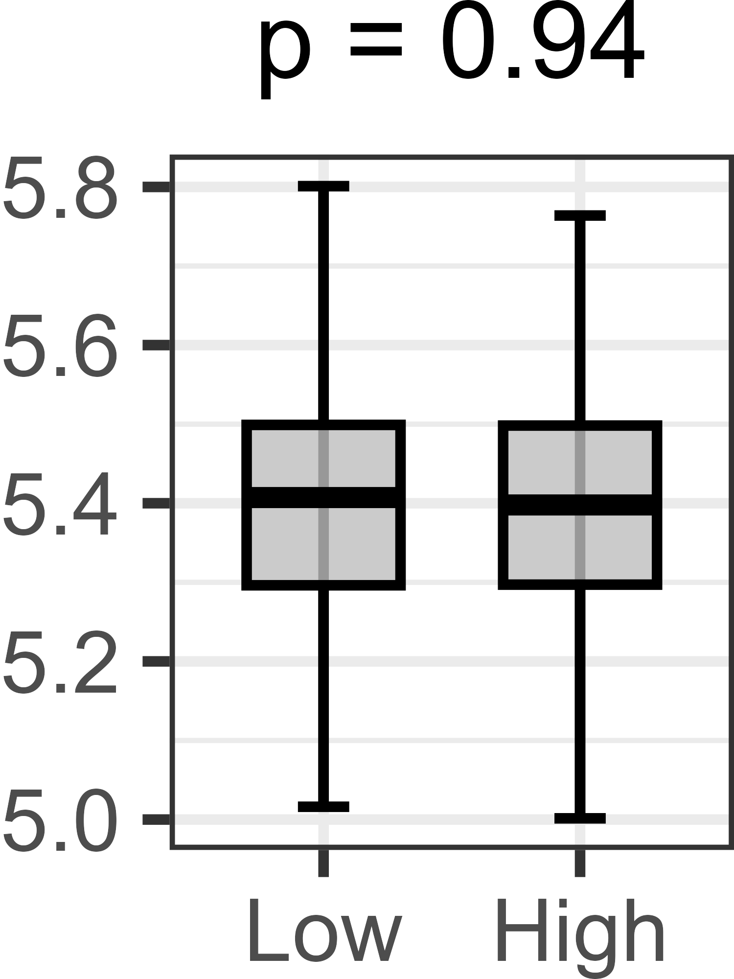
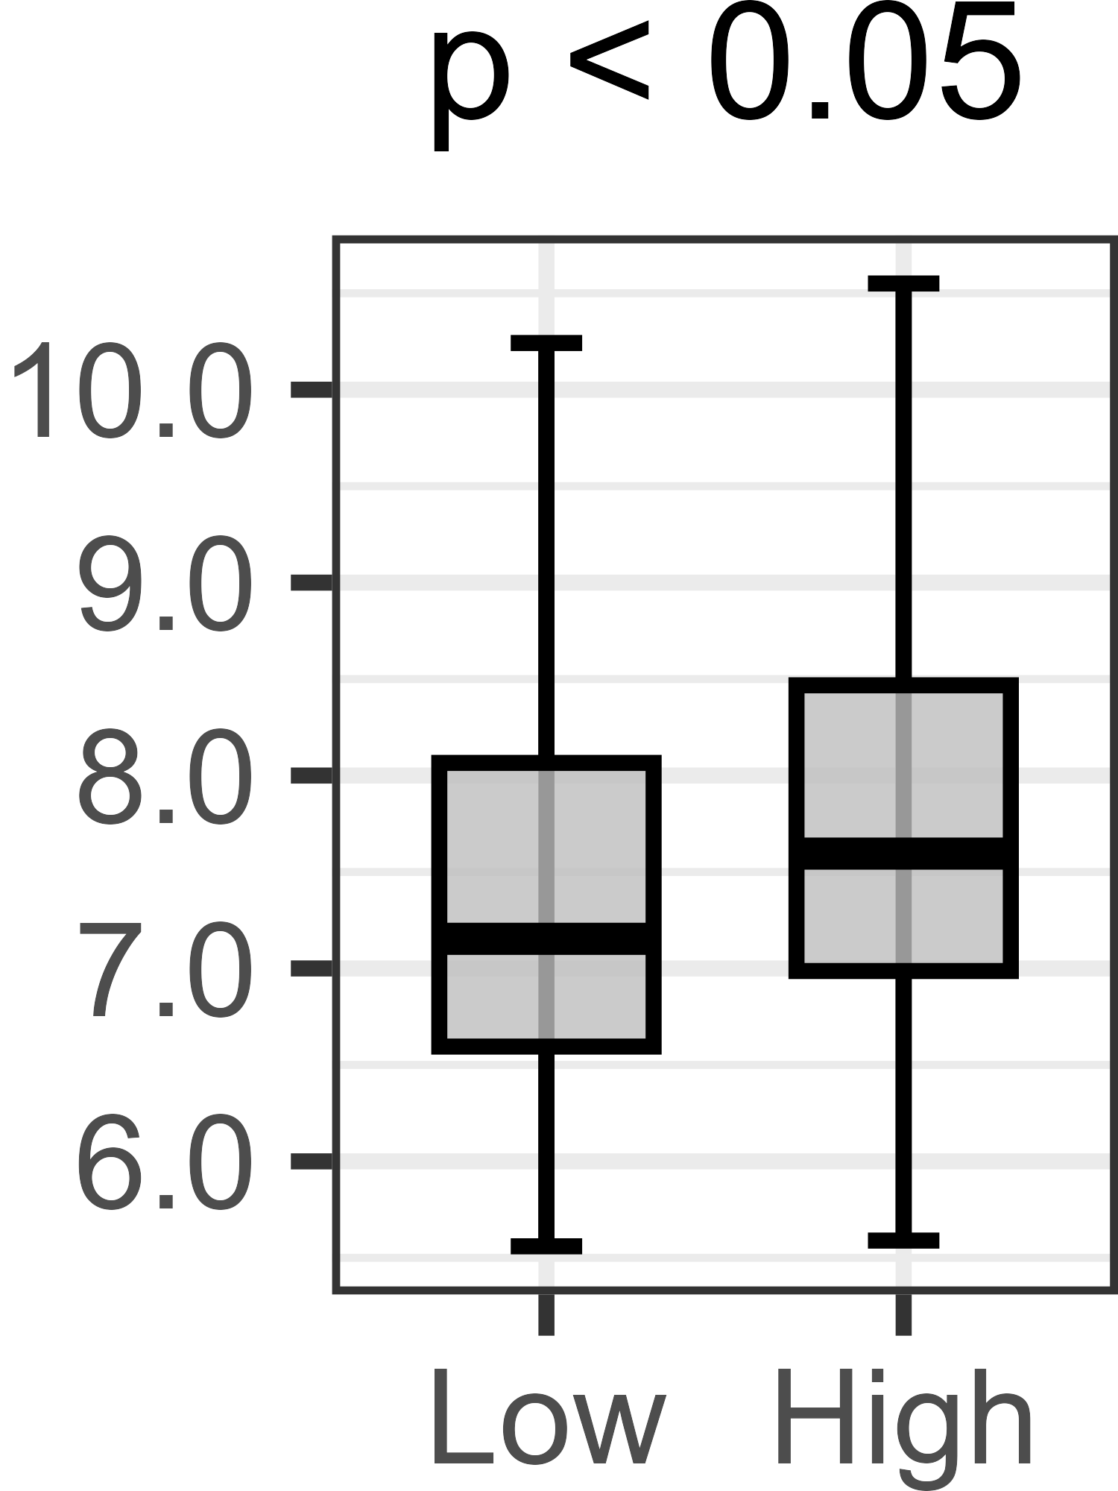
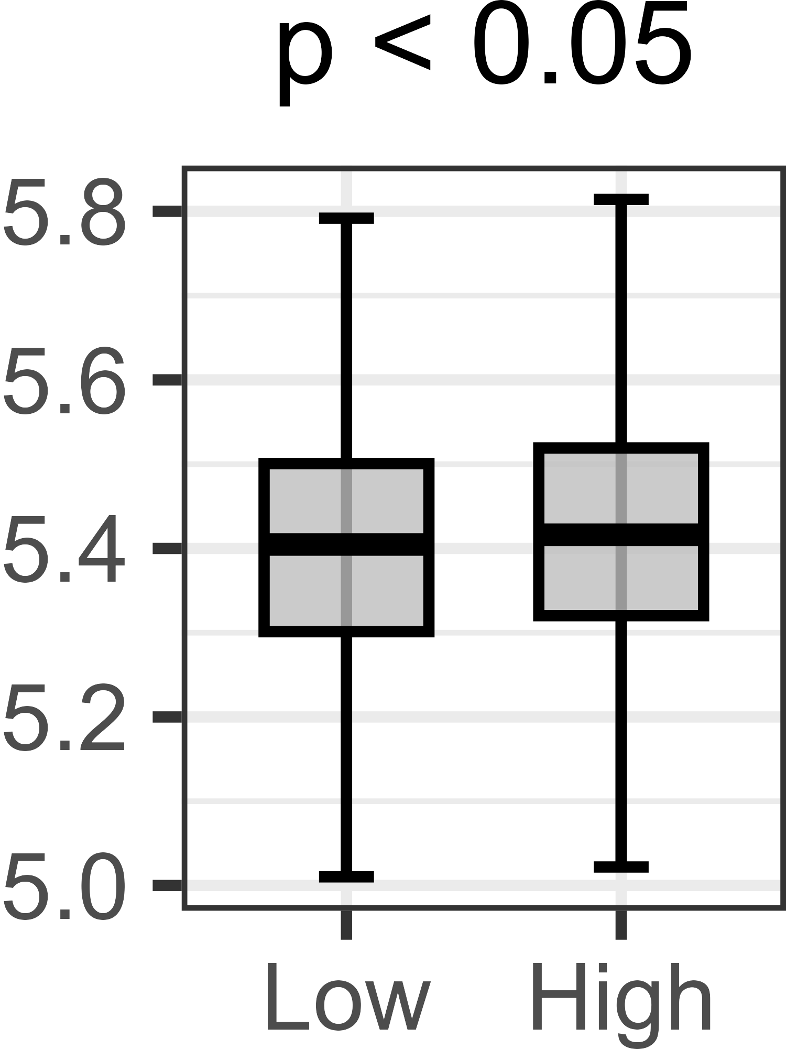
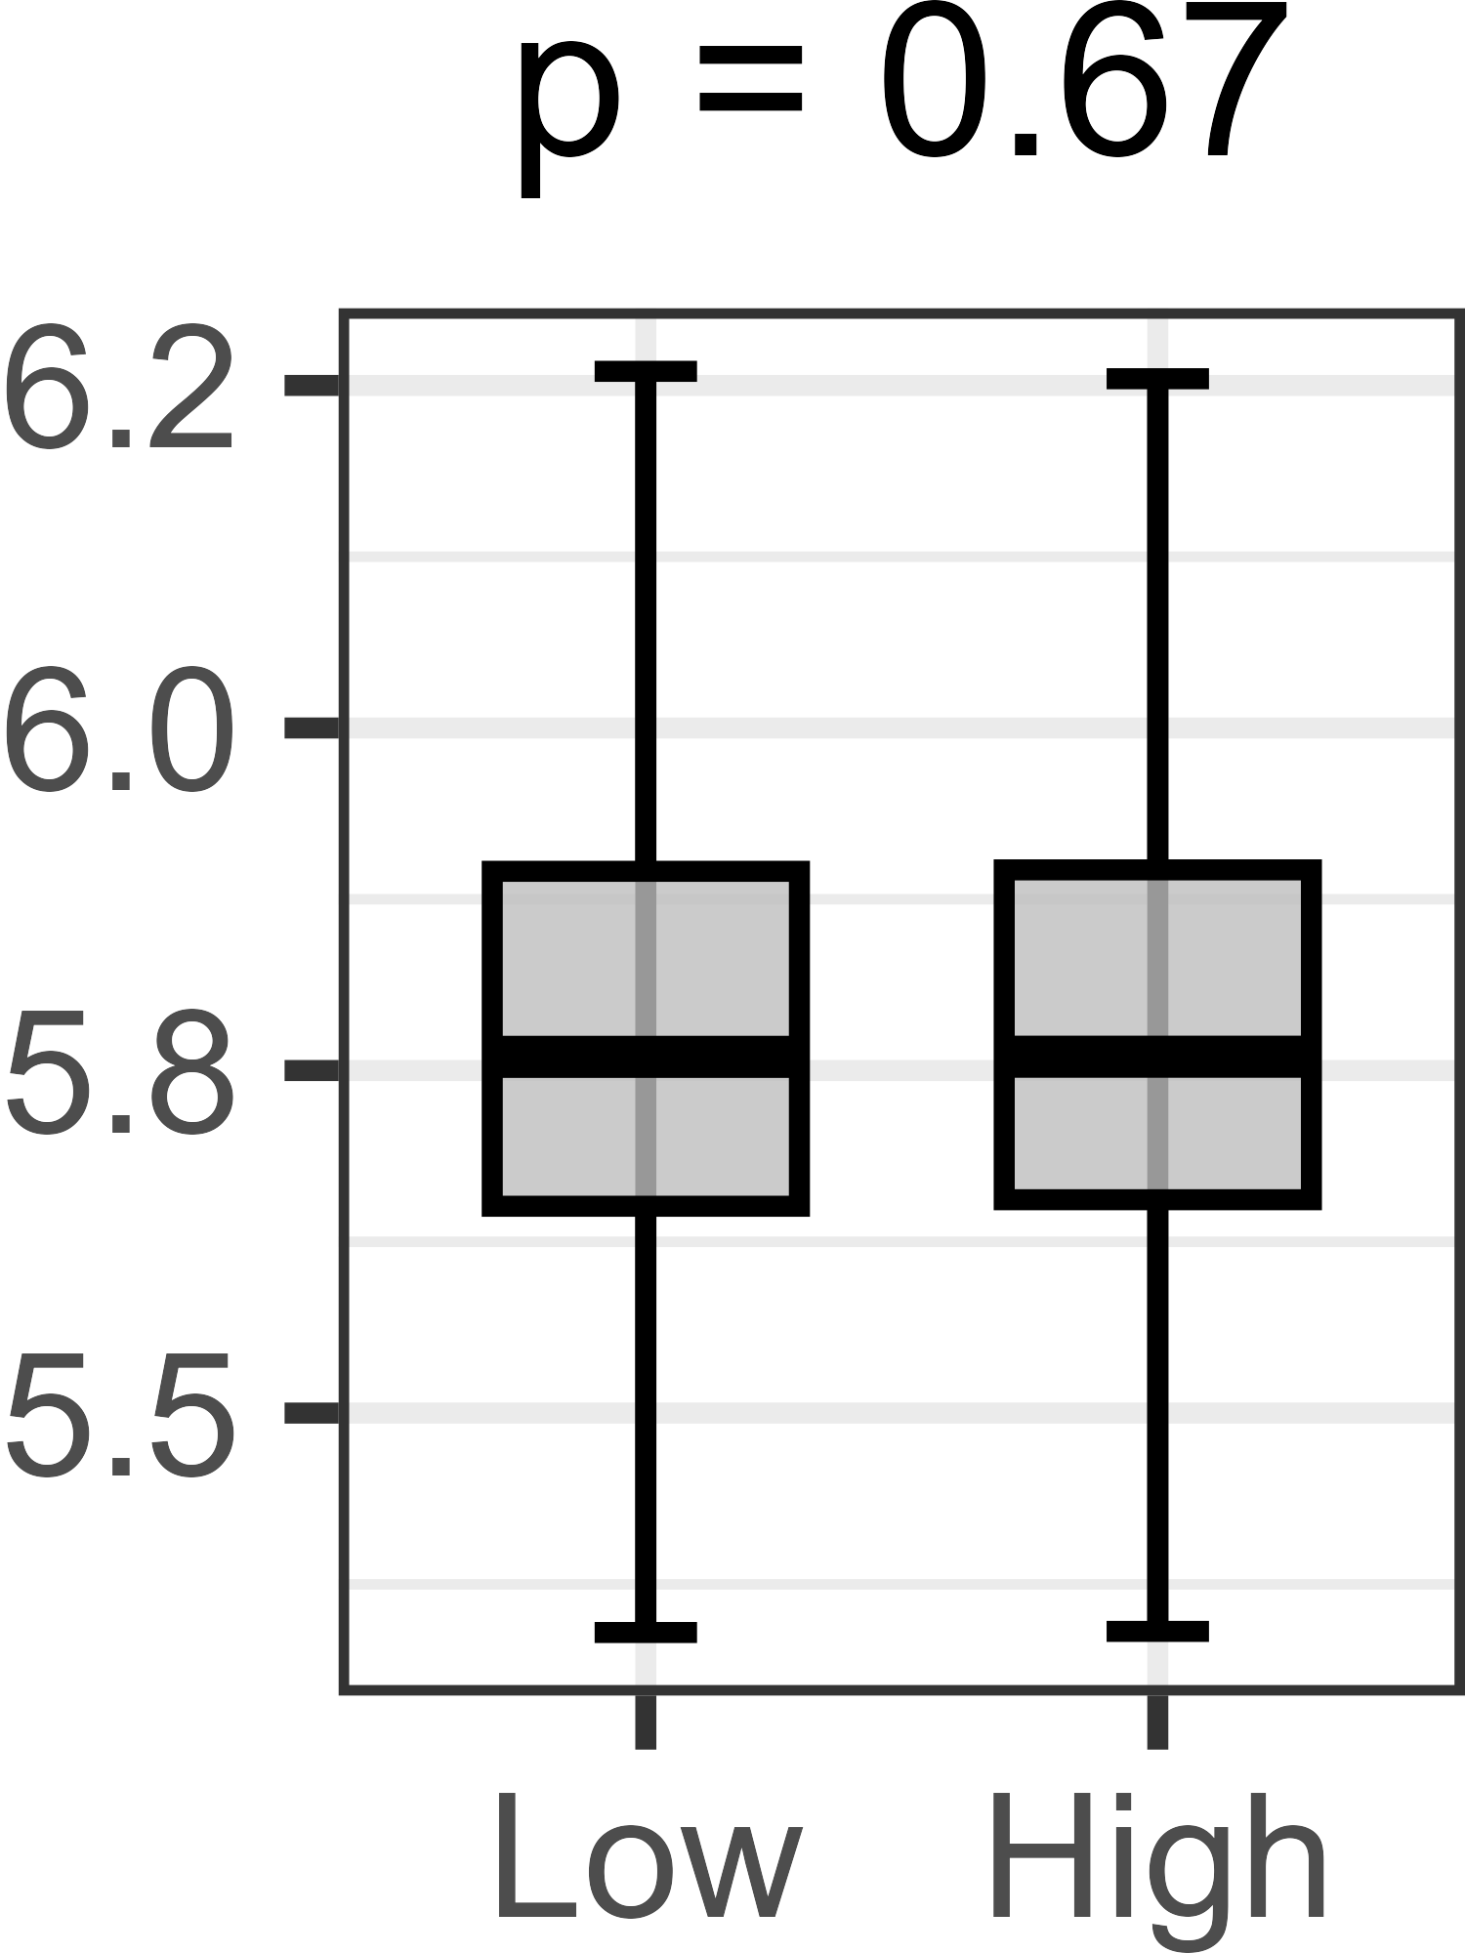
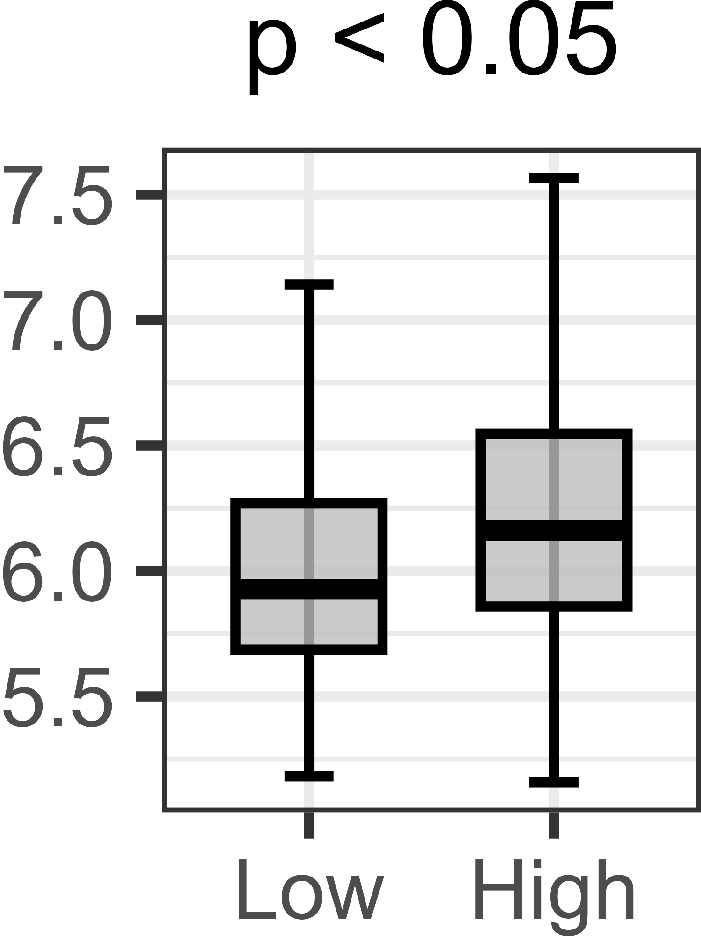
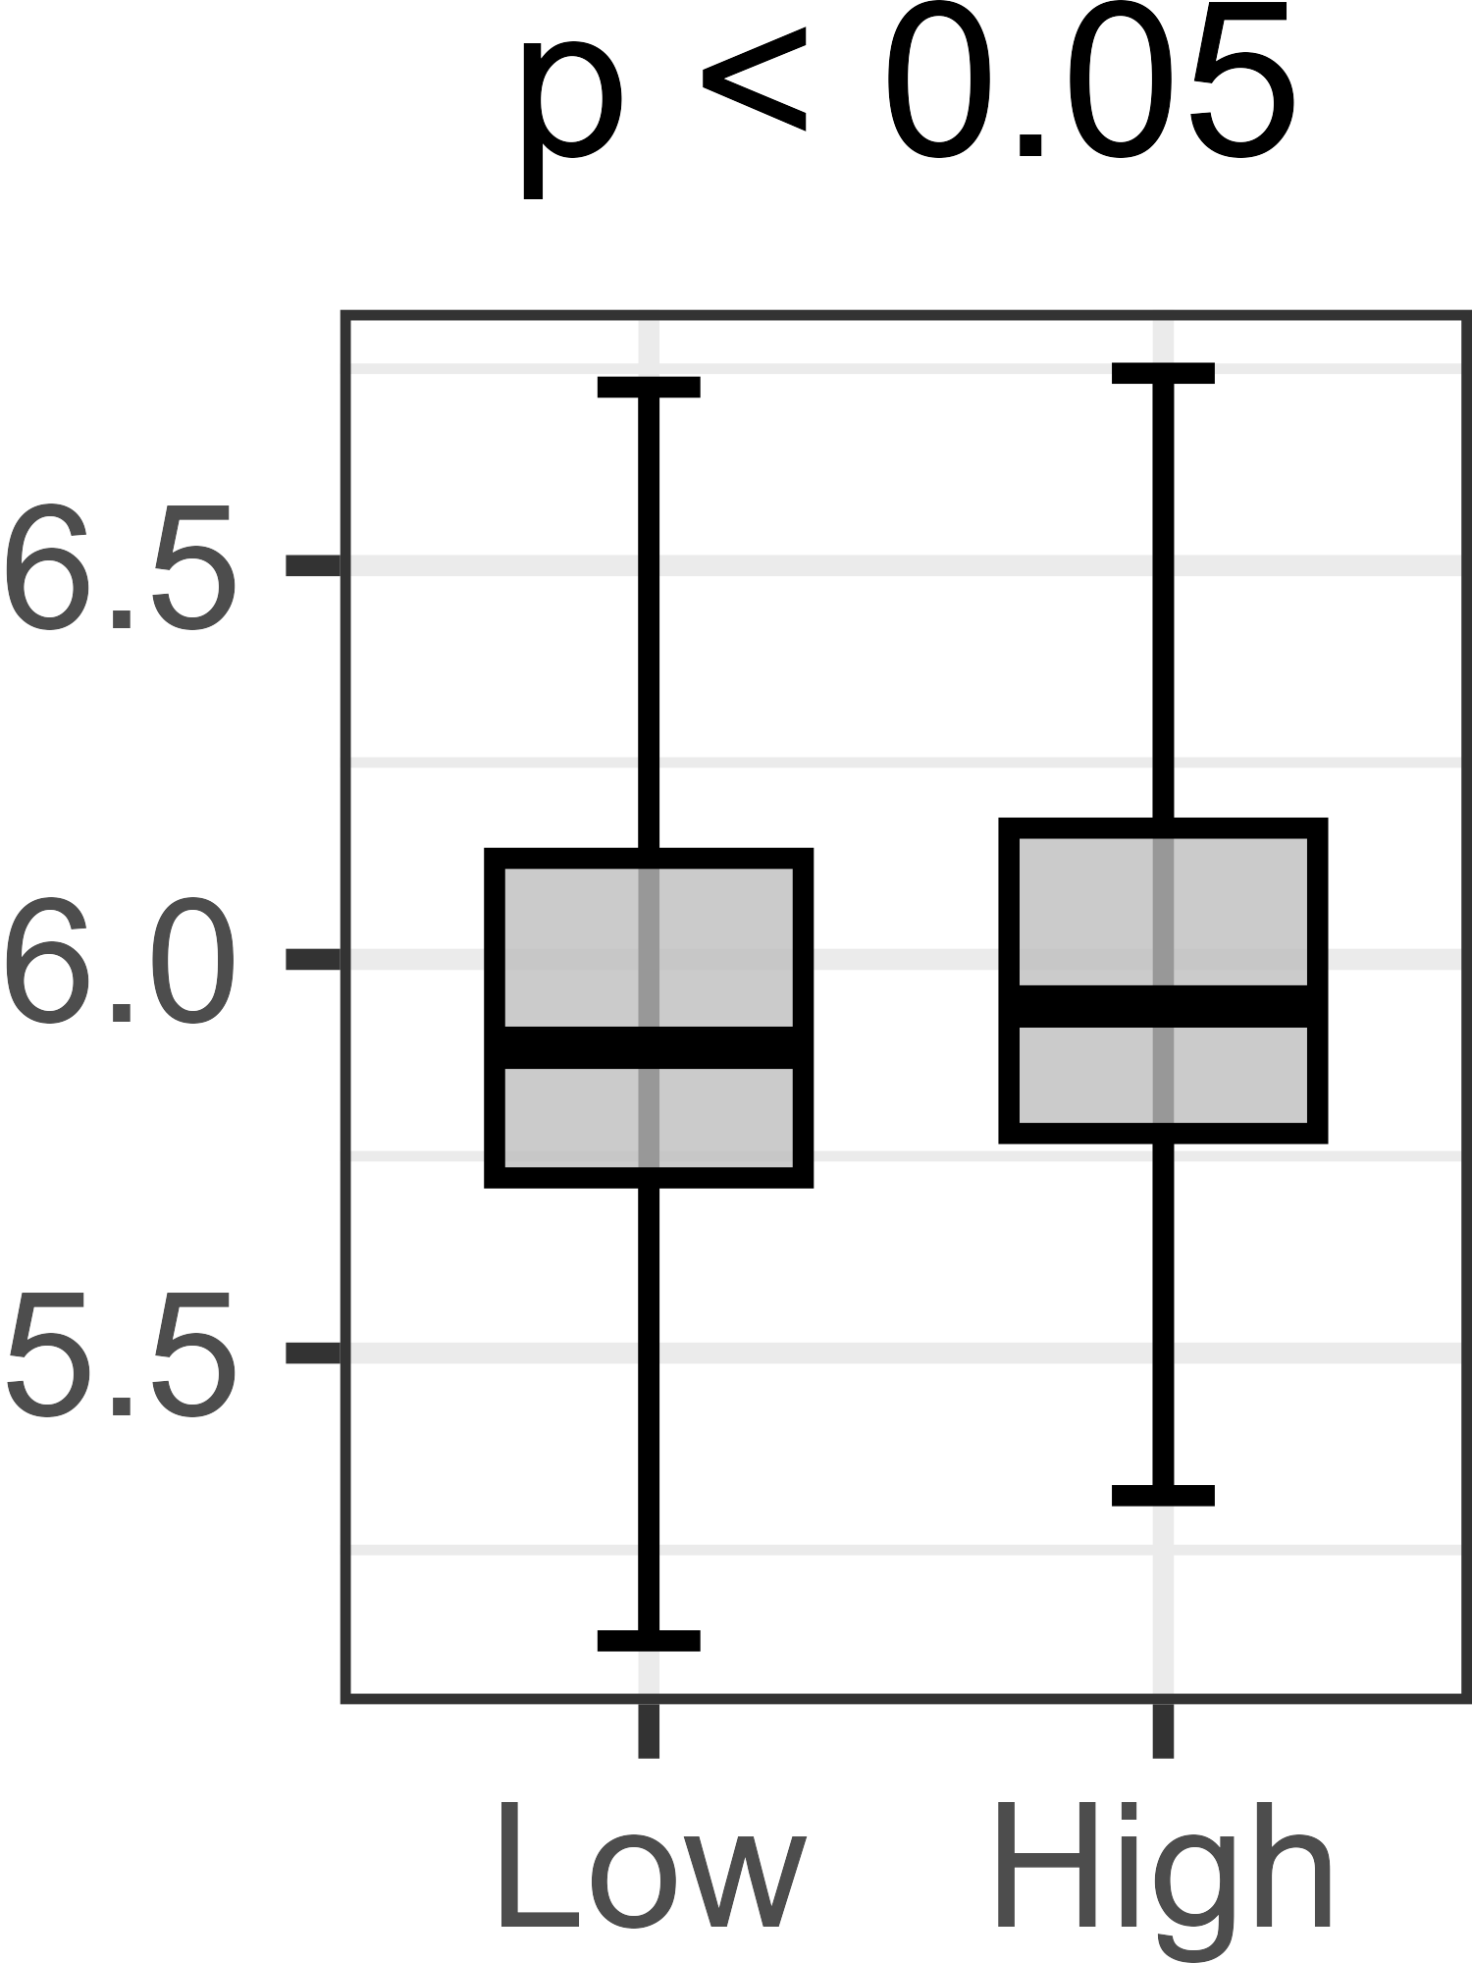
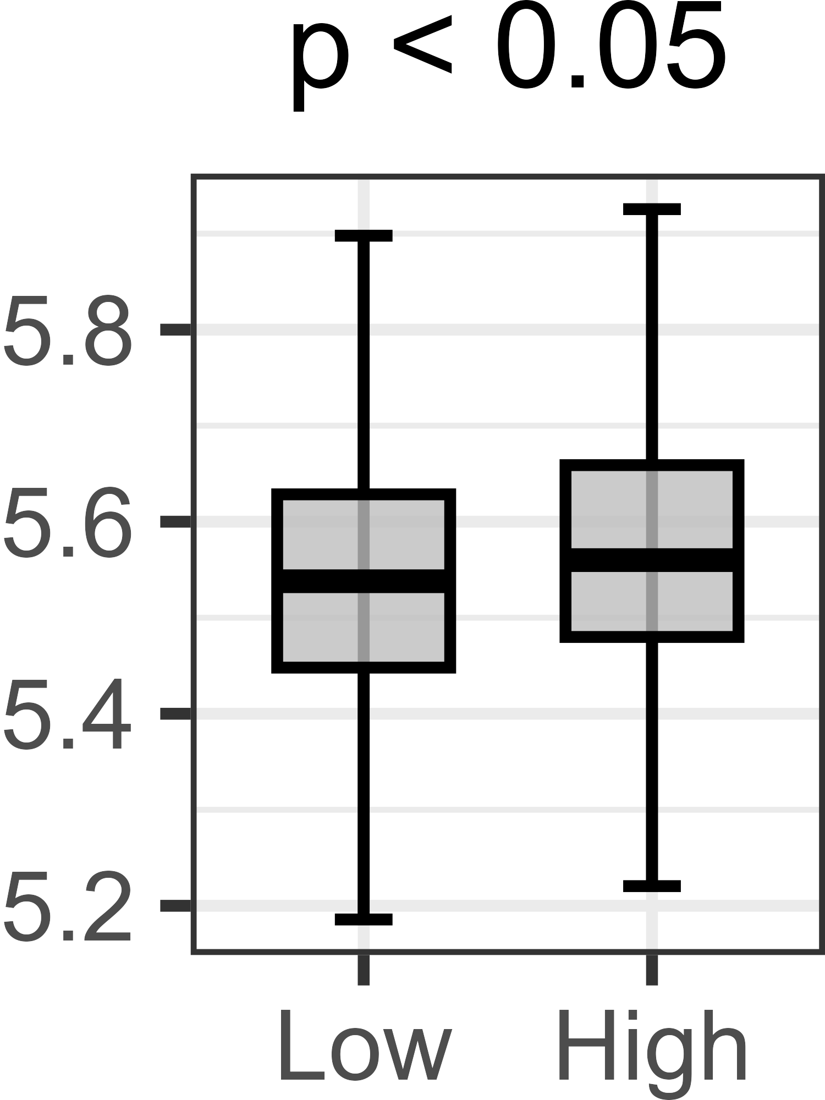
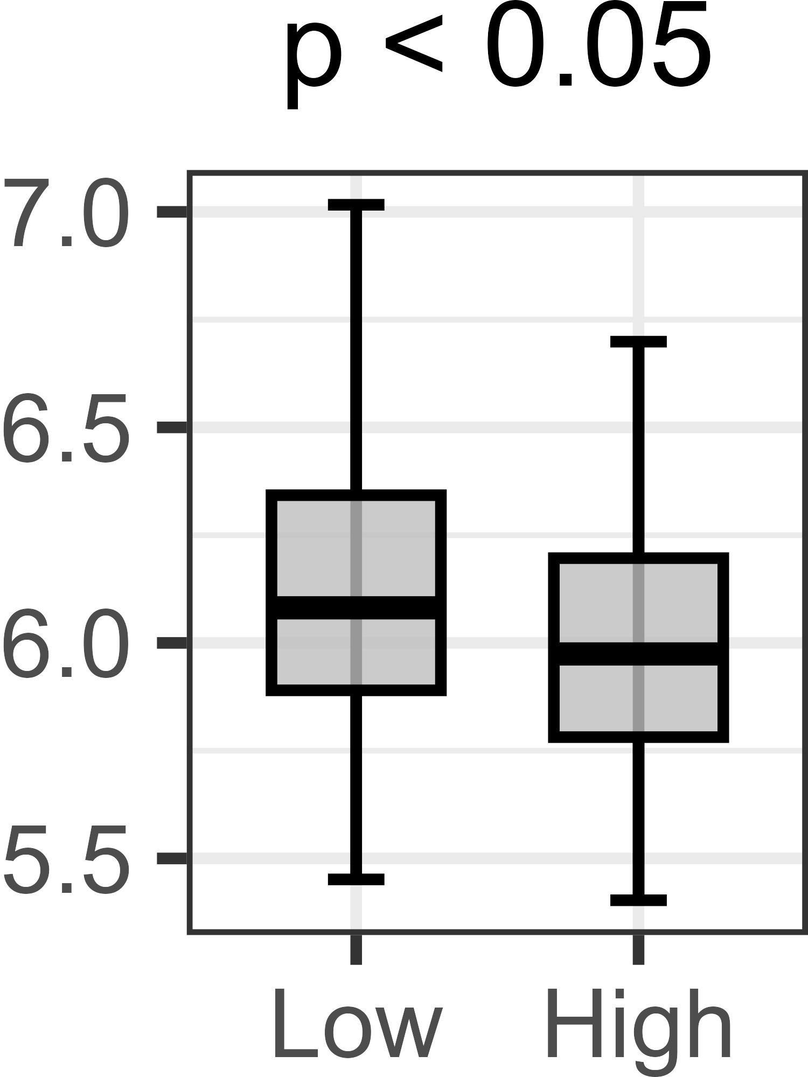
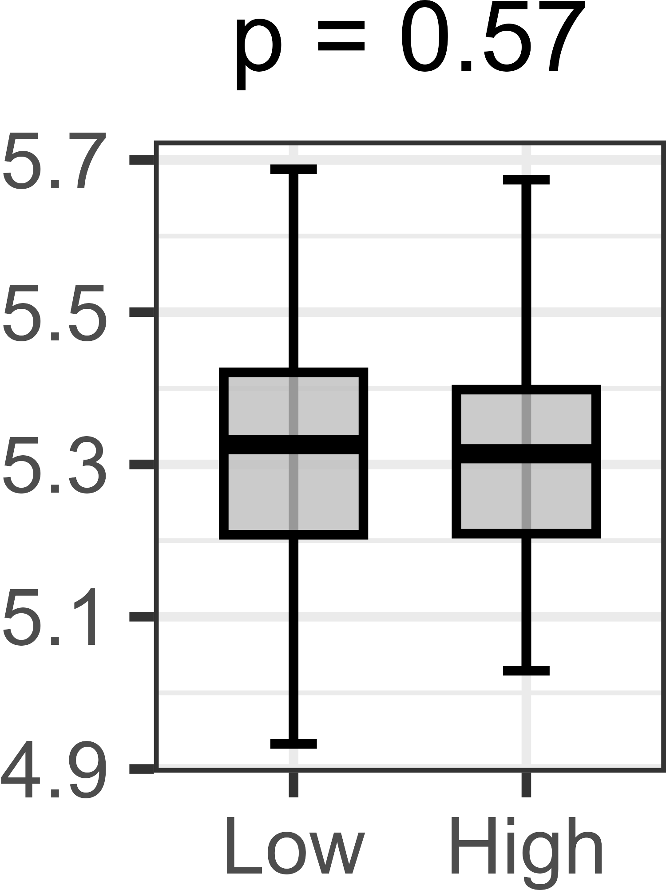
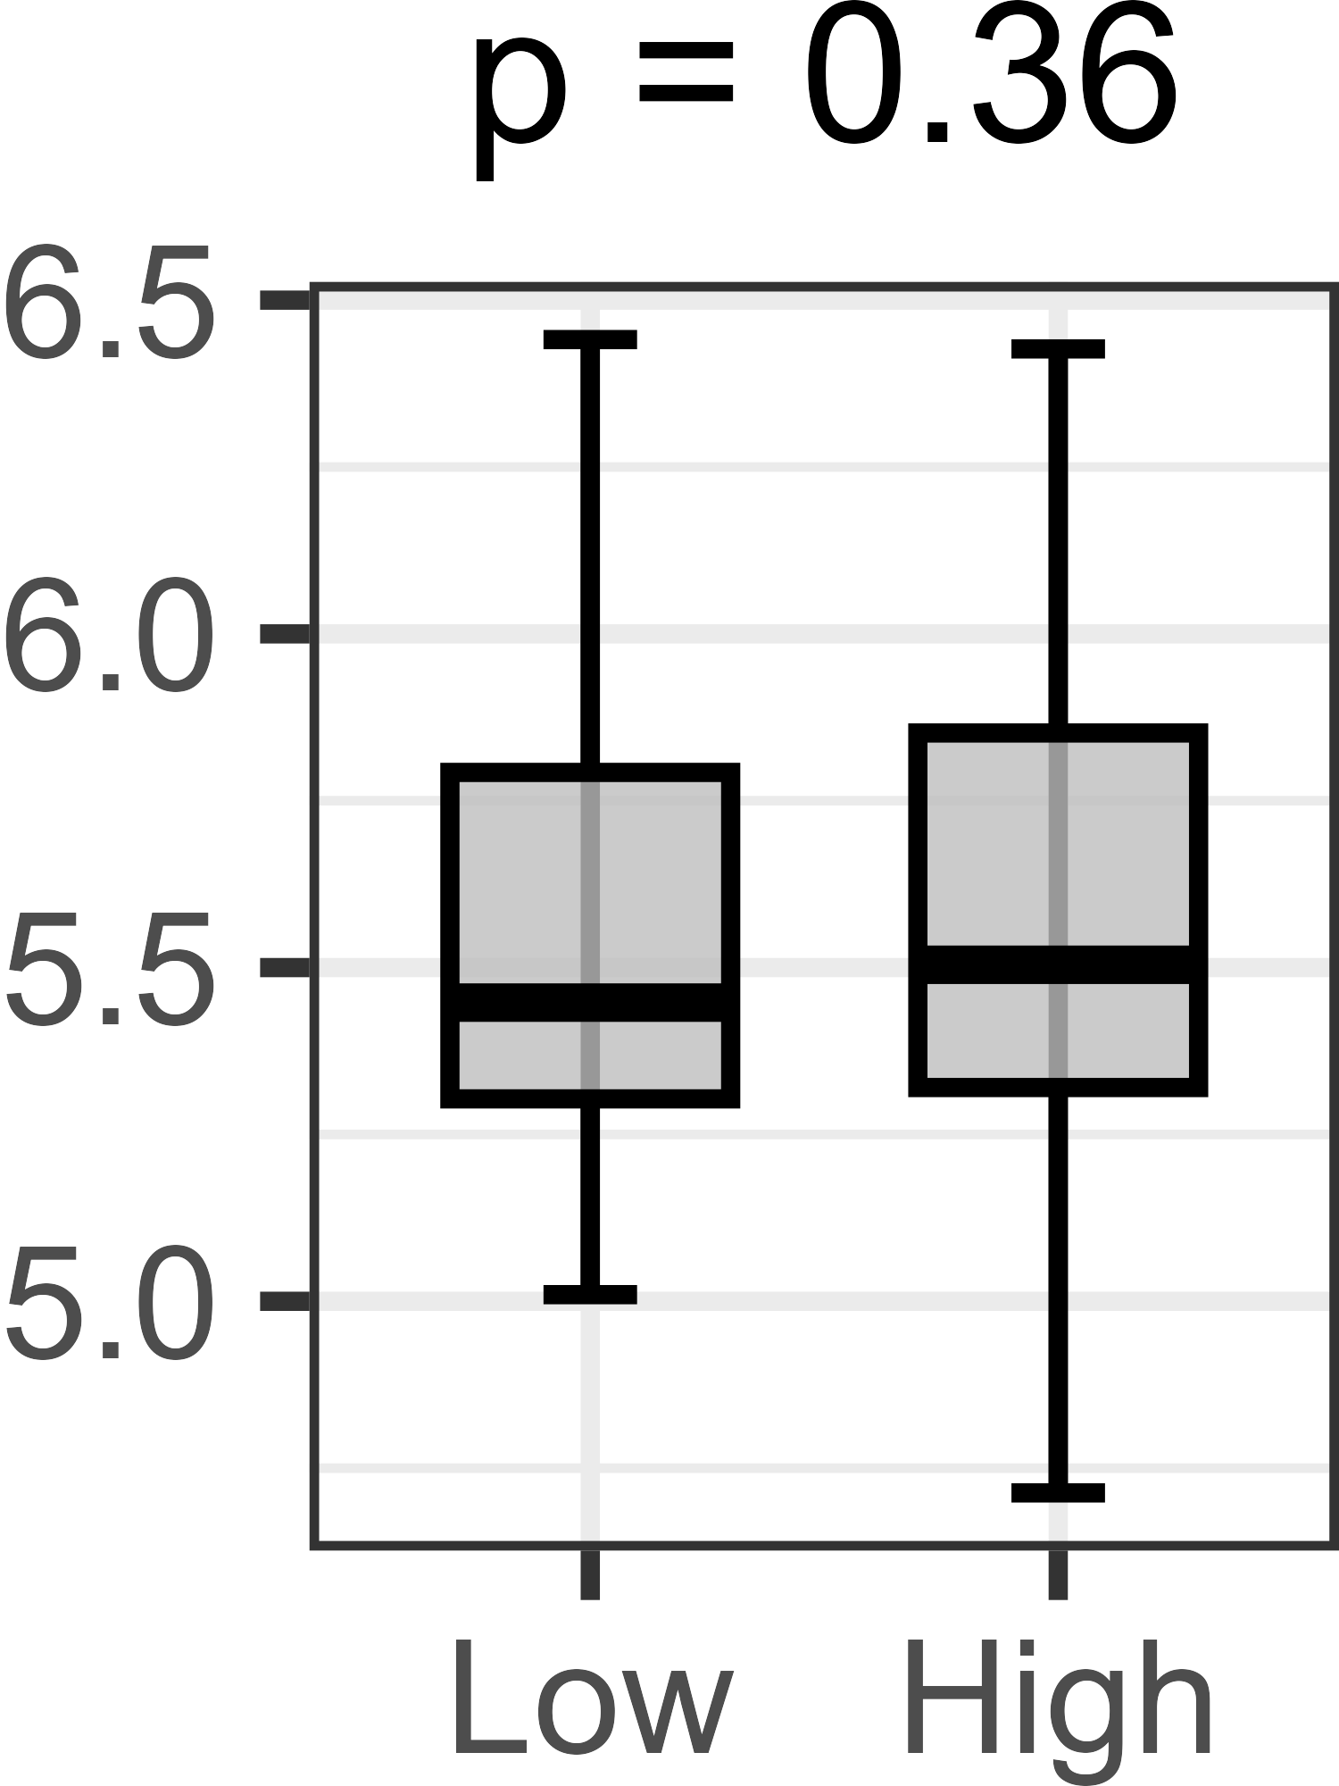
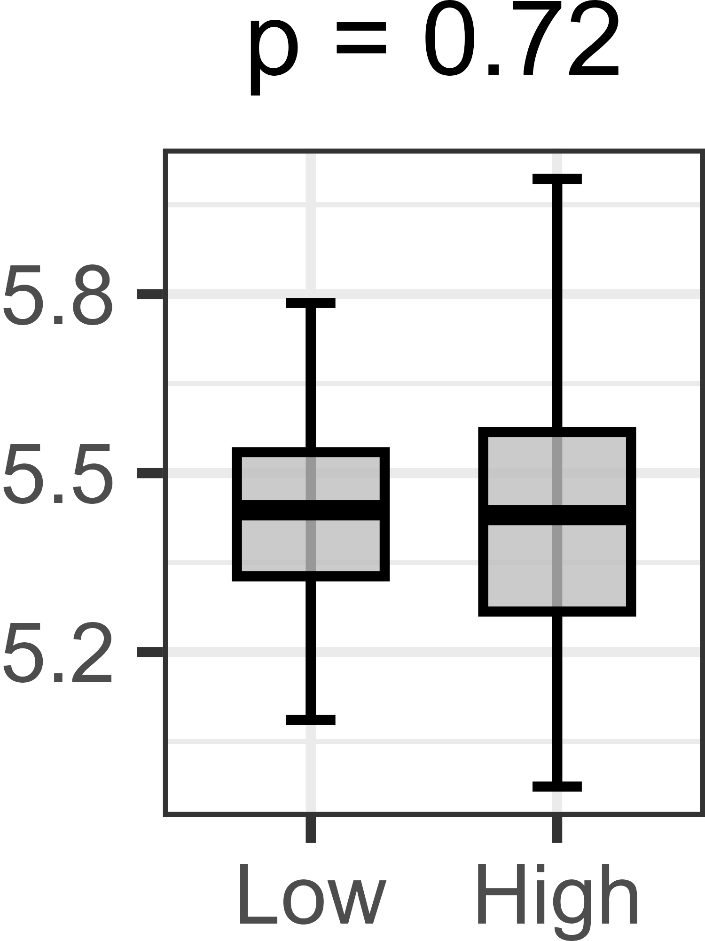
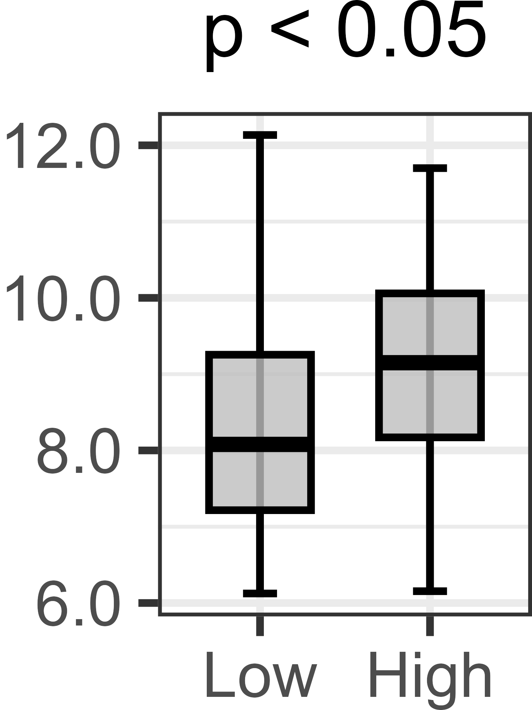
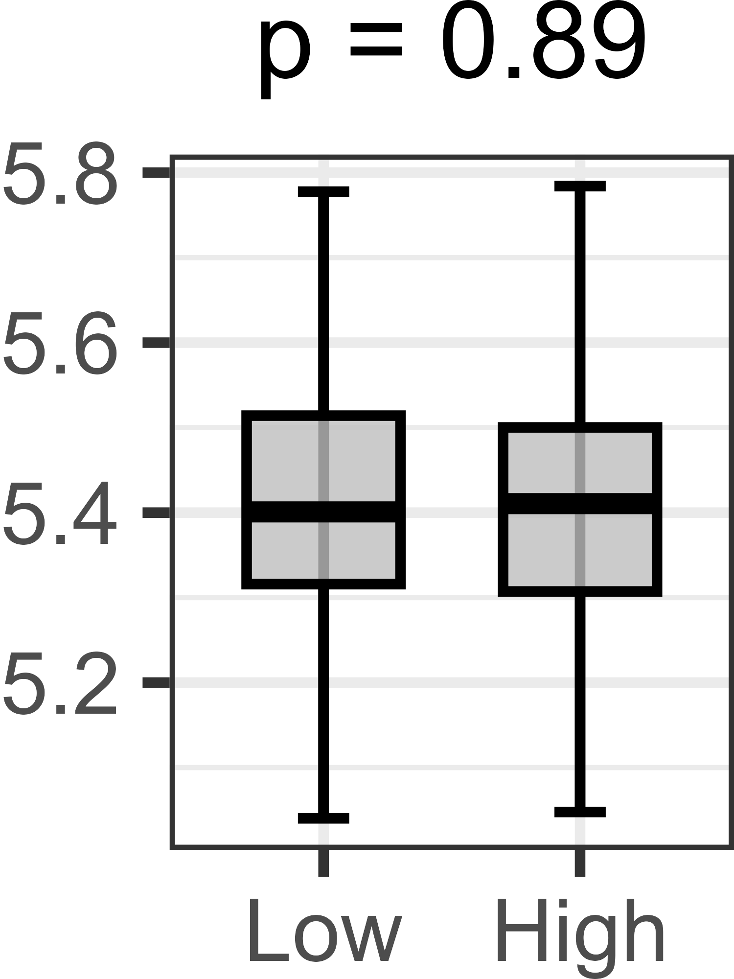
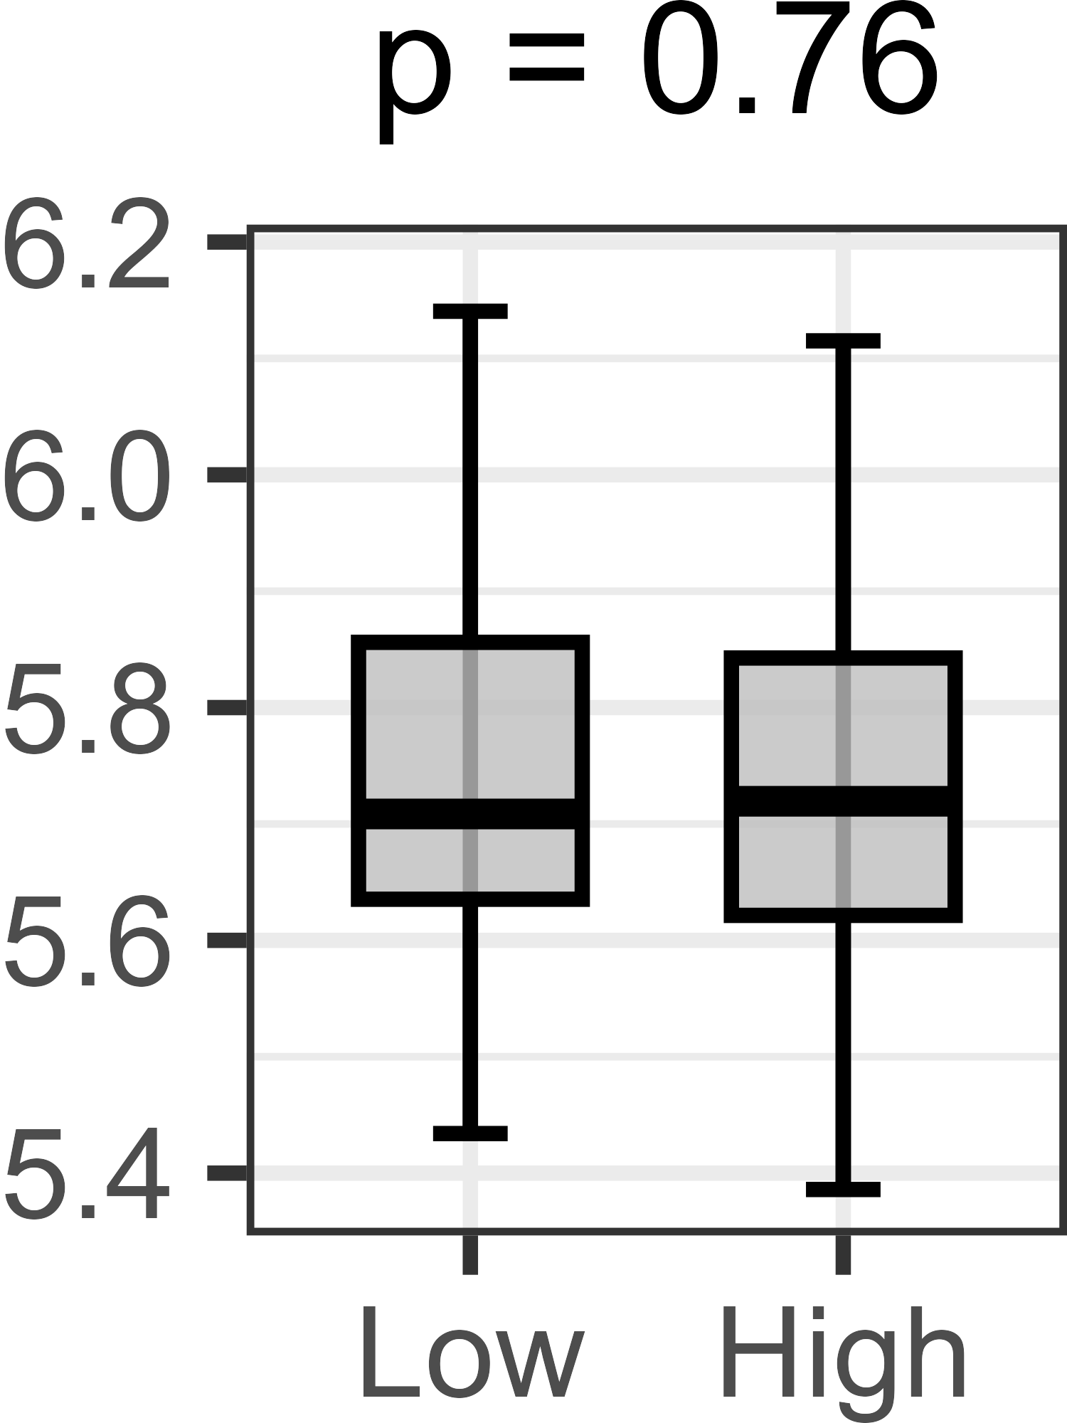
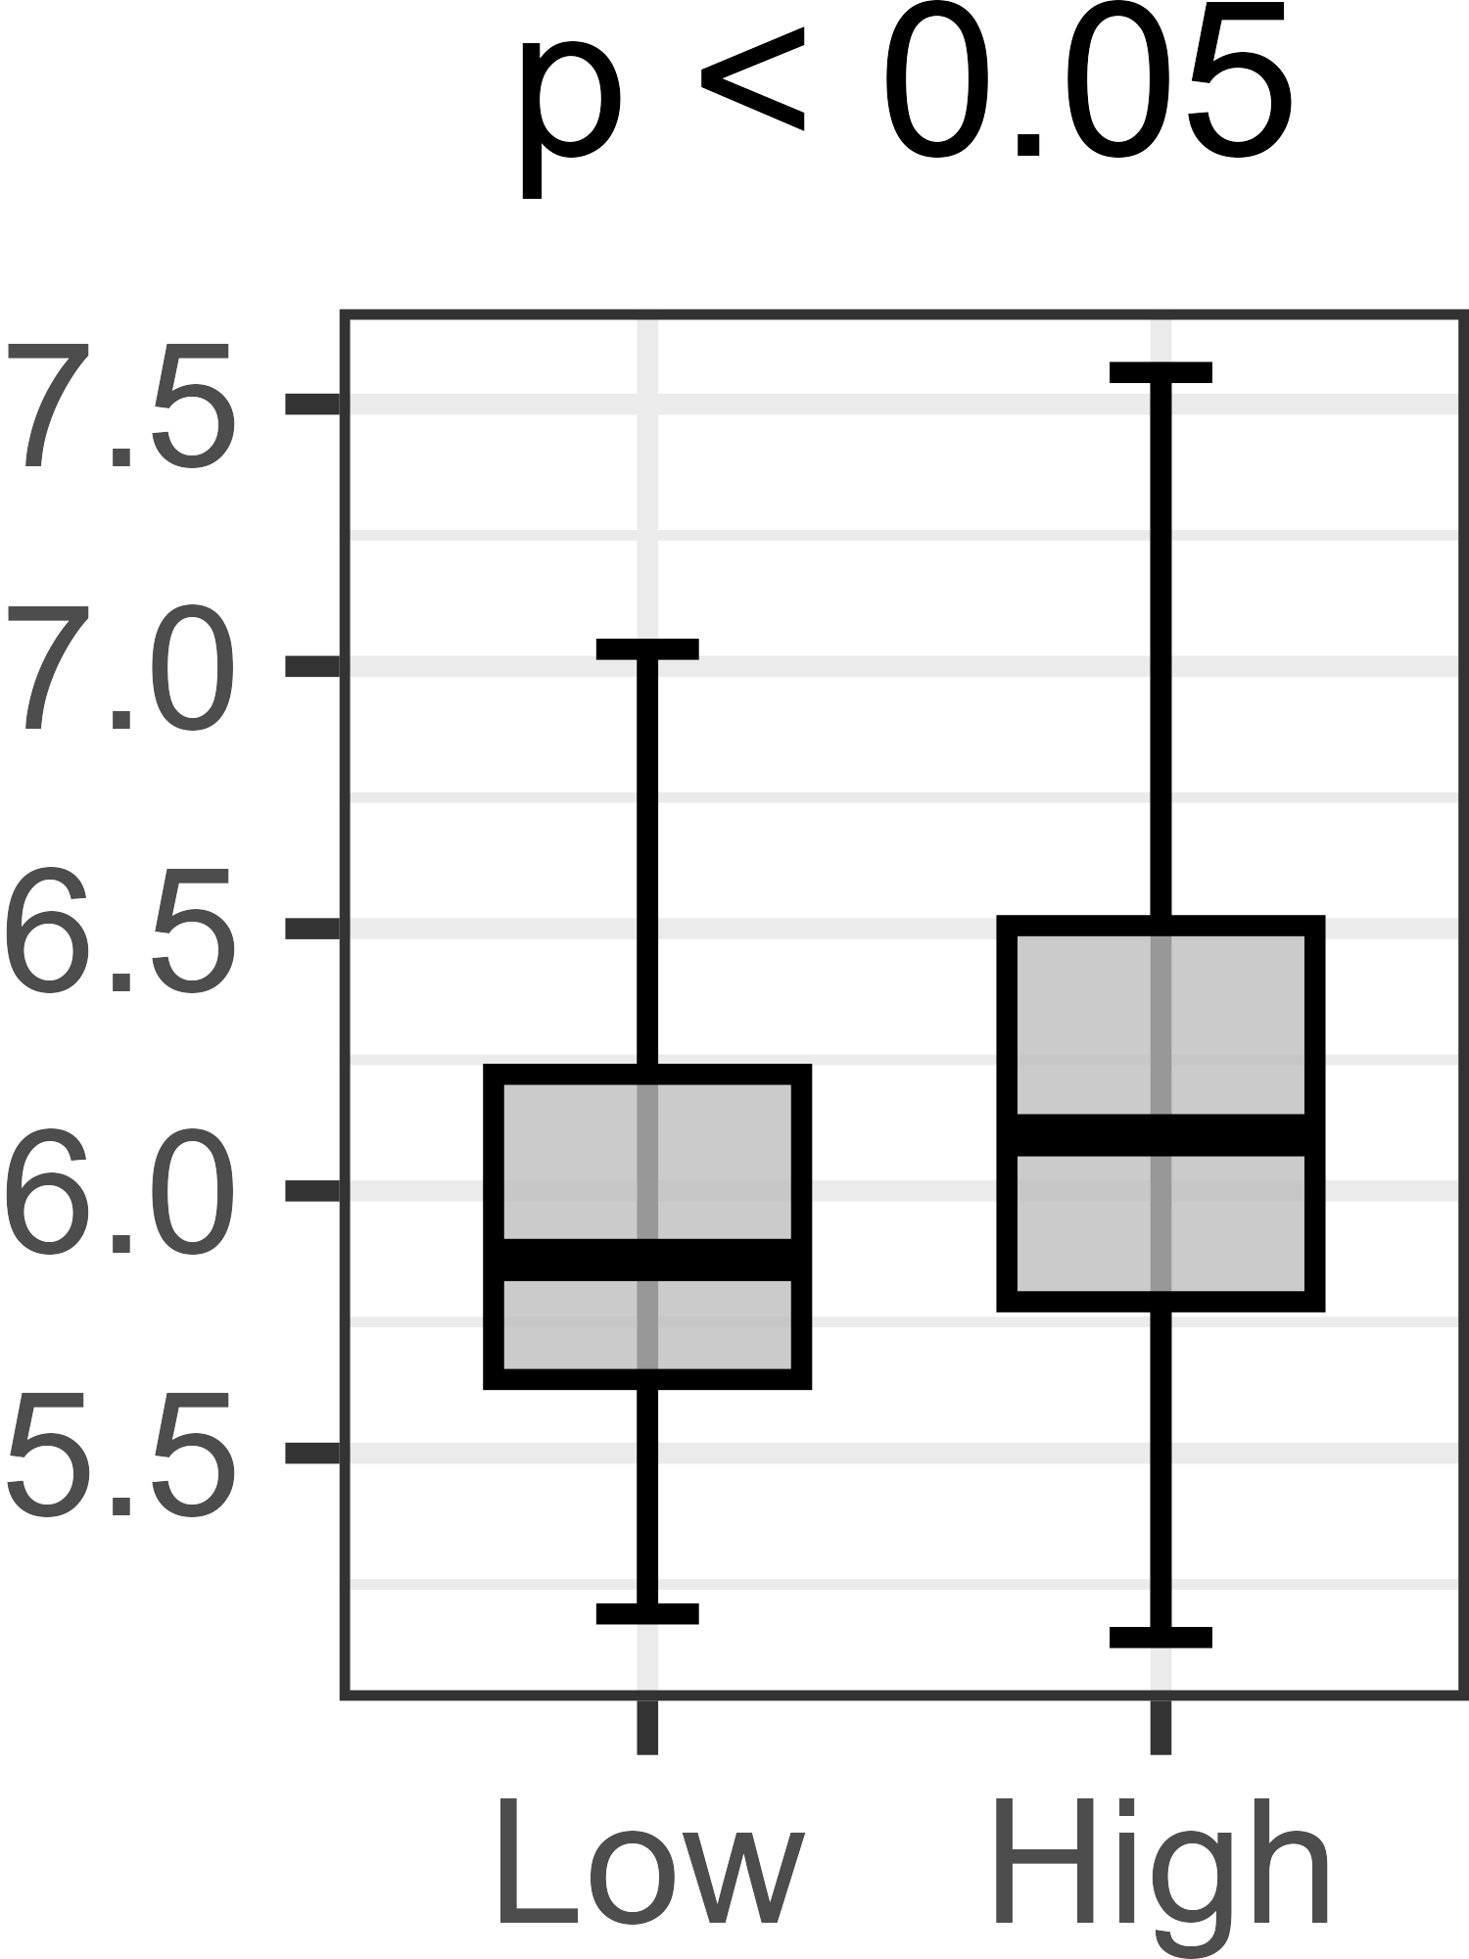
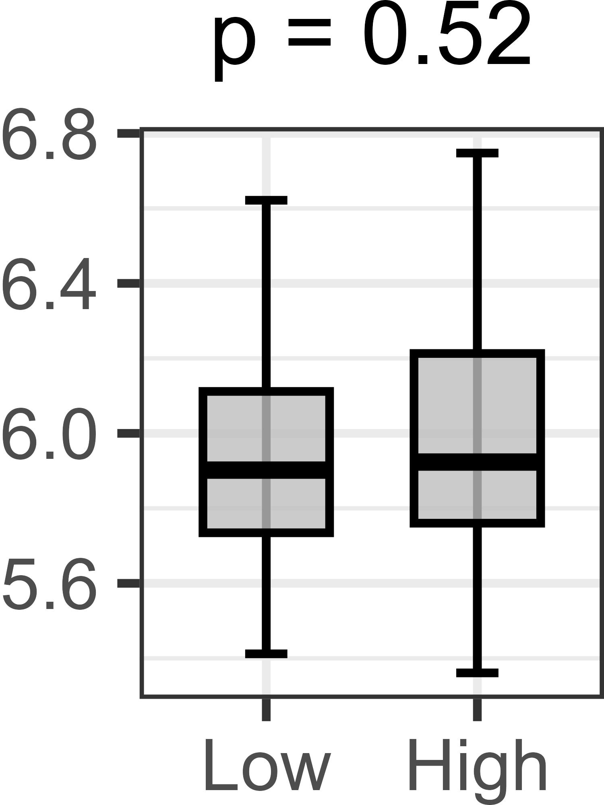
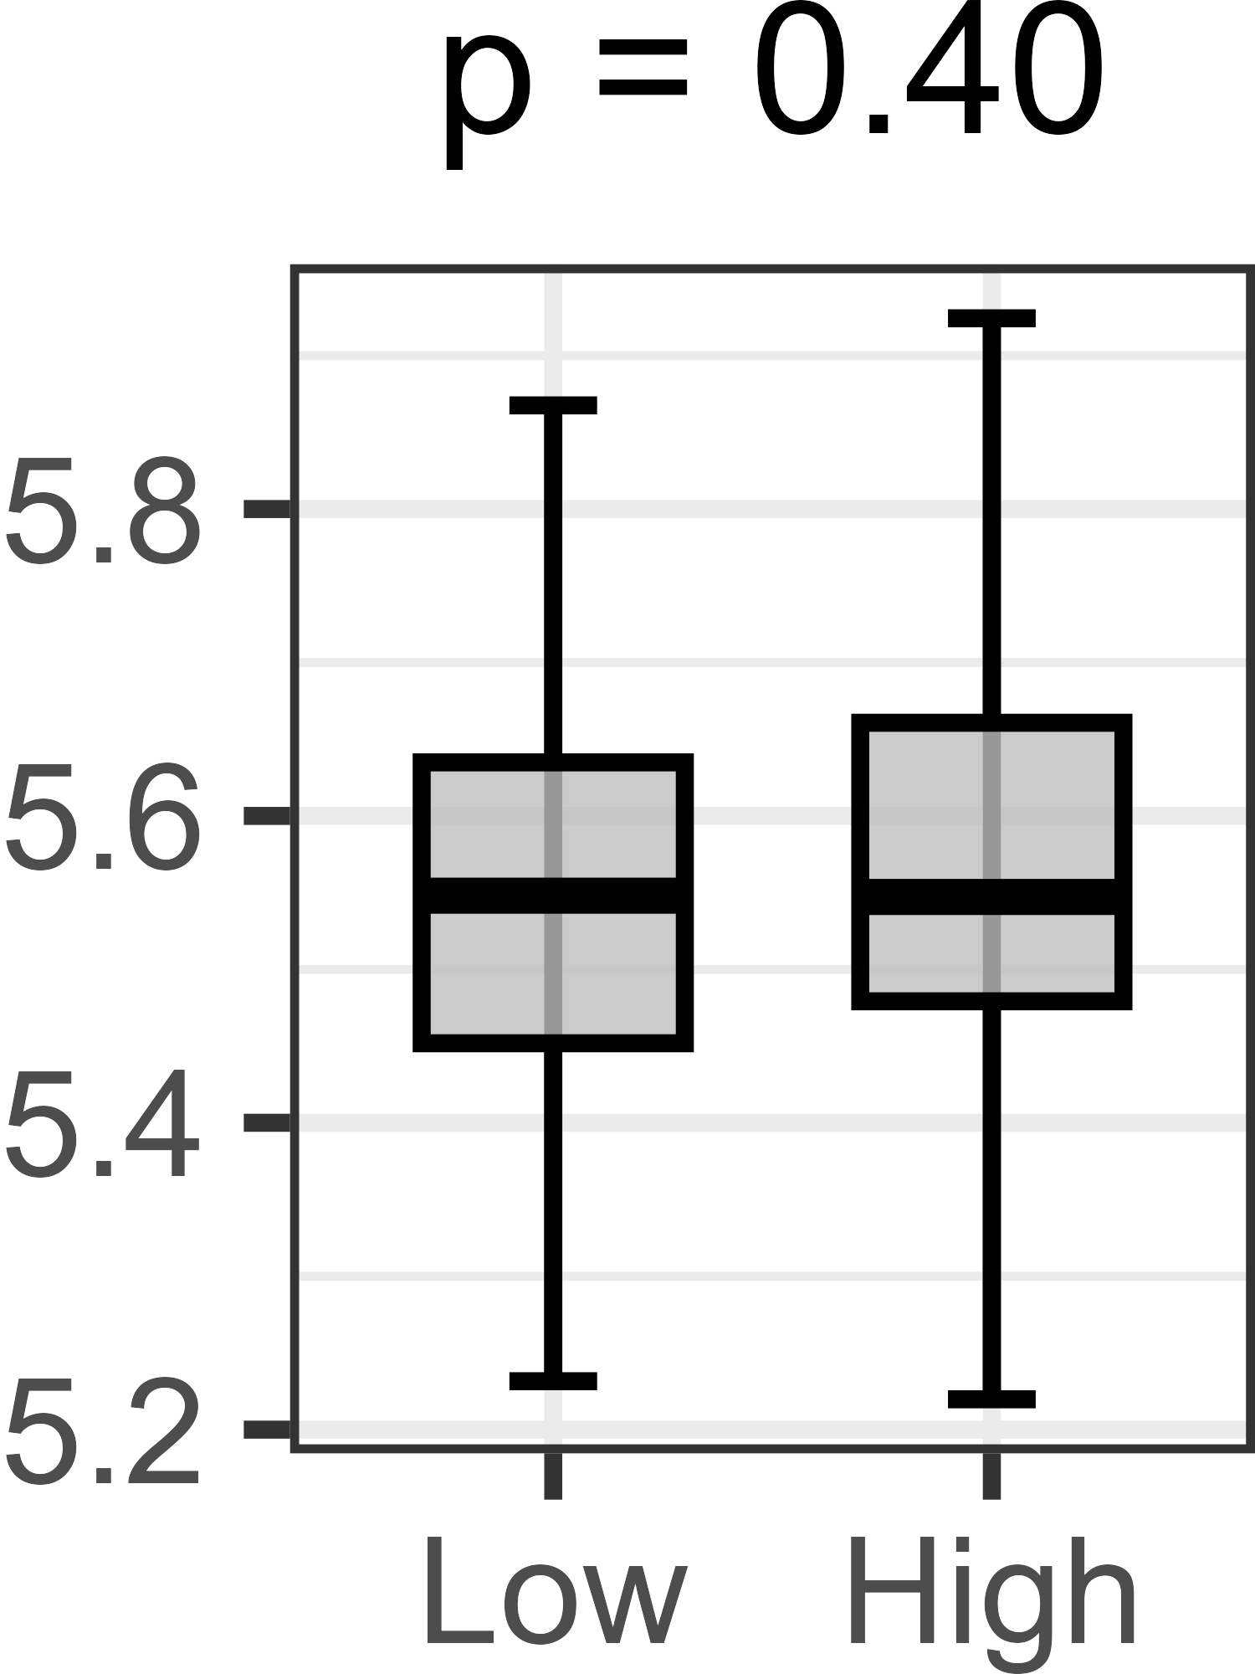
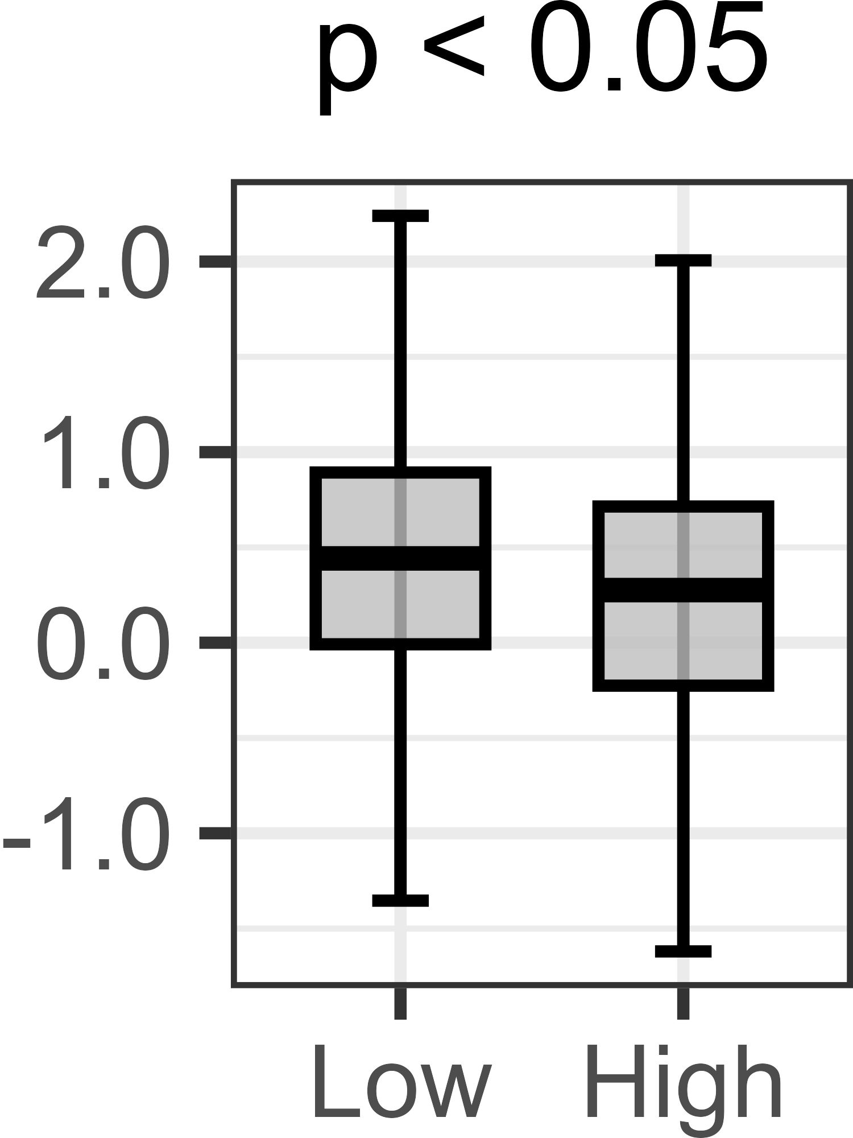
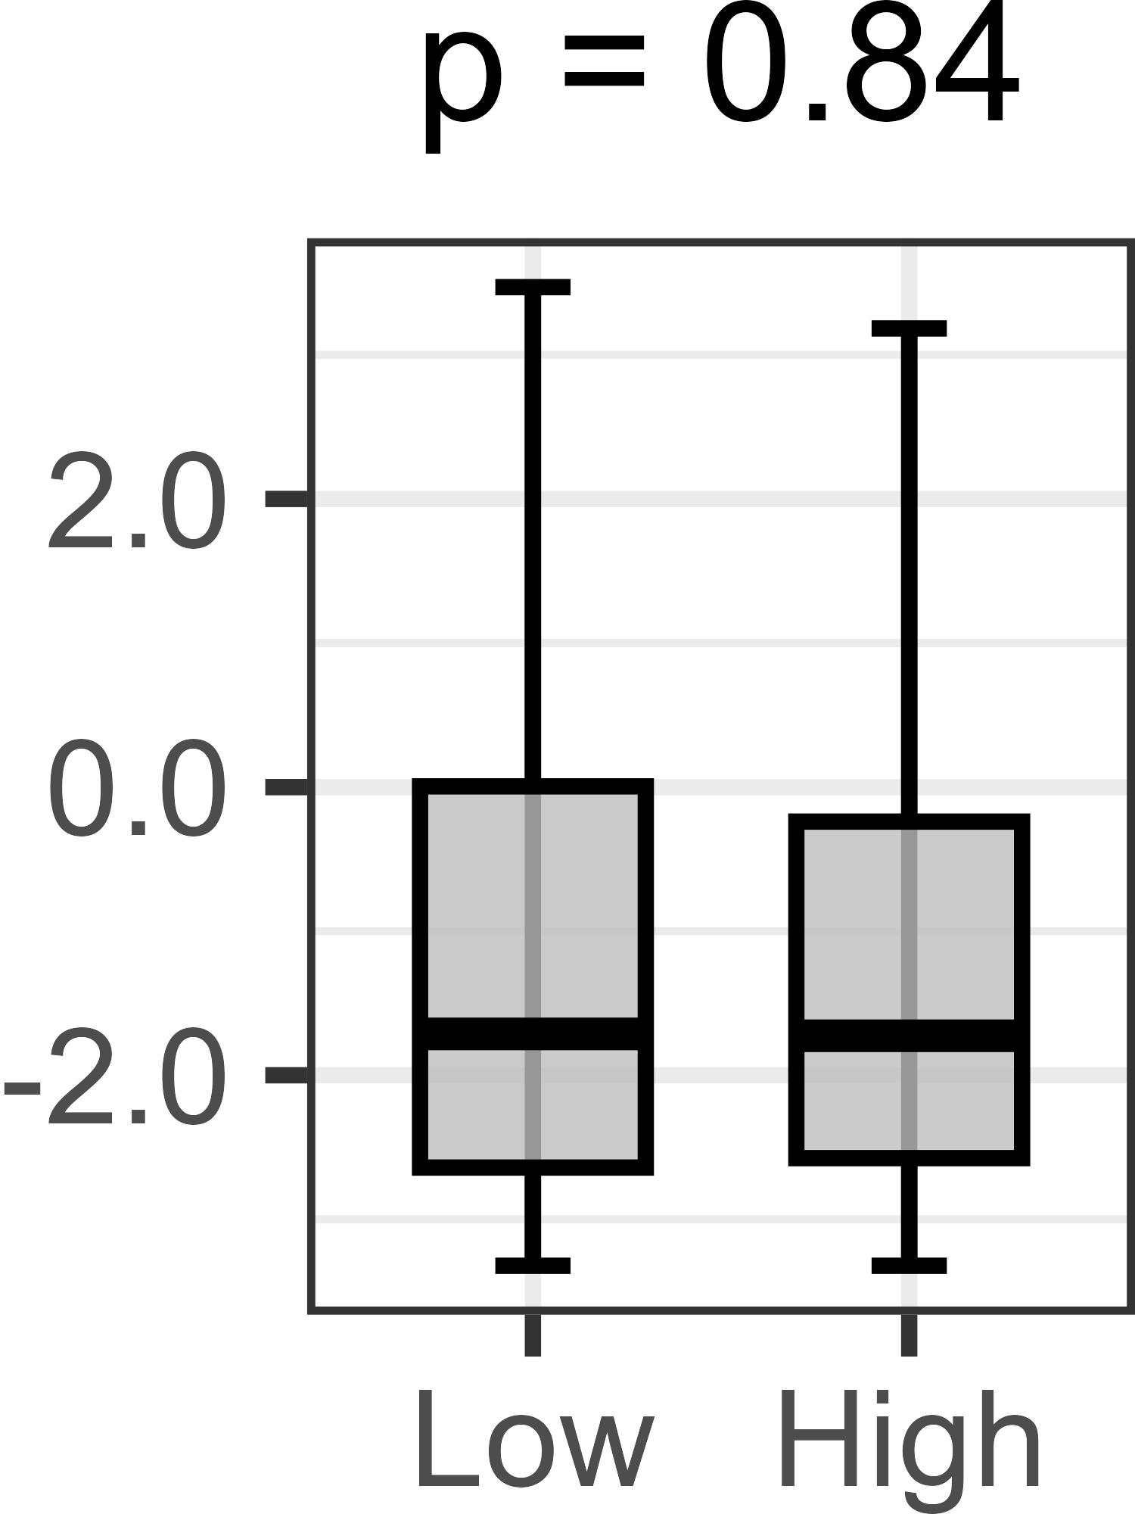
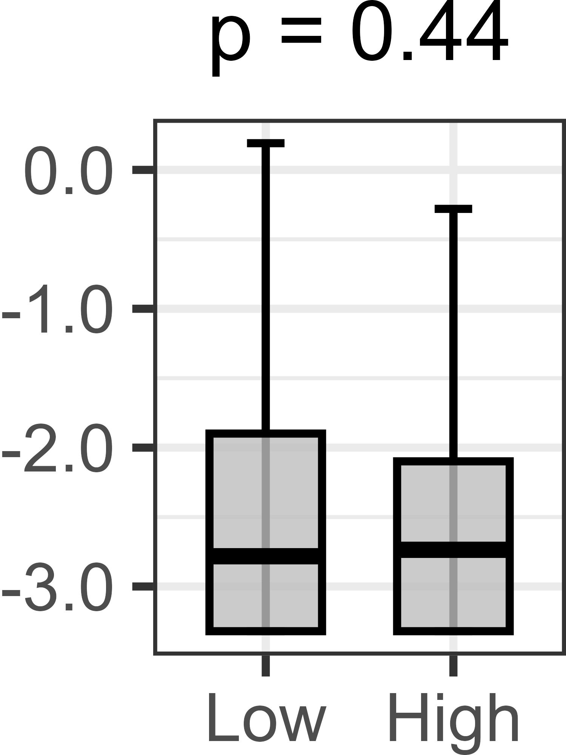
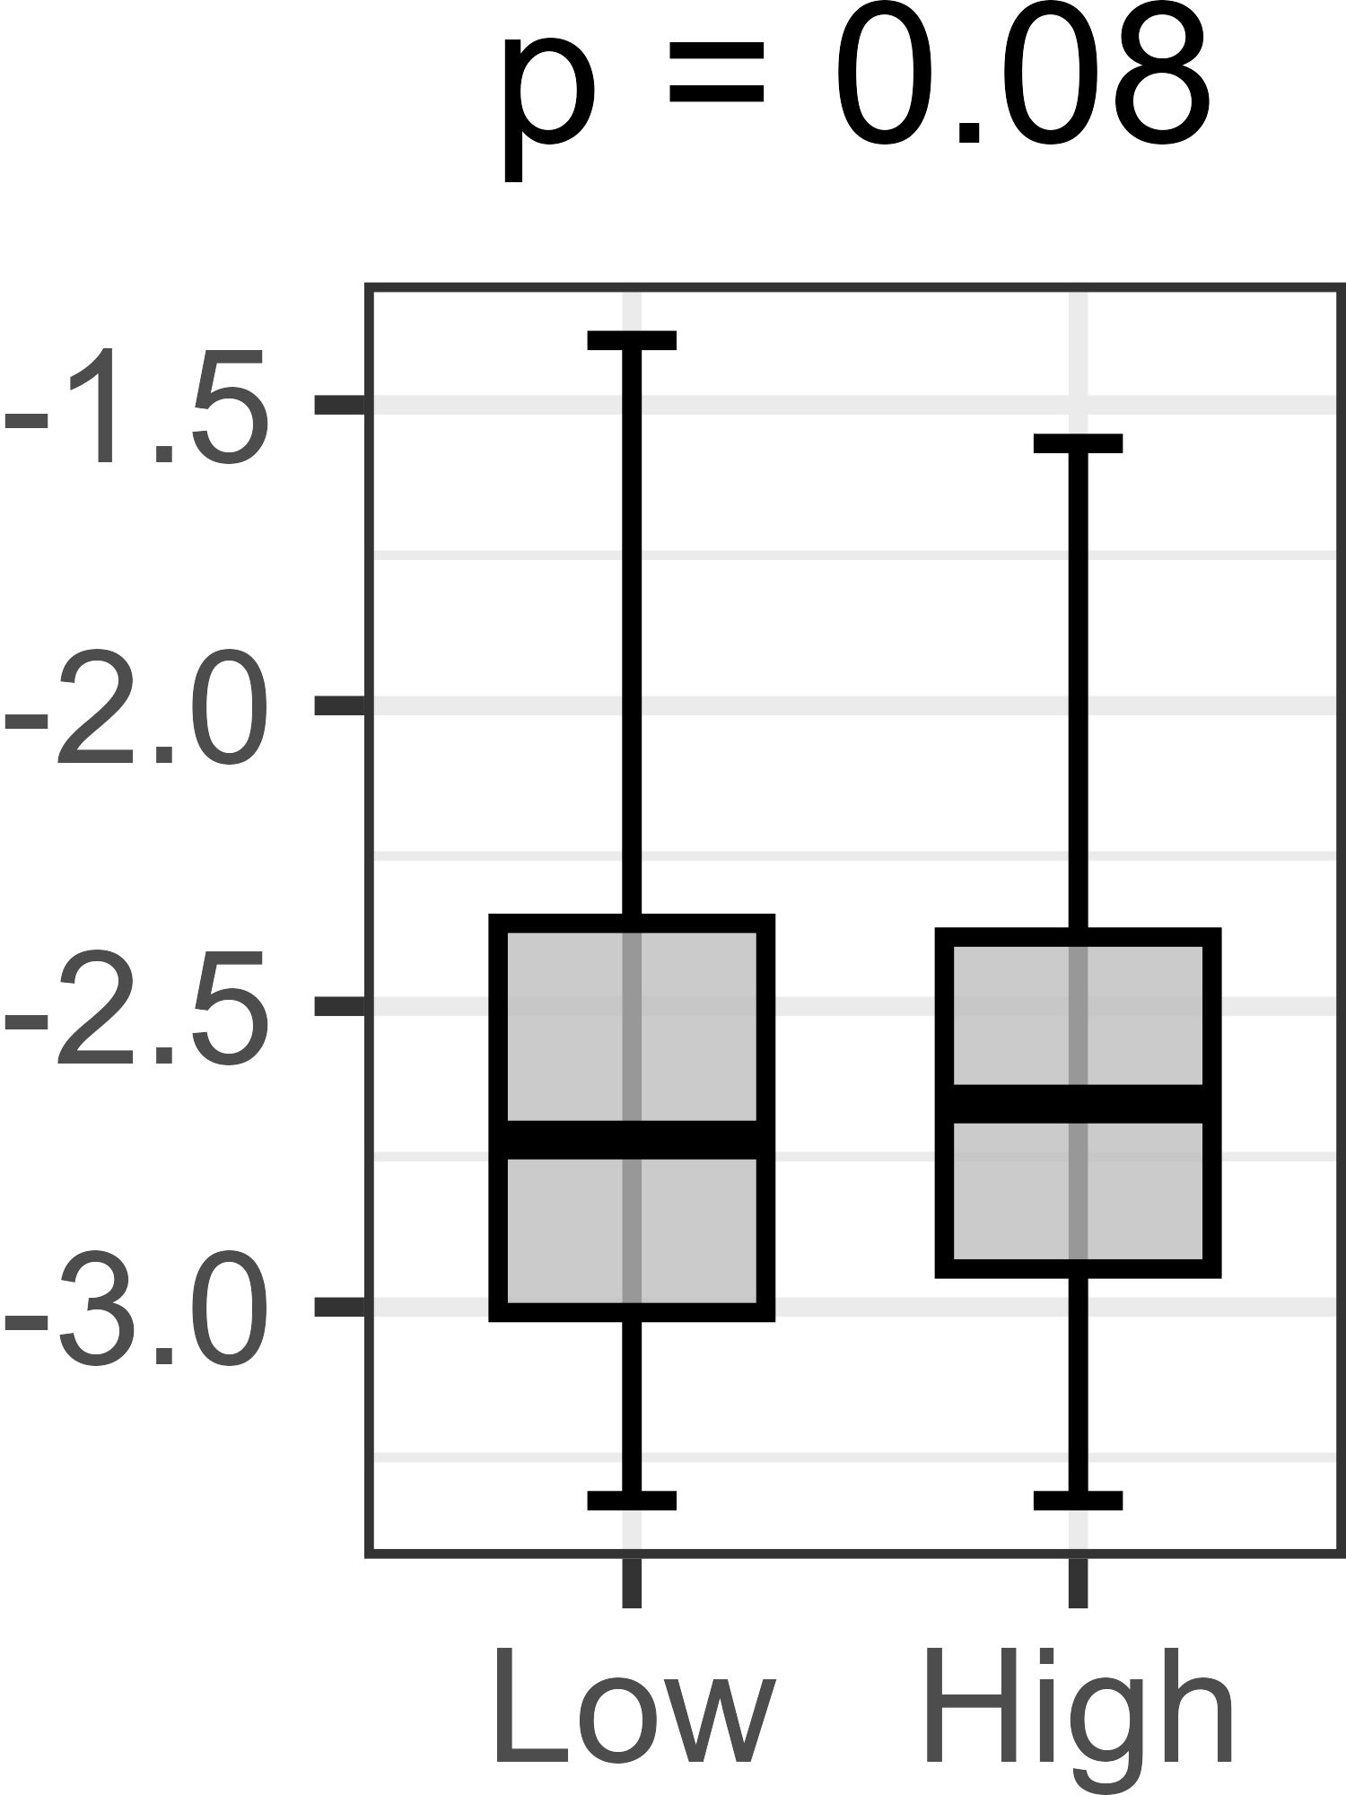
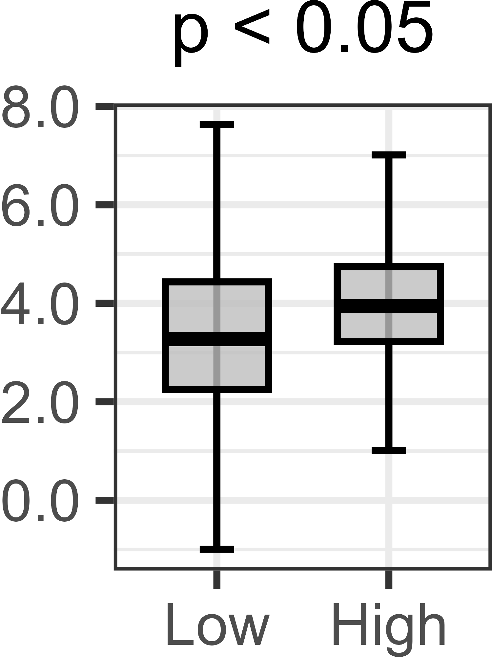
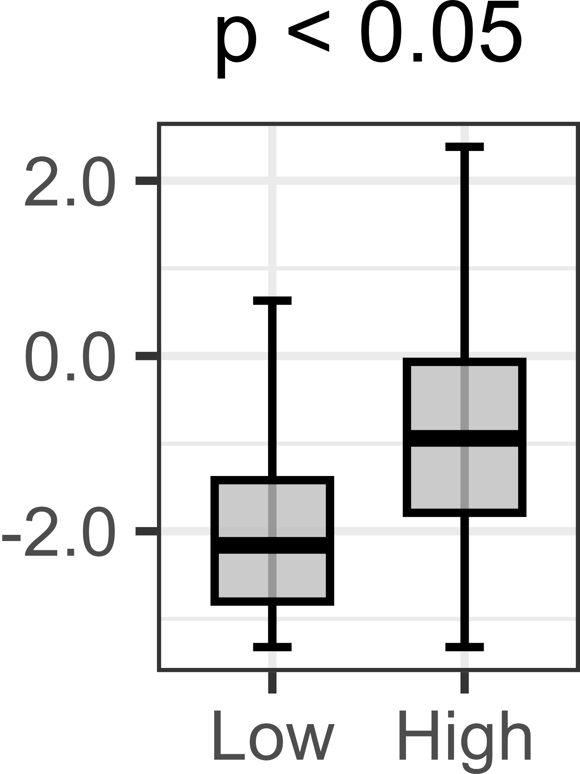
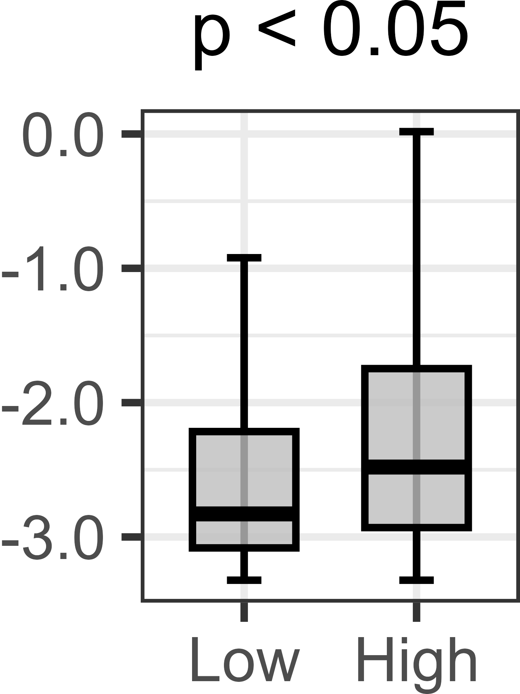
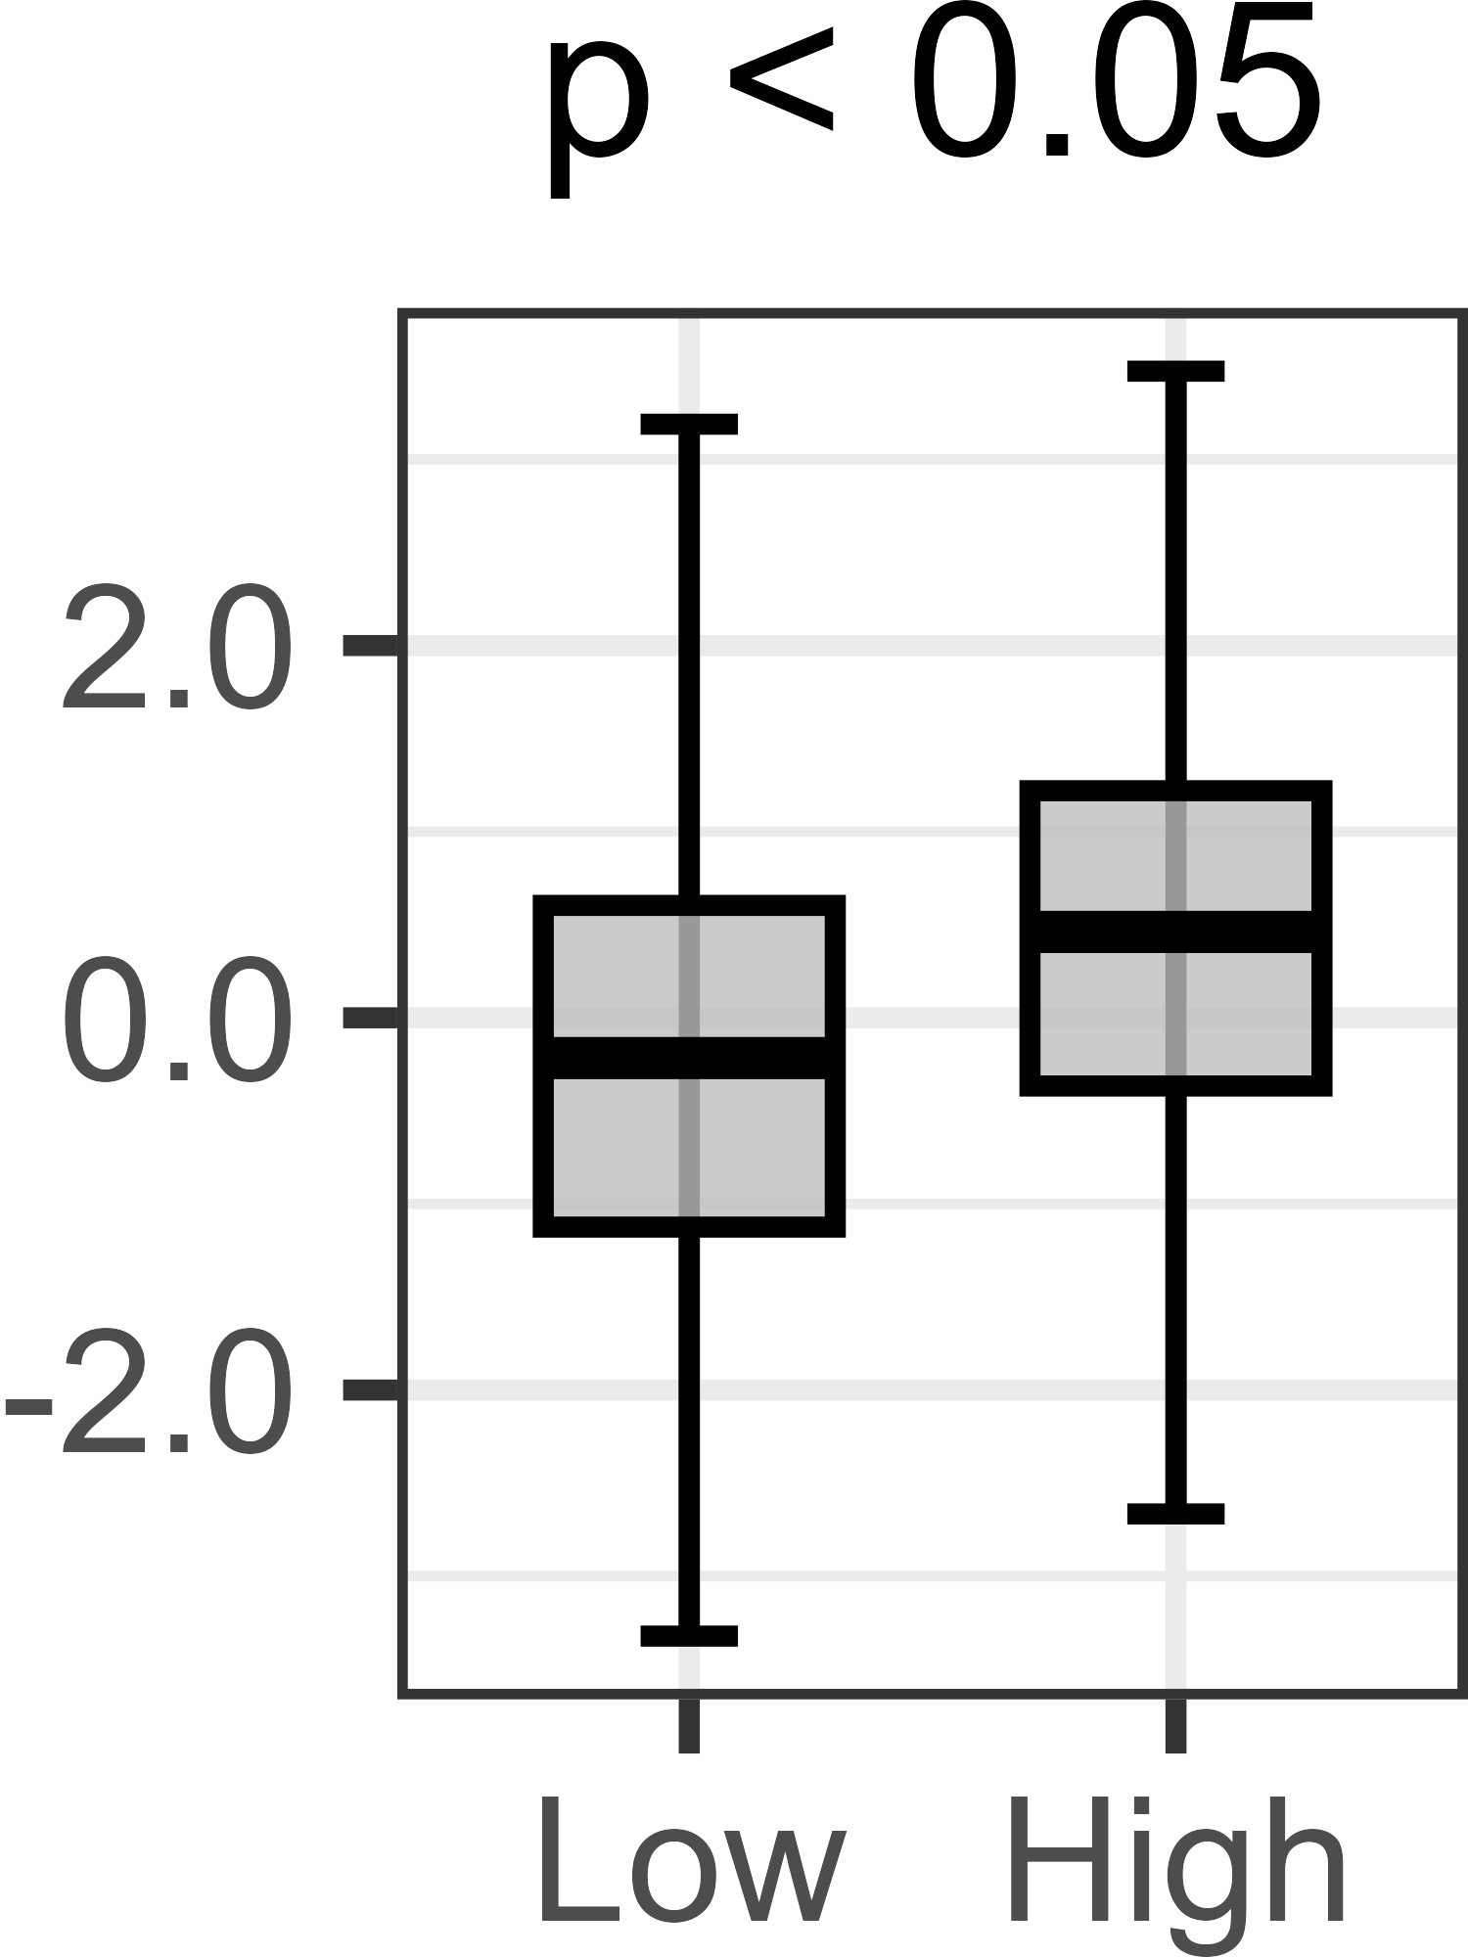
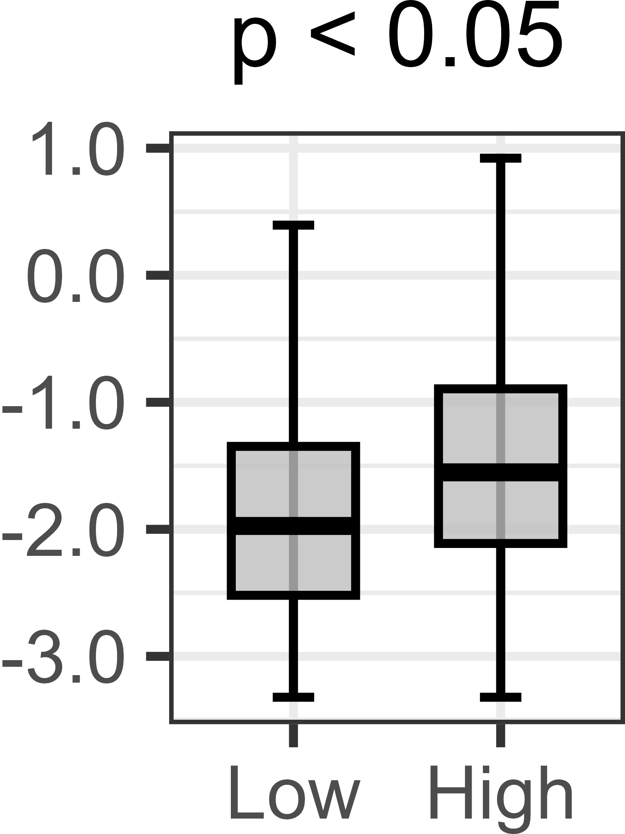
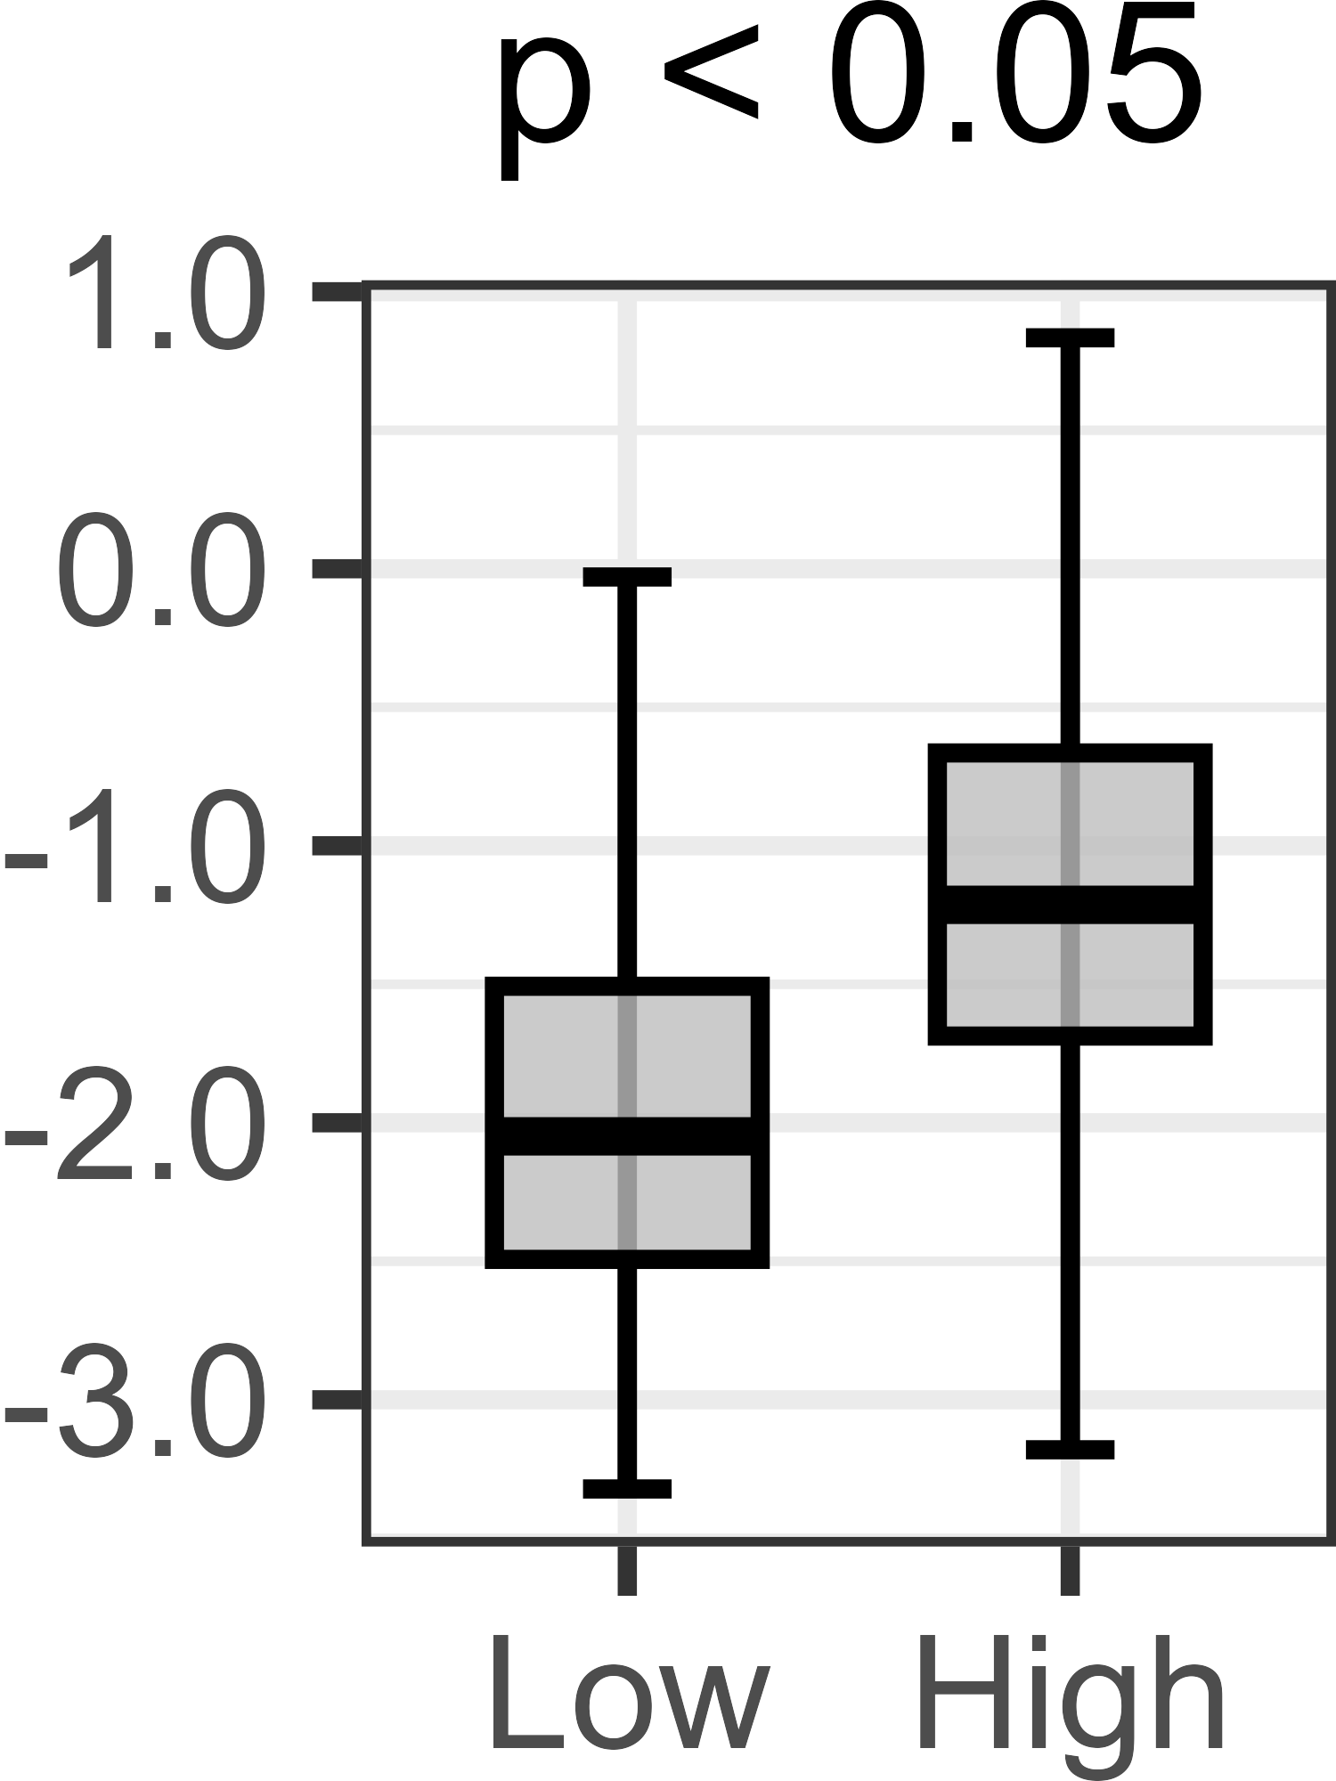
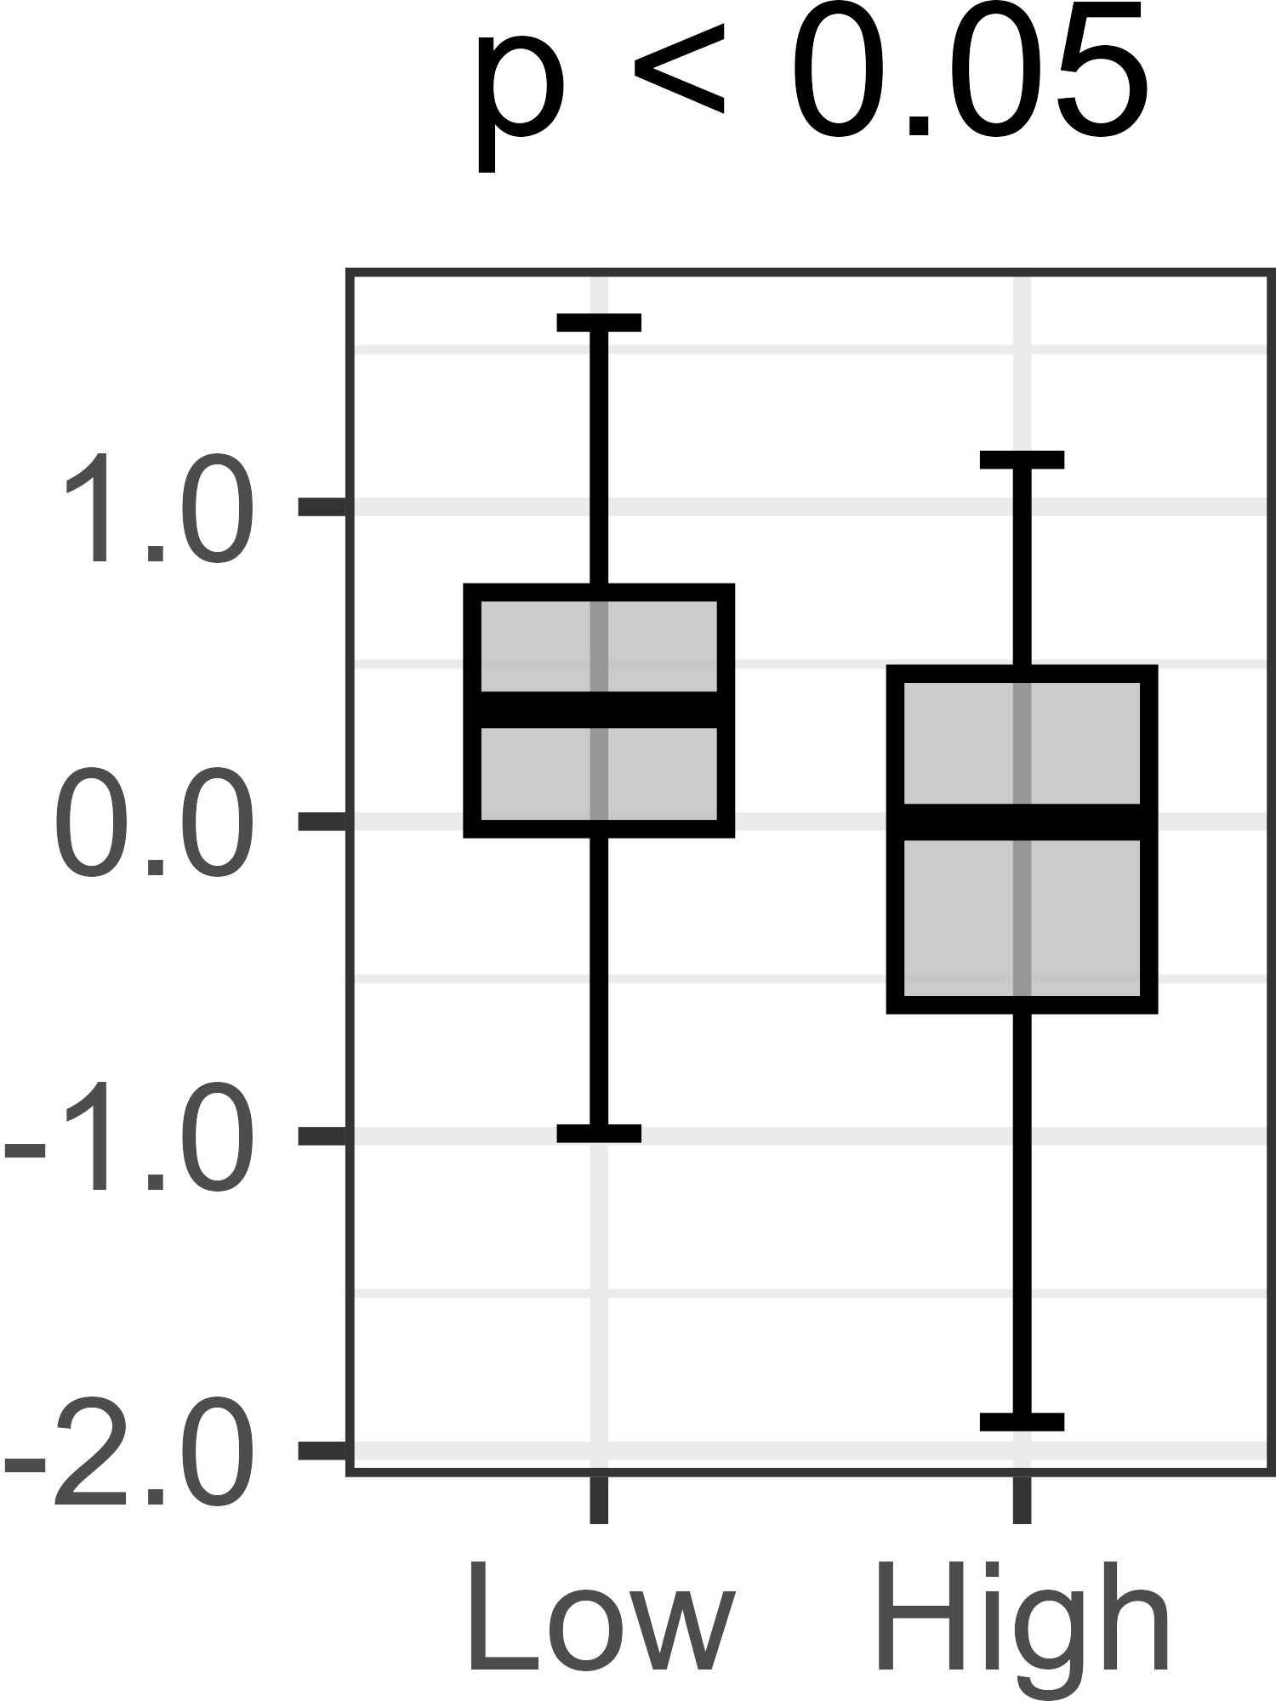
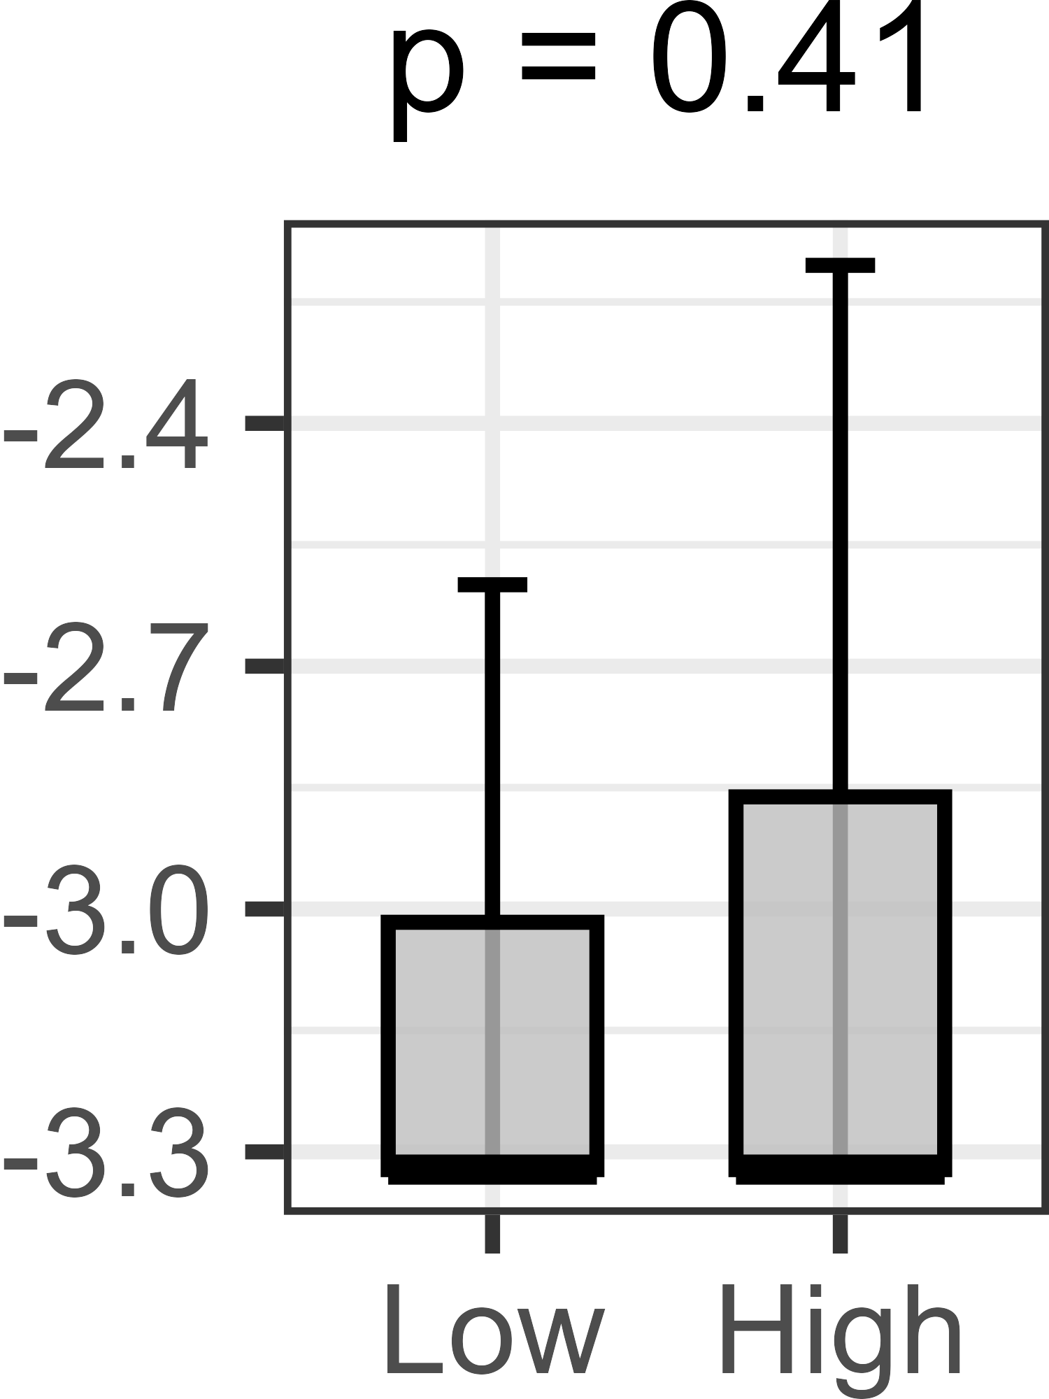
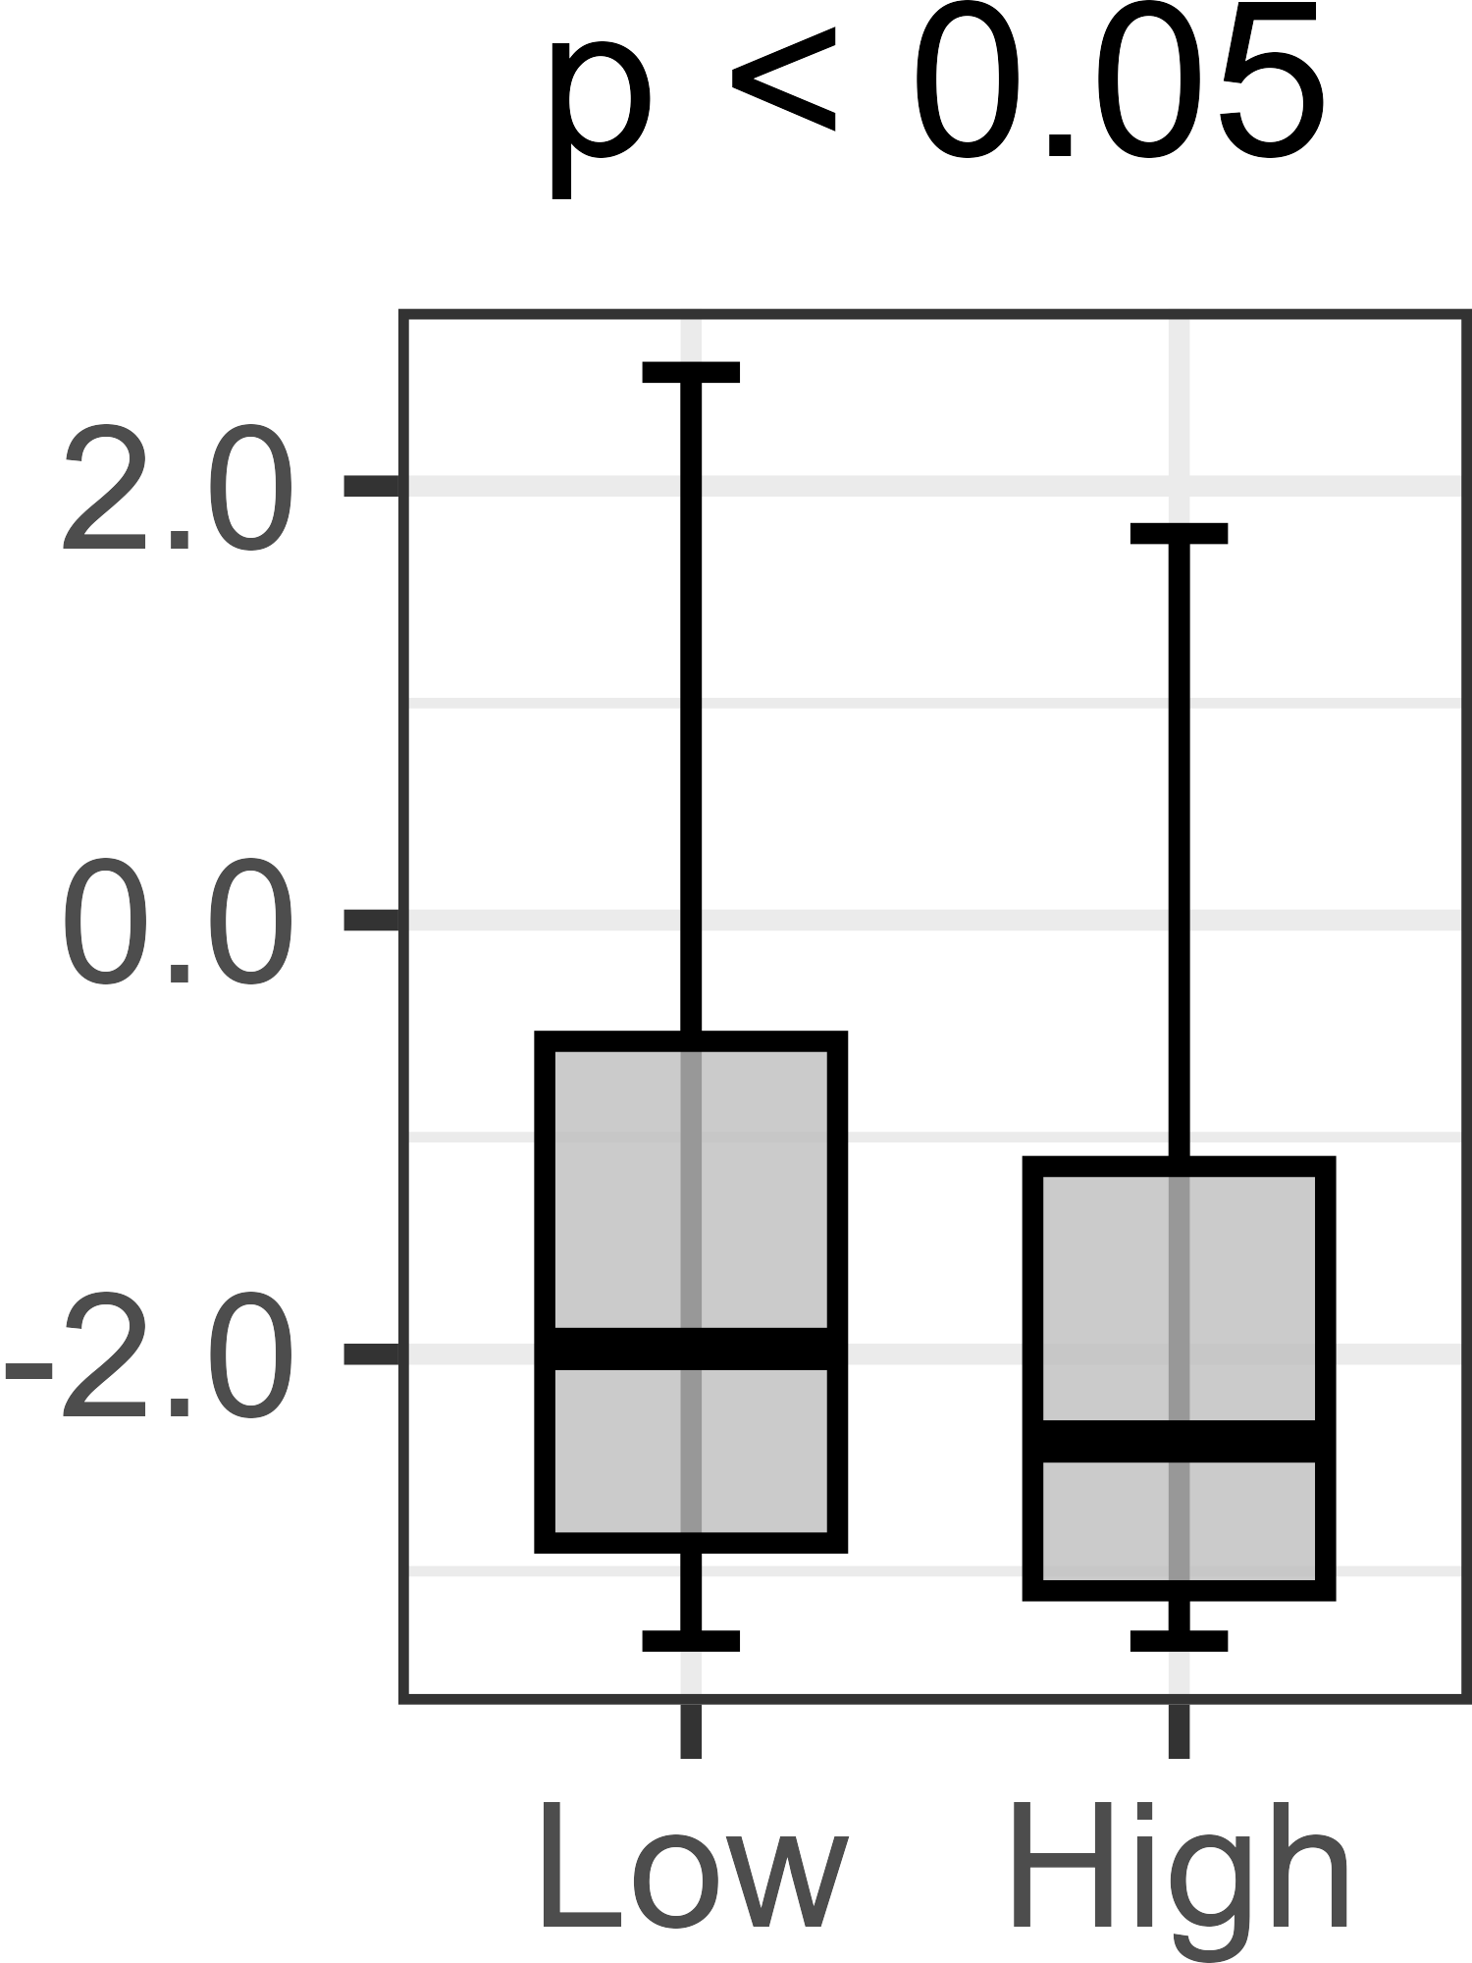

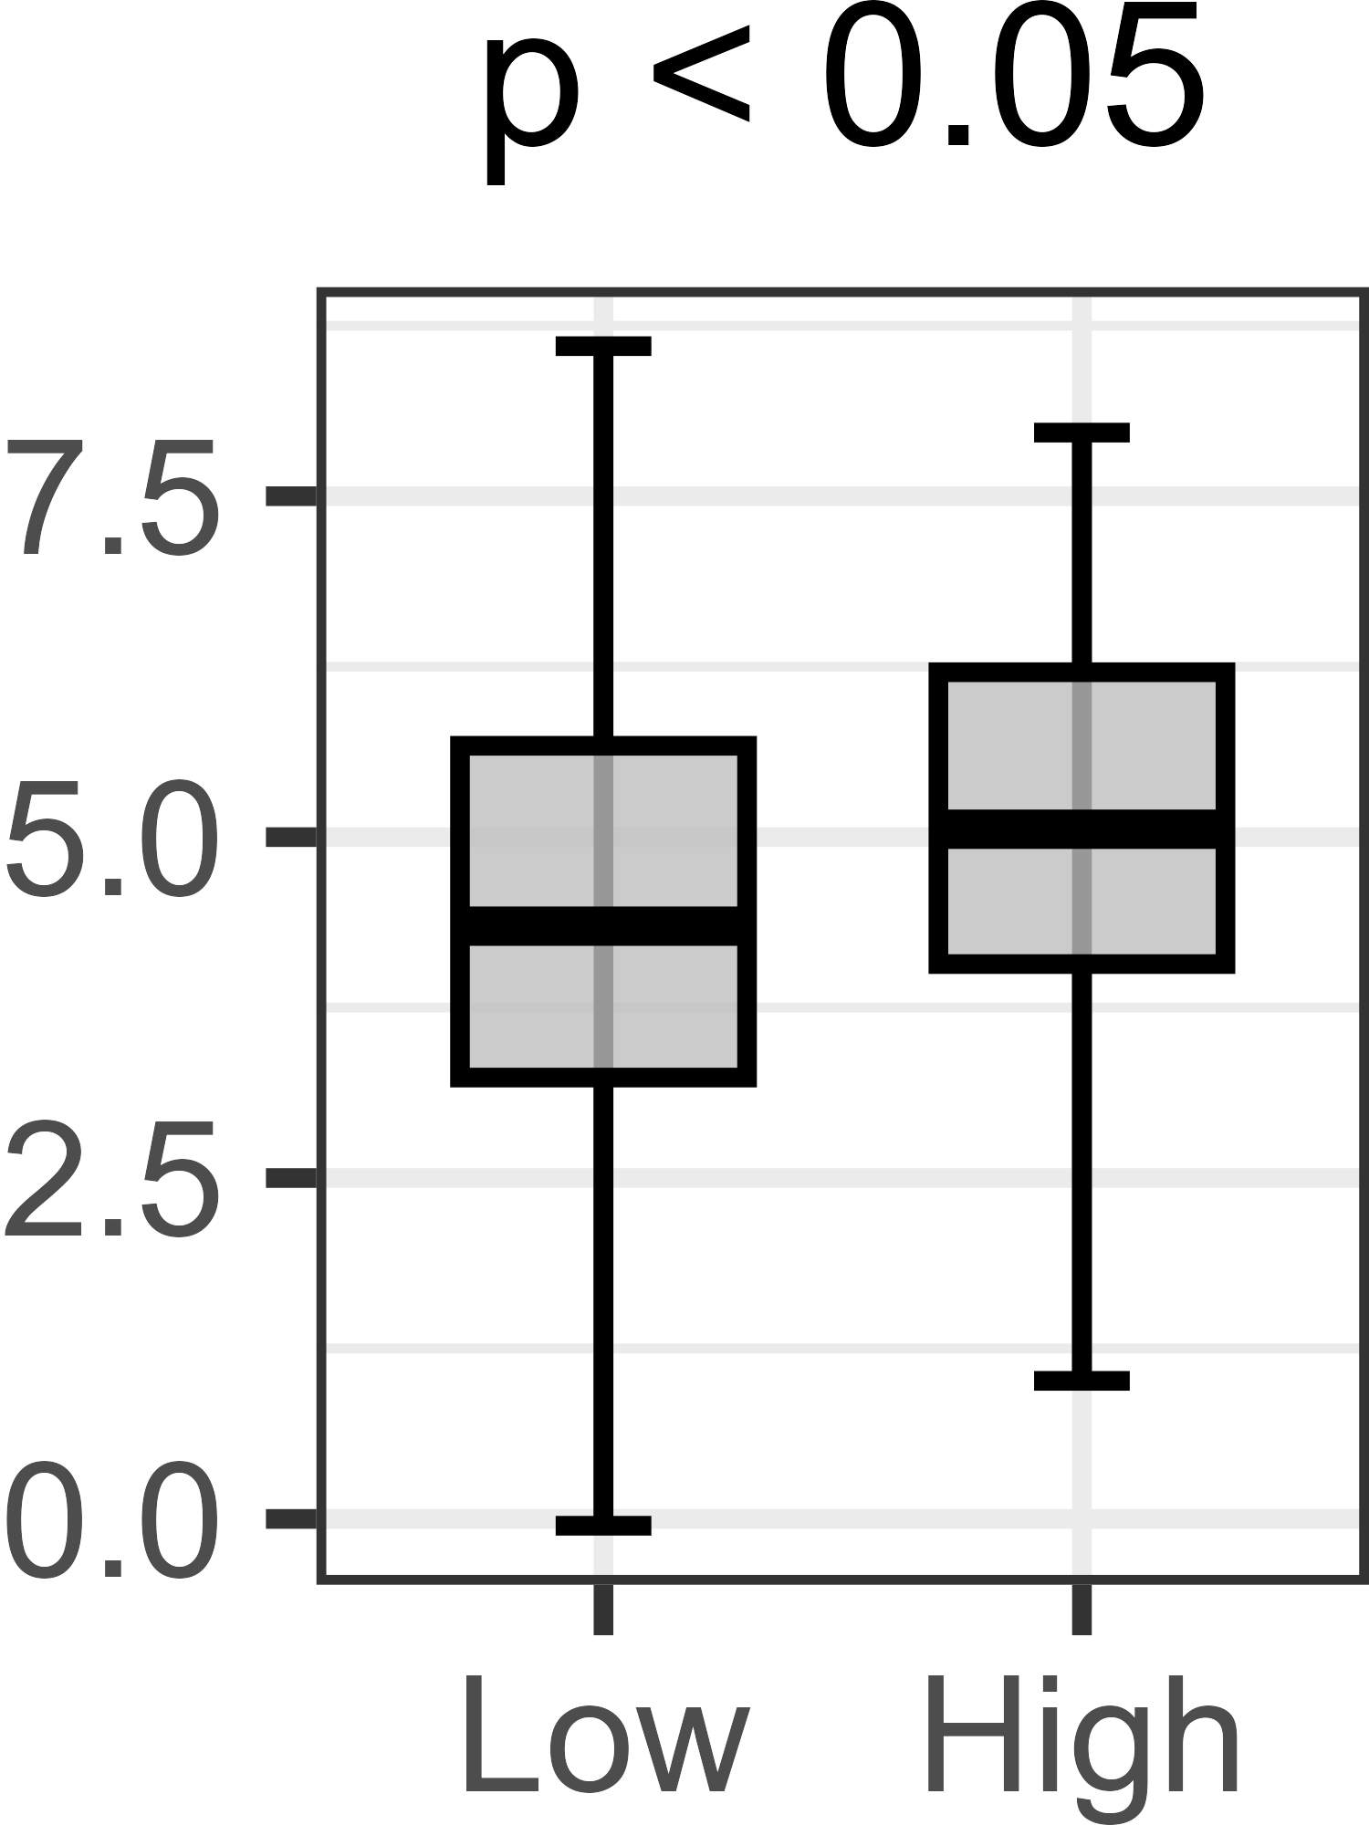
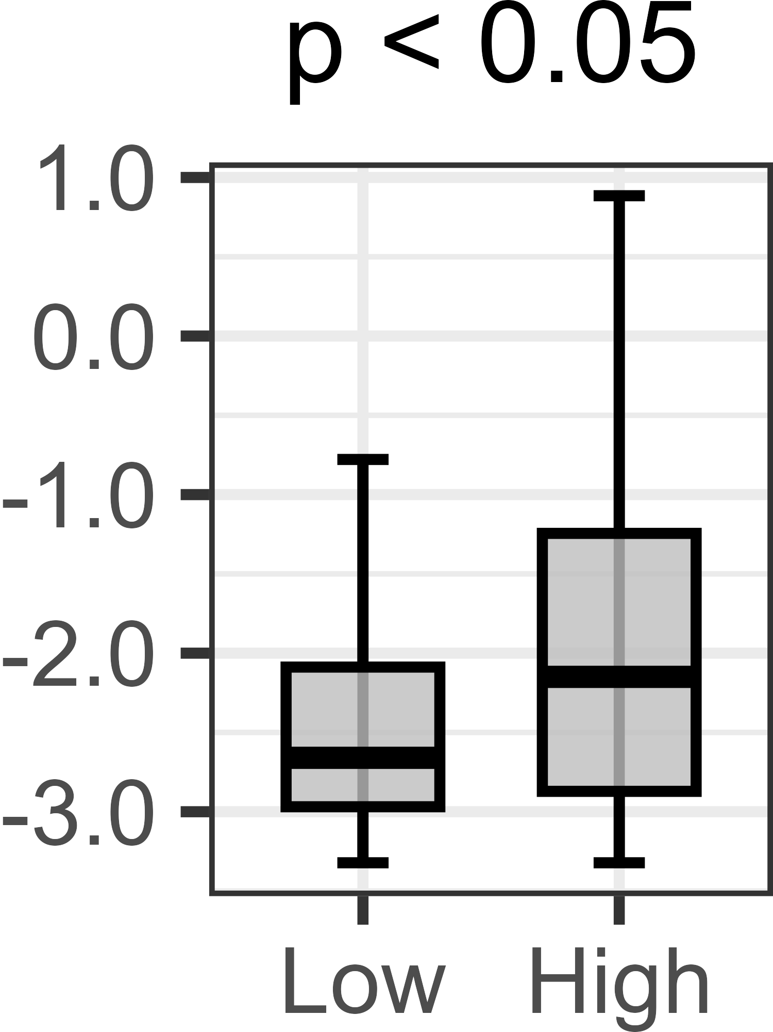
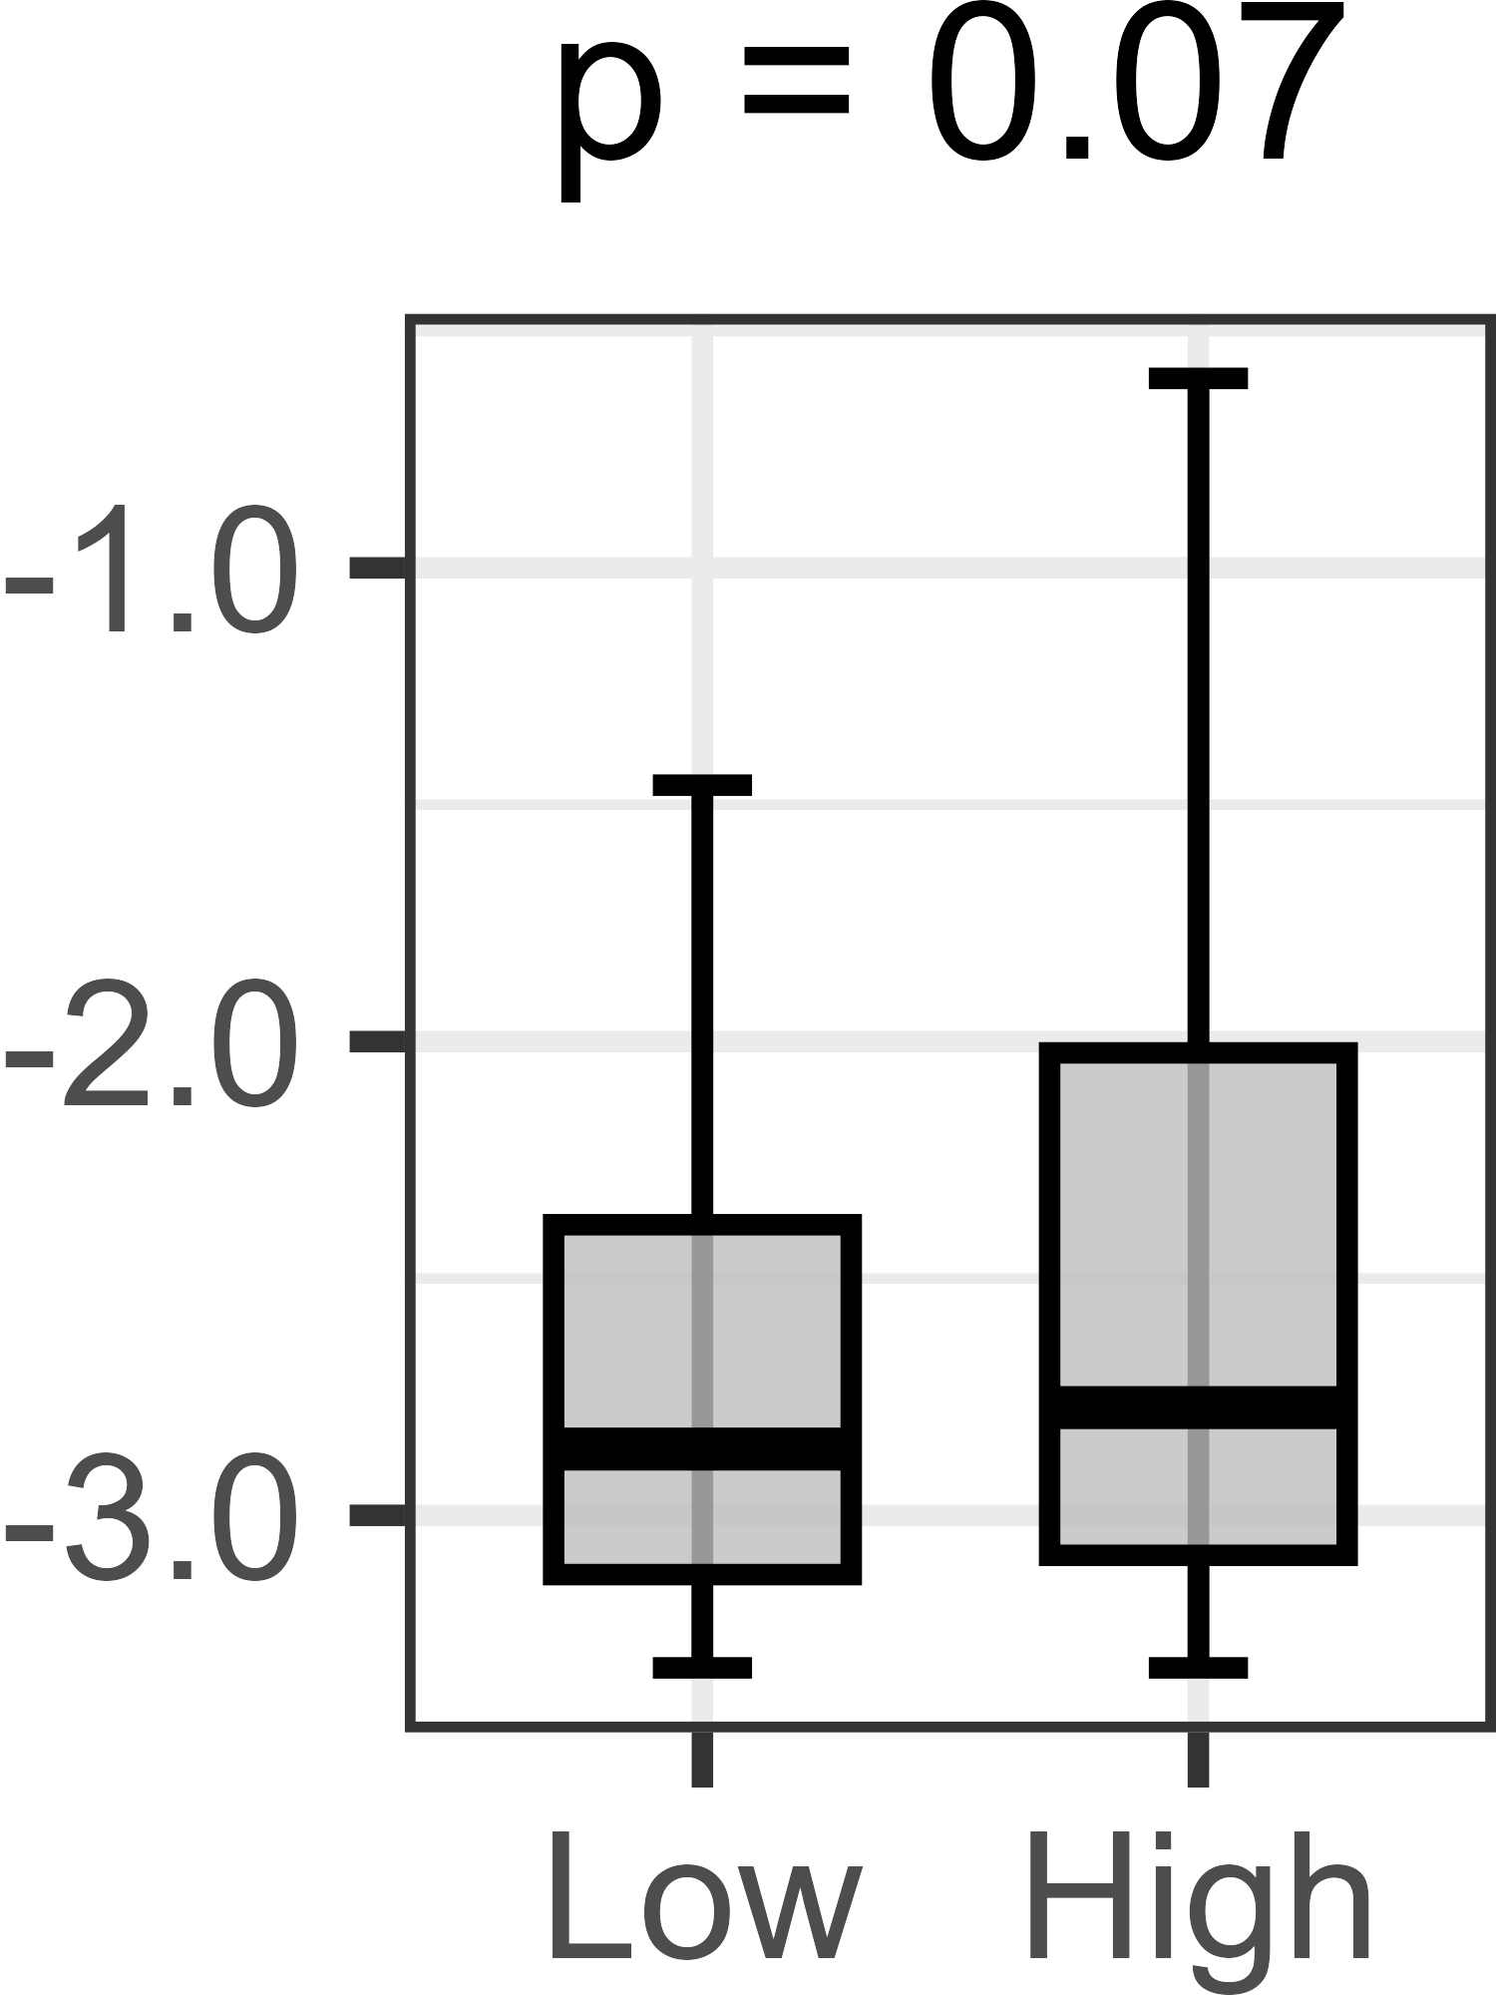
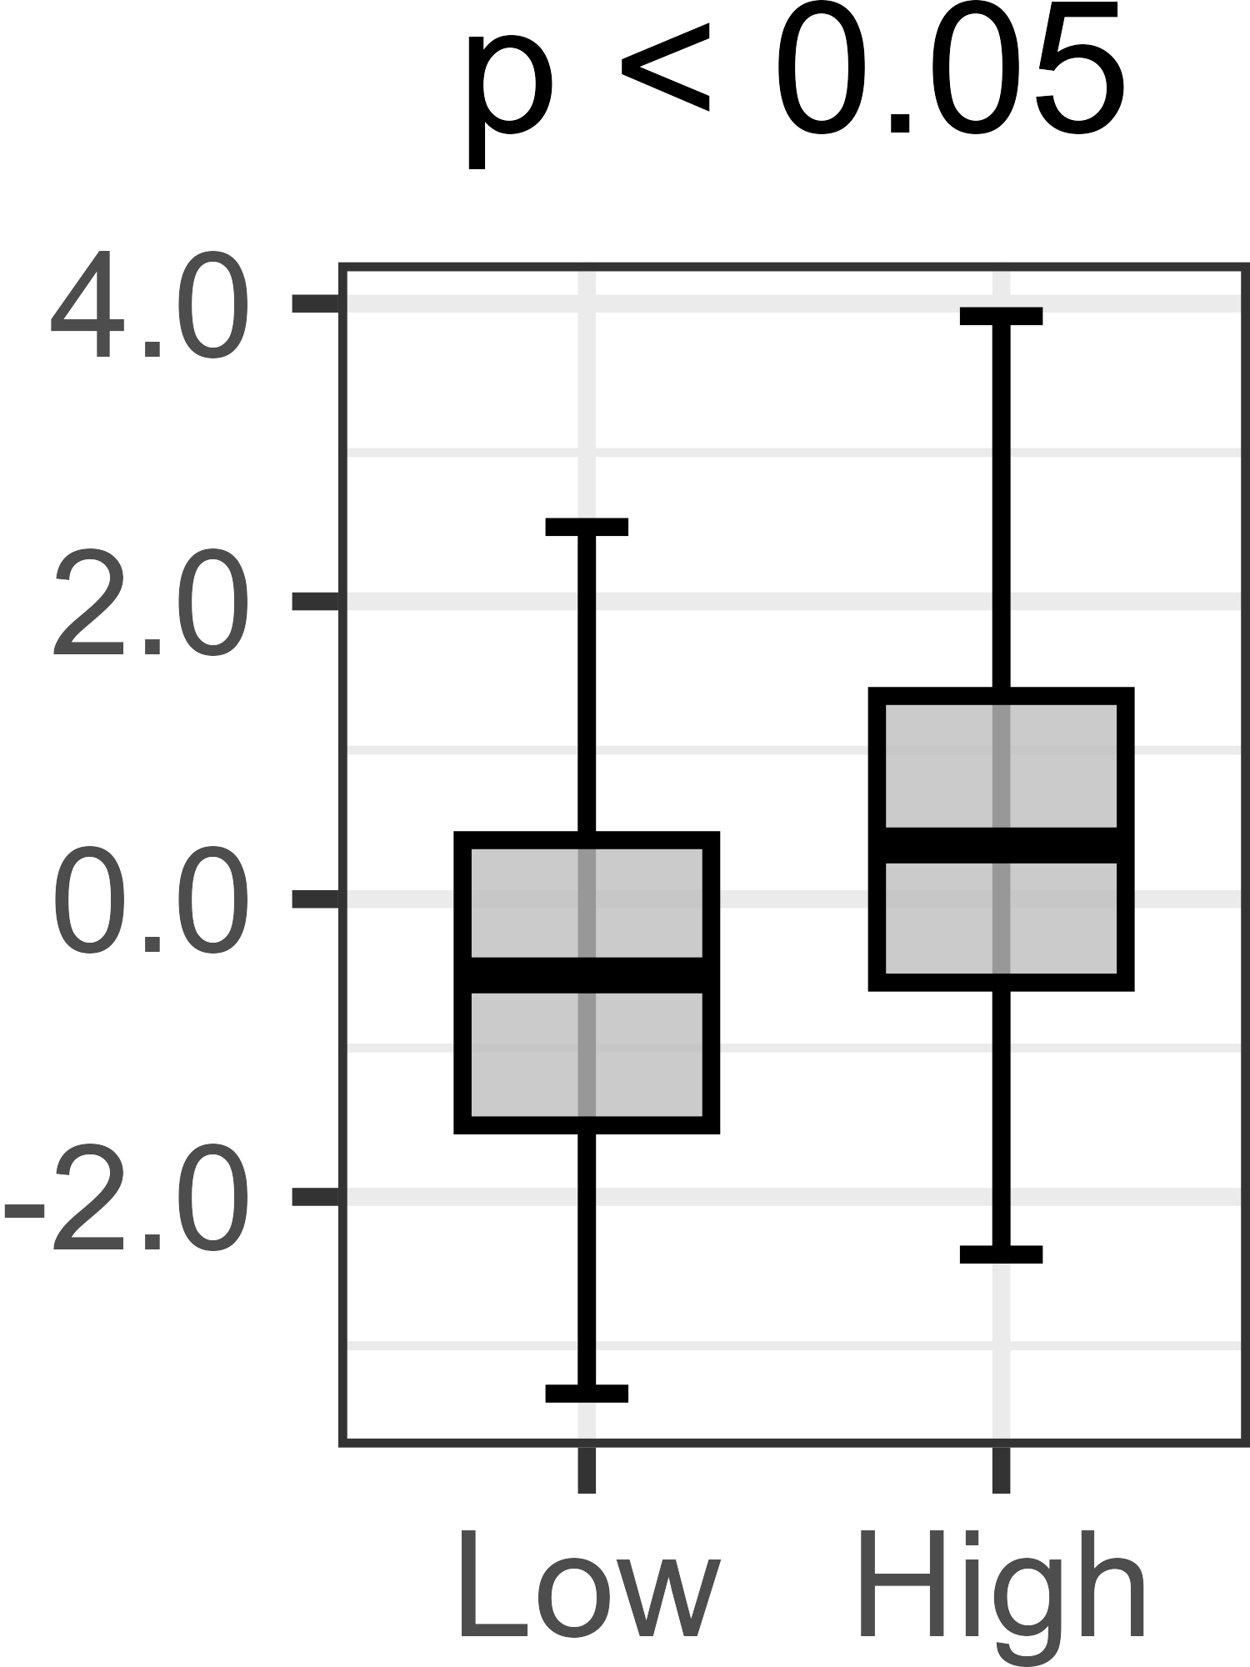
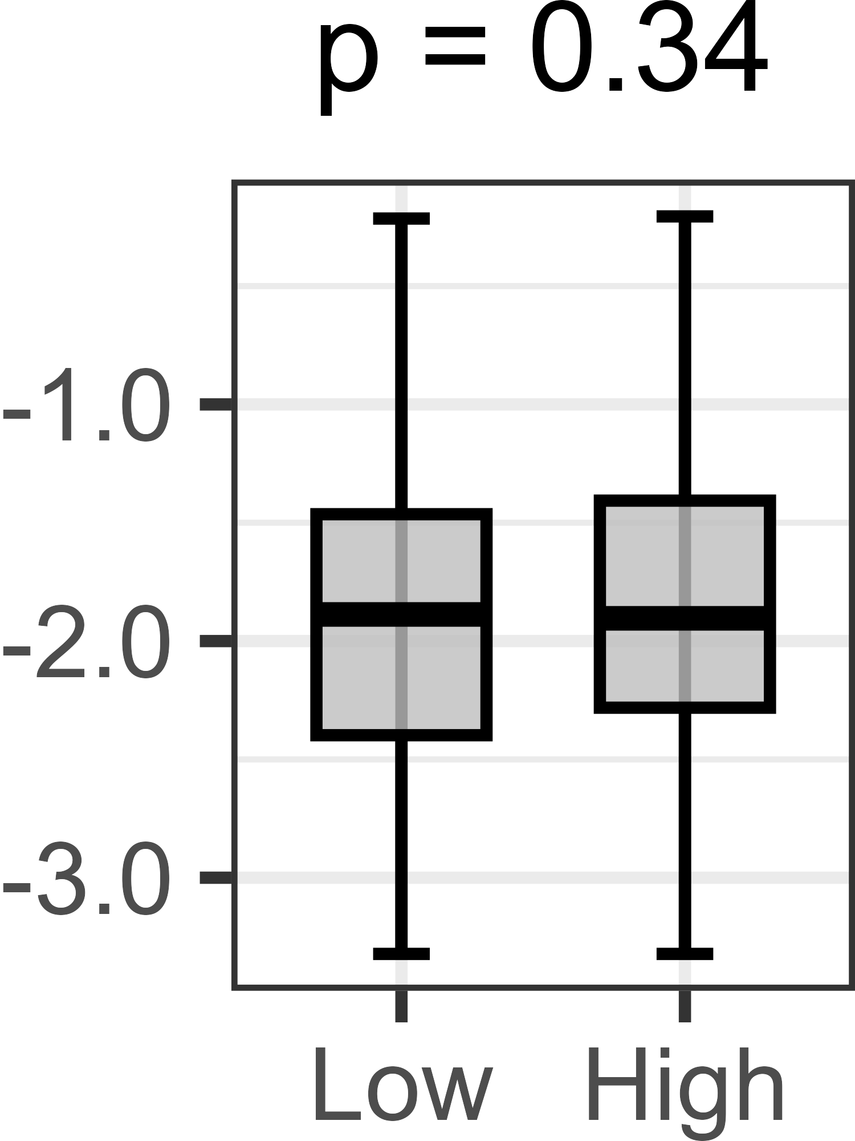
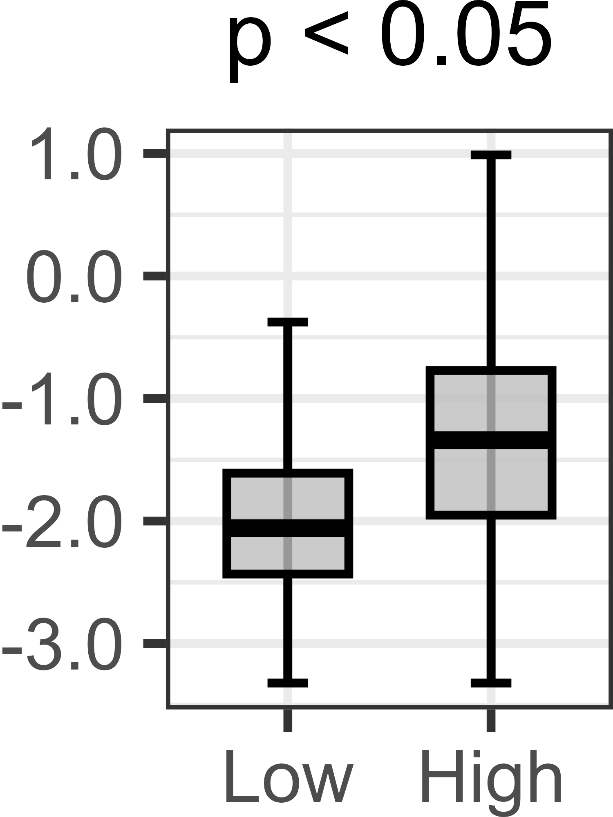
Supplementary Figure S1
A
TCGA
METABRIC
SCAN-B
B
Sensory
nerve
Sympathetic nerve
Axonal cytoskeleton/
Growth cone
Neuron
TRPV1
CALCA
TH
DBH
TUBB3
NEFL
DCX
STMN2
PRPH
GAP43
ER+/HER2-
TCGA
HER2+
ER+/HER2-
METABRIC
HER2+
ER+/HER2-
SCAN-B
HER2+
Supplementary Figure S1 . NPG score distribution across breast cancer subtypes and its association with neuron-related features. (A) Distribution of the NPG score among subtypes (ER-positive/HER2-negative; ER+/HER2−, HER2-positive; HER2+, and triple-negative breast cancer;TNBC) in TCGA, METABRIC, and SCAN-B cohorts. (B) Association of the NPG score with xCell-derived Neuron score and neuron-related gene expression in ER+/HER2− and HER2+ subtypes. Box plots compare NPG-high and NPG-low tumors within each subtype and cohort. In the boxplots, the center line indicates the median, the box represents the interquartile range (IQR), and whiskers extend to 1.5×IQR. Outliers were omitted. P values were calculated using the Wilcoxon rank-sum test. Abbreviations: TUBB3, tubulin beta 3; NEFL, neurofilament light chain; DCX, doublecortin; STMN2, stathmin-2; PRPH, peripherin; GAP43, growth-associated protein 43; TRPV1, transient receptor potential vanilloid 1; CALCA, calcitonin related polypeptide alpha; TH, tyrosine hydroxylase; DBH, dopamine beta hydroxylase.

Slide 3





















Supplementary Figure S2
A
Tumor
grade
MKI67
expression
Proliferation
score
E2F targets
G2M checkpoint
MYC targets v1
MYC targets v2
ER+/HER2-
TCGA
HER2+
ER+/HER2-
METABRIC
HER2+
ER+/HER2-
SCAN-B
HER2+
B
Intratumor
heterogeneity
Altered
fraction
HRD
Non-silent
mutation
Silent
mutation
Neoantigens
SNV
Neoantigens
Indel
ER+/HER2-
TCGA
HER2+
Supplementary Figure S2. Association of NPG score and proliferative activity and tumor immunogenicity -related scores. (A) Box plots showing MKI67 expression, tumor grade, and proliferation score in NPG-high versus NPG-low tumors within ER+/HER2− and HER2+ subtypes across TCGA, METABRIC, and SCAN-B cohorts. Gene set enrichment analysis (GSEA) enrichment plots for proliferation-related Hallmark gene sets (E2F targets, G2M checkpoint, MYC targets v1, and MYC targets v2) comparing NPG-high and NPG-low tumors in each subtype and cohort. The x-axis represents genes ranked by differential expression between groups, and the y-axis represents the enrichment score. Normalized enrichment score (NES) and false discovery rate (FDR) are shown for each pathway. (B) Box plots of estimated genomic instability and mutational burden–related scores, including intratumoral heterogeneity, altered fraction, homologous recombination deficiency (HRD), non-silent and silent mutation burden, and SNV- and indel-derived neoantigens, comparing NPG-high and NPG-low tumors in the TCGA cohort.

Slide 4
Supplementary Figure S3
B
A
B cell
CD4+
T cell
CD8+
T cell
Th1
cell
Th2
cell
T reg
NK T
cell
DC
M1
macro-
phage
M2
macro-
phage
Immune
score
CYT
score
ER+/HER2-
TCGA
HER2+
ER+/HER2-
METABRIC
HER2+
ER+/HER2-
SCAN-B
HER2+

Slide 5
Supplementary Figure S3
C
Interferon alpha
signaling
Interferon gamma
signaling
allograft rejection
TGF beta signaling
ER+/HER2-
TCGA
HER2+
ER+/HER2-
METABRIC
HER2+
ER+/HER2-
SCAN-B
HER2+
Supplementary Figure S3. NPG score and immune cell infiltration and cytolytic activity. (A) Box plots showing xCell-derived infiltration scores of major immune cell populations, including B cells, CD4+ T cells, CD8+ T cells, Th1 cells, Th2 cells, regulatory T cells (Tregs), natural killer T (NKT) cells, dendritic cells (DCs), M1 macrophages, and M2 macrophages, comparing NPG-high and NPG-low tumors. (B) Box plots showing cytolytic activity (CYT) scores comparing NPG-high and NPG-low tumors in each subtype and cohort. (C) ene set enrichment analysis (GSEA) enrichment plots of major immune-related Hallmark pathways (interferon-α response, interferon-γ response, allograft rejection, and TGF-β signaling) comparing NPG-high and NPG-low tumors across cohorts. The x-axis represents genes ranked by differential expression between groups, and the y-axis represents the enrichment score. Normalized enrichment score (NES) and false discovery rate (FDR) are shown for each pathway.

Slide 6
Supplementary Figure S4
I_SPY2
I_SPY2 (ICI)
GSE25066
GSE163882
n = 379
n = 40
n = 165
n = 69
ER+/HER2-
n = 245
n = 29
n = 63
HER2+
GSE123845
GSE20271
GSE230881
GSE41998
n = 53
n = 89
n = 130
n = 100
ER+/HER2-
n = 83
n = 26
n = 84
n = 28
HER2+
Supplementary Figure S4. NPG scores and therapeutic response status. Box plots compare NPG scores between pCR and non-pCR patients in seven neoadjuvant chemotherapy cohorts. P values were calculated using the Wilcoxon rank-sum test.

Slide 7

Supplementary Figure S5
OS
DSS
DFS
ER+/HER2-
p = 0.09
p = 0.77
p = 0.14
TCGA
HER2+
p = 0.43
p = 0.11
p = 0.18
ER+/HER2-
p = 0.93
p = 0.34
p = 0.46
p = 0.09
METABRIC
HER2+
p = 0.82
p = 0.77
p = 0.19
NPG score
ER+/HER2-
METABRIC
Supplementary Figure S5. NPG score and prognostic outcomes in TCGA, METABRIC, and SCAN-B cohorts. Kaplan-Meier survival curves of overall survival (OS), disease-specific survival (DSS) and disease-free survival (DFS) by NPG score group. Red represents NPG score-high and blue represents NPG score-low group.
HER2+

