Slide 1
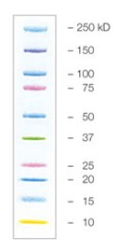
Data Source file – figure 4A
Page 1
Van der Sluis et al. Distinct SARS-CoV-2 sensing pathways in pDCs driving TLR7-antiviral vs. TLR2-immunopathological responses in COVID-19
Donor A
Donor B
AAVS1^{KO}
AAVS1^{KO}
MyD88^{KO}
MyD88^{KO}
Mouse-anti-human Vinculin (VCL)
VCL = 116 kDa
Exposure = 5 sec ECL
150
100
Rabbit-anti-human MyD88 (clone D80F5)
MyD88 = 33 kDa
Exposure = 6 min ECL
50
37
25
20
15
10
Corresponds to figure

Slide 2
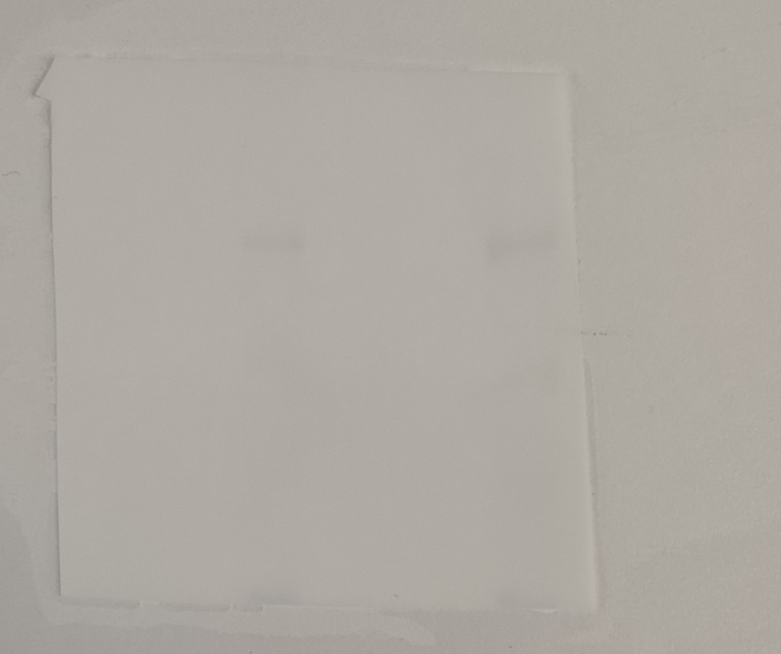
Data Source file – figure 4A
Page 2
Van der Sluis et al. Distinct SARS-CoV-2 sensing pathways in pDCs driving TLR7-antiviral vs. TLR2-immunopathological responses in COVID-19
Donor C
Donor D
AAVS1^{KO}
AAVS1^{KO}
Mouse-anti-human Vinculin (VCL)
VCL = 116 kDa
Exposure = 5 sec ECL
MyD88^{KO}
MyD88^{KO}
150
100
75
75
Rabbit-anti-human MyD88 (clone D80F5)
MyD88 = 33 kDa
Exposure = 3 min ECL
50
37
25

